Slide 1


Data Science

Slide 2

Ben Congdon
[Exec] Course Staff CS 196-25 Data / Python Enthusiast
@benrcongdon

Slide 3
Tyler Kim
Data Science Intern - CEB Global
ACM@UIUC Corporate
R|P Core
TA - STAT430/INFO490
[Exec] Course Staff - CS196-25
Undergrad Researcher - LCDM/NCSA
_
@tyler-thetyrant

Slide 4
Mini Syllabus ~ 7.5% of 196 Grade
Email Policy: Do not email Tyler (He gets 30 emails on a good day?)
Your subject line must include [CS196]
Office Hours: 1 hour after each Hackerspace
Grading: Attendance + Mini Project = 7.5% of total 196 grade
Expectation: Attendance / Participation is Mandatory! Be kind?

Slide 5
Course Plan
Week 3 | Data Science Overview. Work environment setup.
Week 4 | Basic Data Structure + Statistics for Data Science
Week 5 | Numpy & Pandas
Week 6 | Data Visualization
Week 7 | Data Mining & Web Scrapping
Week 8 | API + Mini Project Assigned
Week 9 | Intro to Natural Language Processing

Slide 6
Course Plan
Week 10 | No Hackerspace!
Week 11 | Intro to R + Mini Project Presentations
Week 12 | Relational Databases and SQL for Data Science
Week 13 | Intro to Machine Learning
Week 14 | Machine Learning - continued
Week 15 | Intro to Deep Learning (Convoluted Neural Network) Seminar
Week 16 | No Hackerspace!

Slide 7
Objectives
Familiarity with the core tools of data science
Enough theoretical background to get you starter
Several data science projects to get a feel for the breadth of the field
Given massive loads of data, know what to do.

Slide 8
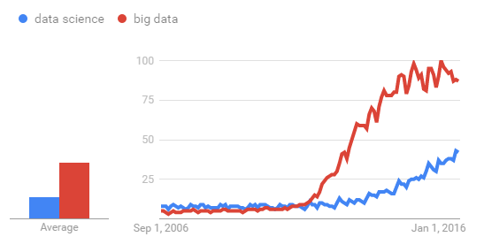
Why Data Science?
Data driven thinking is the future
The scale of data is increasing exponentially
Data has no intrinsic value: it needs to be interpreted and explained

Slide 9
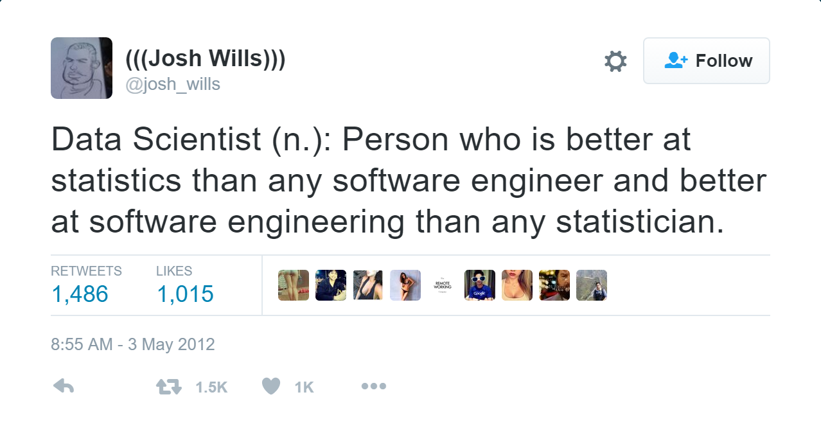
Data Scientist?

Slide 10

Getting started with Jupyter
The data scientists notebook
Mac / Linux: $ sudo pip install jupyter $ jupyter notebook
Windows:
https://jupyter.readthedocs.io/en/latest/install.html
Install Anaconda
Follow instructuctions to install Jupyter

Slide 11
Hello, World

Slide 12
Questions? AMA

Slide 13



