Slide 1


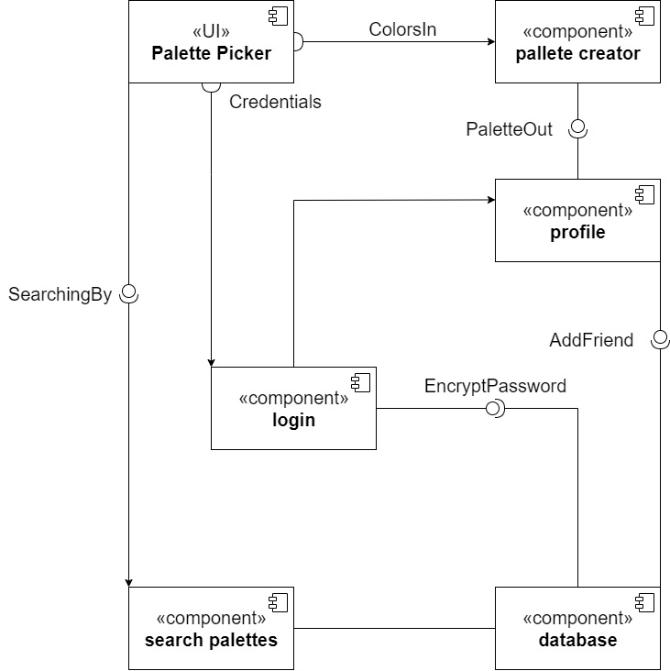
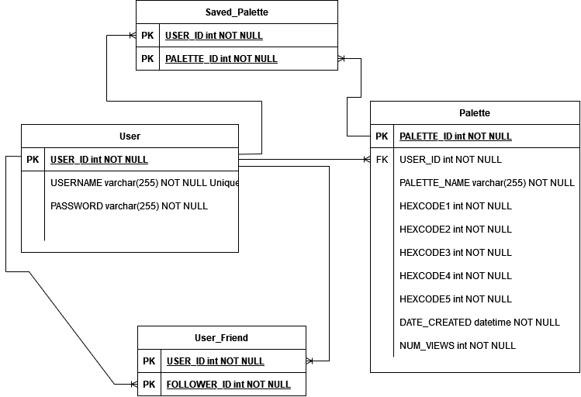
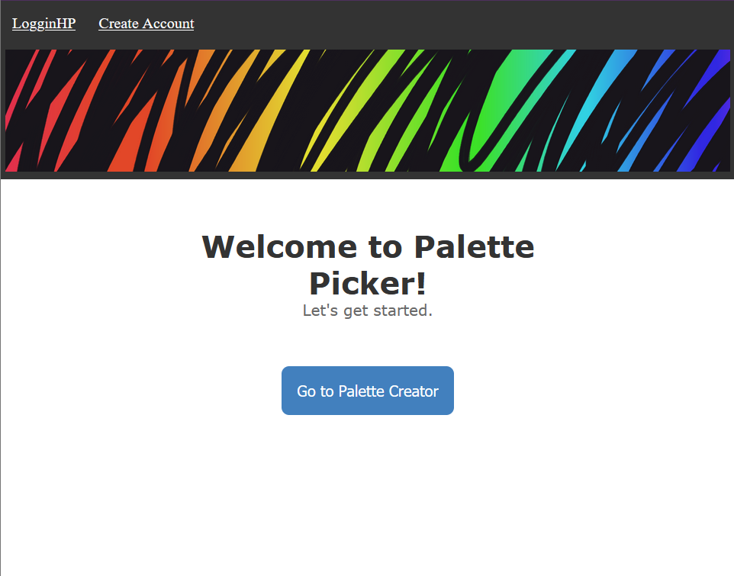
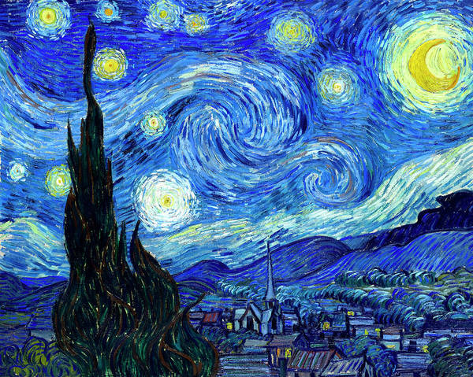
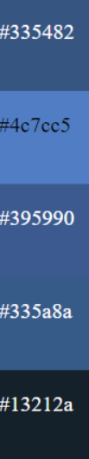
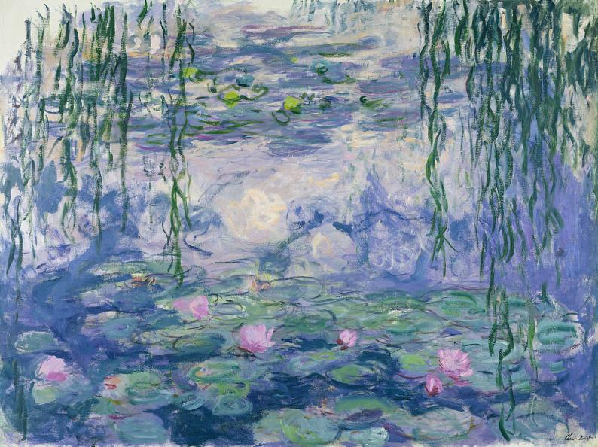
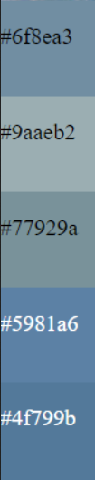
Palette Picker
Simon Stockton, Lily Thompson, Victoria Senn, Eric Brewer
Dept. Of Computer Science and Information Technology
Introduction
Technology
Design
Future Work
The Palette Picker is a web-based application that will allow users to create personalized five color palettes, and then share those patterns with friends and the community. These palettes can be referenced when creating pottery, painting your home, using a digital art program, or other activities that utilize color and require a cohesive look or feel. This application will also allow users to create profiles on the site, allowing the sharing of palettes between members with accounts. Having an account will also allow users to access features such as saving palettes, adding other members as friends, and viewing activity of friends.
This project was developed utilizing Windows operating systems and is hosted using Linode, a third-party hosting company. The code base consists of JavaScript, HTML, and CSS on the client side and PHP on the server side and was developed on Visual Studio Code. For version control we connected GitHub to GitHub Desktop. The system uses the relational database MySQL.
Our project uses JavaScript, PHP, and HTML. Since some of the main functions of the application include creating and saving palettes, we also utilize MySQL for storing the information. The general feel of the website is shown by our Home Page (Figure 2).
The Palette Picker component diagram (Figure 1) illustrates how our components interact with each other starting with the UI. The UI has two required interfaces, which are the Credentials interface and the ColorsIn interface. The ColorsIn interface connects the UI to the palette creator component and gives the new palette its colors. The Credentials interface connects to the login component and gives it a username and password. It also contains a provided interface which will allow users to sort their search results. The palette creator component contains a provided interface called PalleteOut, that connects to the profile component, which allows users to send newly created palettes to their profile. The login component has a required interface called EncryptPassword, that connects to the database component. EncryptPassword makes sure the password is encrypted before reaching the database or searching the database. The login component also connects to the profile component once the user's login credentials have been confirmed. The search palettes component searches the database for relevant palettes from the users search parameters. The profile component has a provided AddFriend interface that connects to the database. This connects two users to one another in the database and gives them more access to interact with each other.
The database (ERD shown in Figure 4) includes four tables: a User table, a Palette table, a User_Friend table, and a Saved_Palette table.
There are also some features we would like to add but will not have the opportunity to implement this semester. One feature would create a second palette of colors that compliment the first. For example, by uploading an image of a room, a user could learn what color items or furniture would work well with the room. Another feature would allow users to download a PNG of a palette, including the hex codes of the colors. While this could be nice, users could already snip a palette, making it of minor importance in comparison.
Background/Purpose
The primary functions of the application include creating and saving palettes to a personal library, as well as searching palettes made by others and saving those. One of the application’s main features automatically creates a palette of five colors from a user-selected image, utilizing the most common color within. The user can upload their own image or choose a pre-existing image built into the site. Users will also be able to click on different areas of an image if they want to get the colors from specific points.
Users can also create palettes through a color search feature. This will allow the user to pick a base hue using a slider and change the selected color’s brightness and saturation. Then, the user will be prompted to pick the specific shade of that color that they are looking for. If the user would prefer to pick their own shades, there will be an option to create custom colors.
On the social side of the site users will be allowed to share their color palettes with friends and the community. The community page will allow users to find color palettes created by other users of the Palette Picker community. When users save a palette, it will automatically post to their profile, and be available through the community page. If users do not wish to share their post with the community there will be a privacy setting, in which you can disable posting to the community page, disable posting to your profile, and disable other users from viewing your profile. Users will also have the option of sharing palettes with friends, uploading palettes, saving palettes, adding friends, and a few other of these features will be limited to users that have created an account on the site.
Figure 4: The database Entity Relationship Diagram
Figure 1: Component Diagram
Resources
MYSQL-https://dev.mysql.com/doc/refman/8.0/en/
PHP-https://www.php.net/manual/en/index.php
Ubuntu-https://help.ubuntu.com/lts/ubuntu-help/index.html
APACHE-https://httpd.apache.org/docs/2.4/
JavaScript-
https://devdocs.io/javascript/
Figure 2: Palette Picker Home Page
Acknowledgements
We would like to thank Dr. Karen Meisch for her support of students in the College of Science, Technology, Engineering & Mathematics, Dr. Leong Lee for his support of students in the Department of Computer Science and Information Technology, and Dr. John Nicholson, our mentor, for his help and support.
Figure 3a: Palette Example from Van Gogh’s Starry Night
Figure 3b: Palette Example from Claude Monet’s Spring Water Lilies

