Slide 1


Farmer’s Aid
Welcome to the presentation of "Farmers Aid," a project designed to empower farmers with advanced technology, improving irrigation efficiency and crop yields.
by Advait Muley

Slide 2
Abstract
My Project “Farmer’s Aid” aims to innovate the current state of Indian agricultural, specifically irrigation practices. Nowadays, irrigation solutions, provide us the ability to control the water pump through mobile applications, but yet, we do not have well known solutions to actually check the moisture level of the soil in the farm before deciding whether to provide irrigation or not. My Project is an IoT (Internet of Things) based project that uses Blynk IoT Server as a platform for data storage and access.
My project allows the user to first check the moisture level of soil (in %age) and then decide whether to turn the water pump ON or OFF. It not only shows the current moisture level, but also presents a realtime graph that allows us to check the moisture level in the past hours.

Slide 3

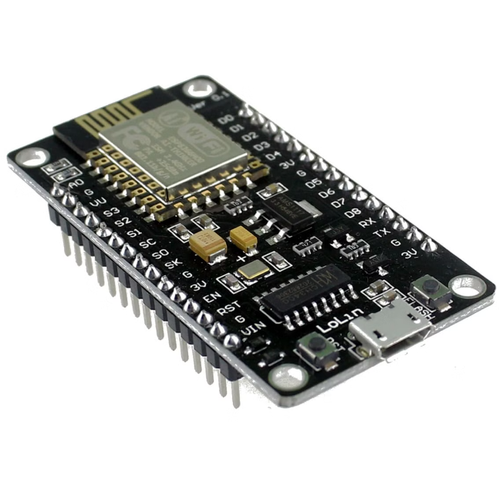
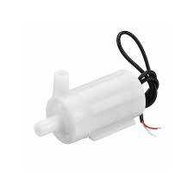
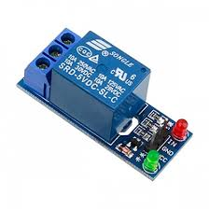
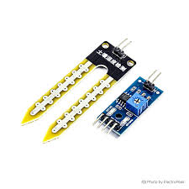
Overview of Components
NodeMCU
Water Pump
The brain of the system, NodeMCU is a microcontroller that provides connectivity and control.
The water pump delivers water to the crops based on the soil moisture levels.
Relay
Soil Moisture Sensor
The relay acts as a switch, allowing the NodeMCU to control the water pump.
The soil moisture sensor monitors the moisture content of the soil, sending data to the NodeMCU.

Slide 4

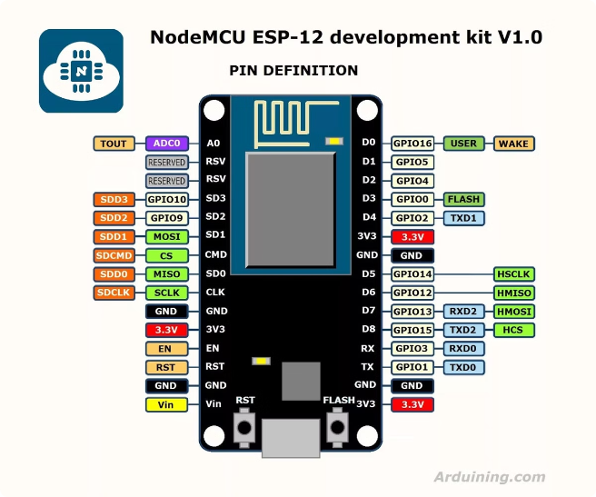
NodeMCU: Microcontroller and Connectivity
1
Microcontroller
2
Connectivity
The NodeMCU serves as the brains of the "Farmers Aid" system, processing data and controlling the irrigation system.
The NodeMCU utilizes Wi-Fi to connect to the internet, enabling remote monitoring and control of the irrigation system through Blynk IOT Platform
3
Programming
4
Data Processing
The NodeMCU can be programmed using the Arduino IDE for adding new features to the project
The NodeMCU collects data from the soil moisture sensor and uploads it to Blynk IOT Cloud Server.

Slide 5

Relay: Controlling the Water Pump
Relay Function
Electrical Safety
NodeMCU Control
The relay acts as a switch, allowing the NodeMCU to control the high voltage current needed to operate the water pump.
The relay ensures that the NodeMCU is isolated from the high voltage current, preventing damage.
The relay is connected to the NodeMCU, which sends signals to activate or deactivate the pump.

Slide 6
Soil Moisture Sensor: Monitoring Soil Conditions
Sensor Type
Data Transmission
Analog and digital soil moisture sensors are available, each offering different levels of precision and sensitivity.
The sensor sends data to the NodeMCU, which interprets the readings and uploads it to IoT sever which then can be accessed through Mobile or Web.
1
2
3
Sensor Placement
The sensor is placed in the soil to measure its moisture content, providing real-time data to the NodeMCU.

Slide 7

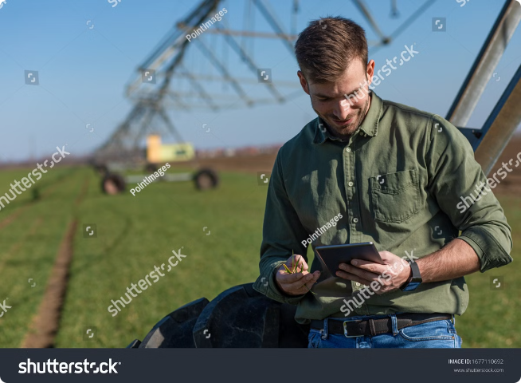
Integration of Components: Automated Irrigation System
NodeMCU
Processes data from the soil moisture sensor and controls the relay.
Relay
Activates or deactivates the water pump based on the NodeMCU's instructions.
Water Pump
Delivers water to the crops, optimizing water usage and reducing waste.
Soil Moisture Sensor
Monitors the moisture content of the soil, providing real-time data to the NodeMCU.

Slide 8






Conclusion and Benefits of "Farmers Aid"
Water Conservation
Increased Productivity
The automated system minimizes water usage, saving valuable resources.
By providing optimal moisture levels, the system promotes healthy plant growth and higher yields.
Time Efficiency and Mobility
Cost Savings
Farmers can focus on other tasks while the system manages irrigation automatically. It also gives them mobility to control their farm’s irrigation from any corner of the world with a click of a button
The automated system reduces labor costs and water bills, improving overall cost-effectiveness.

