Slide 1
Smart Commerce
Problem Solving Presentation
AI-driven e-commerce platform for smarter selling
Role-based workflows for admin, vendor, and customer
Inventory, orders, analytics, and demand forecasting in one system
01

Slide 2
Problem
Small and medium sellers often manage products, stock, and orders manually.
Teams lack a single view of inventory risk, customer demand, and order progress.
Late restocking and weak visibility reduce sales, trust, and operational control.
02

Slide 3
Project Goal
Build a professional full-stack commerce platform.
Make daily operations easier for admins, vendors, and customers.
Use analytics and forecasting to support faster business decisions.
03

Slide 4
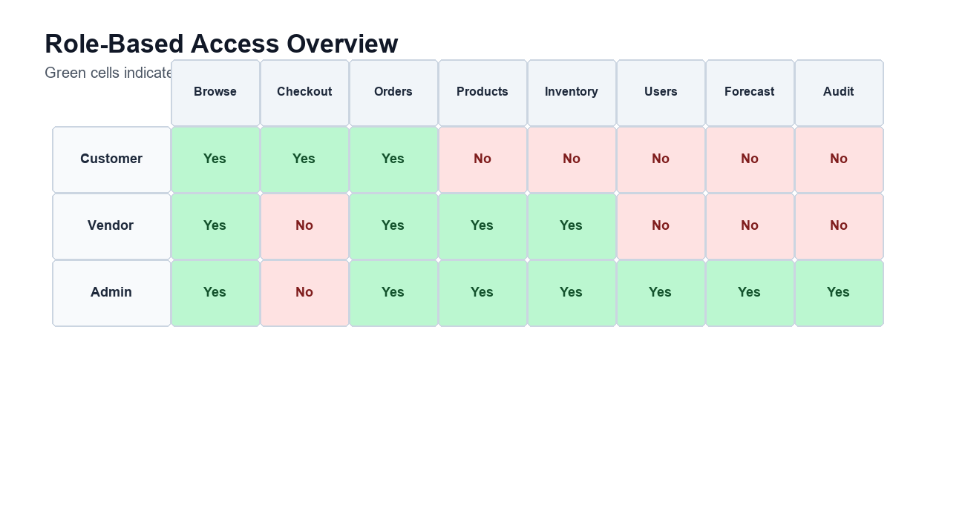
Proposed Solution
Customer storefront with product browsing, cart, checkout, and order tracking.
Admin dashboard for KPIs, orders, users, vendors, inventory alerts, and audit activity.
Vendor dashboard for product management, inventory updates, and order handling.
04

Slide 5
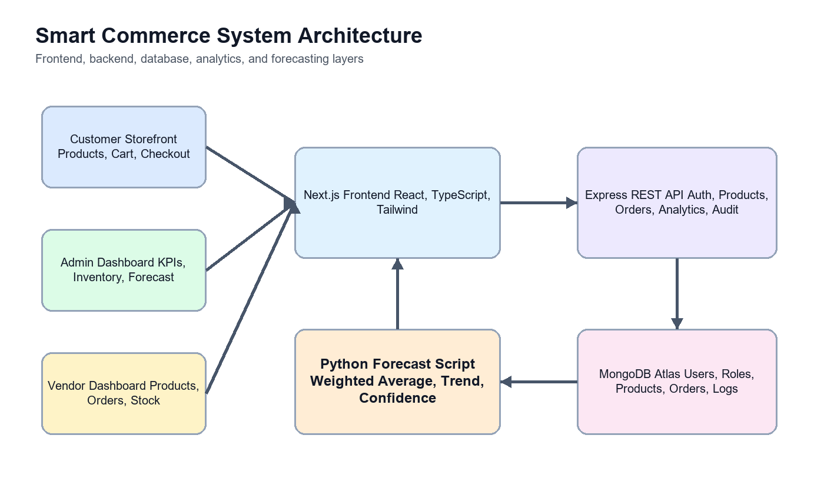
System Architecture
Next.js frontend communicates with an Express REST API.
MongoDB Atlas stores users, roles, products, categories, orders, and audit logs.
JWT authentication with httpOnly cookies protects role-based routes.
05

Slide 6
Core Features
Secure login and role-based access control.
Product catalog, category filtering, cart, checkout, and order confirmation.
Admin and vendor tools for inventory, users, vendors, and order status updates.
06

Slide 7
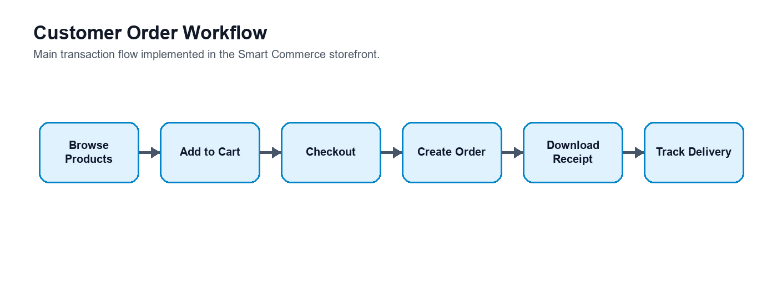
Order Workflow
Customers place orders from cart and checkout.
Admins or vendors move orders through pending, processing, shipped, and delivered.
Tracking events keep customers informed from placement to delivery.
07

Slide 8
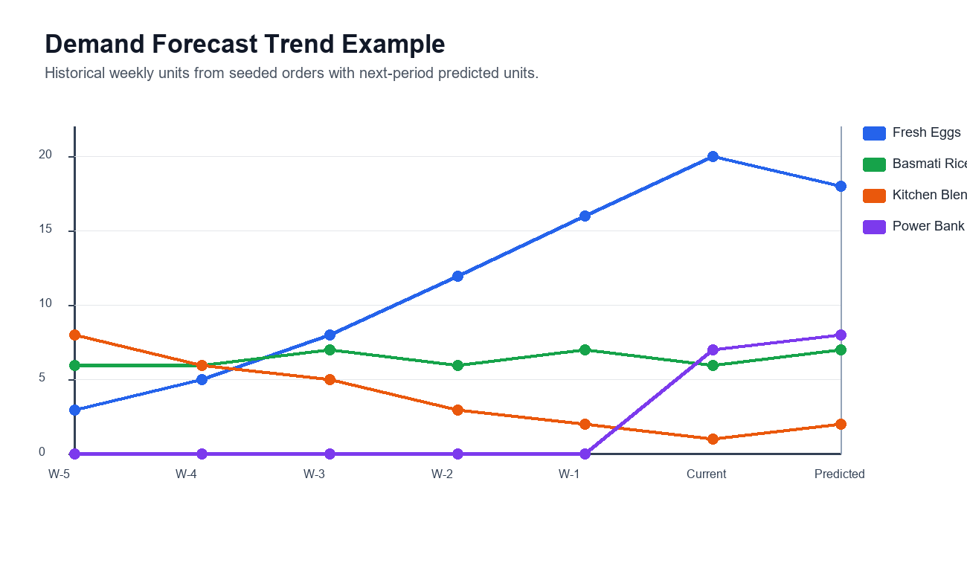
Demand Forecasting
Sales history is grouped into weekly demand buckets.
Python forecasting ranks products by predicted units and trend.
Forecast output helps prioritize restocking and reduce low-stock risk.
08

Slide 9
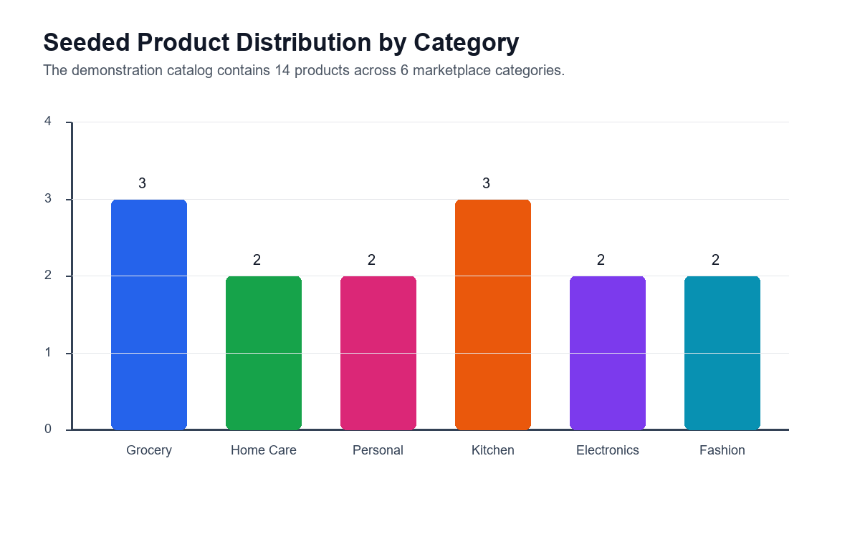
Business Value
Improves operational visibility across products, users, vendors, and orders.
Reduces missed sales by highlighting low stock and future demand.
Creates a scalable base for recommendation engines and advanced analytics.
09

Slide 10
Conclusion
Smart Commerce solves core e-commerce management problems with one integrated platform.
The system combines clean user experience, secure backend services, and data-driven decisions.
Future work can add deeper AI recommendations, payment integration, and automated deployment.
10

