Slide 1
Introduction to Angular
By Alex Wilson

Slide 2
What is Angular?
Angular is a JavaScript-based open-source front-end web application framework
Mainly maintained by Google and by a community of individuals and corporations
Addresses many of the challenges encountered in developing single-page applications
Typescript driven

Slide 3
What is Typescript?
Typescript is a superset of JavaScript
Allows for optional static typing, classes, and interfaces
Very easy for developers that know Java to pick up
Typescript code is compiled down to pure JavaScript

Slide 4
Angular Core Concepts
Module
Component
Template
Service
Metadata
Data Binding
Directive
Lifecycle hooks

Slide 5
Module
A module is a collection of services, directives, controllers, filters, and configuration information
Angular applications use modules as the core mechanism for composition
Modules export things that other modules can import
**Keep your modules fine-grained and self-documenting

Slide 6
Component
A whole application can be modeled as a tree of components
A component is anything that is visible to the end user and which can be reused many times within an application
Properties and methods of the component class are available to the template

Slide 7
Components Example
import { Component } from '@angular/core';
@Component({
selector: 'my-component',
template: '<div>Hello my name is {{name}}. <button (click)="sayMyName()"> Say my name</button></div>’
})
export class MyComponent {
name: string;
constructor() {
this.name = ‘Jal Irani'
}
sayMyName() {
console.log('My name is', this.name)
}
}
***When we use the <my-component></my-component> selector tag in our HTML, this component will be created, our constructor called, and rendered.

Slide 8
Template
A template contains HTML used to render part of a view
Angular leverages native DOM events and properties which dramatically reduces the need for a ton of built in directives

Slide 9
Service
A service is typically a class with a narrow, well-defined purpose
Take the burden of commonly used functionality out of the components
Decorate with @Injectable when we need to inject dependencies into our code

Slide 10
Service Example
//Example: customer.service.ts import { HttpModule } from '@angular/http' @Injectable() export class CustomerService { constructor(private http: Http) { } getCustomers() { return this.http.get('api/customers') .map((response: Response) => <Customer[]>response.json().data) .catch(this.handleError); } private handleError(error: Response) { console.error(error); return Observable.throw(error.json().error || 'Service error'); } }

Slide 11
Metadata
Metadata allows Angular to process a class
Annotations that we have already seen:
The @Component() annotation tells angular that the class is of type component
The @Injectable() annotation tells angular that the class is a service and that it can be injected into another component

Slide 12
Databinding
Data binding is the process that establishes a connection between the application UI and the typescript functionality
The template contains angular specific syntax for databinding

Slide 13
Databinding and Metadata
Data binding type: One way property binding
Used to assign values to properties of another component
Annotation:
The @Input() annotation tells angular that the value of a specified property will get its value from the template.

Slide 14
Databinding and Metadata
Data binding type: One way event binding
Used to register callbacks when an event occurs for another component
Annotation:
The @Output() annotation tells angular that a parameter emits a value from the typescript file to the template

Slide 15
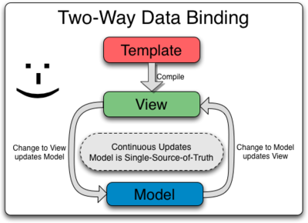
Databinding and Metadata
Data binding type: two way data binding
combines property and event binding into one syntax
Annotation:
Contains an @Output() and a setter so that the value can emit an event but also be set from the template

Slide 16
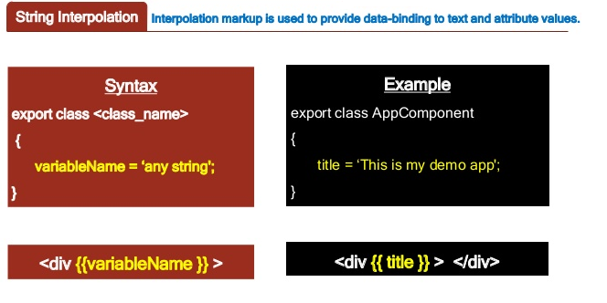
Data binding
Data binding type: Interpolation
Uses curly brace syntax: {{variable-name}}
combines property and event binding into one syntax

Slide 17
Directives
Directives are instructions in HTML code which will tell Angular how to change/alter/manipulate the code/document when it encounters this directive
Angular lets us extend HTML by using directives and attributes.
Types:
Structural directive: Changes the DOM layout by removing /adding DOM element
ngIf, ngFor, ngSwitch
Attribute directive: Changes the appearance or behavior of the element
ngStyle, ngClass

Slide 18
Directive Types
Attribute Directives are called like this, because they are applied like HTML attributes and impact the element they are attached to (e.g. change the styling)
Example: <div [ngClass]=”{‘class-to-be-applied’: true}
Structural Directives are called like this, because they change the structure of the DOM, not only the element on which they sit
Examples:
<li *ngFor=”let item of items”>{{item}}</li>
<div *ngIf=”condition”>

Slide 19
Lifecycle hooks
Commonly use hooks:
ngOnChanges() - Respond when Angular (re)sets data-bound input properties
ngOnInit() - Initialize the directive/component after Angular first displays the data-bound properties and sets the directive/component's input properties
ngAfterViewInit() - Respond after Angular initializes the component's views and child views
Other hooks:
ngDoCheck(), ngAfterContentInit(), ngAfterContentChecked(), ngAfterViewChecked(), ngOnDestroy()

Slide 20
Resources
Angular Tutorial
https://angular.io/docs/js/latest/tutorial/
Official documentation for Angular
https://angular.io/docs/ts/latest/
Rangle.io
https://www.gitbook.com/book/rangle-io/ngcourse2/details

