Slide 1

Smart and Sustainable Public Transport Solution
By-
1.Harshad Bhalsing (Team Leader)
2.Atharva Kamble
3.Anushka Nilakh
4.Prerana Pawar
5.Sakshi Kapase

Slide 2

Problem Statement
Revolutionizing Public Transport Systems – Improve last-mile connectivity, smart ticketing, or sustainable transport.

Slide 3

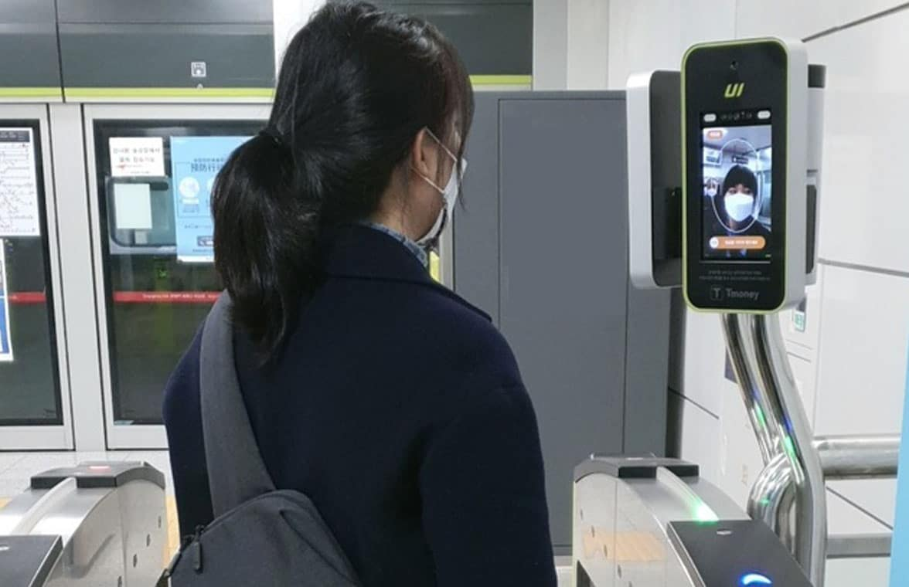

Aim and Objectives
Aim-
The aim of this initiative is to revolutionize public transport systems by addressing key challenges such as enhancing last-mile connectivity, implementing smart ticketing solutions, and promoting sustainable transport practices.
Objectives-
1.Enhance Last-Mile Connectivity
2. Implement Smart Ticketing-
3. Promote Sustainable Transport

Slide 4
Abstract
Facial recognition technology has emerged as a powerful tool for enhancing the ticket booking and entry process across various sectors. It offers a seamless, contactless experience by enabling users to book and access tickets without the need for physical tickets or traditional methods like passwords. Key applications include airports, concerts, public transportation, theme parks, movie theaters, sports stadiums, hotels, and events, where it streamlines check-ins, improves security, and reduces wait times. The technology enhances convenience, personalizes user experiences, and provides efficient crowd management, making it a valuable solution for modern ticketing systems.

Slide 5
Introduction
Public transportation plays a crucial role in shaping the mobility landscape of urban areas, providing an affordable, accessible, and sustainable alternative to private car use. However, current public transport systems often face significant challenges such as inefficient last-mile connectivity, outdated ticketing methods, and unsustainable environmental practices. These issues result in congestion, increased pollution, and a lack of convenience for passengers. To address these challenges, there is a pressing need to revolutionize public transport systems through innovations such as enhanced last-mile connectivity, smart ticketing solutions, and the adoption of sustainable transport practices.

Slide 6

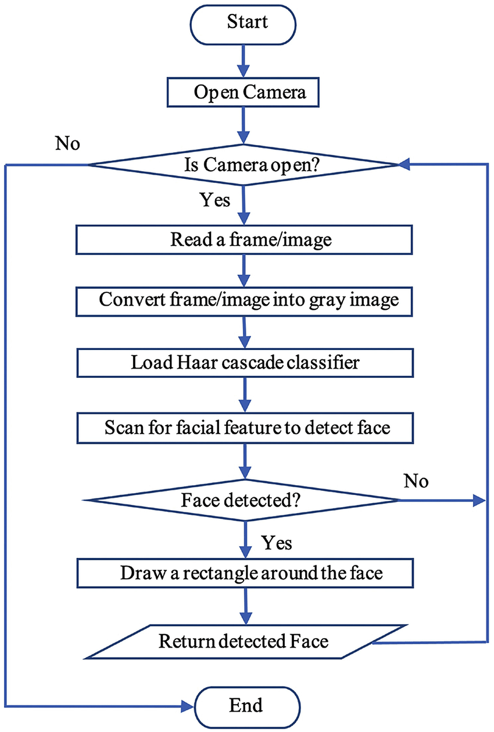
Overview of Face Detection
User can book ticket and while booking ticket user have to scan face.
After detection of face user can enter or exit the station without any physical ticket.
So, ticket booking can be done with the help of biometric features.

Slide 7
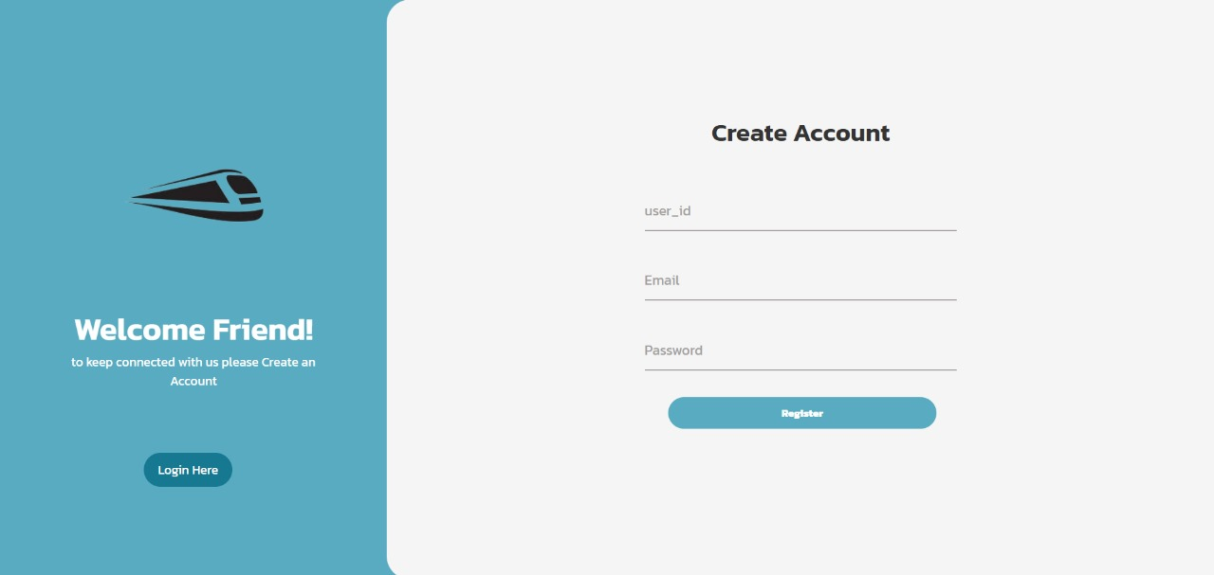
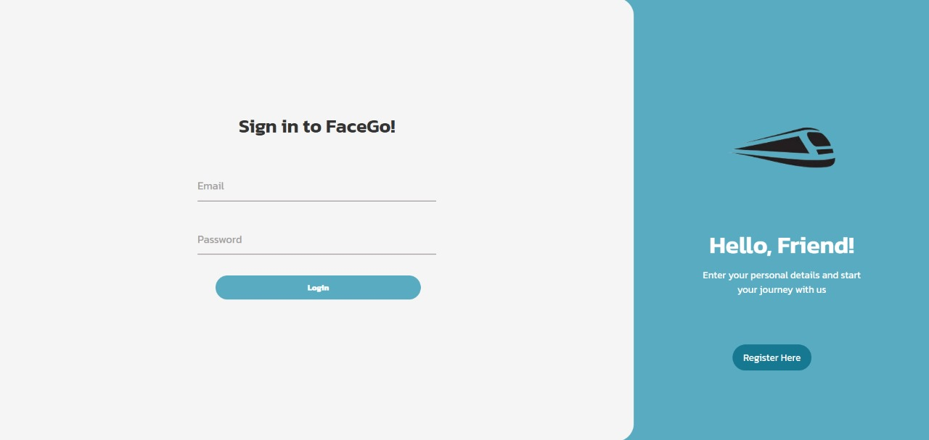
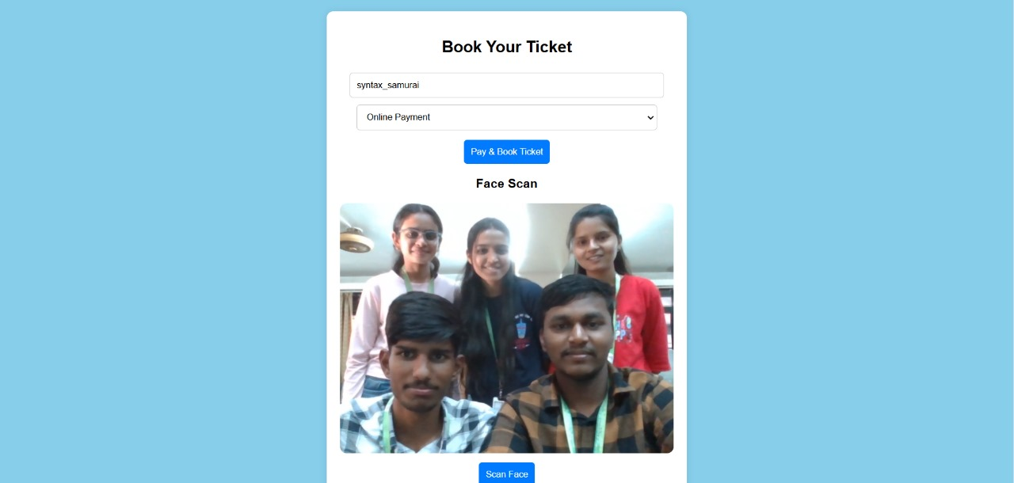
Working of the model

Slide 8
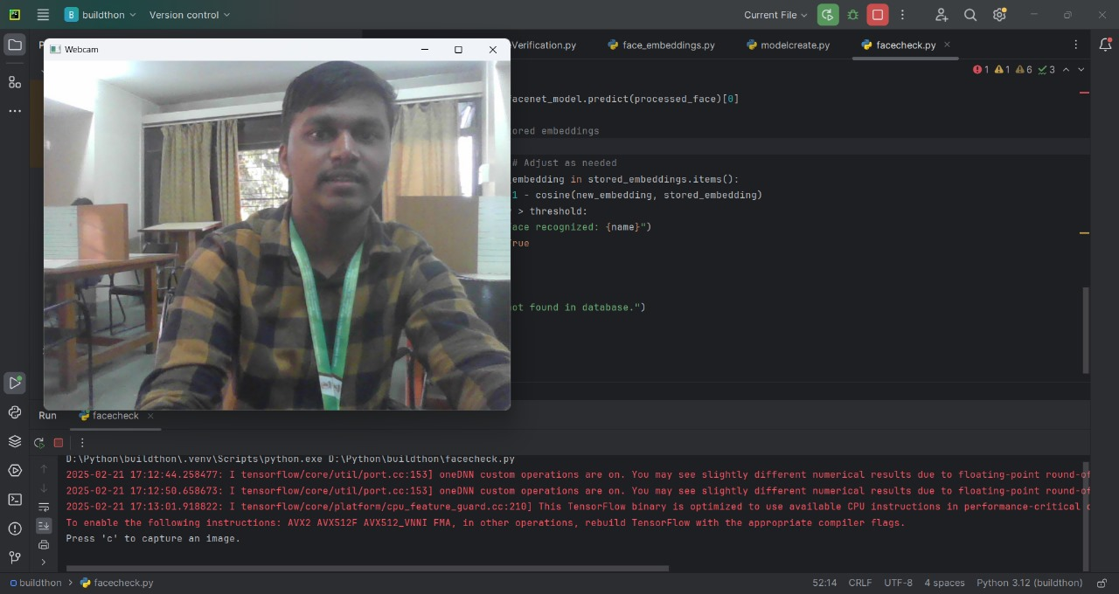
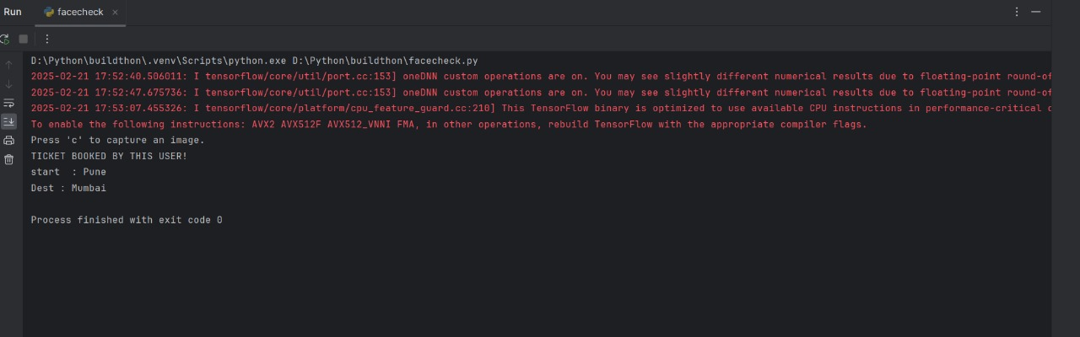
Working of the model

Slide 9
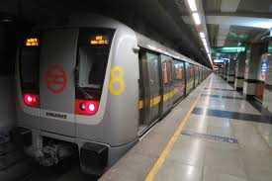

Advantages
1.Convenience and Speed- Speeds up bookings and
check-ins.
2.Increased Security- Reduces fraud and unauthorized
access.
3.Contactless and Hygienic- No need to carry tickets
4.Enhanced User Experience
5.Data Collection and Analytics
6.Efficient in Crowds: Handles large volumes quickly in
busy places.
7.Useful for people with disabilities

Slide 10
Applications
1.Airports: For seamless check-in and boarding by using facial recognition instead of traditional tickets and boarding passes.
2.Concerts and Events: Allows quick and secure entry without physical tickets, just by scanning your face at the entrance.
3.Public Transportation: For ticketless travel on trains, buses, or subways, where passengers are identified by their face for fare collection.
4.Theme Parks: Enhances the guest experience by enabling entry without physical tickets, allowing faster access to rides and attractions.

Slide 11
Literature Review
Zhao et al. (2021) identify last-mile connectivity as a critical factor influencing public transit ridership
Shaheen et al. (2020) examine the potential of shared bikes and electric scooters as part of the solution to last-mile challenges.
Michaels et al. (2019) discuss how technologies such as contactless smart cards, mobile applications, and QR codes are streamlining the ticketing process, reducing queues and manual intervention.

Slide 12
Conclusion
The integration of smart technologies in public transport enhances efficiency, sustainability, and user experience. Future research should focus on AI-driven transit planning, MaaS (Mobility as a Service), and the role of emerging technologies in optimizing urban mobility.

Slide 13
Thank You!

