Slide 1






MACHINE LEARNING · TASK 1
California
House Price
Predictor
Building & Evaluating a Linear Regression Model
20,640
9
80/20
OLS
Prepared by
Data Points
Features
Train/Test Split
Algorithm
Kalyani Borkar
AI & ML Intern

Slide 2


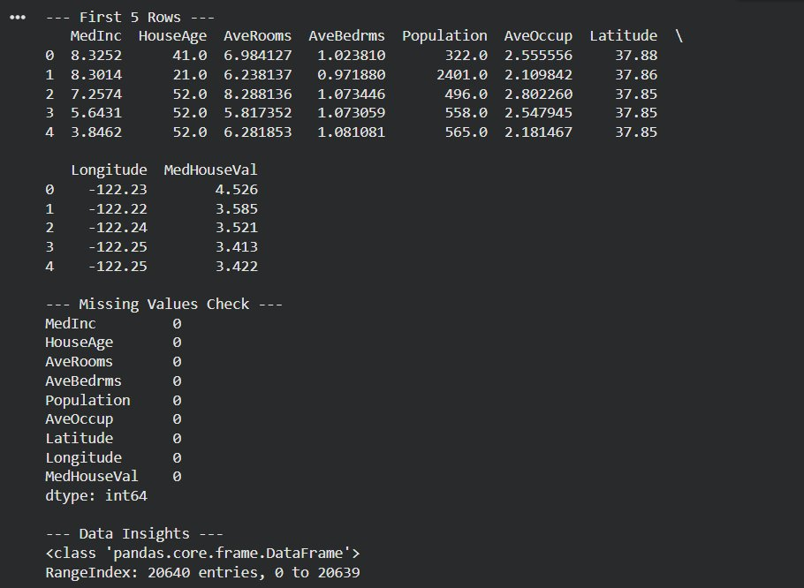
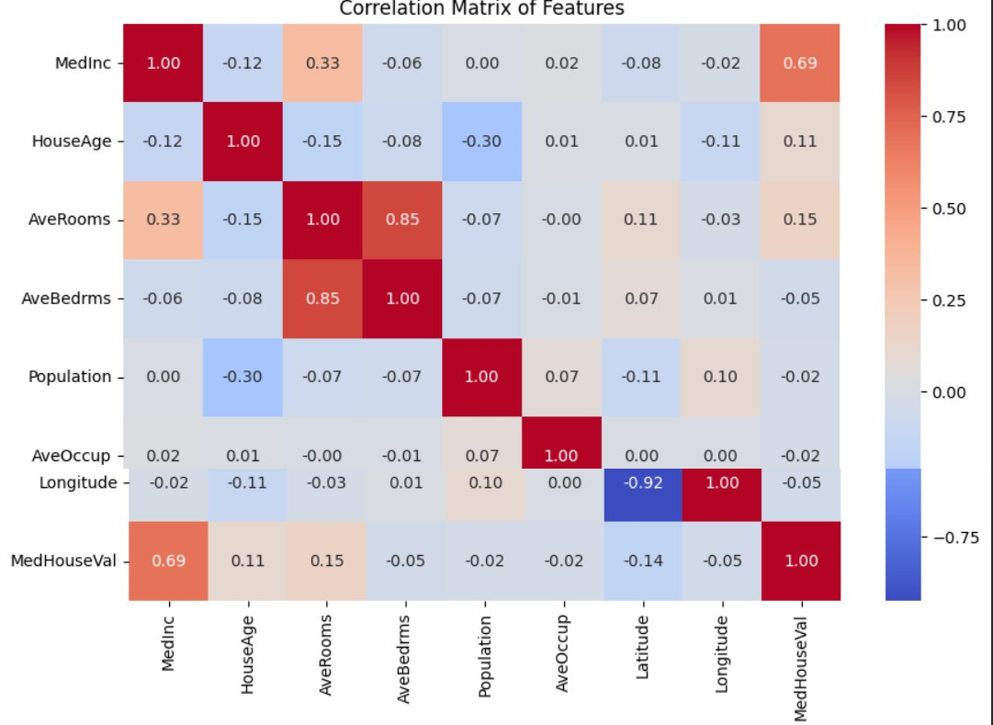
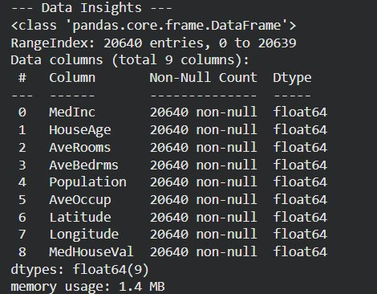
02 / EXPLORATORY DATA ANALYSIS
Dataset Insights & Feature Correlations
DATASET OUTPUT
CORRELATION MATRIX
★ KEY INSIGHT:
MedInc (r = 0.69) is the strongest predictor of house value · Zero missing values across all 20,640 records · All features float64

Slide 3


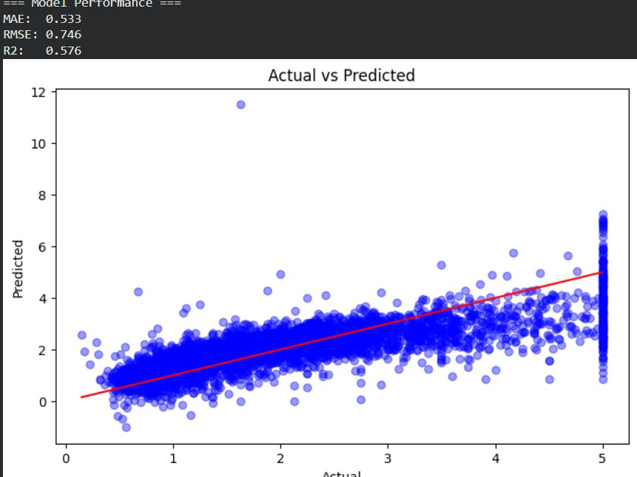

03 / MODEL PERFORMANCE
Evaluation Metrics & Predictions
SPLIT: 80% Train · 20% Test · random_state = 42
ACTUAL vs PREDICTED
0.533
0.746
57.6%
MAE
RMSE
R²
Mean Absolute Error
Root Mean Sq. Error
Coeff. of Determination
~$53,300 avg. deviation
Penalises large outlier gaps
Variance explained by model
Model shows strong linear fit — income is key driver

Slide 4





04 / CONCLUSIONS & NEXT STEPS
Takeaways & Roadmap
CONCLUSION
Linear Regression establishes a strong, interpretable baseline — MedInc alone drives most predictions. The 57.6% R² proves economic factors dominate California housing prices.
01
02
03
Feature Scaling
Ensemble Models
Geo Feature Engineering
Apply StandardScaler — normalize all features so optimization converges faster and coefficients become truly comparable.
Upgrade to Random Forest or XGBoost to capture non-linear interactions Linear Regression fundamentally cannot model.
Transform Lat/Lon into distance from SF & LA economic hubs — far more signal than raw coordinates.
California House Price Predictor · Task 1 · Kalyani Borkar · AI & ML Intern

