Slide 1
Predicting Student Academic Performance
using the KDD framework and machine learning regression
Kalyani Eknath Borkar | PRN 23070521036
B.Tech CSE (AI & ML), Sem VII, Section A
Predictive Analytics (T3366) - CA3, Symbiosis Institute of Technology
Notes:
Good morning. My project is about predicting a student's performance score from simple daily habits, and I followed the KDD process step by step to do it. I used two regression models and compared them.

Slide 2
What are we trying to predict?
Goal: predict a student's Performance Index (a score from 0 to 100) from five habits.
Study hours
per day
Previous score
last exam
Attendance
% of classes
Practice papers
solved
Sleep hours
per day
Target is a continuous number, so this is a regression problem, not classification.
I generated 1,000 synthetic student records in the code, so it runs on any laptop.
I added a few missing values and wrong entries on purpose, to show real data cleaning.
Kalyani Borkar | PRN 23070521036 | T3366 CA3 2
Notes:
Our target is a number between 0 and 100, so it is regression. The five inputs are shown in the boxes. Since I do not have a real college dataset, I created 1,000 records with code. I also put in some missing values and outliers deliberately so that the cleaning step has something to do.

Slide 3
The KDD process I followed
1
2
3
4
5
Selection
Preprocessing
Transformation
Data mining
Evaluation
Pick the data: 1,000 records, 5 inputs + 1 target
Fix missing values and outliers
Train/test split and scaling
Train the regression models
Compare with MAE, RMSE, R-squared
KDD = Knowledge Discovery in Databases. The idea is that good predictions come from the whole pipeline, not only from the model. Bad data gives bad results, however fancy the algorithm is.
Kalyani Borkar | PRN 23070521036 | T3366 CA3 3
Notes:
KDD has five stages and my notebook is organised in exactly this order. The model is only stage 4. Most of the effort goes into getting the data right before and after.

Slide 4
Cleaning and preparing the data
Stage 2: Preprocessing
Stage 3: Transformation
About 2% values were missing, so I filled them with the median.
Outliers found with the IQR rule: anything below Q1 - 1.5 x IQR or above Q3 + 1.5 x IQR.
I capped those values at the limit instead of deleting rows, so all 1,000 records stay.
80% training, 20% testing, with random_state = 42 so results can be repeated.
StandardScaler converts each feature to mean 0 and spread 1.
The scaler learns only from training data, so nothing leaks from the test set.
Scaling is a must for distance-based methods like k-NN, because big-range features such as attendance would dominate the distance.
Kalyani Borkar | PRN 23070521036 | T3366 CA3 4
Notes:
Median is used because it is not pulled by extreme values. I capped outliers rather than removing them since 1,000 rows is not a huge dataset. About scaling: k-NN is not in my final two models, but it is the standard example for why scaling matters, so I mention it. For my models scaling makes the linear regression coefficients comparable, and it does not hurt Random Forest.

Slide 5
The two models I compared
Linear Regression (OLS)
The baseline
Random Forest
The ensemble
Fits one straight-line equation through the data
Easy to explain: each coefficient shows the effect of one habit
Fast, but cannot capture curves on its own
100 decision trees, each trained on a random sample (bagging)
The final answer is the average of all trees
Handles curved patterns and is less likely to overfit than one tree
Both were checked with 5-fold cross-validation on the training data, then tested once on the 20% the models had never seen.
Kalyani Borkar | PRN 23070521036 | T3366 CA3 5
Notes:
I picked one simple model and one stronger model so the comparison is meaningful. Cross-validation splits the training data into 5 parts, trains on 4 and checks on 1, and repeats. That tells us the model is stable and not just lucky.

Slide 6
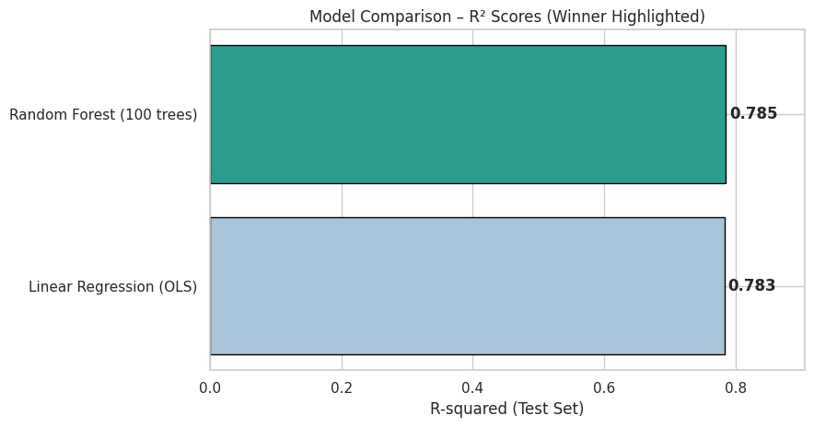
Results on the test set
Model | MAE | RMSE | R2
Random Forest | 3.967 | 4.968 | 0.7853
Linear Regression | 3.818 | 4.988 | 0.7835
Random Forest is slightly ahead on R2 and RMSE.
OLS has a slightly lower MAE.
Both explain about 78% of the variation in scores. An error of about 4 marks out of 100 is small.
R2 on test data, winner highlighted
Kalyani Borkar | PRN 23070521036 | T3366 CA3 6
Notes:
MAE is the average absolute error, RMSE punishes big errors more, and R2 is the share of variation the model explains. The two models are almost tied. My data is mostly linear by design, so the simple model does nearly as well as the forest. In practice that means extra complexity did not buy much here.

Slide 7
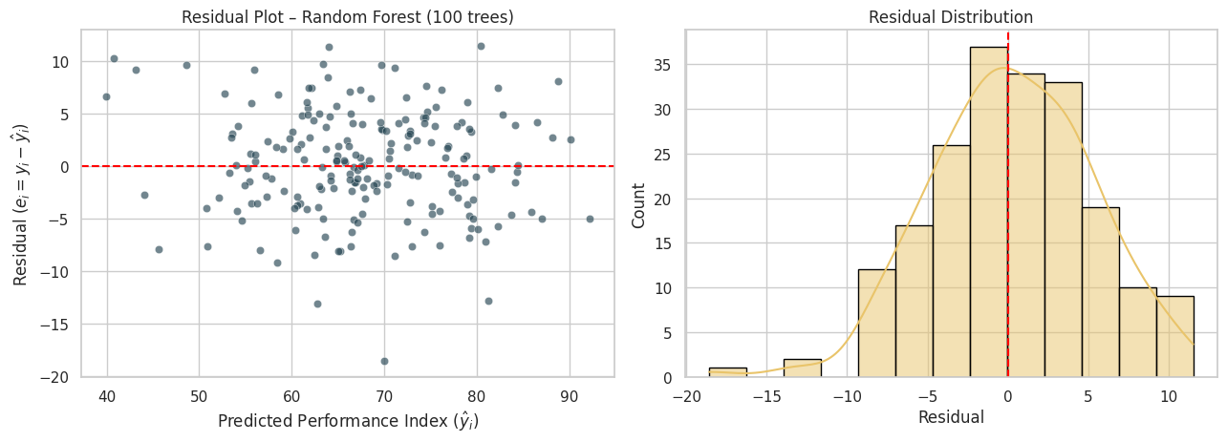
Checking the errors and conclusion
Conclusion
Random Forest is the best model, R2 = 0.785.
The model is reliable: errors are centred near zero.
Limits: data is synthetic, so real data should be tested.
Next step: tune the models and try real college data.
Residual = actual - predicted. The points form a flat band around zero with no funnel shape, so the error size stays steady across predictions (homoscedasticity).
Kalyani Borkar | PRN 23070521036 | T3366 CA3 7
Notes:
The residual plot is the check that the model is not hiding a pattern in its mistakes. A flat random band is what we want. To finish: Random Forest wins narrowly, but the main learning is that following the full KDD process matters more than the choice of model. Thank you, I am happy to take questions.

