Slide 1
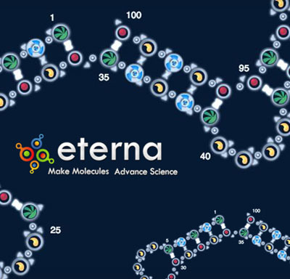
RNA Folding Widget for EteRNA

Slide 2
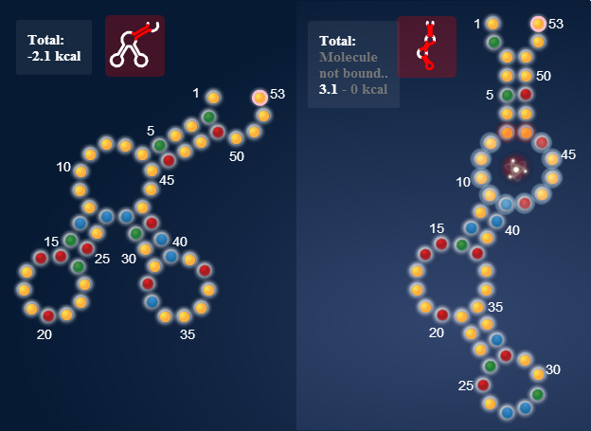
What is EteRNA?
Browser-based “crowdsourced science” game
Fold RNA sequences, minimize free energy

Slide 3
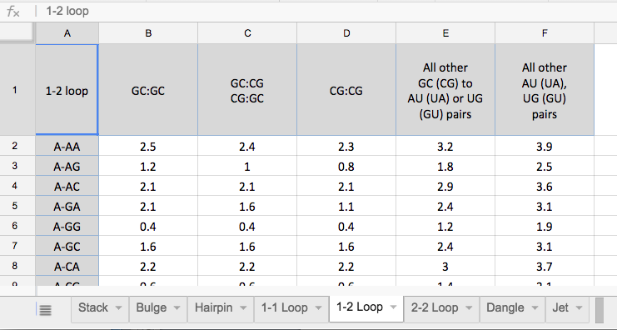
Problem: Players spend time looking up optimal conformations in clunky spreadsheets
Solution: Transform spreadsheet into visual interface to facilitate lookup process
(final screenshot here)

Slide 4
Process
d3.js and SVG for visualization
(Margaret: why is D3 ideal?)
JSON for data
(Sarah: getting data into format)

Slide 5
Difficulties
Learn on the spot!
Variety of user input
Complexity of data structures
Joining front end and back end

