Slide 1
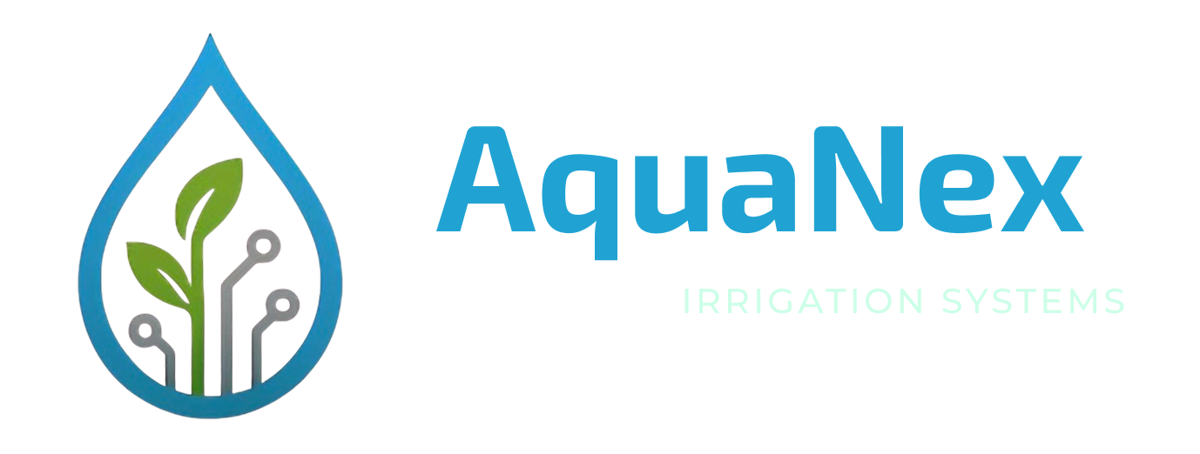
AquaNex
AI-Powered Irrigation Risk Management Platform
Team Technium · CSIT321 Capstone Project
Israr Ahmed | Saad Kadli | Abrar Syed| Atsushi Hashimoto | Muhammad Bilal

Slide 2
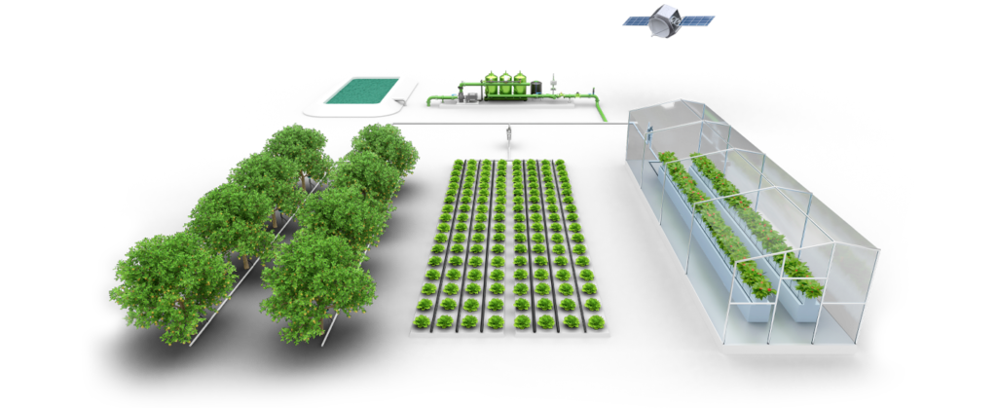
Problem
Why irrigation risk management is hard in the UAE
• High water scarcity (< 100mm rainfall) and extreme temperatures (>50°C)
• Saline groundwater + aging infrastructure increases breakage risk
• Reactive monitoring: manual patrols, SCADA alarms, manual crew scheduling
• Small leaks can escalate into major failures when response is slow

Slide 3
The Problem
30–50%
50°C+
<100mm
Water loss from
leaks & inefficiency
Extreme temps
damaging infrastructure
Annual rainfall in
the UAE
Key Challenges:
Aging irrigation infrastructure with reactive-only maintenance
Fragmented tools, no unified platform for monitoring, detection & response
Manual processes delay repairs, wasting water and increasing costs
UAE National Food Security Strategy 2051 demands modern, reliable irrigation

Slide 4
Our Solution
AquaNex is a cloud-native, AI-powered platform that transforms irrigation operations from reactive maintenance to predictive, automated, and optimized management.
🔗
Unified Platform
Autonomous Intelligence
Human-in-the-Loop
IoT, AI & decision support in a single operational hub
Detects failures, assesses impact & allocates resources automatically
AI recommendations with human approval for critical decisions

Slide 5
5 AI-Driven Modules
01
02
03
Pipeline Risk & Breakage
Soil Salinity Intelligence
Water Demand Forecasting
Real-time anomaly detection with automated repair planning & crew allocation
Continuous soil monitoring with predictive mitigation & crop recommendations
AI-driven dynamic irrigation scheduling using weather & crop data
04
05
Water Quality Monitoring
Anomaly Analysis Engine
Proactive pH, TDS & turbidity analytics with integrated risk mitigation
Cross-system financial intelligence linking technical issues to business impact

Slide 6
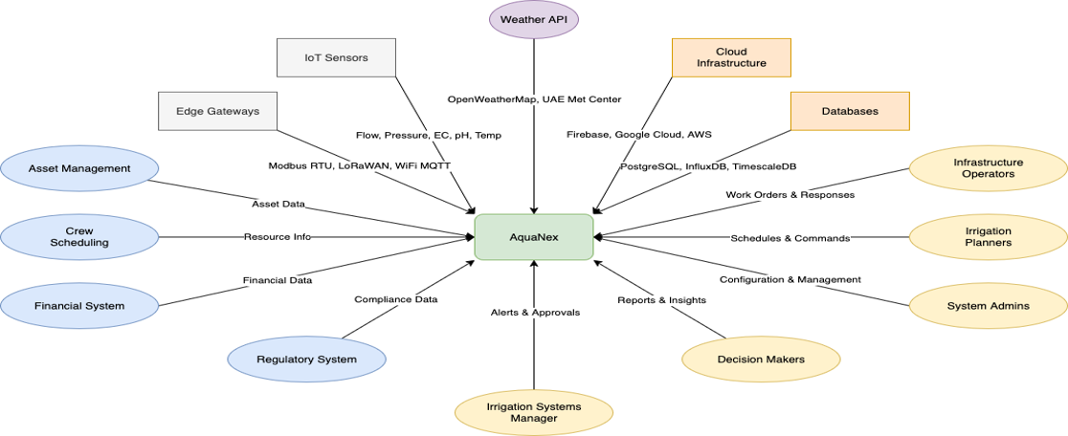
Context Diagram

Slide 7
Tech Stack
Backend
Frontend
Django · DRF · Celery · Redis · SimpleJWT · Google OAuth
React · Vite · TypeScript · Tailwind CSS · Leaflet.js
ML / AI
IoT
FastAPI · scikit-learn · Random Forest · GAN-augmented data · MQTT
MQTT Protocol · Sensor Simulators · ThingsBoard (Oracle Cloud)
Cloud & Infrastructure
DevOps
Render (Backend) · Vercel (Frontend) · Supabase (PostgreSQL) · Cloudflare R2
GitHub · Docker · Environment Variables · WhiteNoise · CORS config

Slide 8
System Architecture
IoT Layer
Backend
ML Service
Frontend
Sensors & Gateways
MQTT Protocol
Django (DRF)
Celery and Redis
FastAPI
XGBoost, ARIMA Models
React and Vite
Leaflet Maps
Cloud Infrastructure
Supabase
PostgreSQL
Cloudflare R2
ML Models
Render Redis
Message Broker

Slide 9
Thank You
AquaNex — Smarter Irrigation. Sustainable Future.
Team Technium
Israr Ahmed (Team Leader) · Saad Kadli (Scribe) · Muhammad Bilal Mala · Atsushi Hashimoto · Abrar Syed
CSIT321 · University of Wollongong Dubai · April 2026
github.com/CodeChef42/Project-AquaNex

