Slide 1

androidGO

Slide 2
Team
Akansha Patel
Ketki Haridas
Pallavi Santosh
Shyama Sankar Vellore
Notes:
Name
University
Background

Slide 3
androidGO
Goal : introduce software developers to the world of mobile app development.
Scope : Cover the key aspects of android development required to create basic applications.
Notes:
We have coding exercises after each module for hands-on exposure of the curriculum.
The designed curriculum is designed to introduce software developers to the world of mobile app development. The course follows a modular structure that introduces the audience to the various elements of Android development, reinforcing the concepts covered in each modules using simple mini-projects. The final module of the course combines all the mini-projects designed in the previous modules to develop a complete “SOS” application.

Slide 4
Why Android
Open source with easy installations available
It is easy to grasp
Android can be taught in a modular fashion.
Basic application can be developed by beginners in a four hour curriculum.

Slide 5
Prerequisite
Intermediate level coding experience with Java
Latest version of Android Studio (the course was built with version 2.1.2)
An Android device running Android 4.4 (KitKat) or above
A USB cable to connect the device to the computer for testing
Notes:
Someone with CS background should have Java or any programming language knowledge and know CS basics.

Slide 6
Course Overview
Module 1: Introduction to Android
Module 2: Android Widgets
Module 3: Communication
Module 4: Android Services
Module 5: Storing Data /Interaction to the Databases
Module 6: Save my Soul –Build an Application

Slide 7
Module 1: Introduction to Android
Basic Terminologies
Elements of Android
Life cycle of Android application
Structure of Android application
Creating a project
Duration of the module:10minutes
Notes:
The first module includes the architecture for introducing basics of android application.

Slide 8
Module 2: Android Widgets
Introduction to typical UI elements of android
Navigating from one activity to another
Input and Output functions
Using Fragments and Intents
Duration of the module:10minutes
Notes:
This module of the curriculum initiates the basic interaction of IO functions within the application and we use the following exercise.

Slide 9
Exercise
Exercise : Create an application that accepts a string input from a user (stating a color) and displays that color in an ImageView. The first activity must consist of two fragments, one containing an EditText and the other containing a “Show Color” button. The second activity must contain an ImageView that displays the color.
Duration of the module:30minutes

Slide 10
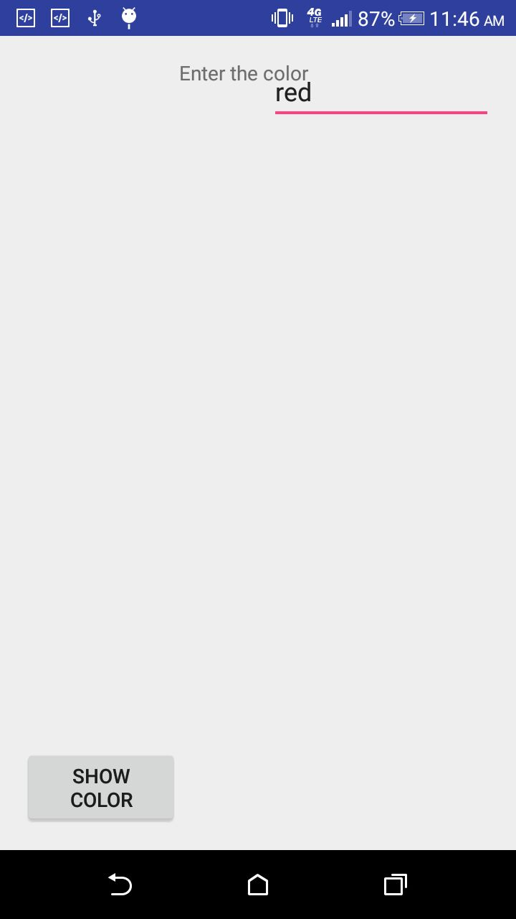
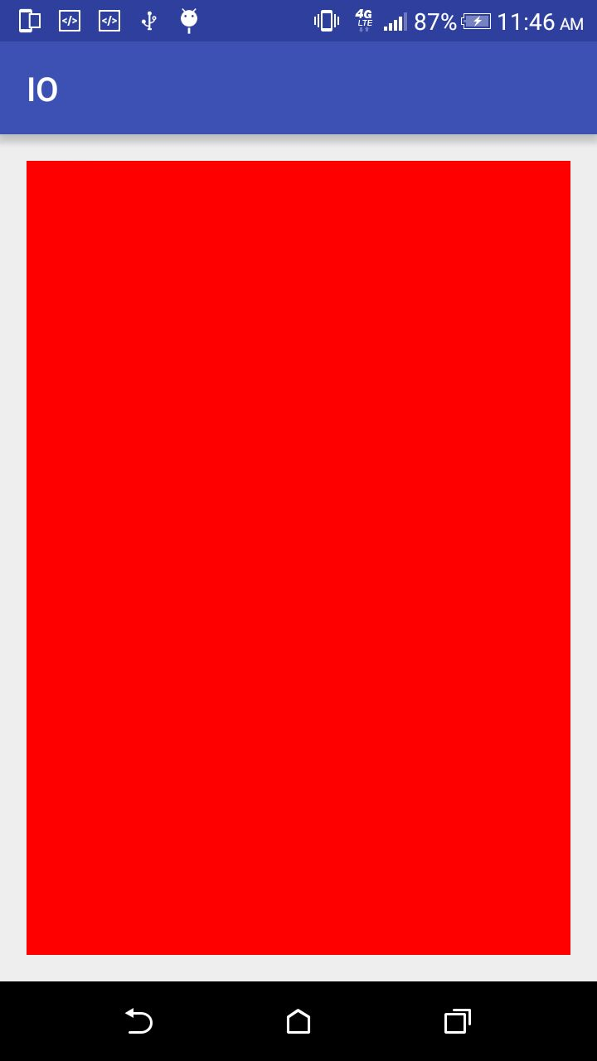
Module 2: Android Widget Hands-on
On click()
Activity 1
Activity 2

Slide 11
Module 3: Communication
Adding the communication capabilities to the application.
Sending an SMS
File Input and Output
Granting Permissions to the Application
Duration of the module:10minutes
Notes:
This module intends to add communication capability to the android application.

Slide 12
Exercise
Create a messaging application that sends a given text message to the phone number provided and also saves the phone number and the text message to a log file stored in external storage.
Duration of the module:30minutes

Slide 13
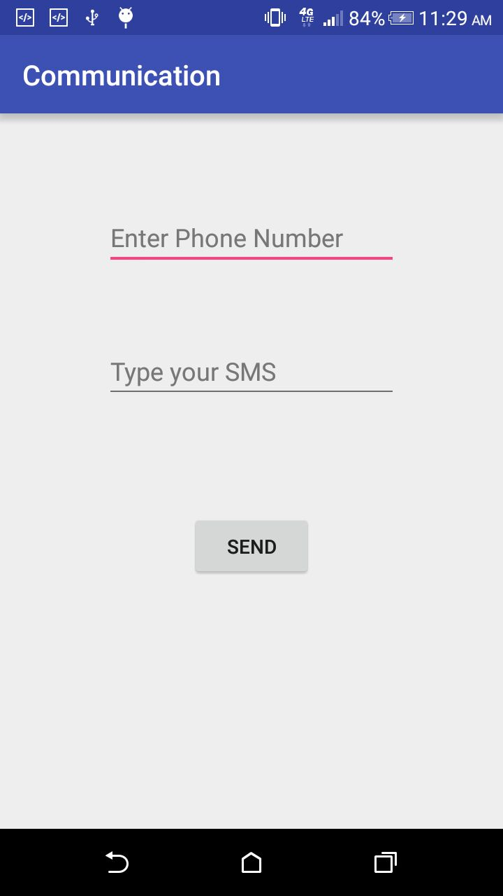
Module 3: Communication Hands-on

Slide 14
Module 4: Android Services
Implementing services
Background Services
Duration of the module:10minutes

Slide 15
Exercise
Exercise: Create an application that works in the background to calculate the user’s location (latitude and longitude) and displays the same via a Toast message on the device’s home screen.
Duration of the module:30minutes

Slide 16
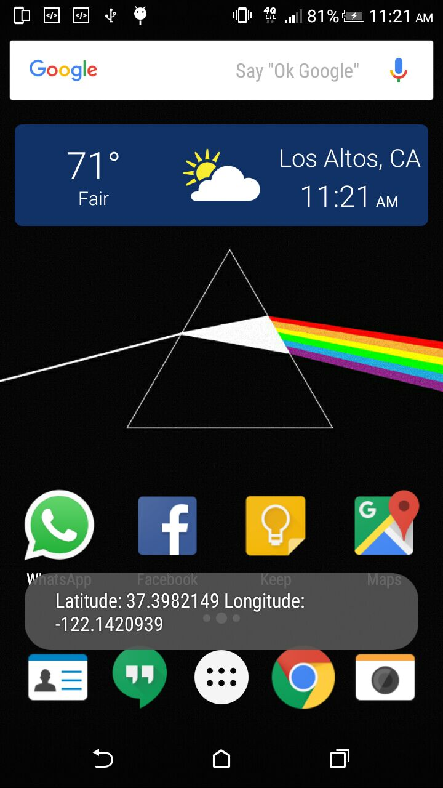
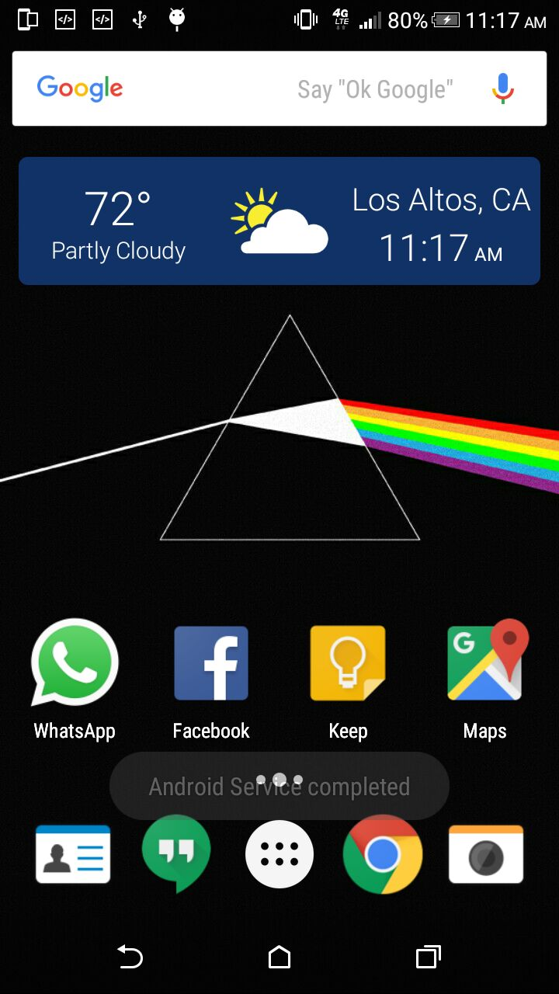
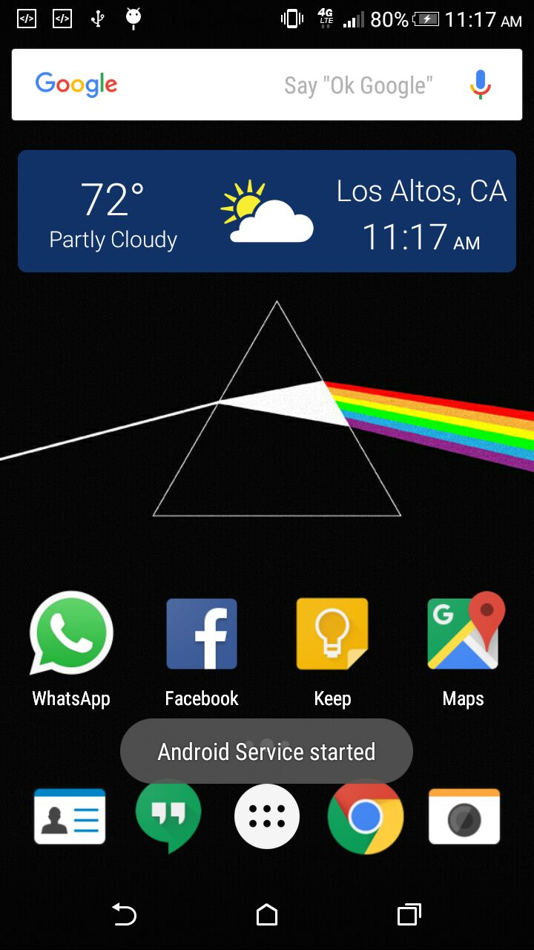
Module 4: Android Services Hands-on

Slide 17
Module 5: Interaction to the Databases
Introduction to SQLite
Creating Databases and tables
Storing and Retrieving Data
Duration of the module:10minutes
Notes:
This module has step by step guidelines how the android application interacts with SQL-Lite

Slide 18
Exercise
Exercise: Create an Android app that lets the user to save and retrieve contacts information (name and phone number).
Duration of the module:30minutes

Slide 19
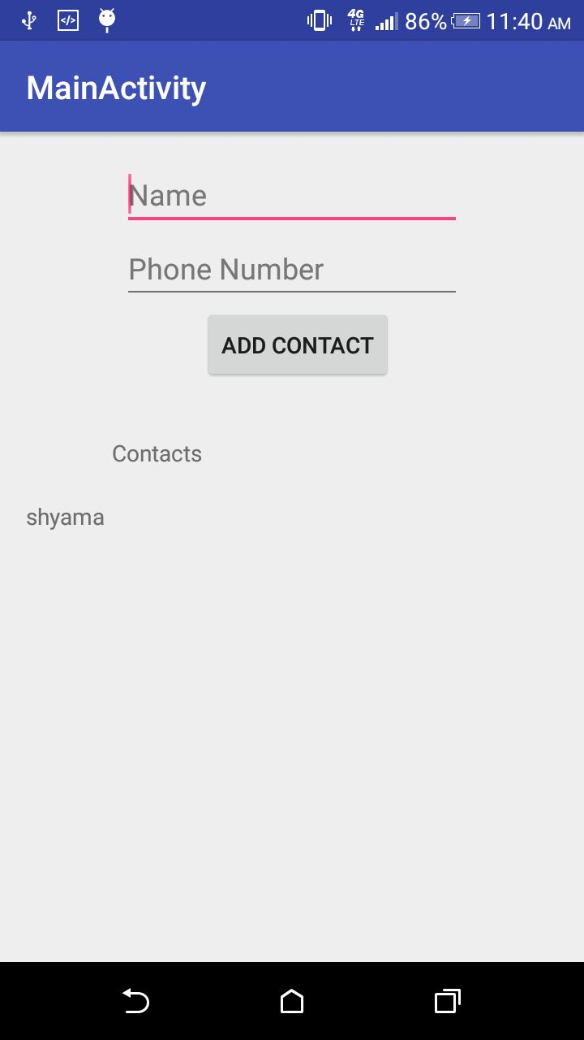
Module 5: Databases Hands-on

Slide 20
Build an Application
Building an end to end application
Duration of the module:30minutes

Slide 21
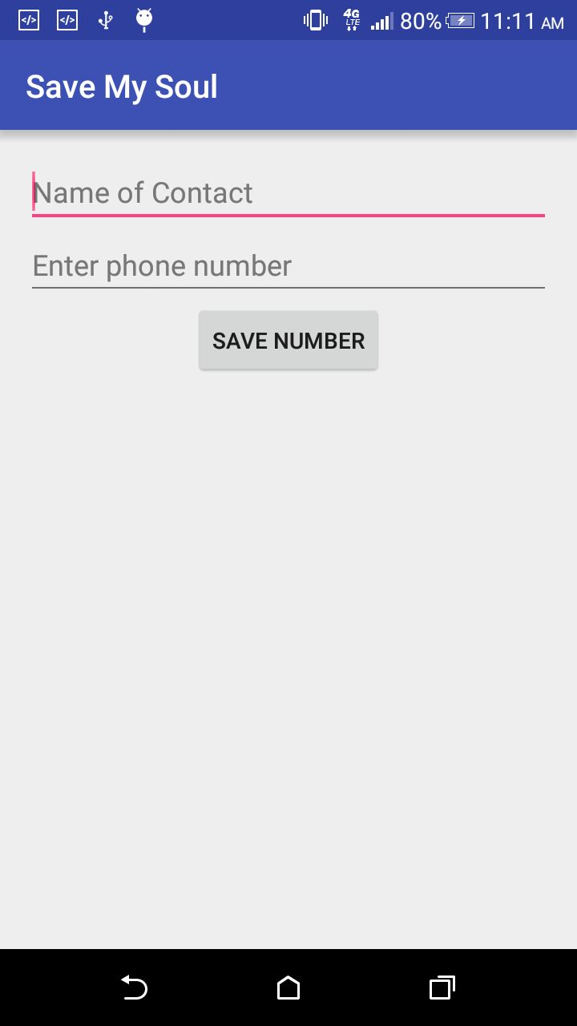
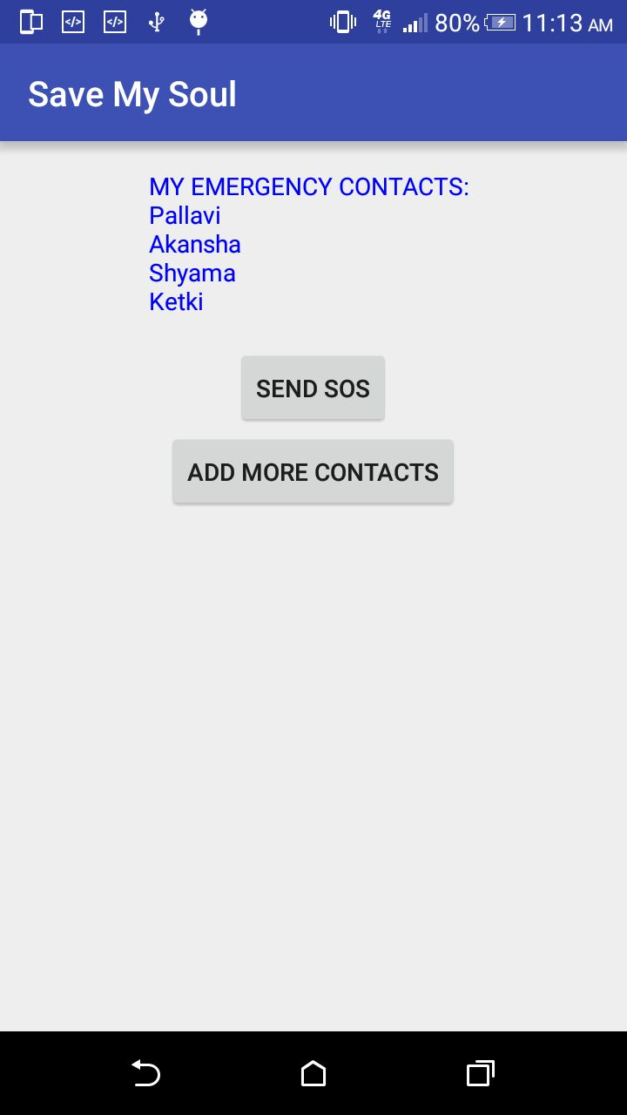
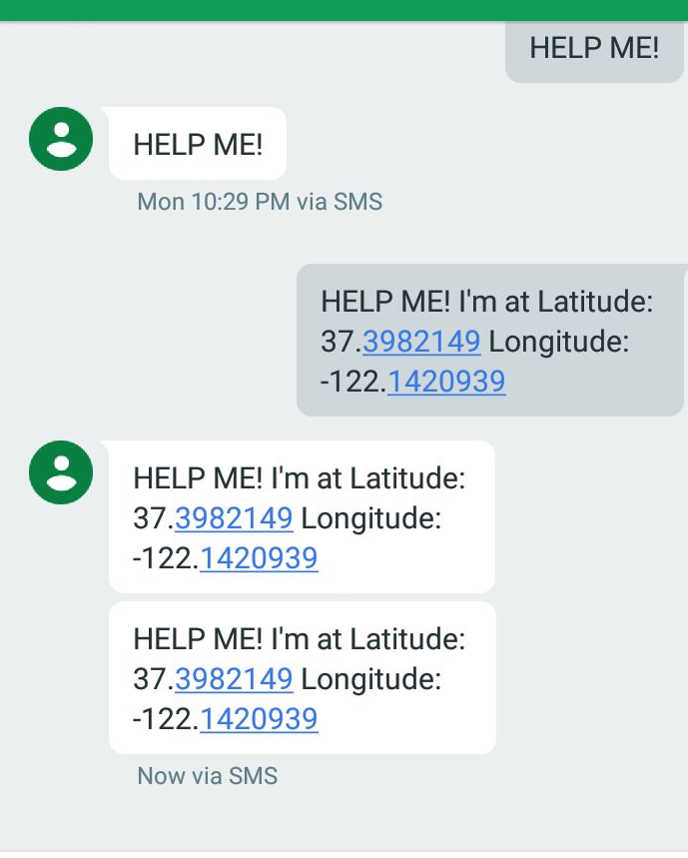
Save My Soul
Output
Notes:
An Android application that allows users to send SOS messages in times of need to a set of (emergency) contacts. The application, on the first run, must prompt the user to enter at least one contact, details of which are stored in a local SQLite database. During a crisis (of any kind) the user must be able to open the app and click one button that sends an SOS message, consisting of the user’s location, to all the contacts that were defined previously. The process of calculating location and sending SMSs must occur in a background service. Additionally, the user must also be able to add new contacts whenever he/she desires.

Slide 22
Wrap Up!
Module 1: Introduction to Android
Module 2: Android Widgets
Module 3: Communication
Module 4: Android Services
Module 5: Storing Data /Interaction to the Databases
Module 6: Save my Soul –Build an Application

Slide 23
Thank you
Question ?

