Slide 1
Introduction to Computer Graphics
PixieGo

Slide 2
Topics covered
Introduction
Processing and Working Environment
Modeling
2D
3D

Slide 3
Topics covered
Rendering
Homogenous Coordinates
Transformation
Matrix Stack
Projection

Slide 4
Introduction
Fundamental, core elements of computer graphics
Modeling: 2D and 3D models
Rendering: geometric transformation, visibility
(this workshop will not cover )
Animation: lifelike characters, natural phenomena,
Notes:
This is an entry-level course which will introduce you to a wide range of topics in computer graphics, and prepare you for continued studies in more specialized sub-fields. You will become familiar with the technical challenges faced in displaying, and generating computer generated images. The course will introduce important concepts such as Homogeneous Coordinates, Projection of objects from 2D to 3D, Transformation, materials. A final project will give students the opportunity to create imaginative, technically complex visuals inspired by solar system.

Slide 5
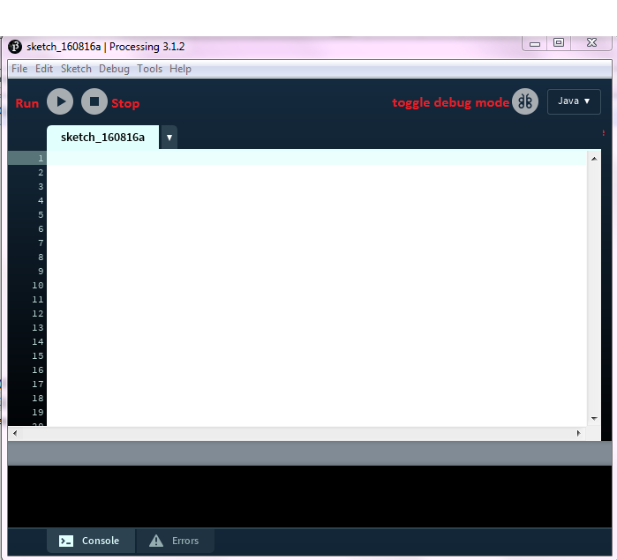
Processing
We will be using Processing to create the web graphics for this course.
So before we begin the concepts of graphics let’s familiarise ourselves with
Processing is a flexible software sketchbook and a language for learning how to code within the context of the visual arts.
Reasons to use:
OS friendly
Easy for learning the concept
Promoted software literacy within the visual arts/ visual literacy within technology

Slide 6
Getting Started with Processing
It can be used in various modes like Java, javascript, Android
We are using Java mode here
The output screen is refreshed 60 times per second by default, this count can be changed with frameRate() method

Slide 7
Getting Started with Processing
Each file should have a setup() and a draw() method. The setup method is called only once at the execution and the draw method is called every time a frame is loaded
We can use the built-in functions size(x,y) and background(r,g,b) to set the size and background of the screen

Slide 8
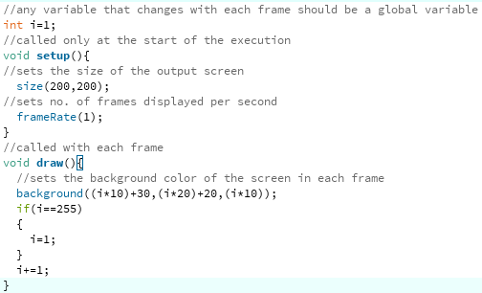
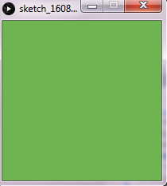
Processing Setup Example

Slide 9
Modeling
2D Models
3D Models
Exercise - Robot drawing

Slide 10
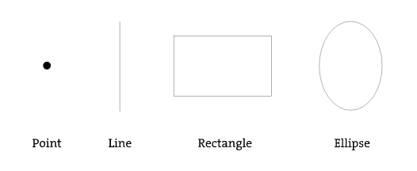
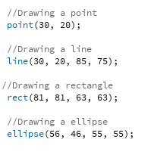
2D Models

Slide 11
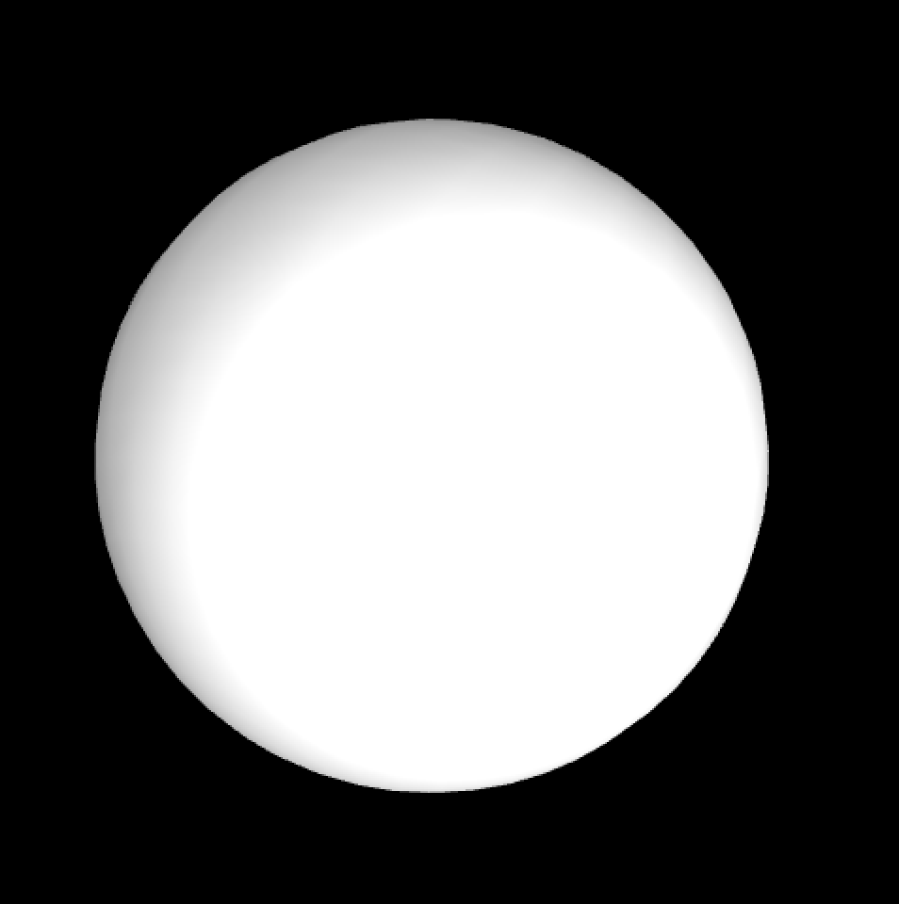
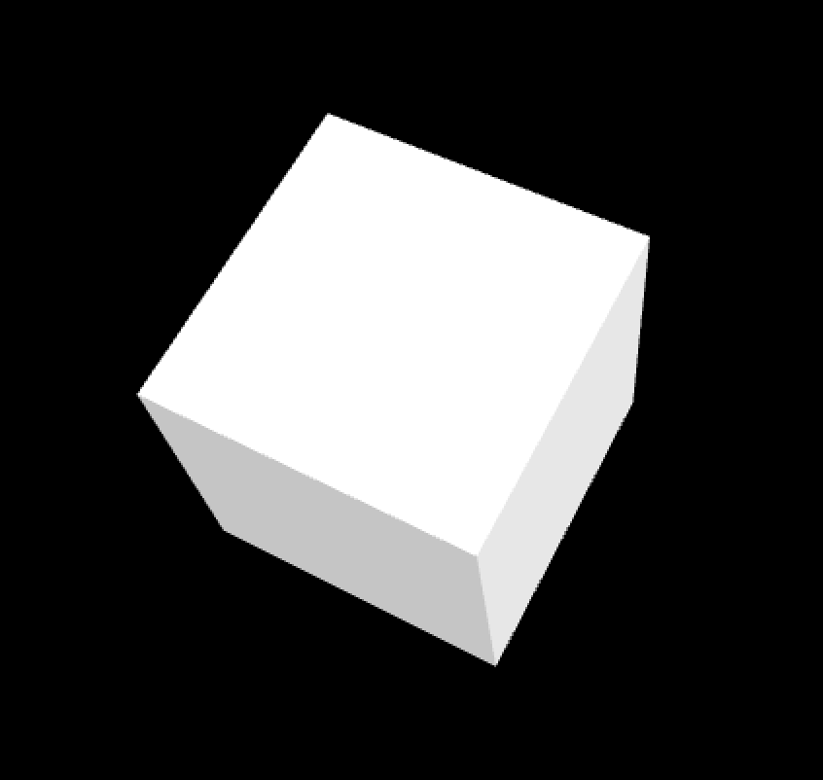
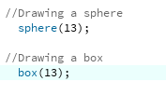
3D Models
Sphere
Box
Notes:
The 3D models can be created using vertex function to specify each vertex of the object like the pyramid in this case

Slide 12
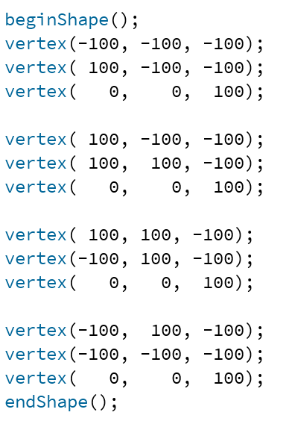
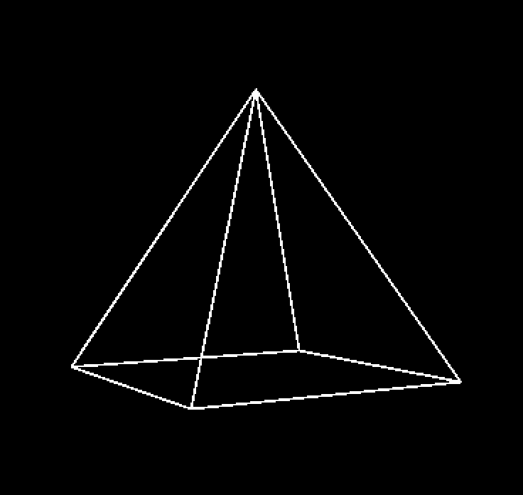
3D Models
Pyramid
Notes:
Reference: https://processing.org/tutorials/p3d/

Slide 13
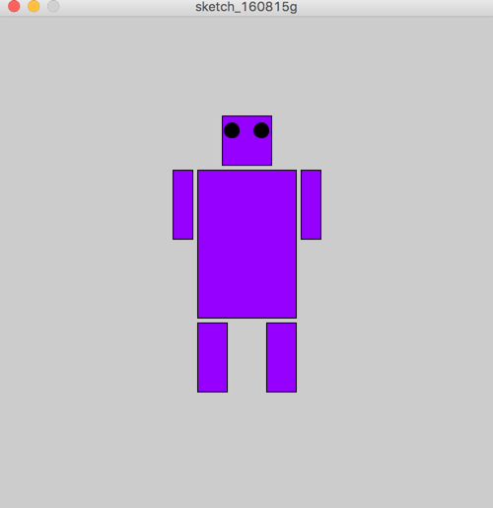
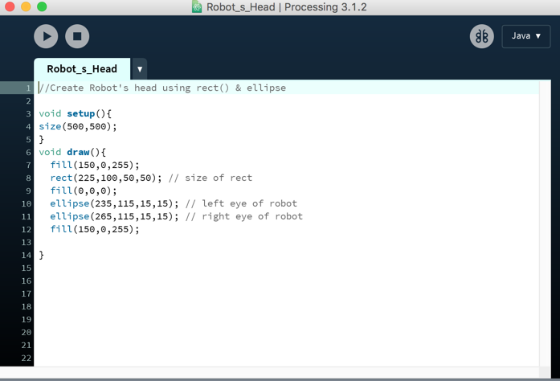
Robot Exercise
1. Create a Robot which looks like the following,
you are given the code which builds its face in the file robot.pde

Slide 14
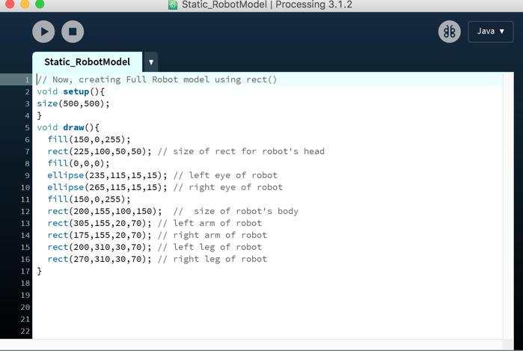
Solution - Robot Model

Slide 15
Rendering
Homogenous Coordinates
Transformation
Matrix Stack
Projection

Slide 16
Homogenous Coordinates
Representation
Why Homogenous Coordinates
Homogenous Transforms

Slide 17

Representation
Add an extra component. 1 for a point, 0 for a vector:

Slide 18
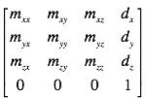
Why Homogenous Coordinates
Homogeneous coordinates enable us to multiply homogeneous matrices to gain the combined geometrical effect.
Use Homogenous coordinates to construct transformation matrix
Last row always 0 , 0 , 0 , 1

Slide 19
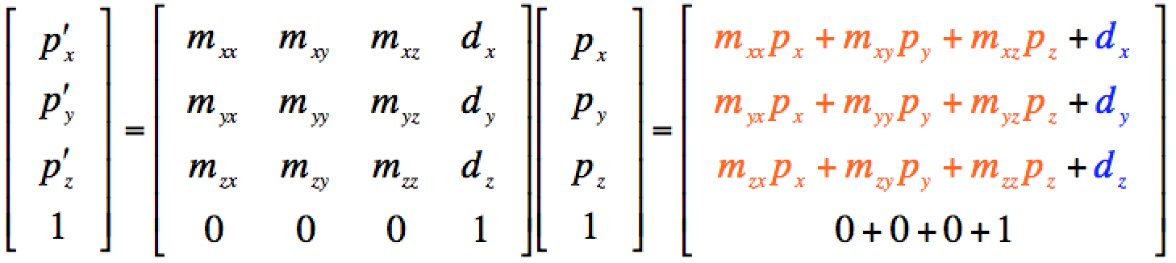

Homogenous Transforms
Transform a 3D point:
Rotation, Scale, and Translation of points and vectors unified in a single matrix transformation:

Slide 20
Transformations
2D Geometric Transformations
3D Geometric Transformations

Slide 21
2D Geometric Transformations
Translation
Scaling
Rotation

Slide 22

Translation
Translation using matrices
Exercise:
Write matrix representation to translate a rectangle with its top left coordinates(5,7) by 3 units in +X and 2 units in -Y direction

Slide 23
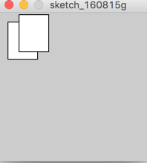

Translation
Code snippet for Translation

Slide 24

Scaling
Scaling involves changing the size of the object
Exercise:
Write matrix representation to translate a rectangle with its top left coordinates(5,7) by 3 units in +X and 2 units in -Y direction

Slide 25
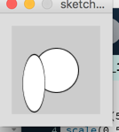
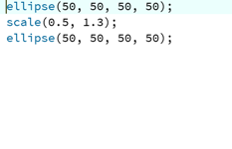
Scaling
Code snippet for scaling

Slide 26

Rotation
Rotation involves rotating the object about the axis perpendicular to its plane in 2D
Exercise:
Write matrix representation to translate a rectangle with its top left coordinates(5,7) by 3 units in +X and 2 units in -Y direction

Slide 27

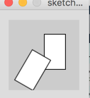
Solution
Code snippet for Rotation

Slide 28



3D Geometric Transformations
Translation Scale Rotation

Slide 29
Matrix Stack
Theory
Exercise - Math problem
Exercise - Robot Moving coding problem

Slide 30
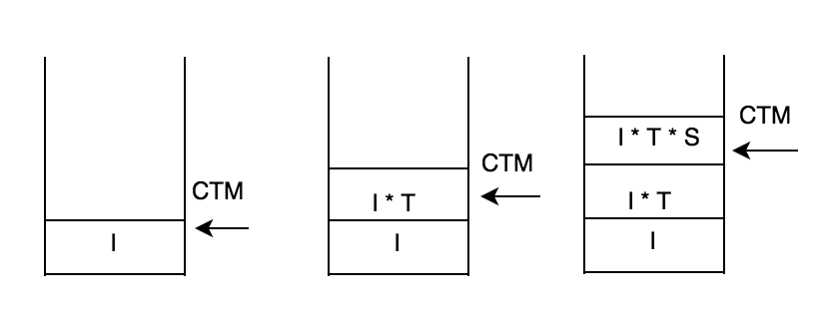
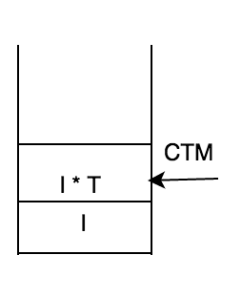
Matrix Stack
CTM : current transformation matrix
Initial state: CTM is identity matrix
pushMatrix();
translate(x, y, z);
pushMatrix();
Scale (a, b,c );
popMatrix();
pushMatrix() : copy top frame and move CTM pointer to the toppest frame
translate/scale: right times the matrix in CTM
popMatrix(): remove top frame and move CTM pointer to next lower frame

Slide 31
Exercise
y
Draw the result of following code:
1. pushMatrix(); 2. pushMatrix();
translate(1,0,0); scale(2,2,2);
scale(2,2,2); translate(1,0,0);
sphere(1); sphere(1);
popMatrix(); popMatrix();
Note: don’t need to draw z
1
x
sphere(1)

Slide 32
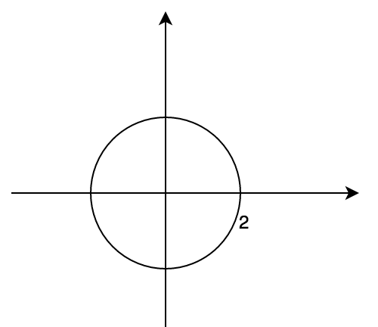
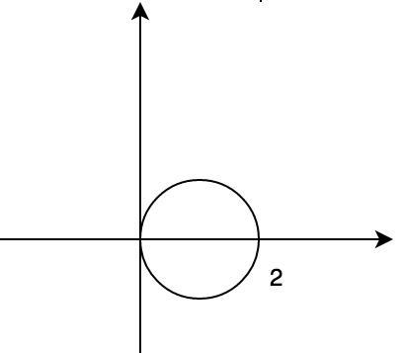
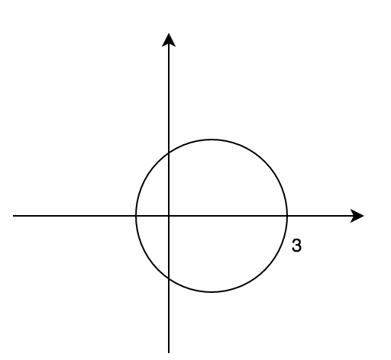
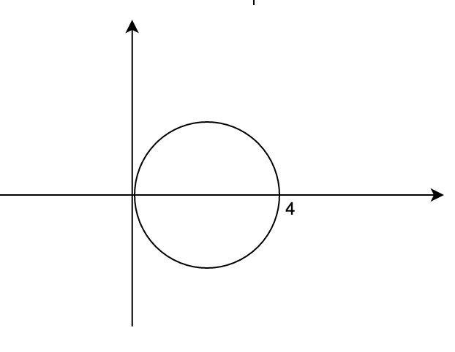
Answer
scale(2,2,2)
translate(1,0,0)
scale(2,2,2)
translate(1,0,0)
Note: the order of transformation in the code is different from the order they executed in the matrix stack

Slide 33
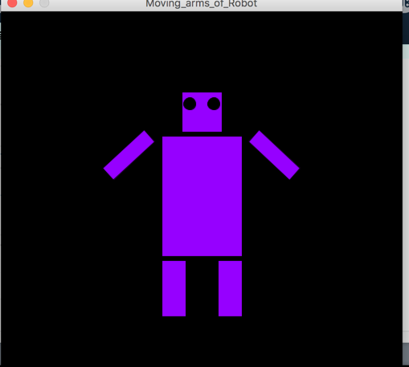
Exercise
Rotate the arms of the robot to by 90 degrees and bring them back to the original position
Note: You can take previous example as startup

Slide 34
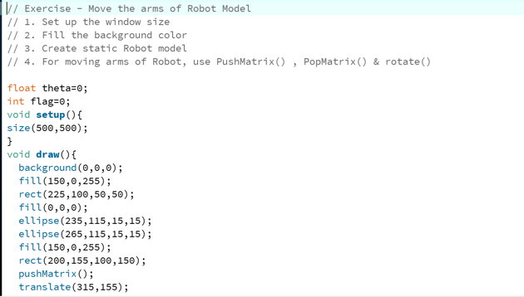
Solution

Slide 35
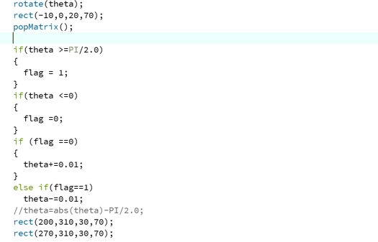
Solution Continues

Slide 36
Projection
Projection
Theory
Exercise - Math problem

Slide 37
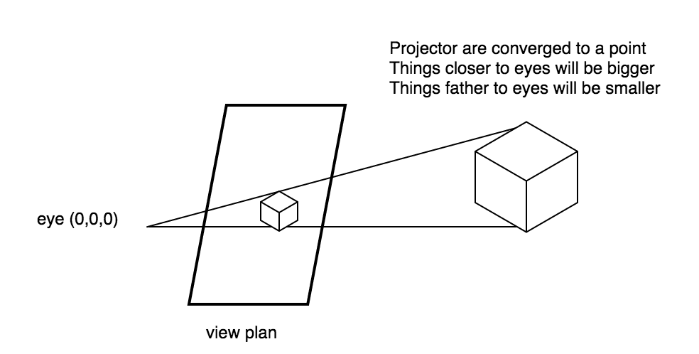
Projection
Perspective Projection

Slide 38
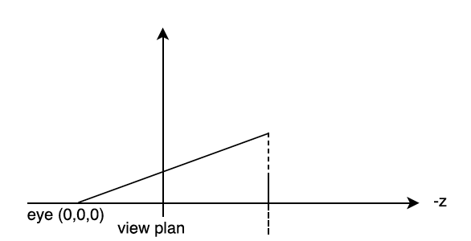
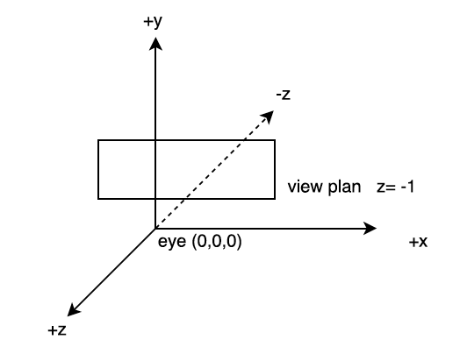
Theory
Convert 3D coordinates to 2D coordinates
P = (x,y,z): point in 3D world
P’ = (x’,y’,z’): point in 2D world (on view plan), since z’ = -1
X’ = x/|z|
Y’ = y/|z|
Z’ = -1
+y
P = (x,y,z)
P’ = (x’,y’,z’)
Eye looks at -z direction

Slide 39
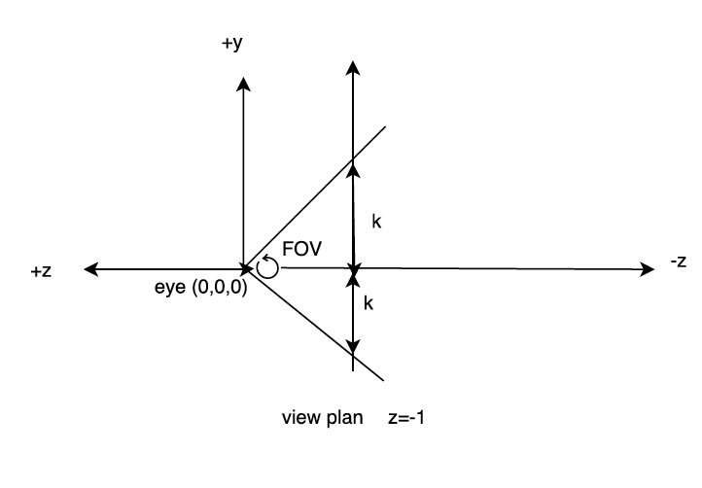


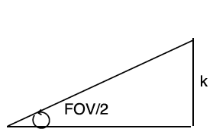

Convert 2D point to screen coordinates
Get view plan size (K) 2. Convert coordinates
k -k
w 0
k
-k
h
0
View plan
Screen
K = tan(FOV/2)
(FOV is field of view)
1

Slide 40
Exercise
If FOV = 60, and the height and weight are h and w
What is the final equation of 3D point in the screen coordinates ? Say 3D point
P = (x, y, z)

Slide 41


Solution

Slide 42
Exercise Time
Now we finish all the theory parts, let’s have an exercise party !
Hands on Exercise- Building 2D Solar System
Exercise - Building 3D Solar System

Slide 43
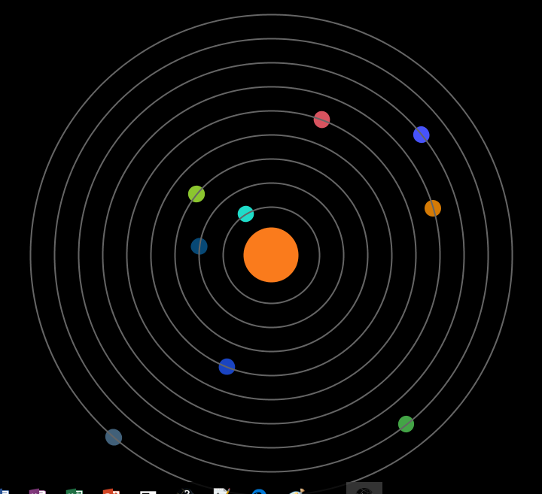
Hands on exercise (Solar System 2D)
Creating Planet Class
Creating Orbit Class
Initializing Planets and Orbits
Drawing Sun,Planets and Orbits

Slide 44
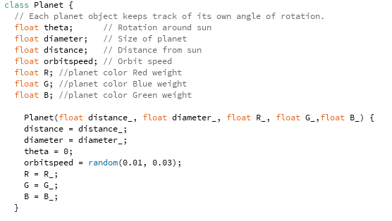
Hands on exercise (Solar System 2D)
Creating Planet Class
Planet Class

Slide 45

Guided example (Solar System 2D)
Creating Planet Class
Update method

Slide 46
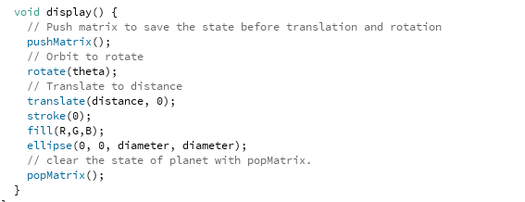
Guided example (Solar System 2D)
Creating Planet Class
Display Method

Slide 47
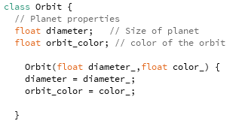
Guided example(Solar System 2D)
Creating Orbit Class
Orbit Class

Slide 48
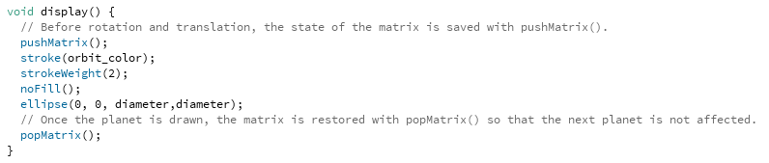
Guided example (Solar System 2D)
Creating Orbit Class
Display Method

Slide 49
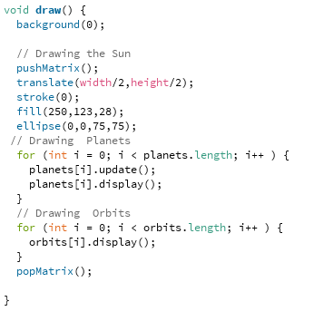
Guided example (Solar System 2D)
Drawing Sun, Planets and Orbits
Draw Method

Slide 50
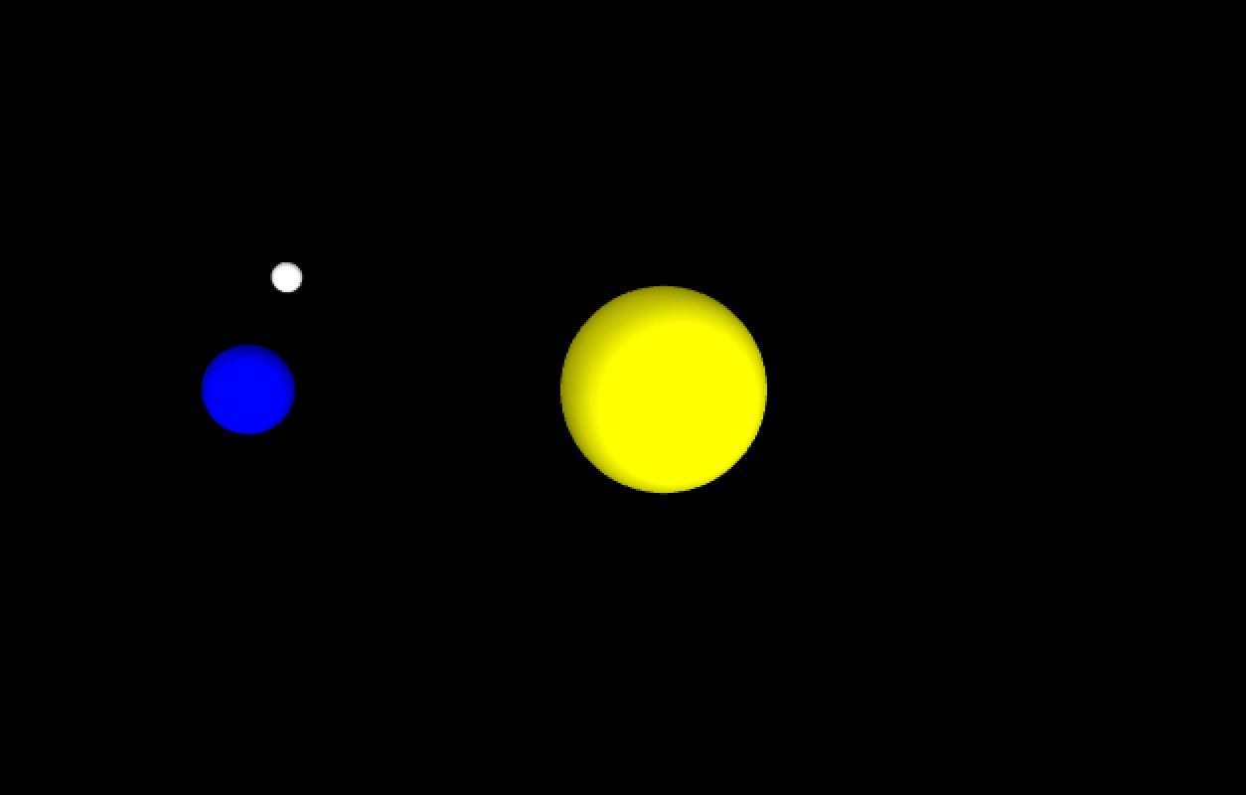
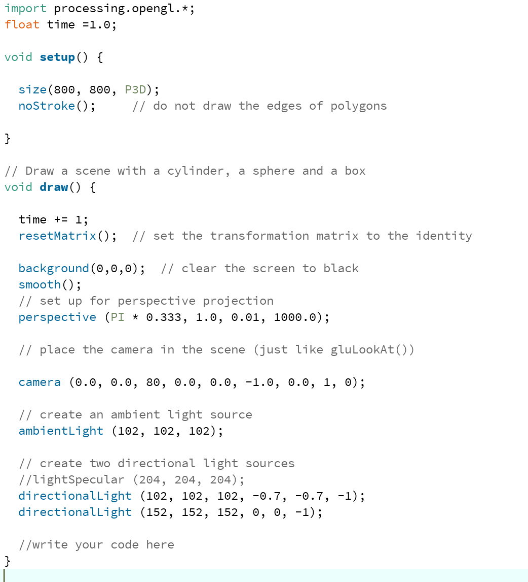
Exercise (Build 3D system)
The Earth should rotate around sun and the Moon should rotate around the Earth
Notes:
Code for setup the environment

Slide 51
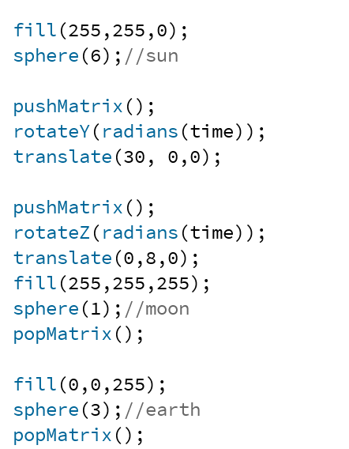
Answer

Slide 52

Final Project
Let’s build something fun ! Minion !
Techniques to use: matrix stack, transformation
Codes for environment setup and cylinder are provided

Slide 53
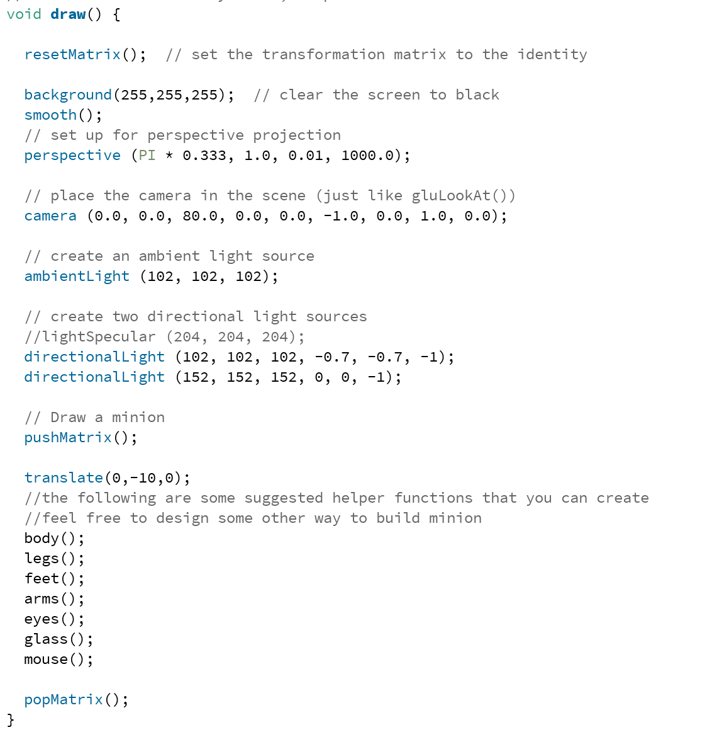
Provided code

Slide 54
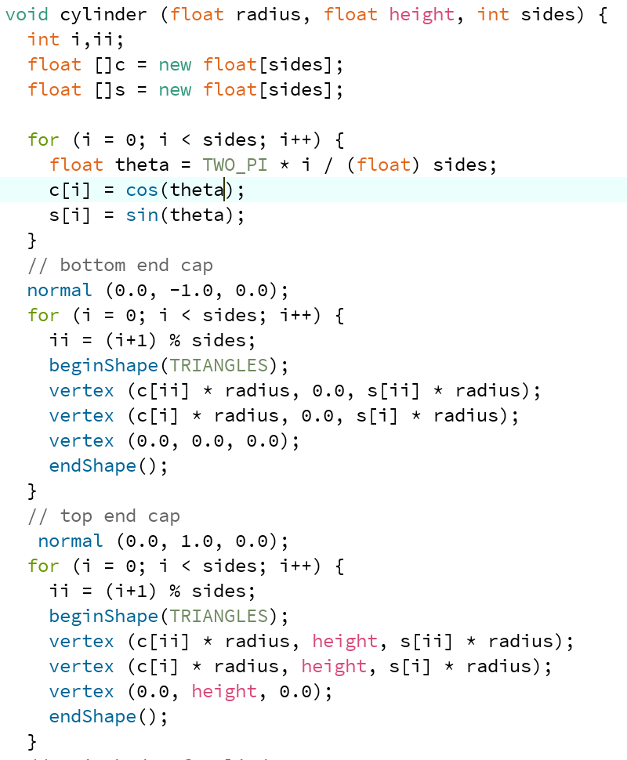
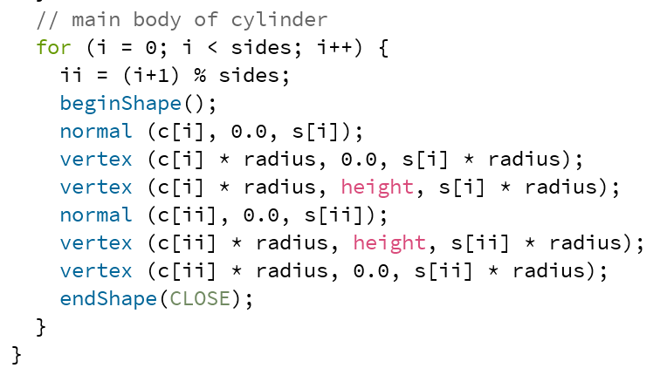
Provided code continue

Slide 55
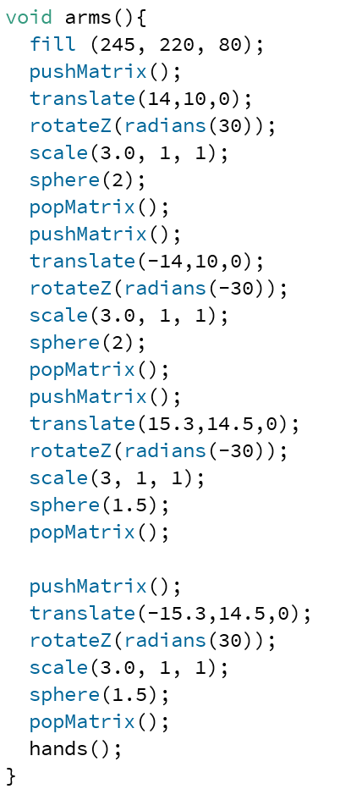
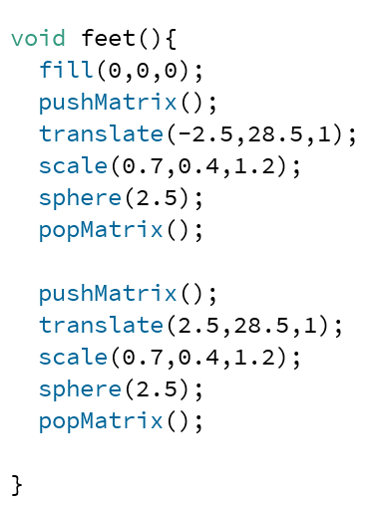
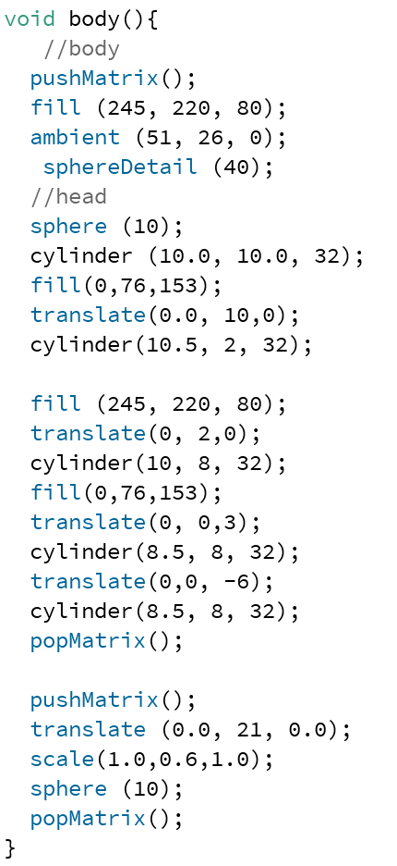
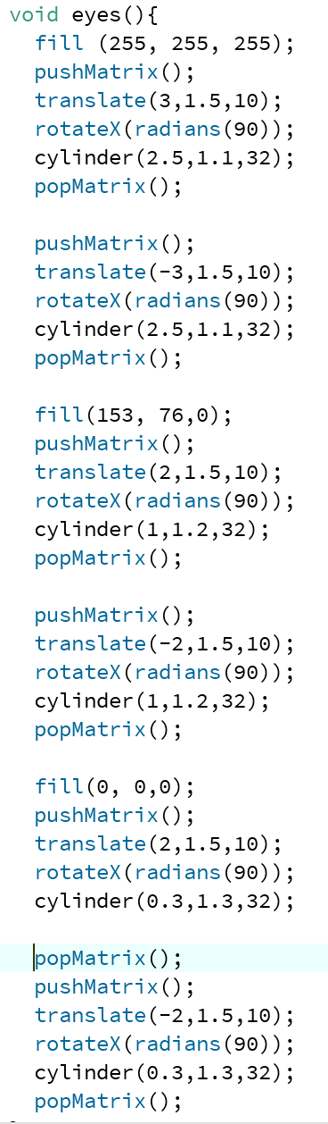
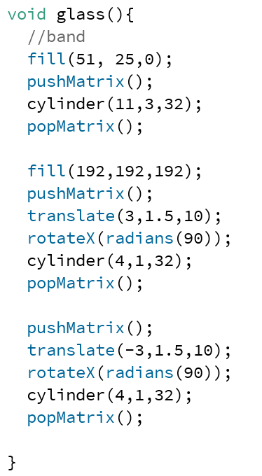

Solution
The following code is just for reference, you can create any minion you like

Slide 56
Conclusion
Topics covered:
Introduction
Processing and Working Environment
Modeling
2D
3D
Rendering
Homogenous Coordinates
Transformation
Matrix Stack
Projection

Slide 57
Conclusion
Coding Exercise covered:
Modeling:
Robot drawing
Rendering:
Robot moving
2D solar system
3D earth, moon, sun
Final Project : minion

Slide 58
Congratulation for your achievements !

Slide 59
Further Study Topics:
Rendering
Ray tracing
Lighting and Shading
Texture Mapping
Animation
Particle systems
Constrained dynamics
Character control

