Slide 1
Introduction to Computer Graphics
PixieGo

Slide 2
Topics covered
Introduction and Overview
Processing IDE
2D and 3D Models
Homogenous Coordinates
Transformations
Matrix Stack
Projection
Final Project

Slide 3
Introduction
What is Computer Graphics?
The creation of, manipulation of, analysis of, and interaction with pictorial representations of objects and data using computers.
- Dictionary of Computing
Fundamental, core elements of computer graphics
– Modeling: representation choices, geometric processing
– Rendering: geometric transformation, visibility, simulation of light
– Interaction: input/output devices, tools
– Animation: lifelike characters, natural phenomena, their interactions, surrounding environments
Notes:
This is an entry-level course which will introduce you to a wide range of topics in computer graphics, and prepare you for continued studies in more specialized sub-fields. You will become familiar with the technical challenges faced in displaying, and generating computer generated images. The course will introduce important concepts such as Homogeneous Coordinates, Projection of objects from 2D to 3D, Transformation, materials. A final project will give students the opportunity to create imaginative, technically complex visuals inspired by solar system.

Slide 4

Why learn Computer Graphics
Applications
User Interfaces - Video Games, Virtual Reality, Augmented Reality, Digital Art.
Design - Web design, Graphics design, Computer Aid Design
Display of Information - Scientific Visualization, Computational Physics
Education - Visualization, Computer Simulation

Slide 5
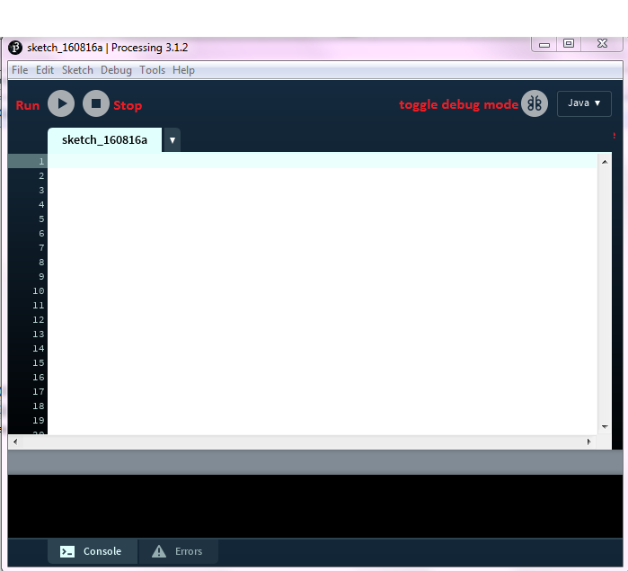
Processing
We will be using Processing to create the web graphics for this course.
So before we begin the concepts of graphics let’s familiarise ourselves with
Processing is a flexible software sketchbook and a language for learning how to code within the context of the visual arts.
Reasons to use:
OS friendly
Easy for learning the concept
Promoted software literacy within the visual arts/ visual literacy within technology

Slide 6
Getting Started with Processing
It can be used in various modes like Java, javascript, Android
We are using Java mode here
The output screen is refreshed 60 times per second by default, this count can be changed with frameRate() method
Each file should have a setup() and a draw() method. The setup method is called only once at the execution and the draw method is called every time a frame is loaded
We can use the built-in functions size(x,y) and background(r,g,b) to set the size and background of the screen

Slide 7
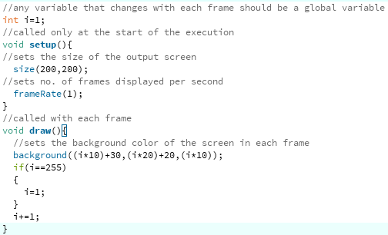
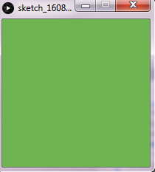
Getting Started with Processing

Slide 8
2D and 3D Models
2D Models
3D Models
Exercise - Building a Robot

Slide 9
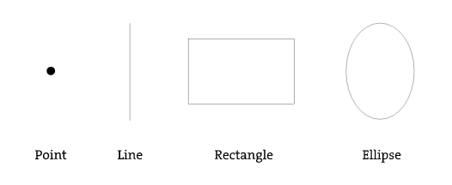
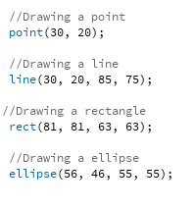
2D Models

Slide 10
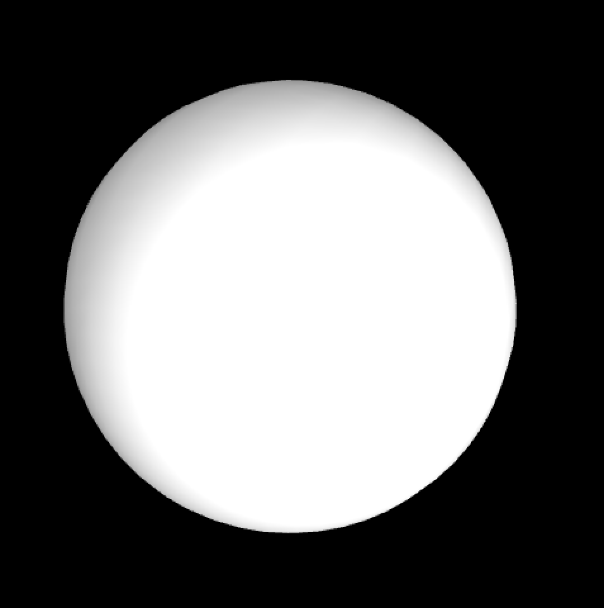
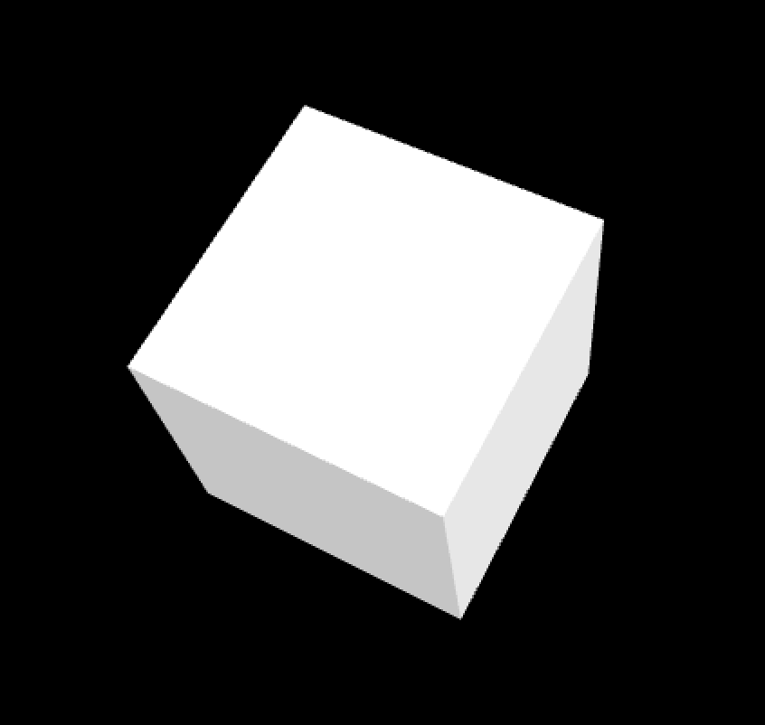
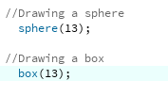
3D Models
Sphere
Box
Notes:
The 3D models can be created using vertex function to specify each vertex of the object like the pyramid in this case

Slide 11
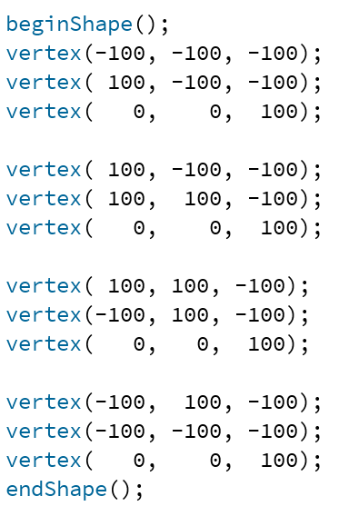
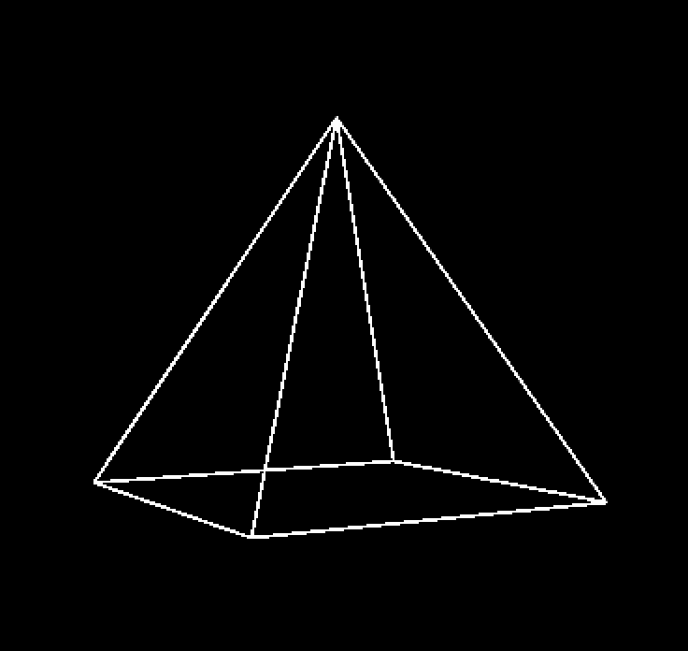
3D Models
Pyramid
Notes:
Reference: https://processing.org/tutorials/p3d/

Slide 12
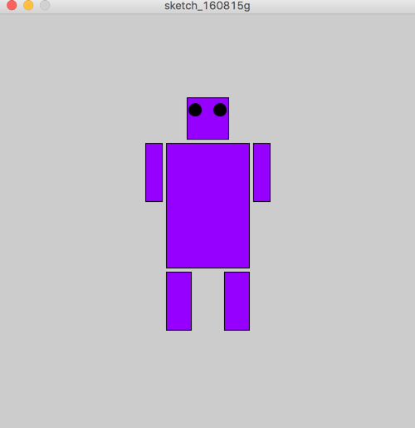
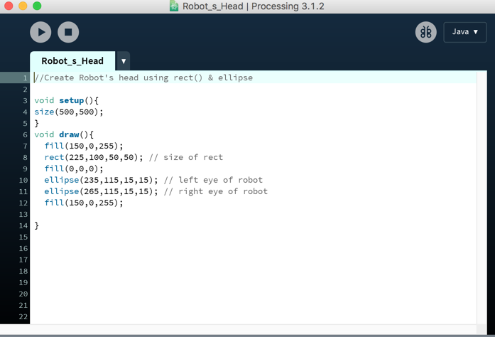
Exercise
1. Create a Robot which looks like the following,
you are given the code which builds its face in the file robot.pde

Slide 13
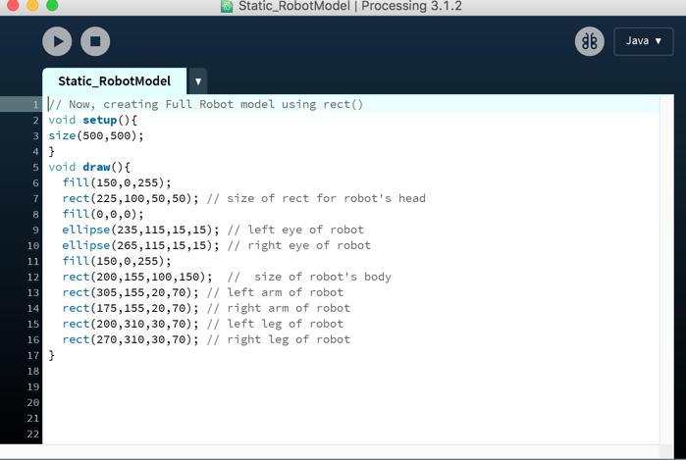
Solution - Robot Model

Slide 14

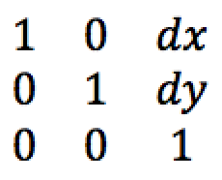

Homogenous Coordinates
(x’, y’)
(x, y)
dy
dx
Transformation Matrix
Homogenous coordinates
x’ = x + dx
y’ = y + dy

Slide 15
Exercise
How to represent a point at infinity in homogenous coordinate?

Slide 16

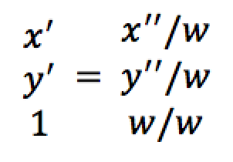
Answer
Explain
When W is not 0 the point represented is the point (X/W, Y/W) in the Euclidean plane.
When W is 0 the point represented is a point at infinity.

Slide 17
Transformations
2D Geometric Transformations
3D Geometric Transformations
Exercise - Robot Moving
Hands on Exercise- Building 2D Solar System
Exercise - Building 3D Solar System

Slide 18
2D Geometric Transformations
Translation
Scaling
Rotation

Slide 19

Translation
Translation using matrices
Exercise:
Write matrix representation to translate a rectangle with its top left coordinates(5,7) by 3 units in +X and 2 units in -Y direction

Slide 20
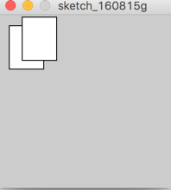

Translation
Code snippet for Translation

Slide 21

Scaling
Scaling involves changing the size of the object
Exercise:
Write matrix representation to translate a rectangle with its top left coordinates(5,7) by 3 units in +X and 2 units in -Y direction

Slide 22
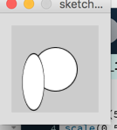
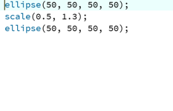
Scaling
Code snippet for scaling

Slide 23

Rotation
Rotation involves rotating the object about the axis perpendicular to its plane in 2D
Exercise:
Write matrix representation to translate a rectangle with its top left coordinates(5,7) by 3 units in +X and 2 units in -Y direction

Slide 24

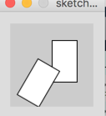
Solution
Code snippet for Rotation

Slide 25



3D Geometric Transformations
Translation Scale Rotation

Slide 26
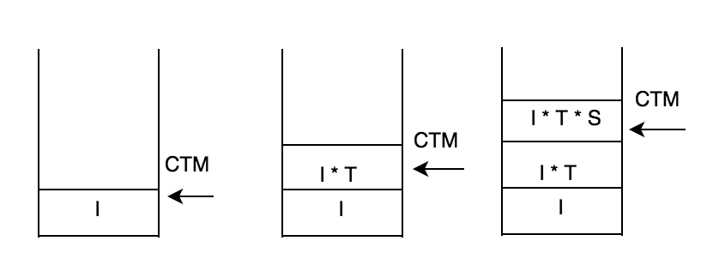
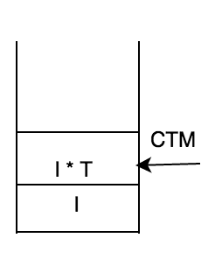
Matrix Stack
CTM : current transformation matrix
Initial state: CTM is identity matrix
pushMatrix();
translate(x, y, z);
pushMatrix();
Scale (a, b,c );
popMatrix();
pushMatrix() : copy top frame and move CTM pointer to the toppest frame
translate/scale: right times the matrix in CTM
popMatrix(): remove top frame and move CTM pointer to next lower frame

Slide 27
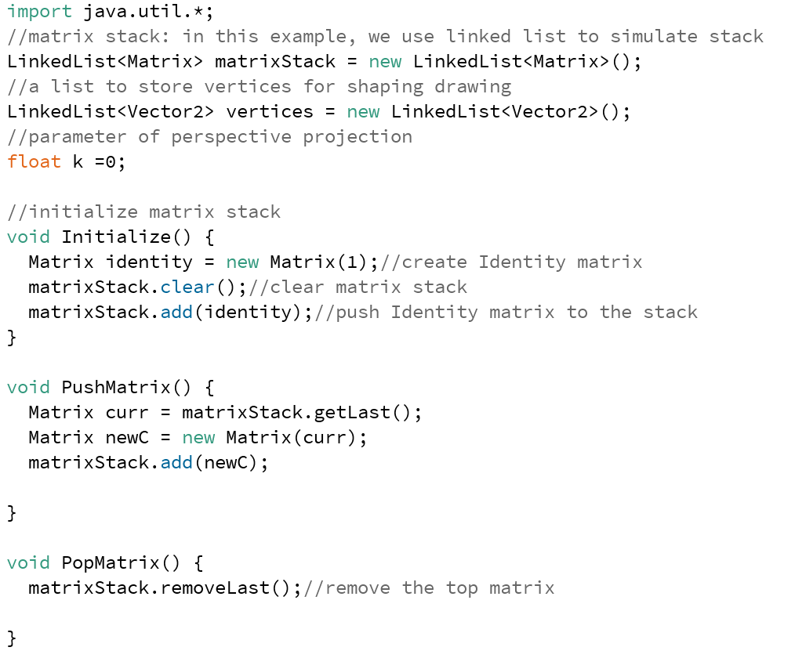
Code example for implementing Matrix Stack

Slide 28
Exercise
y
Draw the result of following code:
1. pushMatrix(); 2. pushMatrix();
translate(1,0,0); scale(2,2,2);
scale(2,2,2); translate(1,0,0);
sphere(1); sphere(1);
popMatrix(); popMatrix();
Note: don’t need to draw z
1
x
sphere(1)

Slide 29
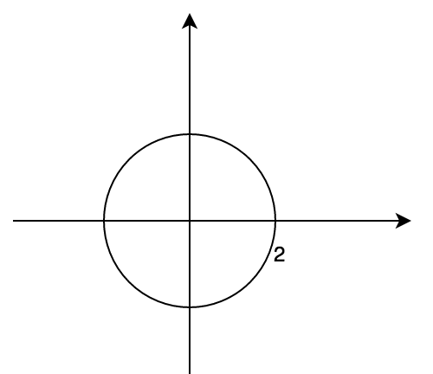
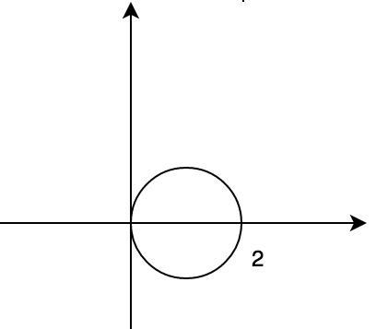
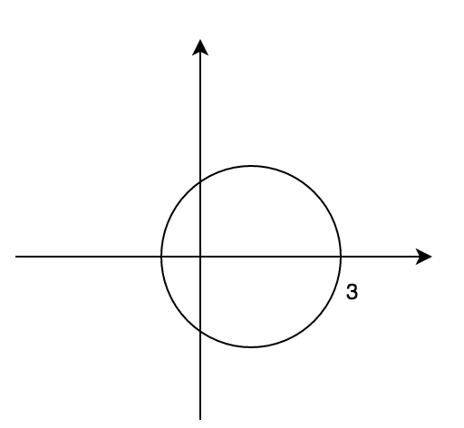
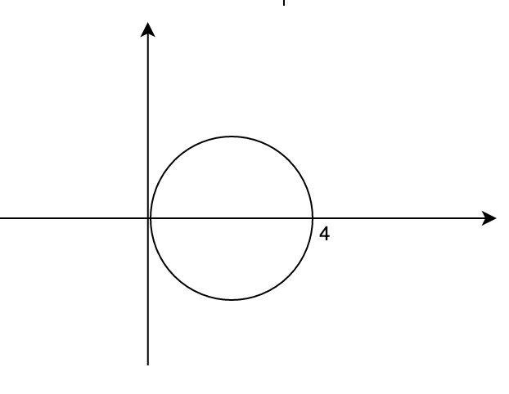
Answer
scale(2,2,2)
translate(1,0,0)
scale(2,2,2)
translate(1,0,0)
Note: the order of transformation in the code is different from the order they executed in the matrix stack

Slide 30
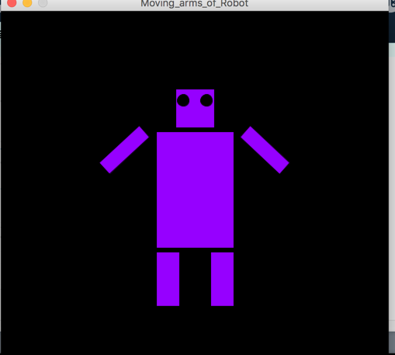
Exercise
Rotate the arms of the robot to by 90 degrees and bring them back to the original position
Note: You can take previous example as startup

Slide 31
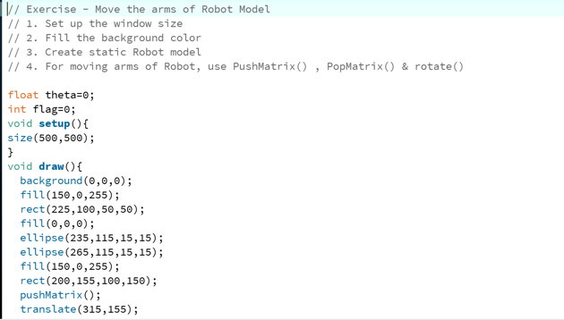
Solution

Slide 32
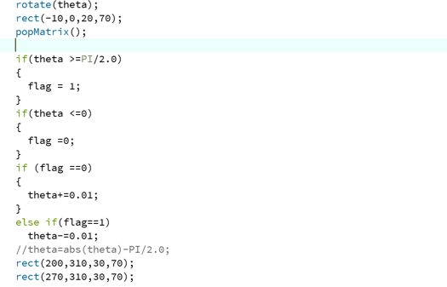
Solution Continues

Slide 33
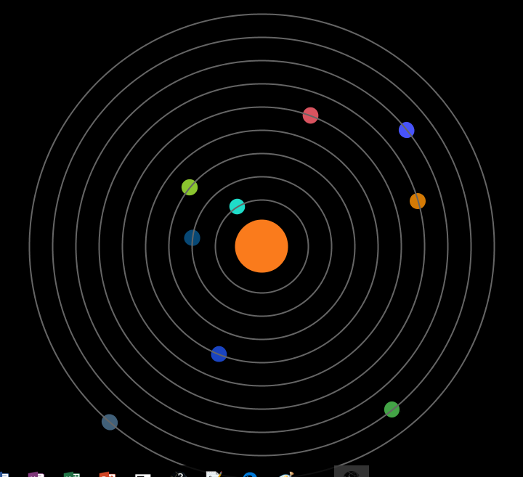
Hands on exercise (Solar System 2D)
Creating Planet Class
Creating Orbit Class
Initializing Planets and Orbits
Drawing Sun,Planets and Orbits

Slide 34
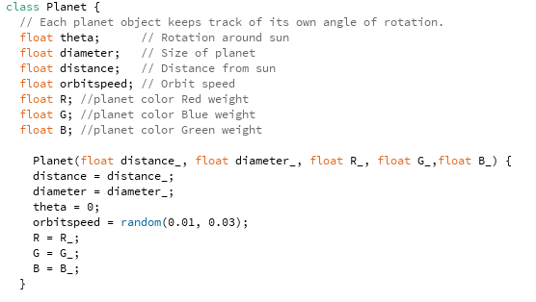
Hands on exercise (Solar System 2D)
Creating Planet Class
Planet Class

Slide 35

Guided example (Solar System 2D)
Creating Planet Class
Update method

Slide 36
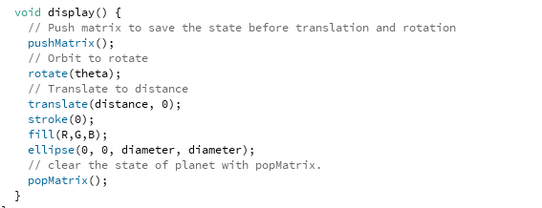
Guided example (Solar System 2D)
Creating Planet Class
Display Method

Slide 37
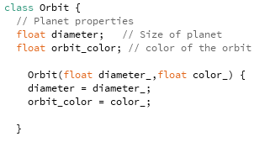
Guided example(Solar System 2D)
Creating Orbit Class
Orbit Class

Slide 38
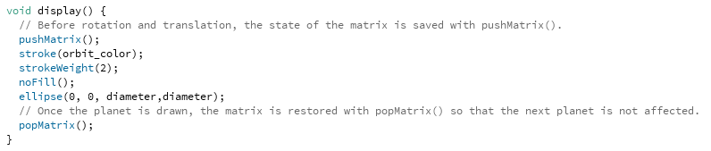
Guided example (Solar System 2D)
Creating Orbit Class
Display Method

Slide 39
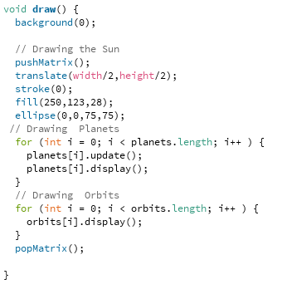
Guided example (Solar System 2D)
Drawing Sun, Planets and Orbits
Draw Method

Slide 40
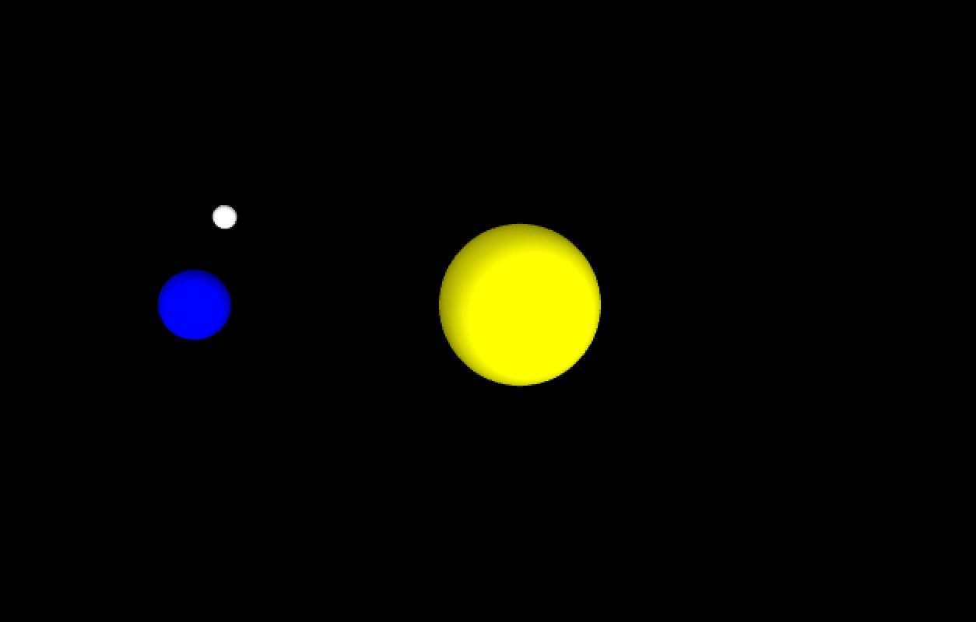
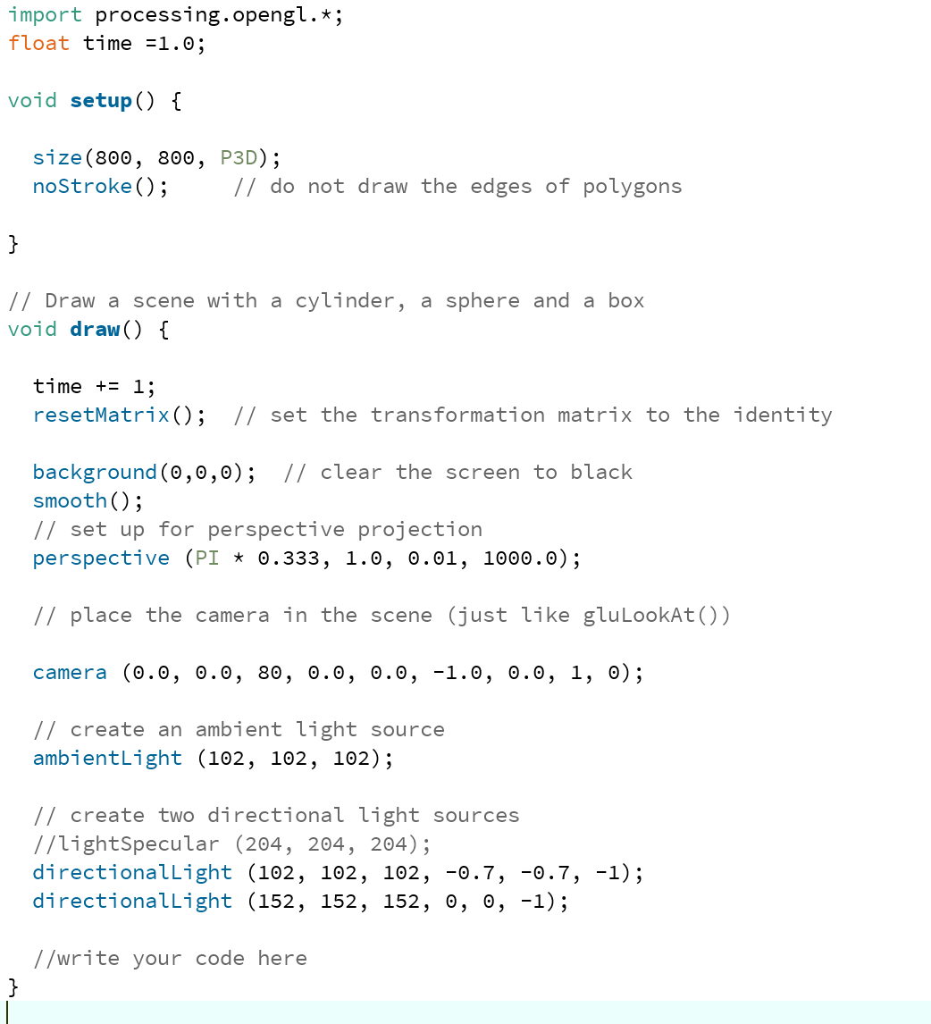
Exercise (Build 3D system)
The Earth should rotate around sun and the Moon should rotate around the Earth
Notes:
Code for setup the environment

Slide 41
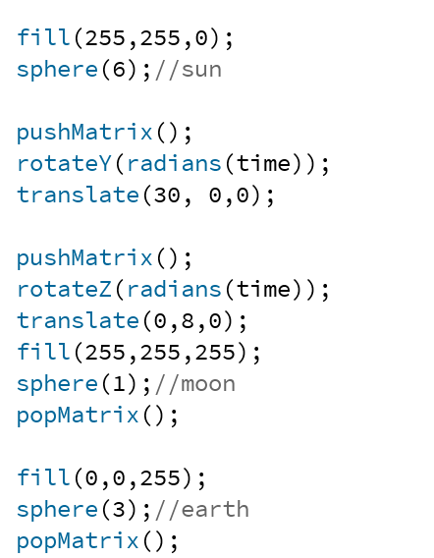
Answer

Slide 42
Projection
Projection
Theory
Exercise
Exercise- Build 2D Solar System

Slide 43
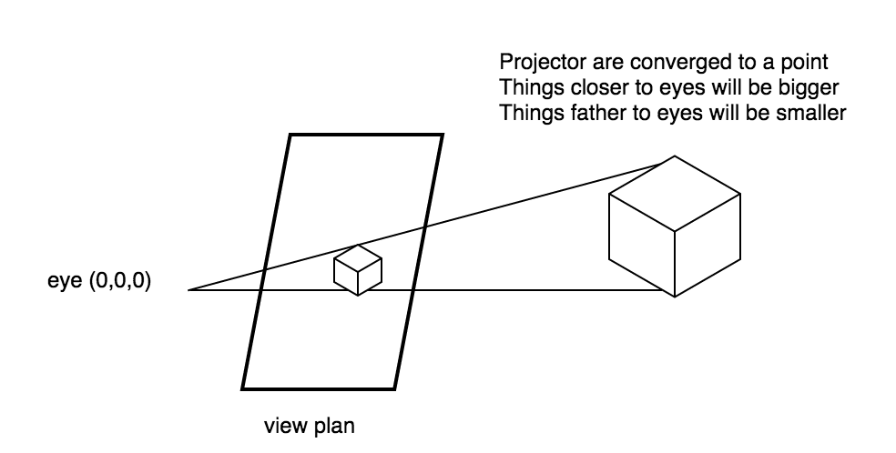
Projection
Perspective Projection

Slide 44
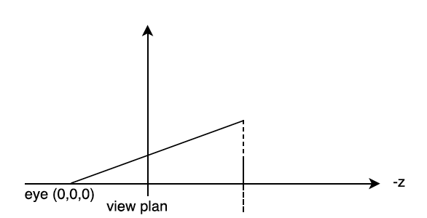
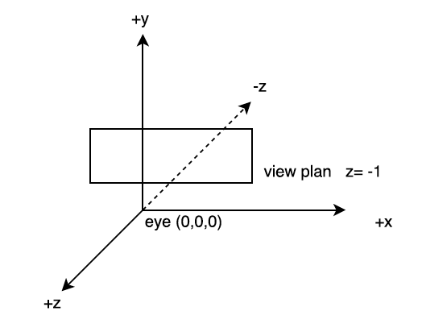
Theory
Convert 3D coordinates to 2D coordinates
P = (x,y,z): point in 3D world
P’ = (x’,y’,z’): point in 2D world, since z’ = -1
X’ = x/|z|
Y’ = y/|z|
Z’ = -1
+y
P = (x,y,z)
P’ = (x’,y’,z’)

Slide 45
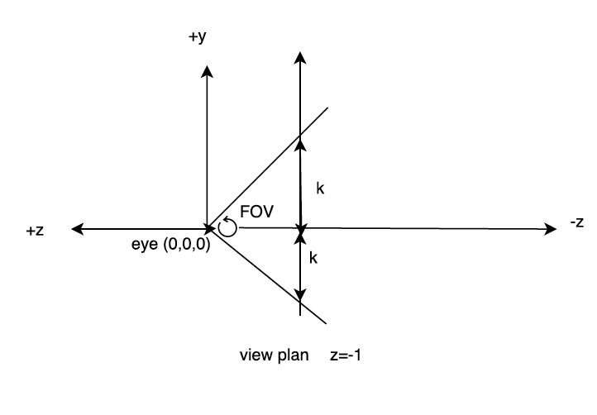



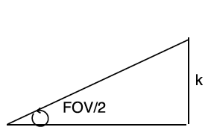
Convert 2D point to screen coordinates
Get field of view (FOV) 2. Convert coordinates
k -k
w 0
k
-k
h
0
View plan
Screen
K = tan(FOV/2)
1

Slide 46
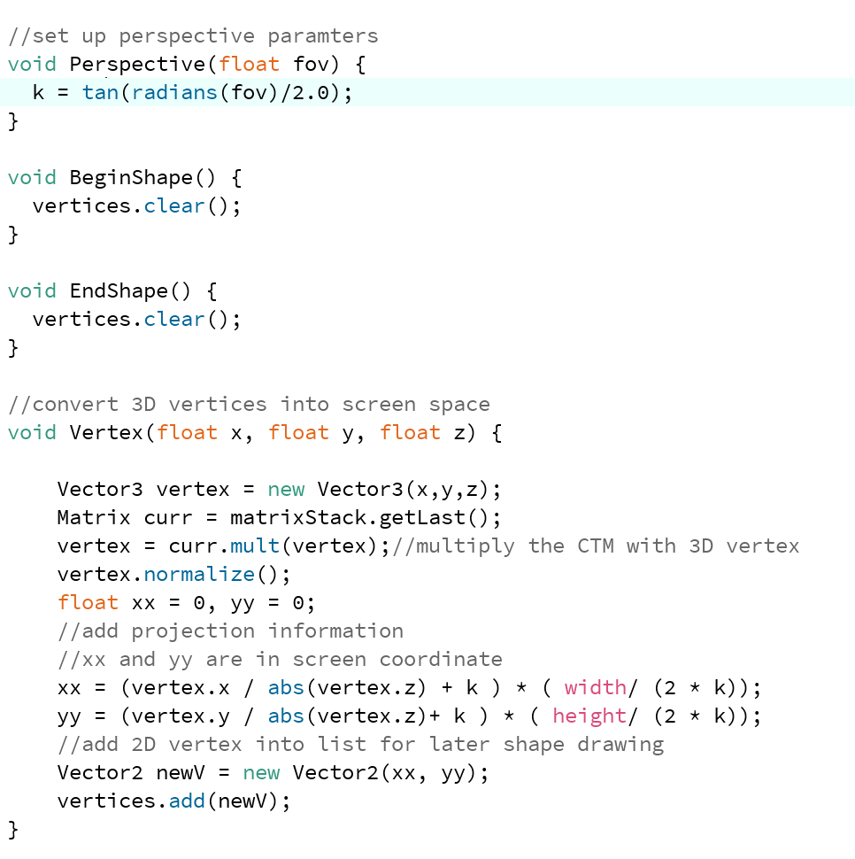
Code example for Projection

Slide 47
Exercise
If FOV = 60, and the height and weight are h and w
What is the final equation of 3D point in the screen coordinates ? Say 3D point
P = (x, y, z)

Slide 48


Solution

Slide 49
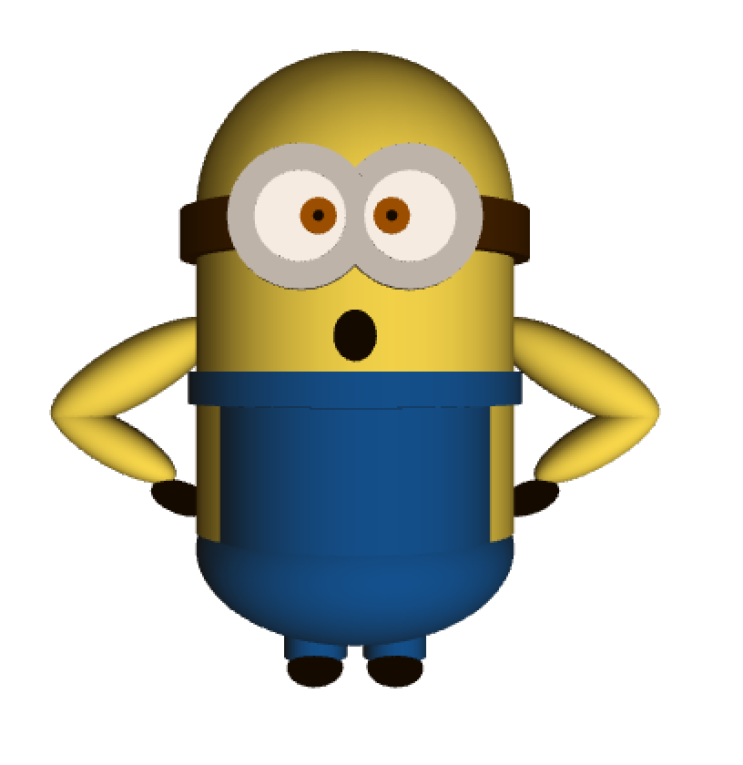
Final Project
Let’s build something fun ! Minion !
Techniques to use: matrix stack, transformation
Codes for environment setup and cylinder are provided

Slide 50
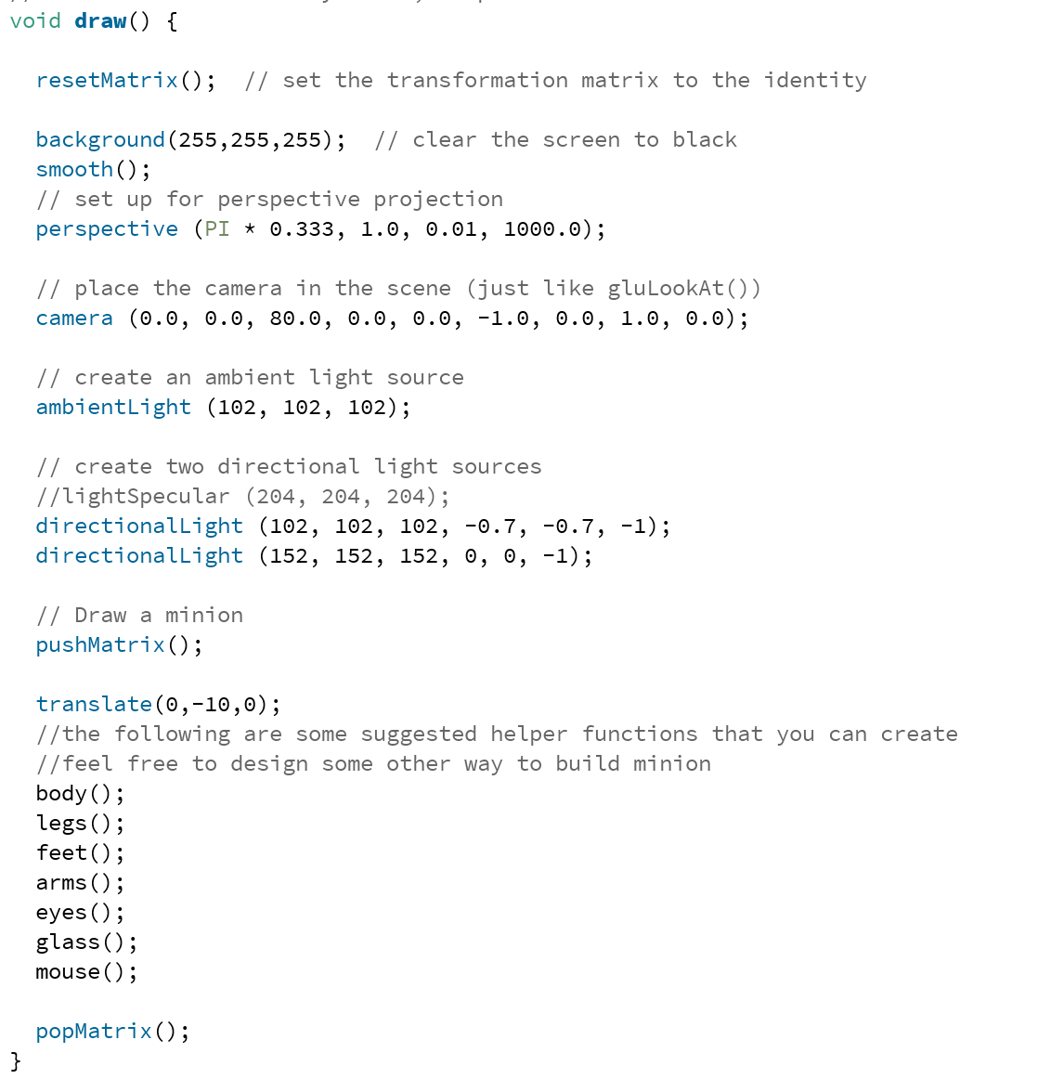
Provided code

Slide 51
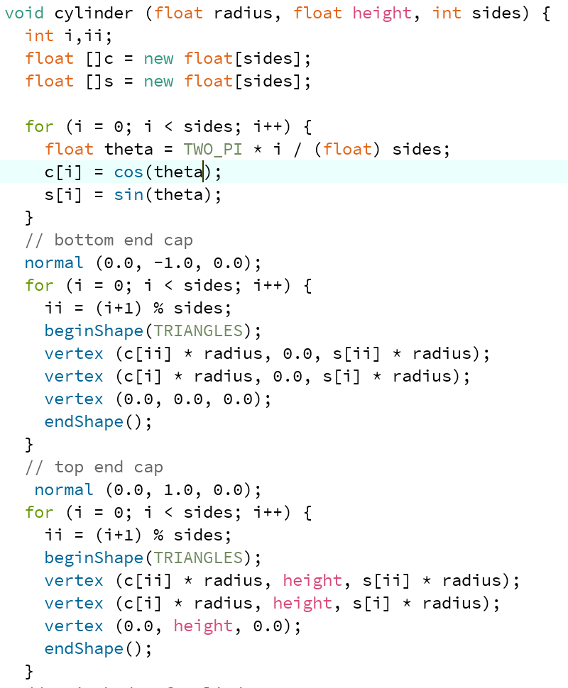
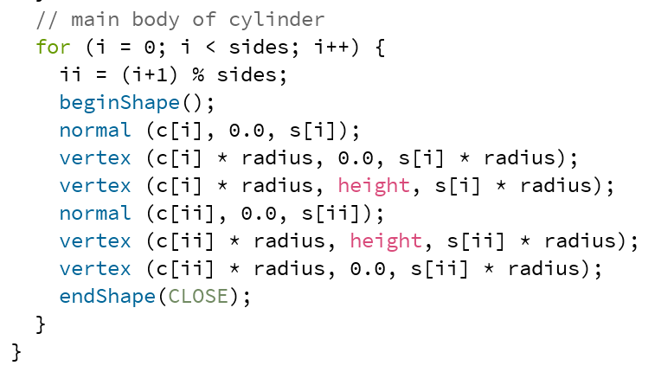
Provided code continue

Slide 52
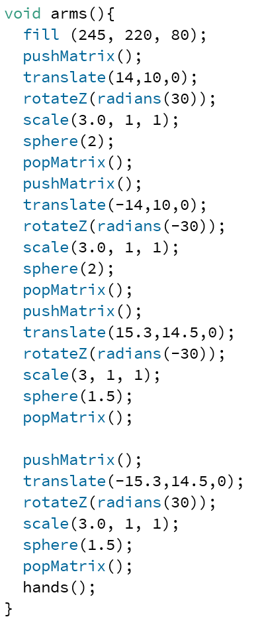
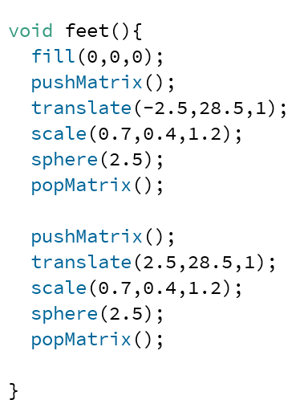




Solution
The following code is just for reference, you can create any minion you like

Slide 53

Future Extension
Make the minion dance !
Notes:
There is a video in the exercise folder for the dancing minion show those to the students to make one later

Slide 54
Conclusion
Key points to remember from this course
Homogenous Coordinates
Transformation
Matrix Stack
Projection

Slide 55

Bonus challenge
Extend the code in the example to draw multiple lines such that one of the x coordinates on the end point of each the line is randomly generated.

Slide 56

Solution

