Slide 1
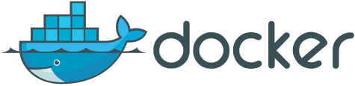
Introduction to Docker
Presenter
Anusha Ragunathan (anusha@docker.com)
Teaching Assistants
Harish Jayakumar (harish@docker.com)
Madhuri Yechuri (cosmokramer@gmail.com)
DevPulseCon April 23, 2016

Slide 2
Agenda
Introduction to Docker
Terminology
Challenges in application landscape
How containerization resolves the challenge
How Containers work
Modern software life-cycle using containers.
Workshop exercises

Slide 3
What is Docker?
Docker Engine – synonymous with “Docker” and the open source container management. Today's focus.
Docker DataCenter – Suite to manage containers in your datacenter.
Docker Hub - online home and hub for managing your Docker containers.

Slide 4
Terminology
Container: process with a scoped view of system resources
Images: On-disk representation of the container
Scaled up apps: Vertical scale, more cpu/mem
Scale out apps: Horizontal scale, more instances.
Cloud-native apps: Decoupled from physical/virtual resources.

Slide 5
Change in Application landscape
The software industry has changed.
Applications used to be monolithic, with long life-cycles, scaled up.
Today, applications are decoupled, built iteratively, scaled out.
As a result, deployment is tough

Slide 6
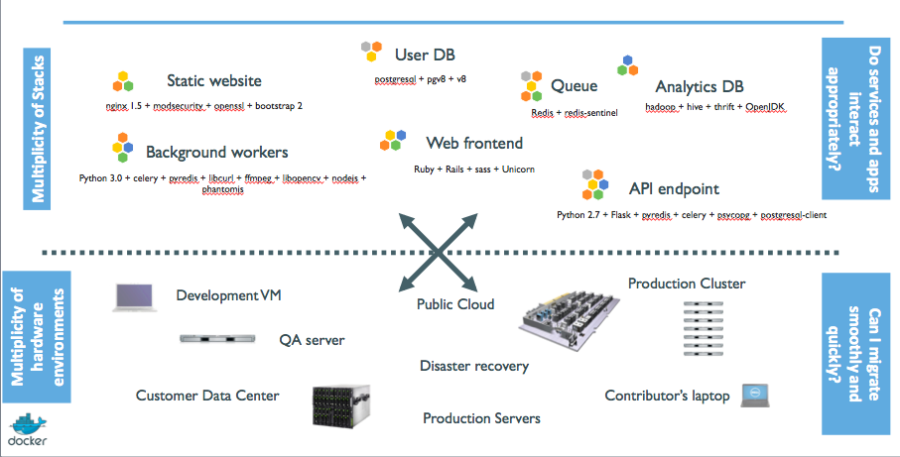
The challenge circa 2015

Slide 7
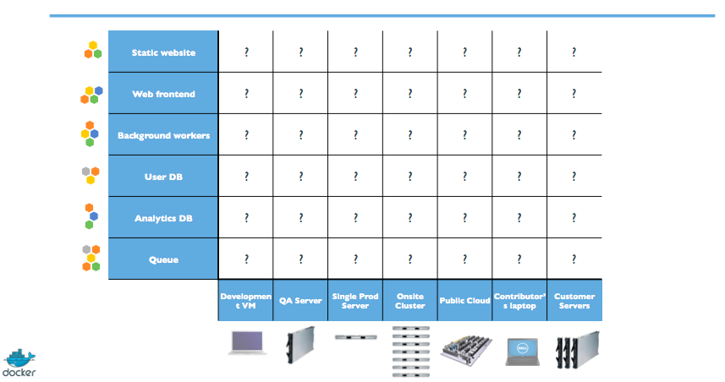
The Matrix from Hell

Slide 8
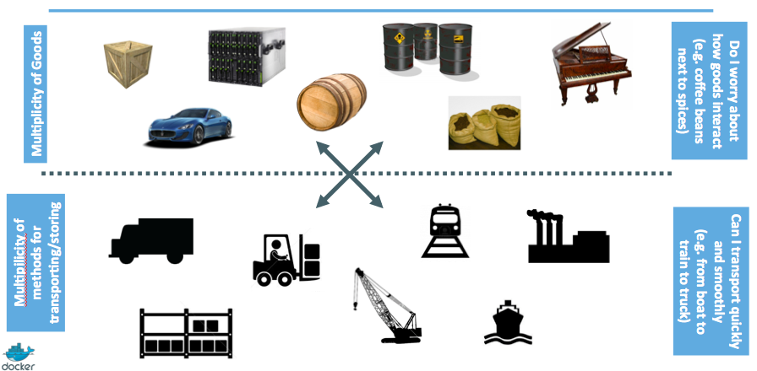
A look back at history
for inspiration

Slide 9
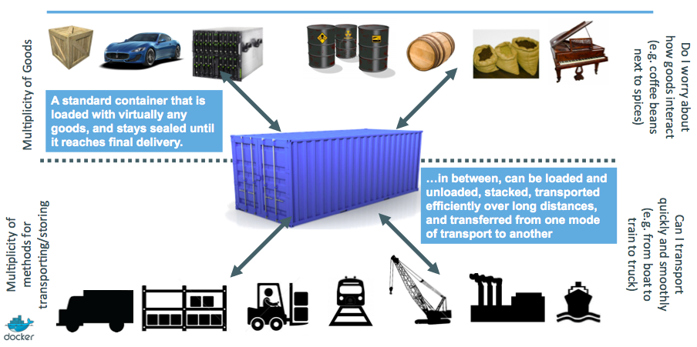
Inter-modal shipping containers

Slide 10
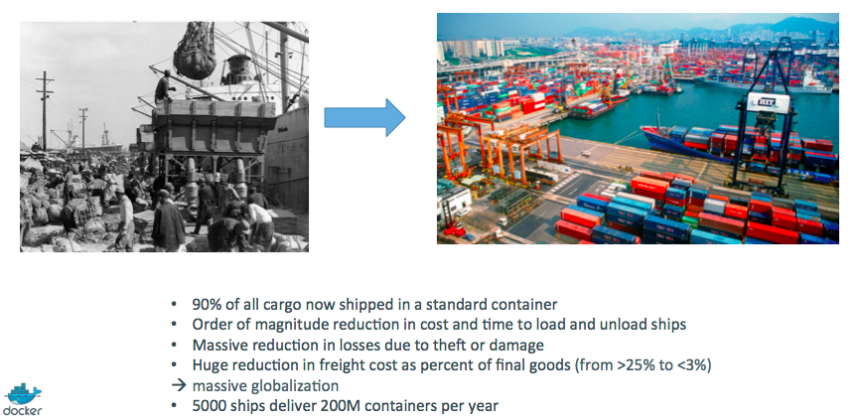
A Shipping Container Ecosystem

Slide 11
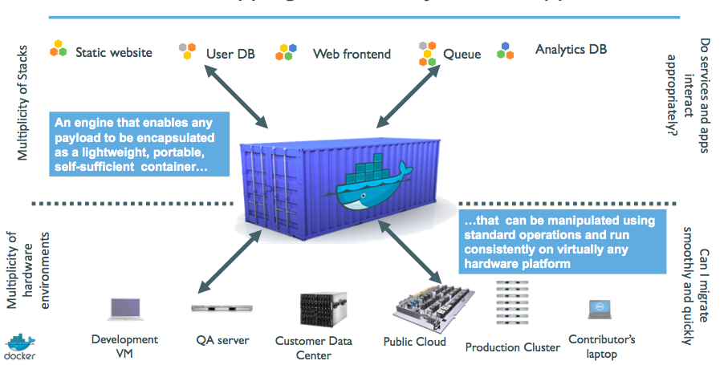
A Shipping container system
for applications

Slide 12
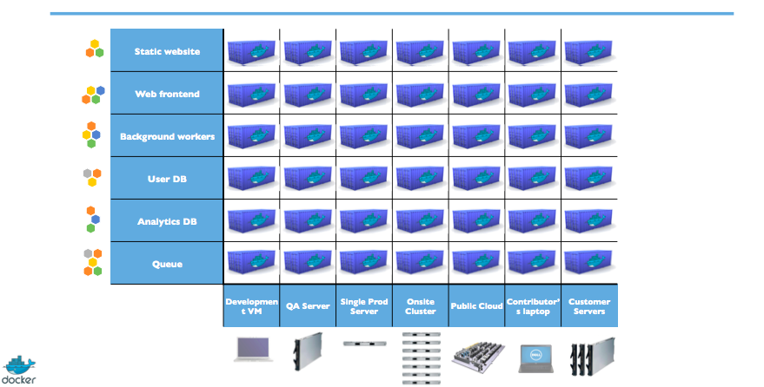
Eliminate the matrix from hell

Slide 13
Zoom into containers
Step 1: What's a container, really?
Step 2: Commoditization of containers
Step 3: Shipping containers efficiently
Step 4: Containers in a modern software factory

Slide 14
Step 1: What's a container really?
High level: Its a light weight VM
Can run a shell
Feels like a VM given, it has:
Own process space
Own network interface
Can run as root
Can install packages
Can run services
Can run applications

Slide 15
Step1: What's a container, really?
Low-level: process isolation on steroids.
Containers are unlike a VM since they:
Use host kernel
Cant boot an OS different from the host
Cant have its own kernel modules
Does not need to have init as PID 1
The building blocks
Control groups (aka cgroups)
Namespaces
COW filesystem

Slide 16
Step1: Cgroups
Resource metering and limiting on subsystems
Memory, cpu, block i/o, network
Each subsystem has a hierarchy tree ( under /sys/fs)
Hierarchies are independent.
Each process belongs to one node in a hierarchy
All processes initially belong to root of the hierarchy
Device (/dev/*) node access control

Slide 17
Step1: cgroup hierarchy
example
├─cpu,cpuacct
│ ├─ 1 /sbin/init splash
│ ├─710 /sbin/cgmanager -m name=systemd
│ ├─system.slice
│ │ ├─avahi-daemon.service
│ │ │ ├─672 avahi-daemon: running hostname.local
│ │ │ └─682 avahi-daemon: chroot helper
│ │ ├─console-kit-daemon.service
│ │ │ └─3408 /usr/sbin/console-kit-daemon --no-daemon
│ │ ├─thermald.service
│ │ │ └─679 /usr/sbin/thermald --no-daemon --dbus-enable
│ │ ├─dbus.service
│ │ │ └─747 /usr/bin/dbus-daemon --system --address=systemd: --nofork
│ │ ├─ModemManager.service
│ │ │ └─698 /usr/sbin/ModemManager

Slide 18
Step1: Namespaces
Provides processes with their scoped view of the system
Cgroups limits how much a process can use.
Namespaces limits what a process can see & use
Multiple namespace types: net, mnt, ipc, user, pid, utc
Each process is in one namespace of each type

Slide 19
Step1: Namespaces
PID: Processes in a PID namespace can only see processes within the same PID namespace.
NET: Processes within a given network namespace get their own private network stack including network interfaces, route tables, sockets, etc
MNT: Processes have their own rootfs
IPC: Allows processes in the namespace to have their own IPC (semaphores, message queues, shared memory) without conflicts with other instances.
USR: Big security improvement for containers. Allows mapping host UID/GID into a different container UID/GID. Popular use case: UID 0 (root) in container mapped to non-privileged user on host.

Slide 20
Step1: Copy-On-Write
Create a new container instantly, instead of copying its entire filesystem
Storage drivers keep track of what has changed
Considerably reduces boot times and disk footprint.

Slide 21
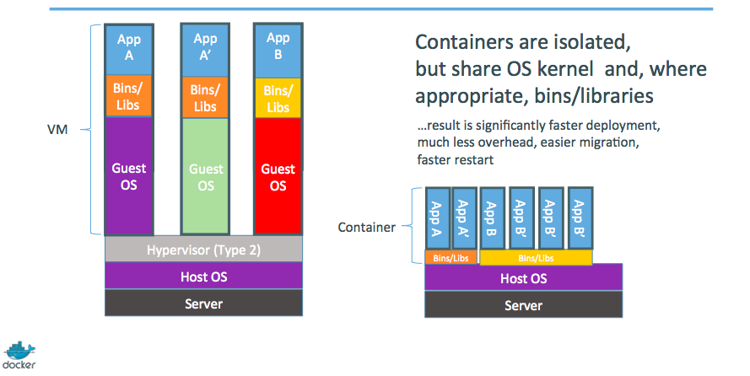
Step1: Containers vs
VMs

Slide 22
Step 2: Commoditization of
containers
Container technology has been around for a while (eg. LXC on Linux, Solaris Zones, BSD Jails)
What's new with Docker:
Standardized container format, because containers were not portable.
Make containers easy for developers
Emphasis on reusable components, APIs, ecosystem of standard tools
Huge improvement over ad-hoc, inhouse tools

Slide 23
Step 2: Running containers
everywhere
Maturity of underlying systems (cgroups, namespaces, copy-on-write systems)
Ability to run on any system today: Physical, VM, cloud, etc
Ease of migration between any of the above within seconds, without any modifications
Self contained environment = no dependency hell
Tools for running containers everywhere: linking, discovery, orchestration.

Slide 24
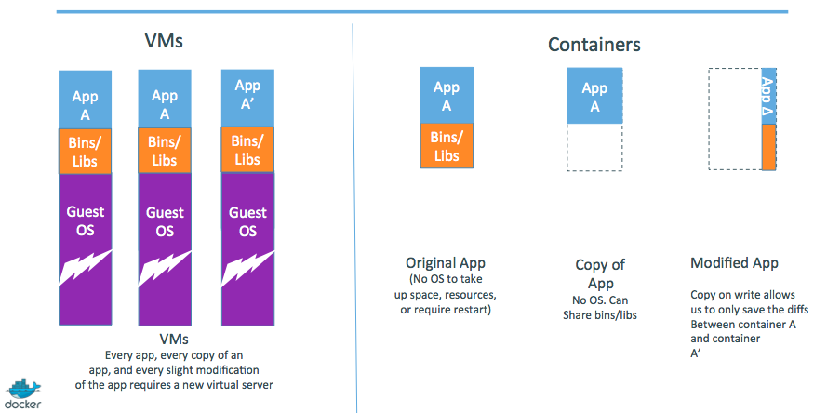
Step 3: Shipping containers
efficiently
Ship container images, made of reusable shared layers. Saves memory, disk and network usage

Slide 25
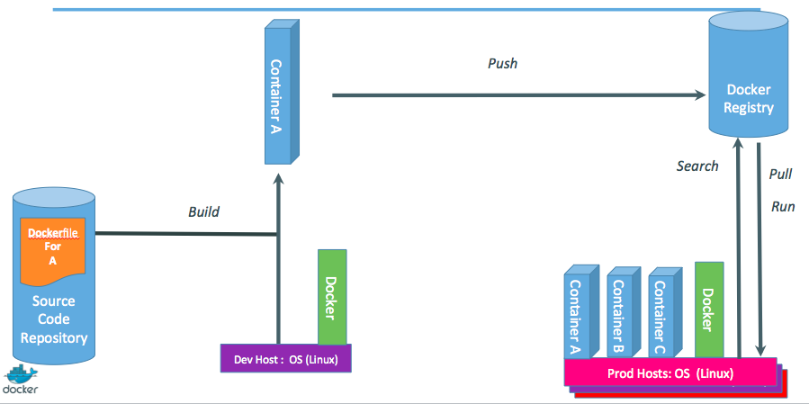
Step 4: Containers in a
modern software factory

Slide 26
References
training.docker.com
github.com/docker/docker
Huge thanks to jpetazzo@docker for his invaluable reference material.

