Slide 1
Introduction to Docker
Presenter
Anusha Ragunathan (Docker Inc)
Teaching Assistants
Harish Jayakumar (Docker Inc)
Madhuri Yechuri (ClusterHQ)
April 23, 2016

Slide 2
Agenda
Introduction to Docker
Terminology
Challenges in application landscape
How containerization resolves the challenge
How Containers work
Modern software life-cycle using containers.
Workshop exercises

Slide 3
What is Docker?
Docker Engine – synonymous with “Docker” and the open source container management. Today's focus.
Docker DataCenter – Suite to manage containers in your datacenter.
Docker Hub - online home and hub for managing your Docker containers.
Docker Enterprise Support - commercial support for Docker.
Docker Services & Training - professional services and training to help you get the best out of Docker.

Slide 4
Terminology
Container: process with a scoped view of system resources
Images: On-disk representation of the container
Scaled up apps: Vertical scale, bigger footprint
Scale out apps: Horizontal scale, more instances.
Cloud-native apps: Decoupled from physical/virtual resources.

Slide 5
Change in Application landscape
The software industry has changed.
Applications used to be monolithic, with long life-cycles, scaled up.
Today, applications are decoupled, built iteratively, scaled out.
As a result, deployment is tough!

Slide 6
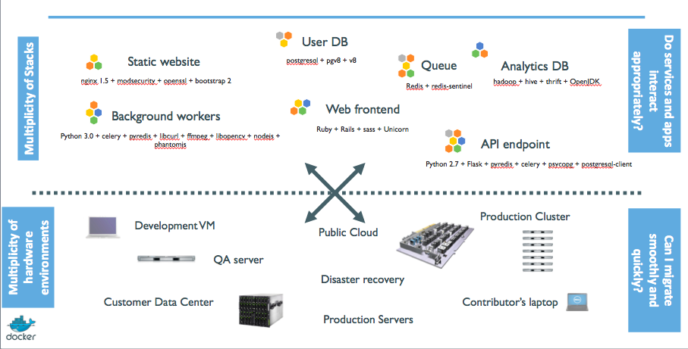
The challenge circa 2015

Slide 7
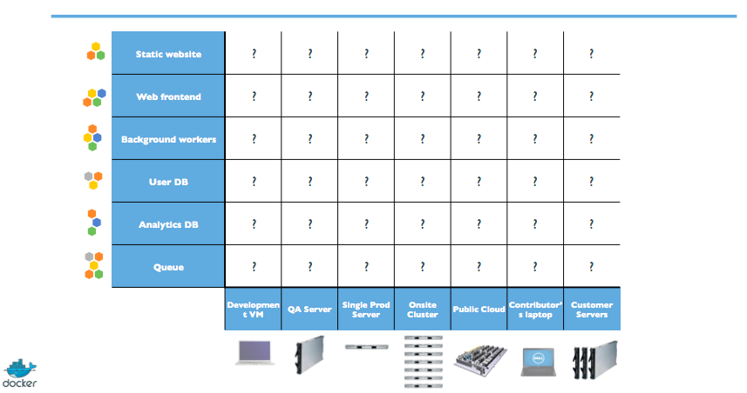
The Matrix from Hell

Slide 8
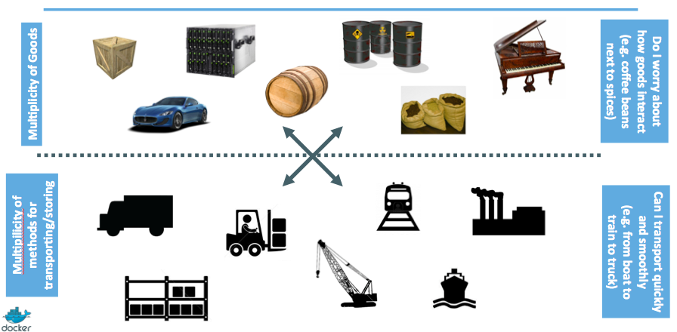
A look back at history for inspiration

Slide 9
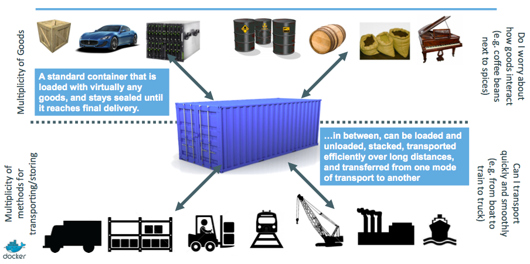
Inter-modal shipping containers

Slide 10
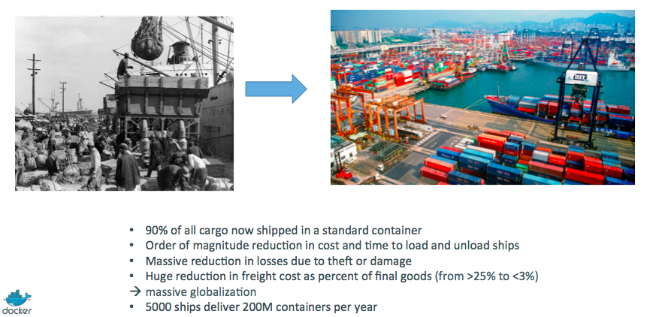
The Shipping Container Ecosystem

Slide 11
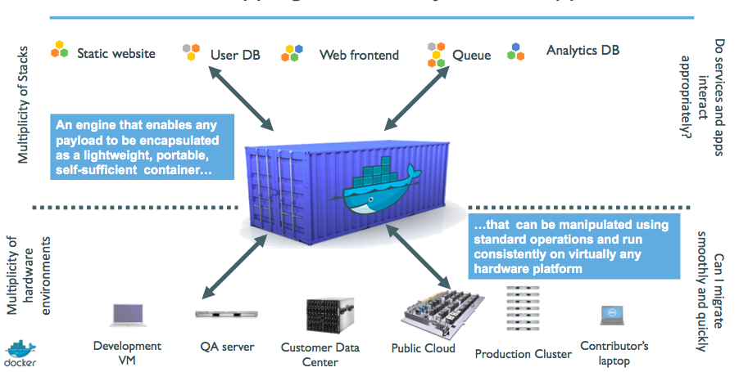
A shipping container system for applications

Slide 12
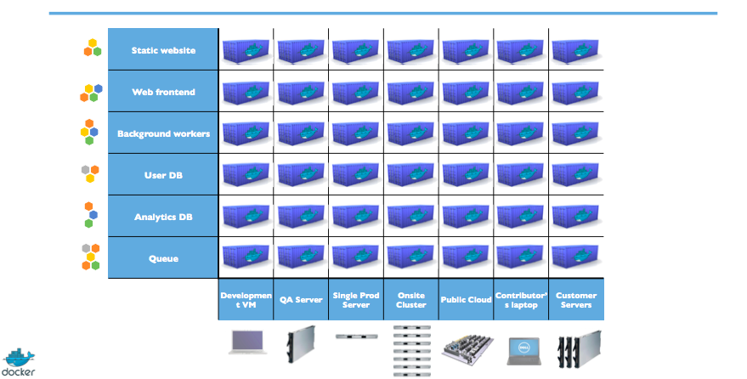
Eliminate the matrix from hell

Slide 13
Zooming into containers
Step 1: What's a container, really?
Step 2: Commoditization of containers
Step 3: Shipping containers efficiently
Step 4: Containers in a modern software factory

Slide 14
Step 1: What's a container, really?
High level: Its a light weight VM
Can shell onto it
Feels like a VM given, it has:
Own process space
Own network interface
Can run as root
Can install packages
Can run services
Can run applications

Slide 15
Step1: What's a container, really?
Low-level: process isolation on steroids.
Containers are unlike a VM since they:
Use host kernel
Cant boot an OS different from the host
Cant have its own kernel modules
Does not need to have init as PID 1
The building blocks
Control groups (aka cgroups)
Namespaces
COW filesystem

Slide 16
Step1: Cgroups
Resource metering and limiting on subsystems
Memory, cpu, block i/o, network
Each subsystem has a hierarchy tree ( under /sys/fs)
Hierarchies are independent.
Each process belongs to one node in a hierarchy
All processes initially belong to root of the hierarchy
Device (/dev/*) node access control

Slide 17
Step1: Example cgroup hierarchy
├─cpu,cpuacct
│ ├─ 1 /sbin/init splash
│ ├─710 /sbin/cgmanager -m name=systemd
│ ├─system.slice
│ │ ├─avahi-daemon.service
│ │ │ ├─672 avahi-daemon: running [aragunathan-XPS-13-9343.local
│ │ │ └─682 avahi-daemon: chroot helpe
│ │ ├─console-kit-daemon.service
│ │ │ └─3408 /usr/sbin/console-kit-daemon --no-daemon
│ │ ├─thermald.service
│ │ │ └─679 /usr/sbin/thermald --no-daemon --dbus-enable
│ │ ├─dbus.service
│ │ │ └─747 /usr/bin/dbus-daemon --system --address=systemd: --nofork --nopidfile --systemd-activation
│ │ ├─ModemManager.service
│ │ │ └─698 /usr/sbin/ModemManager

Slide 18
Step1: Namespaces
Provides processes with their scoped view of the system
Cgroups limits how much a process can use.
Namespaces limits what a process can see & use
Multiple namespace types: net, mnt, ipc, user, pid, utc
Each process is in one namespace of each type

Slide 19
Step1: Namespaces (contd...)
PID
Processes in a PID namespace can only see processes within the same PID namespace.
NET
Processes within a given network namespace get their own private network stack including network interfaces, route tables, sockets, etc
MNT
Processes have their own rootfs
IPC
Allows processes in the namespace to have their own IPC (semaphores, message queues, shared memory) without conflicts with other instances.
USER
Big security improvement for containers. Allows mapping host UID/GID into a different container UID/GID. Popular use case: UID 0 (root) in container mapped to non-privileged user on host.

Slide 20
Step1: Copy-On-Write
Create a new container instantly, instead of copying its entire filesystem
Storage drivers keep track of what has changed
Considerably reduces boot times and disk footprint.

Slide 21
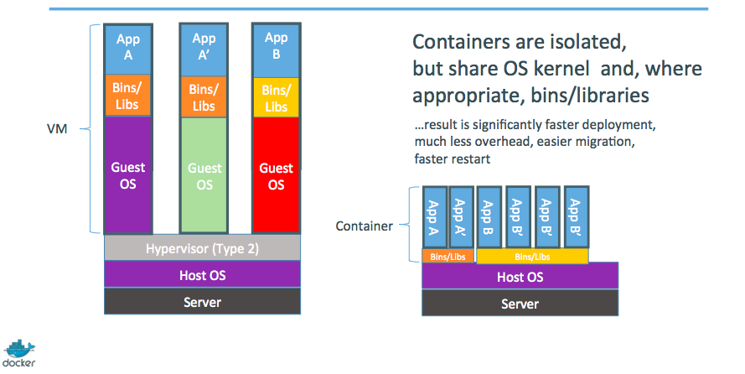
Step1: Containers as light weight VMs

Slide 22
Step 2: Commoditization of containers
Container technology has been around for a while (eg. LXC on Linux, Solaris Zones, BSD Jails)
What's new with Docker:
Standardized container format, because containers were not portable.
Make containers easy for developers
Emphasis on reusable components, APIs, ecosystem of standard tools
Huge improvement over ad-hoc, inhouse tools

Slide 23
Step 2: Running containers everywhere
Maturity of underlying systems (cgroups, namespaces, copy-on-write systems)
Ability to run on any system today: Physical, VM, cloud, etc
Ease of migration between any of the above within seconds, without any modifications
Self contained environment = no dependency hell
Tools for running containers everywhere: linking, discovery, orchestration.

Slide 24
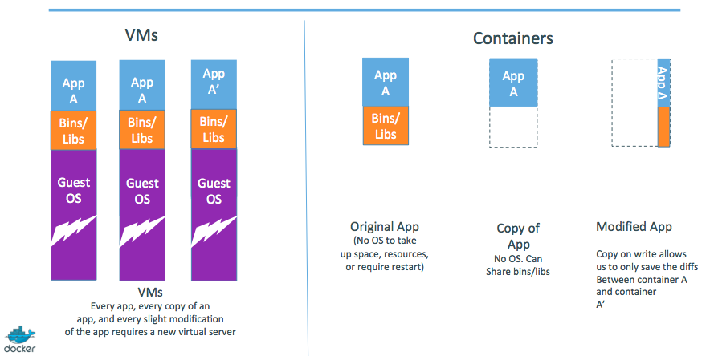
Step 3: Shipping containers efficiently
Ship container images, made of reusable shared layers. Saves memory, disk and network usage

Slide 25
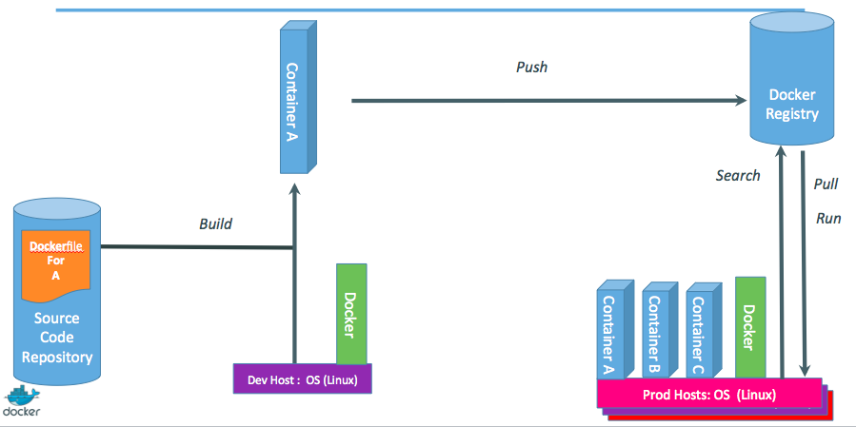
Step 4: Containers in a modern software factory

Slide 26
References
training.docker.com
github.com/docker/docker
Huge thanks to jpetazzo@docker for his invaluable reference material.

