Slide 1

Algorithms 6 – The End is Nigh by Hans Wichman

Slide 2
Today's topics
Saving the world through Tic Tac Toe
MiniMax
MonteCarlo
Alternative dungeon generation methods
Tips/information for the assessment
Recommendations on what to study next
Gettin' even

Slide 3
Tic Tac Toe
Saving the world one game at a time ...

Slide 4


Slide 5
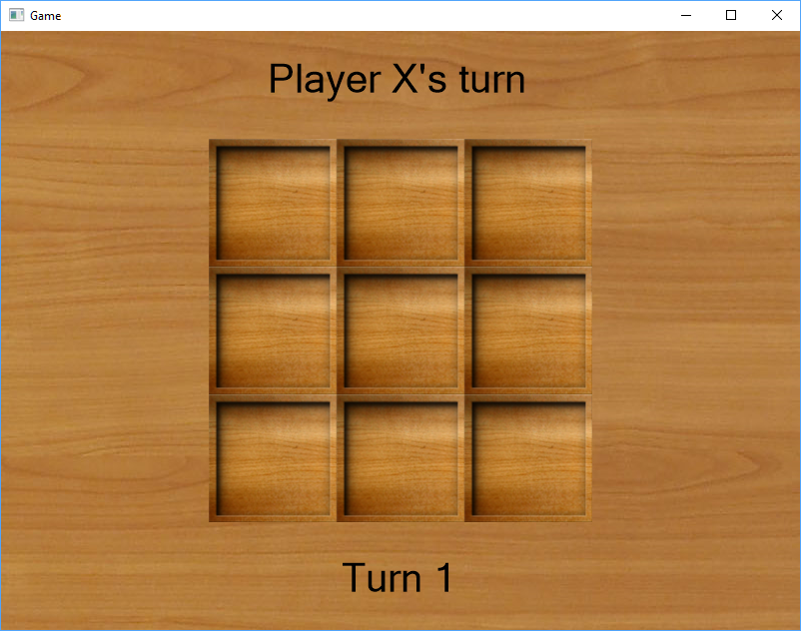
Let's steal that...
001_tic_tac_toe_basics

Slide 6
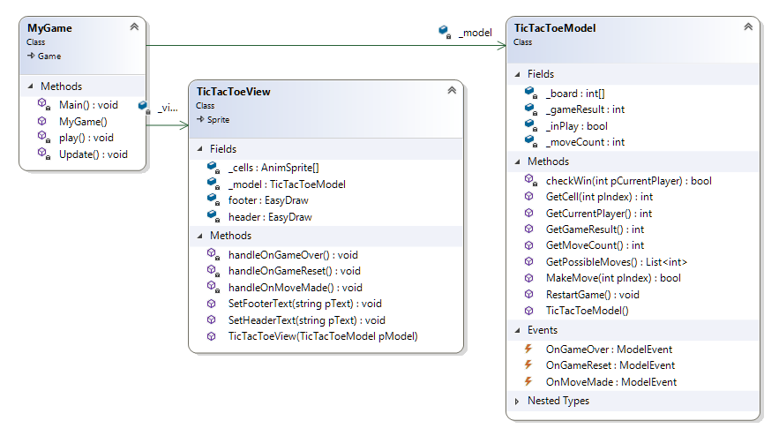
Tic Tac Toe Structure I
-1 = Player X
1 = Player O
-1 = Player X won
1 = Player O won
0 = Draw
0,1,2,3,4,5,6,7,8

Slide 7
Tic Tac Toe Structure
Things to note:
Separation between model and view
Communication through events
Random game simulation, but all the basic requirements are there!
A board
A list of possible moves
A way to make a move
A way to 'listen'/detect what is happening
Now for some 'real' players!

Slide 8
Let's make it interactive!
002_tic_tac_toe_players

Slide 9
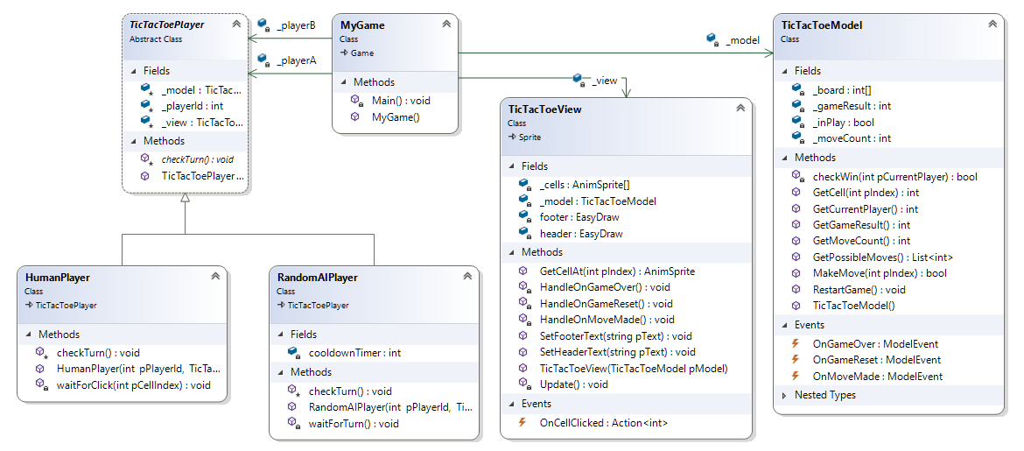
Tic Tac Toe Structure II

Slide 10
Tic Tac Toe Structure
Things to note:
We introduced the basics of players using an abstract TicTacToePlayer
Both players fully function by just listening to the model and acting on it
Very flexible, we can have:
a human vs a random player
a random vs a random player
a human vs a human player
And we can also mess it up ! (Two players with the same id ☺)

Slide 11
The MiniMax algorithm
Selecting the best possible move

Slide 12
MiniMax, what’s in a name…
For games like Tic Tac Toe, we have two players:
Black & White, Player 1 & Player 2, Left & Right, Cross (X) & Naught (O)
or Min & Max, based on how we identify players in code, with -1 OR +1
Similar to player 'values' we can also score terminal board states:
Min (aka X aka -1 aka etc) wins → the board score is -1
Max (aka O aka 1 aka etc) wins → the board score is +1
Draw → the board score is 0
Non-terminal states have an active player, and a set of possible moves.

Slide 13
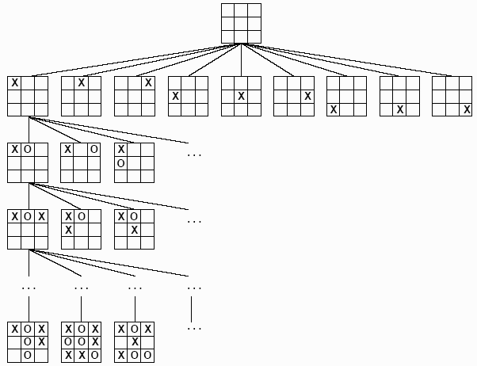
Tic-Tac-Toe Sample NodeGraph
Active player: Min (X/-1)
Active player: Max (O/+1)
Active player: Min (X/-1)
Active player: Max (O/+1)
Note that these are not really in the same layer
Until finally...
1
0
-1

Slide 14
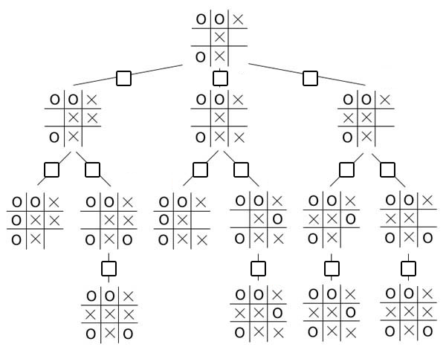
Minimax Step 1 – Assign all terminal values
Find every leaf node in the whole tree and assign:
- 1 if Min (X) won
+1 if Max (O) won
0 in case of draw
(recursion anyone? ☺)
+1
+1
-1
0
0
-1

Slide 15


MiniMax Step 2 – Calculate all parent values
As a player we can follow each path to a terminal node, leading to a score of either -1, 0, 1
I am Max, I would like to end up with a board score of +1
So given the choice I will always choose the path with the highest possible end result
I am Min, I would like to end up with a board score of -1
So given the choice I will always choose the path with the lowest possible end result
-
+
I am playing against that stupid Max, who I can only assume will go for the highest score amongst the possible choices!
I am playing against that stupid Min, who I can only assume will go for the lowest scores amongst the possible choices!

Slide 16
Minimax Step 2 – Assign parent values
Let's start 'simple', assign values to those nodes with only one option, because whether you are Min or Max, 1 choice is 1 choice.
+1
-1
+1
0
0
-1
-1
0
0
-1

Slide 17
Minimax Step 2 – Assign parent values
Active player: Min (X/-1)
?
+1
+1
0
?
?
Active player: Max (O/+1)
If you were Max, playing to the
best of your ability, what would you do?
Or differently, what should Min
assume Max is going to do?
+1
-1
+1
0
0
-1
-1
0
0
-1

Slide 18
Minimax Step 2 – Assign parent values
?
Active player: Min (X/-1)
And what will Min do?
+1
+1
0
Active player: Max (O/+1)
+1
-1
+1
0
0
-1
-1
0
0
-1

Slide 19
Minimax Algorithm - Implementation
How do we actually implement this?
Two possibilities:
Explicit nodegraph: Store all nodes in memory, and bottom up from the terminal nodes, compute their values until we reach the start node. Then for every board state we can pick and choose the best move based on whether we are Min or Max.
Implicit nodegraph: We recalculate all scores for the 'child' board state on the fly as we are making a move. Some recalculation, but more flexible combined with other approaches (which we'll get to in a sec)

Slide 20
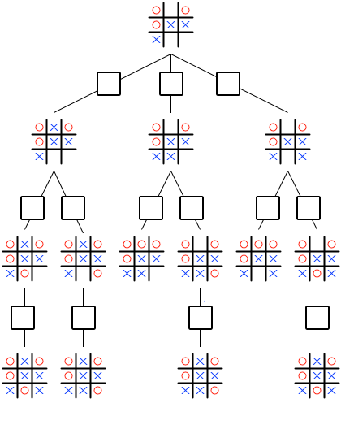
Minimax Algorithm – Paper first
Who is first and what move will (s)he make?

Slide 21
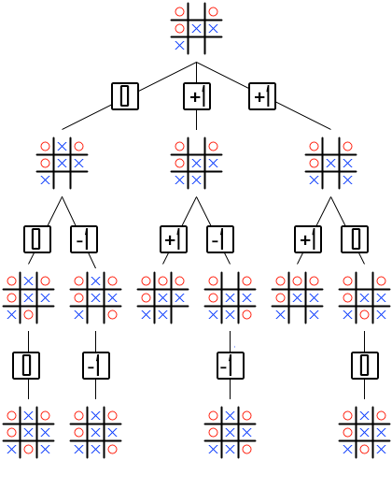
Minimax Algorithm – Paper first
Step 1. Know whose turn it is
Step 2. Score all nodes from bottom to top
Step 3. Select top move
Min (X/-1)
Max (O/+1)
Min (X/-1)

Slide 22
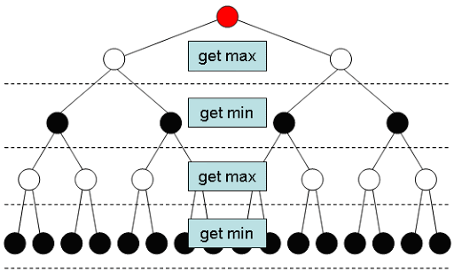
MiniMax - 003_tic_tac_toe_minimax
Changes with respect to example 2:
Added MinimaxAgent
Random start player

Slide 23
Minimax considerations
When computing recursively, we consider:
9 options for first move
8 for 2nd
7 for 3rd
Etc, so 9!
9! = 362,880 board states...
Here we counted a bit too much, since:
We also count “post-win” states – these can be ignored. The true number is 255,168.

Slide 24
Approximate number of board states
Tic-Tac-Toe: 10⁵
Connect Four: 10²¹
Chess: 10¹²³
Go: 10³⁶⁰
For comparison, some estimations:
Lifetime of universe in microseconds: 10²³
Number of atoms in the universe: 10⁸⁰

Slide 25
Evaluation / Utility functions
Searching the entire recursion tree / board state graph is only viable for simple games like Tic-Tac-Toe.
Can we not search it up to a certain depth, and use an approximate value for the “deepest” states we visit?
This is the idea behind many 2P game AI's: define an Evaluation / Utility function.
For example, in chess:
I have a queen, my opponent doesn’t = good for me! High value. Etc.

Slide 26
Evaluation / Utility functions
Defining a good utility function requires
Help of a game expert
A lot of fine tuning / experience
…and still it will work only for one game.
Is there no simple solution that works decently for all games?
Actually, there is…

Slide 27
Welcome to Monte Carlo

Slide 28

1 Start State
9 teams
9 Possible Moves
Each team gets one preconstructed board with the X superglued at the indicated position
TEAM 1
TEAM 2
TEAM 3
TEAM 4
TEAM 5
TEAM 6
TEAM 7
TEAM 8
TEAM 9

Slide 29
Then we force each team to play 250 games on their preconstructed board ...
250 games
250 games
250 games
250 games
TEAM 1
TEAM 2
TEAM 3
TEAM 4
TEAM 5
TEAM 6
TEAM 7
TEAM 8
TEAM 9
250 games
250 games
250 games
250 games
250 games

Slide 30
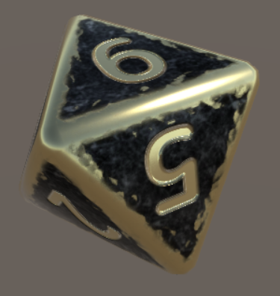
... using 'random' to generate their moves
250 games
250 games
250 games
250 games
TEAM 1
TEAM 2
TEAM 3
TEAM 4
TEAM 5
TEAM 6
TEAM 7
TEAM 8
TEAM 9
250 games
250 games
250 games
250 games
250 games

Slide 31
Then we spend the next 2 days, 4 hours and 18 minutes counting the results...
TEAM 1
TEAM 2
TEAM 3
TEAM 4
TEAM 5
TEAM 6
TEAM 7
TEAM 8
TEAM 9

Slide 32
And lo and behold... the scores...
137/250
160/250
140/250
150/250
TEAM 1
TEAM 2
TEAM 3
TEAM 4
TEAM 5
TEAM 6
TEAM 7
TEAM 8
TEAM 9
149/250
148/250
134/250
185/250
123/250

Slide 33
Given an empty board, which move will you make?
?
137/250
160/250
140/250
150/250
TEAM 1
TEAM 2
TEAM 3
TEAM 4
TEAM 5
TEAM 6
TEAM 7
TEAM 8
TEAM 9
149/250
148/250
134/250
185/250
123/250

Slide 34
This is exactly how Monte Carlo works...
Every time Monty is allowed to make a move, it:
Checks all possible moves based on the current board
Creates a copy of the current board for each of the possible moves:
Can be viewed as a new node in an implicit node graph
Makes move x on board copy x
Can be viewed as a connection to a new node in an implicit node graph
Plays y games using random moves on that board copy, counting the wins
Returns the move that resulted in the highest number of wins

Slide 35
How does this differ from MiniMax?
MiniMax searches through 250k + board states
Monte Carlo searches through (number of moves) * (number of samples board states_, eg at the start with #moves = 9 and #samples = 250 ➔ 2250
The best thing?
We don't have to use 250 samples, we can also use 25 samples if we wish!
This will make our AI seem less smart ☺

Slide 36
Monte Carlo - 004_tic_tac_toe_montecarlo
Changes with respect to example 3:
Added Monte Carlo Agent

Slide 37
Possible improvements
Check whether making a certain move is an automatic win or loss
If I make this move do I automatically win? Make it
If I can't win, but can block a direct opposite win → block it
Score both plus and min, weighted with the required turncount (See BetterMonteCarlo for a demo of this last principle)

Slide 38
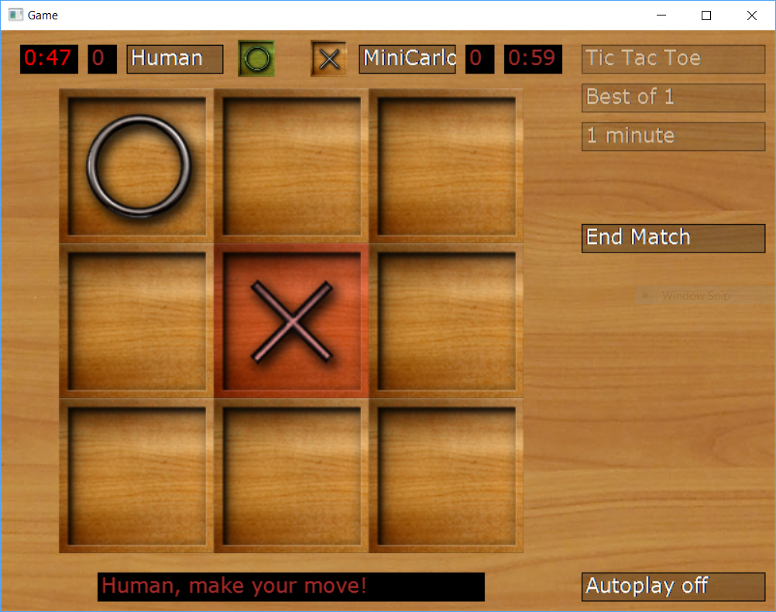
Haven't had enough yet?
005_more_board_games (Courtesy P. Bonsma)

Slide 39
Dungeon Generation
Using Cellular Automata

Slide 40
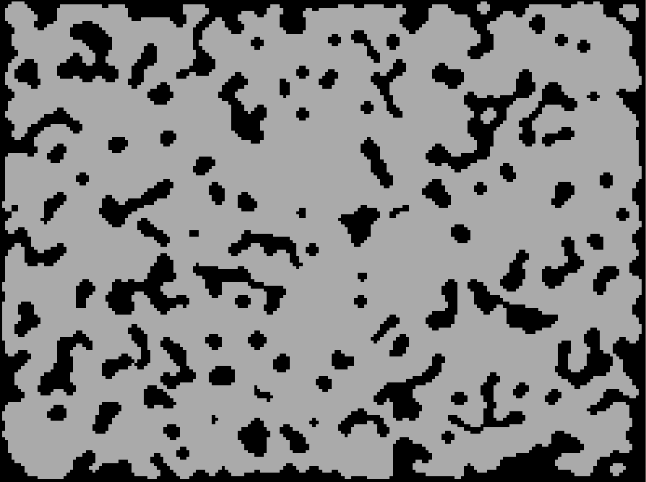
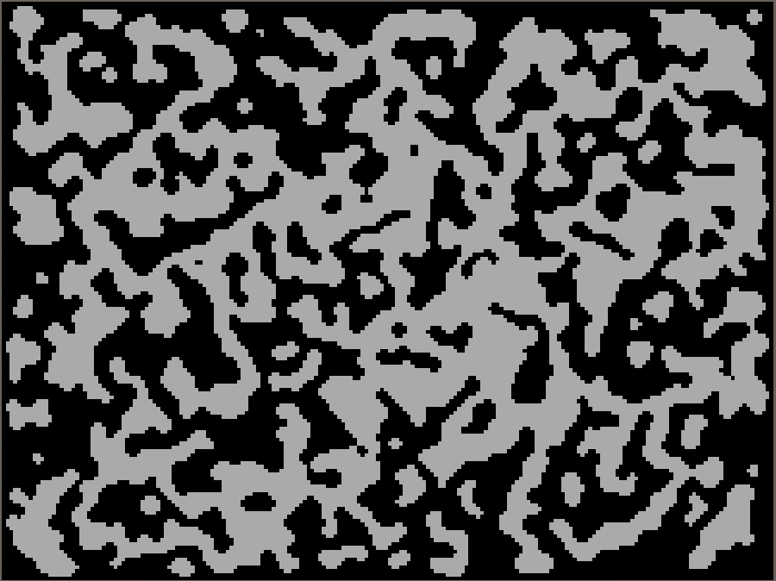
"Cellular Automata" dungeons:

Slide 41
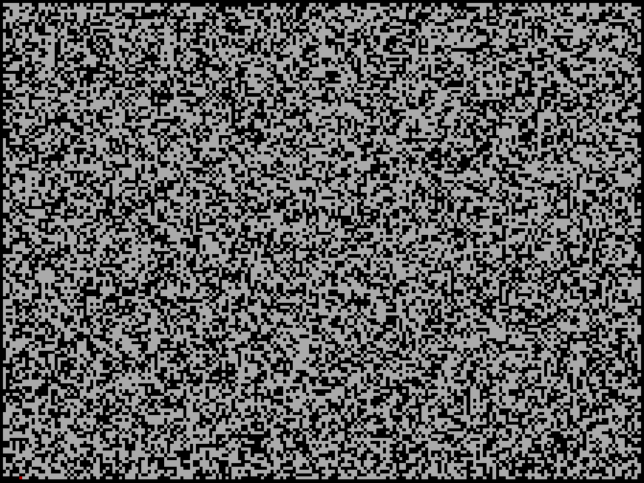
Idea?
Generate Random Noise:
Process it until we got this:

Slide 42
Proces?
foreach square in all squares
set c = square.#walkable_neighbours
if (c != 4) square.walkable = c > 4;
(minor detail: the square you are iterating over and the square you are setting need to be in different 'maps'. Similar to why x = x/Length(); y = y/Length(); will not work)

Slide 43
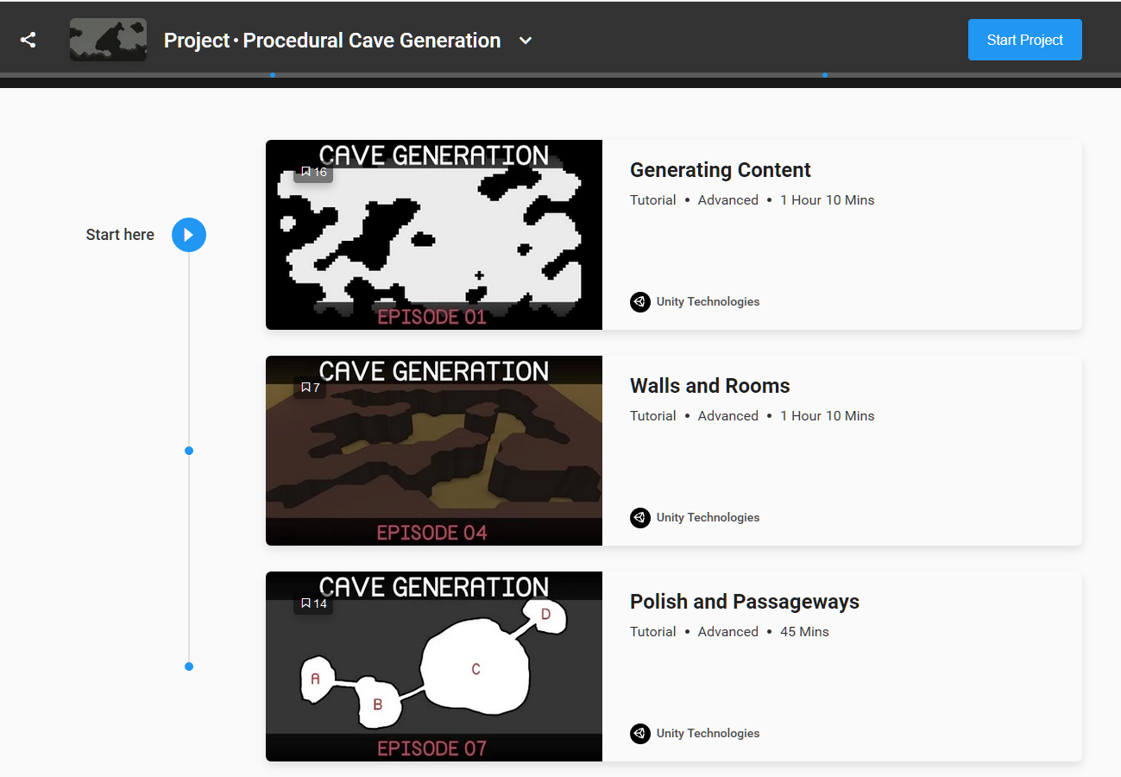
More info

Slide 44
Closing words

Slide 45
What did we set out to do?
Lists, Dictionaries, Graphs, Recursion, Search algorithms
Dungeons, Navigation, Pathfinding
Pseudocode, drawings to describe your algorithm
Problem solving techniques (mostly self study + assignments)
Some advanced algorithms...
... and then suddenly, it is almost done ...

Slide 46
Assessment
Before:
Read the assessment criteria, check whether you meet all them all
Prepare your "presentation", this is your moment to 'shine'
During:
Present & explain the general idea of your algorithm and its implementation
Don't hide your mistakes or errors, highlight them with suggestions for improvements
Help us grade you: highlight what you think your score is on all the criteria:
Explain some code, show the documentation, show logbook/drawings etc
Try to relax, if you don't pass, there is always a next time
Stay professional (No crying "I NEED TO PASS THIS COURSE OR I HAVE TO LEAVE")
After:
Some questions to verify (y)our understanding of the concepts
Grading

Slide 47
Assessment deadline
Officially: end of this week
Not officially: the day of the assessment

Slide 48
Typical Assessment Questions
What are the steps in solving a problem?
Can you name a few problem solving methods?
Given the task to describe an algorithm, what would you do?
What is the difference between DFS and BFS?
What is the downside of using recursion for searching?
What do you do if you get stuck?
Can you name a problem you encountered and how you solved it?
Does your code meet the required quality standards? Why (not)?
Can you show how you implement a swap method?

Slide 49
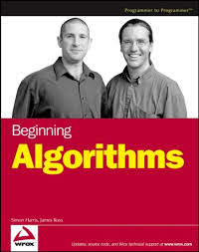
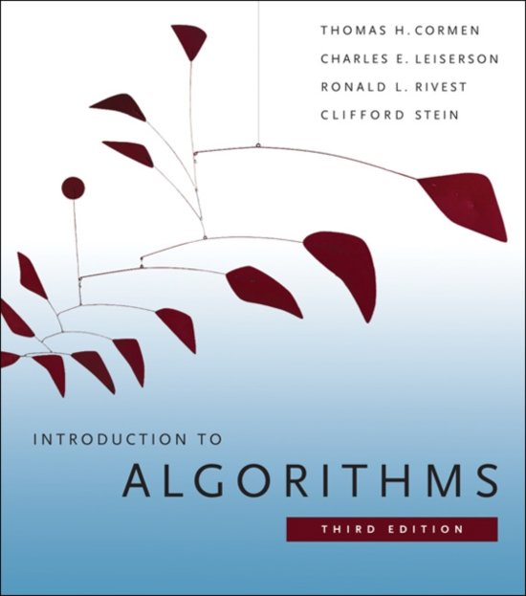
Where to go next?
First of all: just program a lot (worry less, program more)
Second, if you ever need more in depth info beside the interwebs:

Slide 50
But first
Please please please.... fill out the evaluation form
Did the course match your expectations?
Do you feel it helped you meet the learnings goal and learn new things?
Did you become a better programmer/problem solver because of it?
Or anything else you'd like to mention, improvements etc ➔ fill it in!
The link/email to the evaluation form will appear later today on blackboard!

Slide 51


