Slide 1
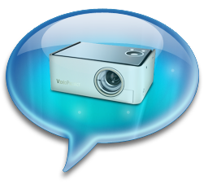
Media Markups
Capture attribute
Input tags now have the capture attribute
Works with attribute type set to “file”
Allows to take picture with a camera
<input type="file" accept="image/*" capture="camera">

Slide 2
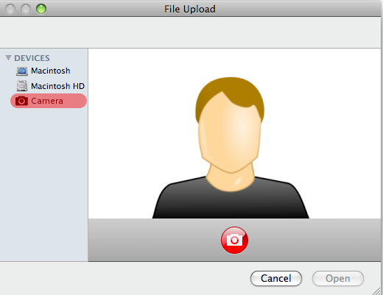
Media Markups
Capture attribute
Rendering example

Slide 3
ARIA
Exercise (1/2)
Let’s design a simple widget: an HTML5 slider!
Encapsulte an input inside a <form> markup
With the “range” type, and some ARIA attributes
Define a simple style for your widget
Use the following attributes:
-vendor-appearance for the input itself
input::-vendor-slider-thumb for the draggable cursor
Set “none” to them in order to change their default shape!

Slide 4
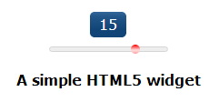
ARIA
Exercise (2/2)
Let’s design a simple widget: an HTML5 slider!
Use JavaScript to display the slider’s value
Target the slider’s “onchange” event
Style the output in a creative manner
Possible result:

Slide 5

Variables
CSS 3

Slide 6

Syntax
Variables
CSS 3 reaches a new dimension with variables support
Based on common stylesheet syntax
var-{name} : value;
Variable declaration
property : var(name);
Variable usage
var-mycolor: #0F5;
color: var(mycolor);

Slide 7
Cascading and scope
Variables
Variables scope are defined like other CSS properties
For the selector, and its children, unless the declaration is overriden somewhere below
div { var-mycolor: #0F5; }
div p { var-mycolor: red; }
* { color: var(mycolor); }
/* The text color will be set to #0F5 in each div element, and to red in each paragraph declared inside it */

Slide 8
Invalid values
Variables
Be careful when using variables
CSS is a weak typing language
Specifying a bad value sets the property to its default
div { var-dimension: 20px; }
div p {
background-color: red; }
background-color: var(dimension);
}
/* The paragraph will have transparent background, as the second declaration is not valid (even if the first one was)*/

Slide 9
Operations
Variables
CSS 3 also provides calculations methods!
Useful to create responsive design* with resizing
Applied with variables, allows to create a modular design
*Responsive design: Write your design once in an flexible way, making it adaptable for all devices’ resolution.

Slide 10
Operations
Variables
Done with the calc() function
Example:
Usable for types: length, frequency, angle, time, number or integer
background-position: calc(50% + 20px), calc(50% + 5px), 0, 0;

Slide 11
Invalid operations
Variables
Be careful with cyclic references
For example, defining two variables in function of the other one’s value
In this case, both variables are considered as invalid.
Properties set with invalid variables goes to default
var-mydimension: calc(50px + var(yourdimension));
var-yourdimension: calc(50px - var(mydimension));

Slide 12


Questions ?

Slide 13

Web Messaging
HTML5 - New APIs

Slide 14
Presentation
Messaging
Allows to talk between two documents
Cross-domain compatible
Secure
Most JavaScript types (strings, integers, JSON, Date, …)
Useful with Web Workers

Slide 15
Talking with iFrames
Messaging
Two ways:
Sending a single message
Punctual message
No context
Defining a channel
Bipolar communication
Message handler defined on each side

Slide 16
Single message - Sending
Messaging
To send a message, you need to:
Define your iFrame tag with a valid src property
Retrieve the iFrame ContentWindow property
Invokes the method
postMessage(message, targetOrigin)

Slide 17
<!-- File: http://origin.com/index.html -->
<body>
<button disabled>Send</button>
<iframe src="http://remote.com"></iframe>
<script type="text/javascript">
var button = document.querySelector("button")
, frame = document.querySelector("iframe")
, i = 0;
frame.onload = function() {
button.removeAttribute("disabled");
};
button.onclick = function() {
frame.contentWindow.postMessage(++i,
frame.src);
};
</script>
</body>
Single message - Sending

Slide 18
Single message - Receiving
Messaging
To read the message in the remote page:
Define a Window.onmessage event handler
Use the MessageEvent object in the handler to
Check the event origin to prevent malicious code
Retrieve the message

Slide 19
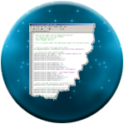
Single message - Receiving
Messaging
Handling message example:
<!-- File: http://remote.com/index.html -->
<body>
<p></p>
<script type="text/javascript">
window.onmessage = function(e){
if( e.origin == 'http://origin.com' )
document.querySelector('p').innerHTML += e.data +'<br>';
};
</script>
</body>

Slide 20
Channels
Messaging
Defines a private channel between two pages
Allows to retrieve a context
Facilitates communication
Managed by a MessageChannel object
Encapsulates two MessagePort objects
Represent current and remote context parts!

Slide 21
Channels
Messaging
To build your channel you need to:
Create a new MessageChannel object
Send a message with the following method:
postMessage(message, targetOrigin, ports)
This done, you can use your MessagePort objects on each side easily

Slide 22
<!-- File: http://origin.com/channel.html -->
<body>
<button disabled>Send</button>
<iframe src="http://remote.com"></iframe>
<p></p>
<script type="text/javascript">
var button = document.querySelector("button")
, frame = document.querySelector("iframe")
, i = 0
, channel = new MessageChannel()
, p = document.querySelector("p");
frame.onload = function() {
button.removeAttribute("disabled");
frame.contentWindow.postMessage("__SETUP__",
frame.src, [channel.port2]);
};
...
Channels - Example

Slide 23
...
button.onclick = function() {
channel.port1.postMessage(++i);
};
channel.port1.onmessage = function(e) {
if(e.data.__SETUP__)
d.innerHTML += e.data.__SETUP__ + "<br/>";
else if(e.data.number) {
i = parseInt(e.data.number);
d.innerHTML += i + "<br/>";
}
};
</script>
</body>
Channels - Example

Slide 24
Channels
Messaging
The MessageChannel interface has two MessagePort attributes: port1 and port2
The port2 attribute is sent on the remote document
The port1 attribute is used to retrieve messages

Slide 25
Channels
Messaging
The MessagePort interface expose a postMessage() function:
No need to send origin anymore
Just specify data you want to send

Slide 26
<!-- File: http://remote.com/channel.html -->
<body>
<p></p>
<script type="text/javascript">
var p = document.querySelector("p");
window.onmessage = function (e) {
if( e.origin == 'http://origin.com' ) {
if (e.data == "__SETUP__") {
port = e.ports[0];
port.onmessage = onPortMessage;
port.postMessage({
__SETUP__: "Connection established"
});
} else { alert("Bad request"); }
} else { alert("Bad origin"); }
}
...
Channels - Receiving

Slide 27
...
function onPortMessage(e) {
port.postMessage({
number: parseInt(e.data) + 1
});
p.innerHTML += e.data + "<br/>";
}
</script>
</body>
Channels - Receiving

Slide 28
Talking with modal dialogs
Messaging
Summon a dialog box – a new window
Available with the method:
window.showModalDialog()
Allows to return the result of the specified window in the main page

Slide 29
Talking with modal dialogs
Messaging
showModalDialog(uri, args, options)
uri: The resource address
args: Values to send to the remote window
options: Optional parameters defining the window
Returns the property “returnValue” of the remote window object

Slide 30
<!-- File: http://website.com/main.html -->
...
<body>
<p></p>
<script type="text/javascript">
window.onload = function(){
var samples = [3, 7];
var result = window.showModalDialog(
"http://website.com/remoteDialog.html",
samples, "dialogWidth:200;
dialogHeight:50; resizable:no;");
var p = document.querySelector("p");
p.textContent = "Result: " + result;
};
</script>
</body>
...
showModalDialog 1/2

Slide 31
<!-- File: http://website.com/remoteDialog.html -->
...
<body>
<p></p>
<script type="text/javascript">
document.write("Received : " +
window.dialogArguments);
var da = window.dialogArguments;
var addition = parseInt(da[0]) + parseInt(da[1]);
</script>
<input type="button" value="Send addition result"
onclick="window.returnValue = addition;
window.close();" />
</body>
...
showModalDialog 2/2

Slide 32


Questions ?

