Slide 1
Junior Python Developer Assignment
BDL e-commerce scraping
https://github.com/CodeCraftIA/BDL_E-commerce_scrape_assignment
Ηλίας Αδαμίδης

Slide 2
Libraries Used
selenium
time
requests
pandas
unittest

Slide 3
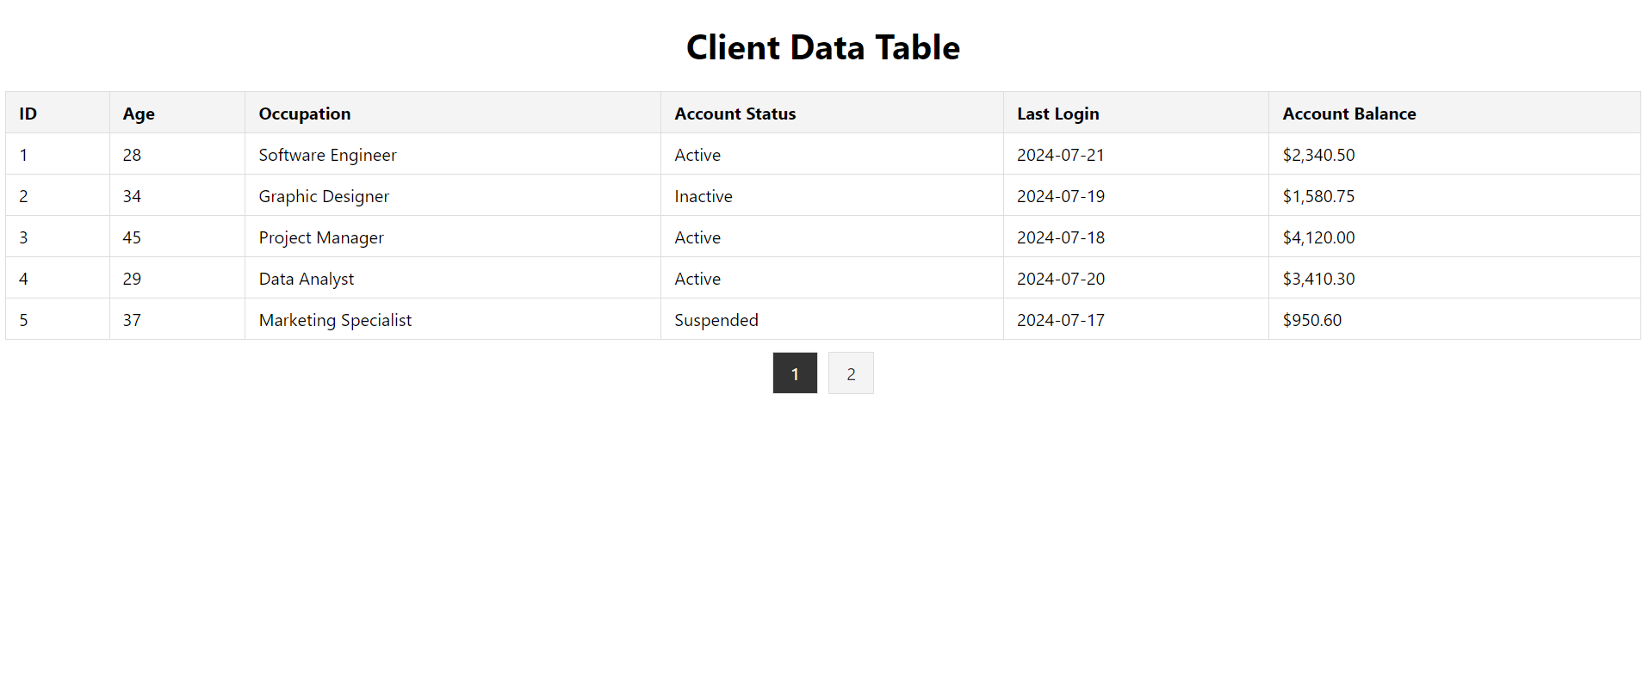
Task 1 - Website
Get the information from:
https://bigdatalab.ai/assignment_pd001_data/

Slide 4
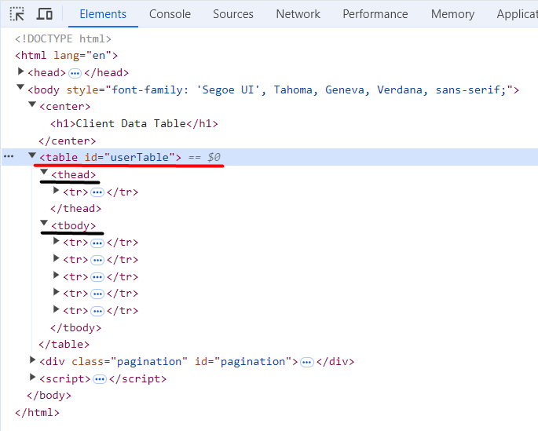
Task 1 - Structure
table = driver.find_element(By.ID, "userTable")
rows = table.find_elements(By.TAG_NAME, "tr")

Slide 5
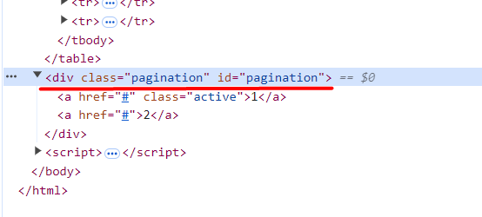
Task 1 – Pagination
pagination = driver.find_element(By.ID, "pagination")
all_pages = pagination.find_elements(By.TAG_NAME, 'a')

Slide 6
Task 2-3-4
fetch data from Fake Store
simple requests on https://fakestoreapi.com/
https://fakestoreapi.com/carts
https://fakestoreapi.com/users/{user_id}, user_id from users found from task 1
https://fakestoreapi.com/products/{product_id}, product_id from task 2 products fetched

Slide 7
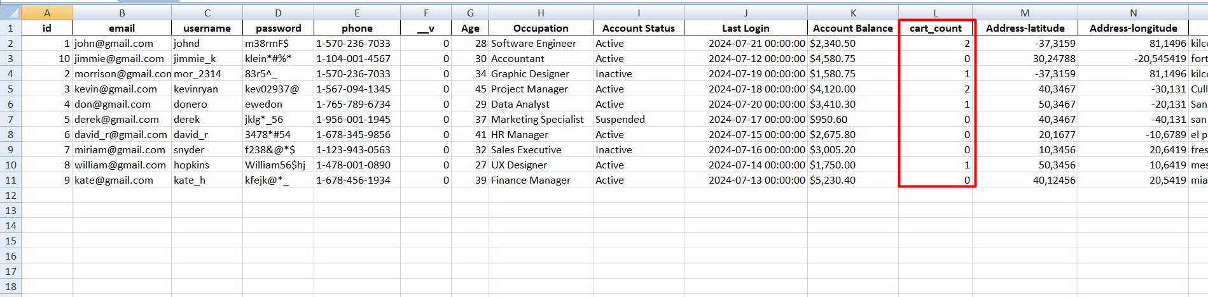
Task 5
Save the combined data of user from task 1 and 3 plus “count of carts of each user”.
Merge based on id.
Count cards with: df_carts.groupby("userId")["id"].count()

Slide 8
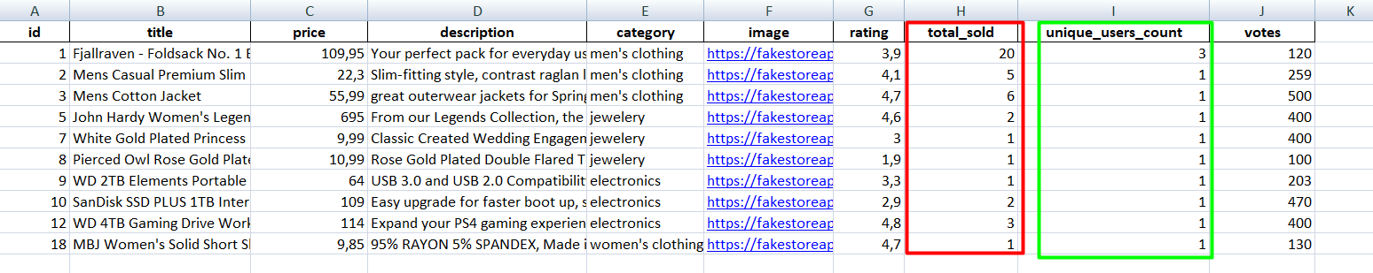
Task 6
Save the data of products, plus “how many items of this product have been sold in total” and “unique users that have put at least one item of this product in their carts”.
Iterate on all cards and for every product:
Count the total number sold.
Count the unique number of users that have the product.

Slide 9
Final Preprocess
Change the type of columns to the correct ones. For example 'Last Login‘ must be datetime, id-votes integers, rating-price floats etc.
Split data of large columns to multiple columns. For example ‘rating’ to ‘rate’ and ‘count’ etc.

Slide 10
Test
Test the first 4 functions-tasks.
Checking what the functions returning. Check that headers and data not empty, headers contain expected columns, row data should have the same number of columns as headers etc.

Slide 11
THE END
Thank you!

