Slide 1
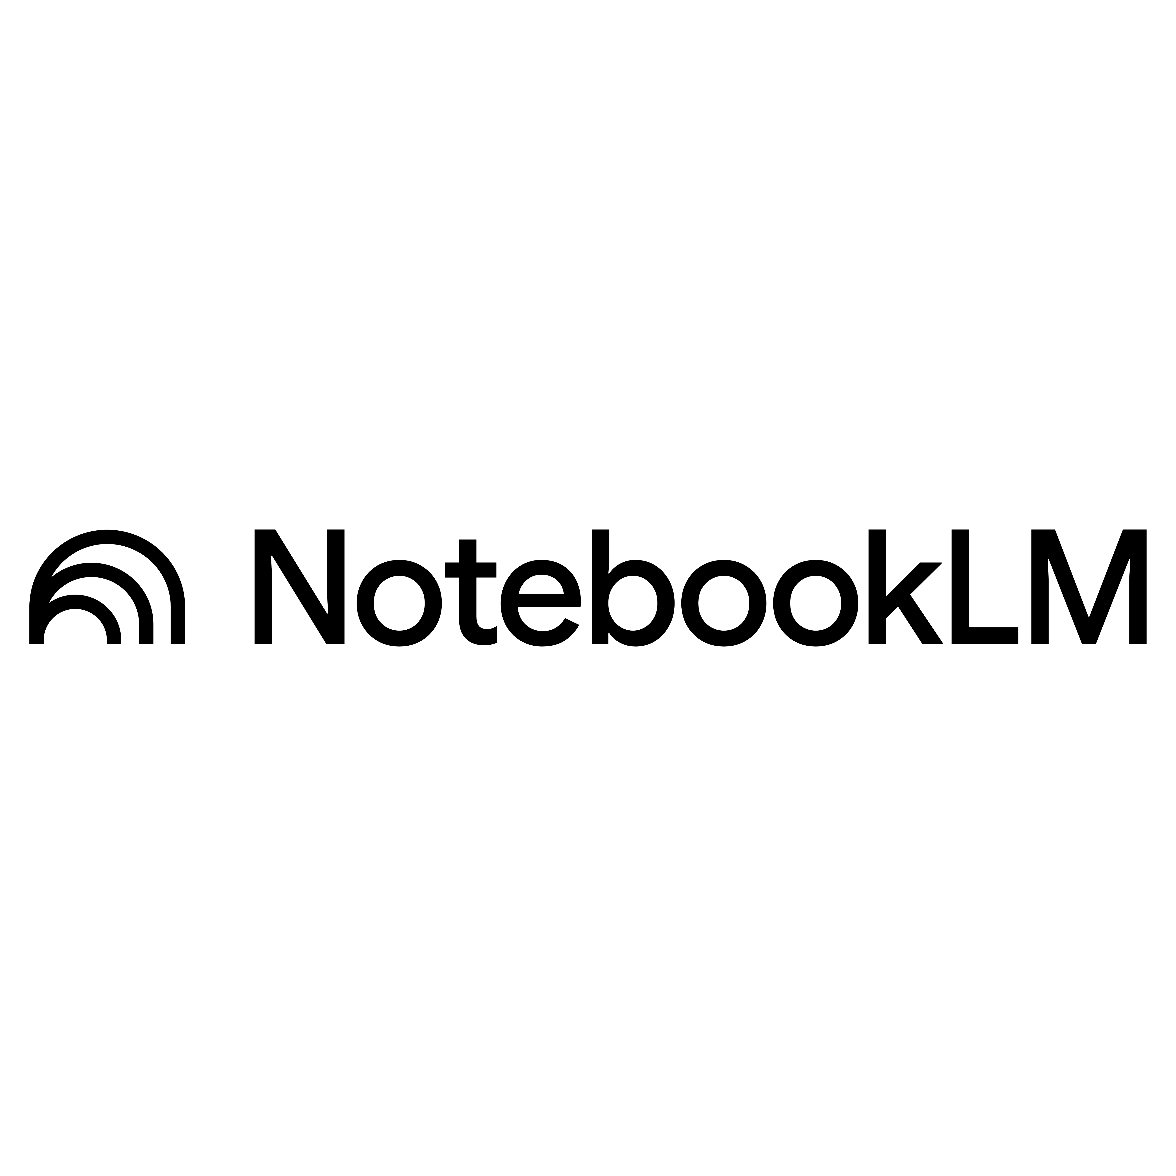

Slide 2
Agenda
Introduction
Creating Your First Notebook
Adding Knowledge Sources
Asking Better Questions
Summaries,
Notes & Study Guides
Audio
Video
Slide deck
mind maps,
Reports
Flashcards,
Quiz
Infographics..

Slide 3

Let’s Get Started

Slide 4
What Is NotebookLM
NotebookLM is Google's AI-powered research assistant that answers questions using only your uploaded documents.

Slide 5
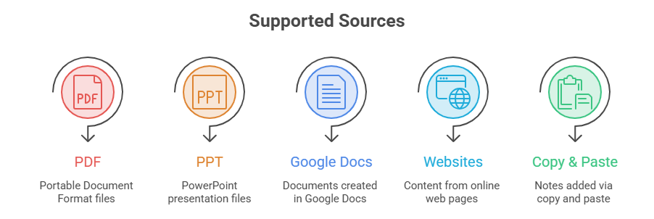
Adding Knowledge Sources

Slide 6
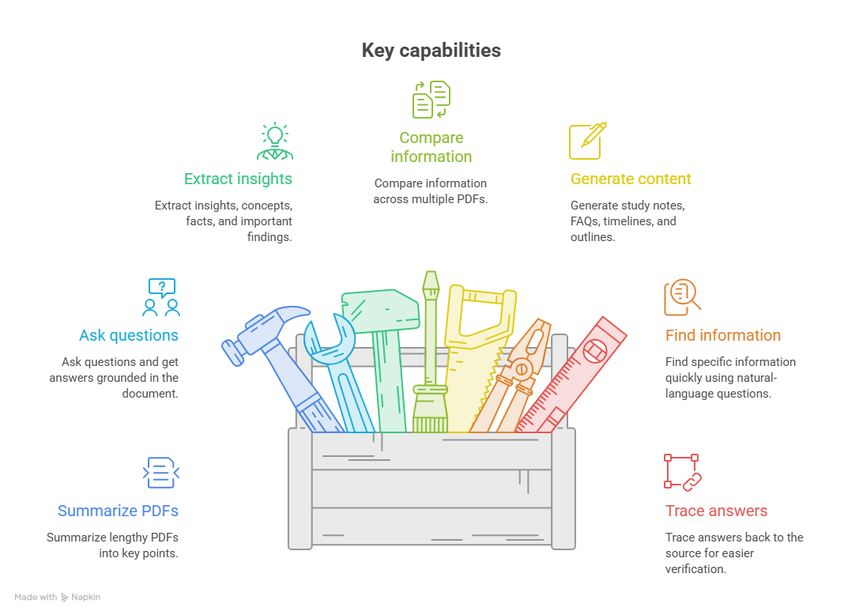
Analysing Pdfs With Notebooklm
Google NotebookLM can turn lengthy PDF documents into an interactive knowledge source. Instead of reading an entire PDF manually, you can upload it and ask questions directly based on its content.

Slide 7
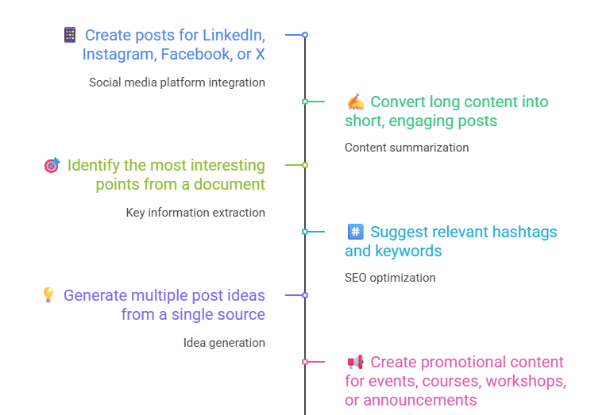
Generating Social Media Posts
NotebookLM can help transform your documents, newsletters, reports, or research content into engaging social media posts. Instead of creating content from scratch, you can provide your source material and ask NotebookLM to adapt the key ideas for different platforms.

Slide 8
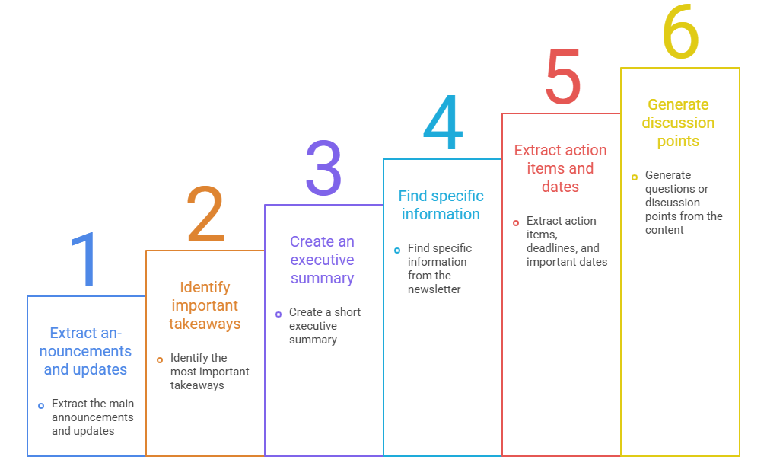
Summarizing A Newsletter With Notebooklm
NotebookLM can quickly transform a long newsletter into a concise summary, helping you understand the most important updates without reading every section.

Slide 9
Conclusions
NotebookLM is a powerful AI-powered research and learning assistant that helps users understand, analyse, summarize, and interact with their own documents. It can turn PDFs, notes, reports, newsletters, and other sources into useful insights and actionable content.
Key Takeaways:
📚 Understand lengthy documents quickly
🔍 Ask questions and find relevant information
📝 Generate summaries, notes, and reports
💡 Extract insights and important ideas
📱 Convert information into social media content
🎯 Support learning, research, and productivity
Overall:
NotebookLM helps users move from “reading information” to “interacting with and using information effectively.”

Slide 10

Quick Questions
What is the main purpose of NotebookLM?
What is the difference between NotebookLM and a normal chatbot?
What happens when you upload multiple sources to NotebookLM?
Can NotebookLM help you compare two documents?
How can you verify whether an answer is supported by your source?
Can NotebookLM generate study notes from your sources?
What can you do with a newsletter using NotebookLM?
Can NotebookLM help generate social media post ideas?
Can you use NotebookLM to find important dates from a document?
Can NotebookLM work with more than one source at the same time?

Slide 11
Q&A

Slide 12
Thank you

