Slide 1
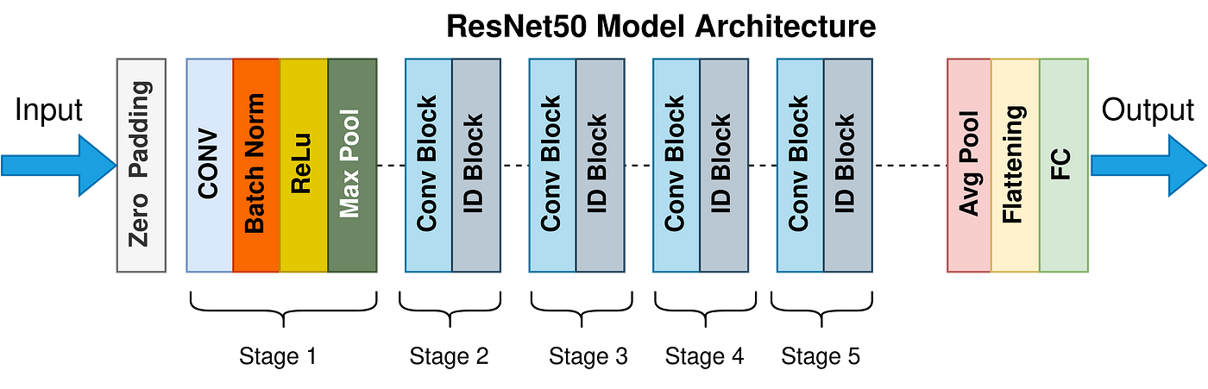
Original Architecture

Slide 2
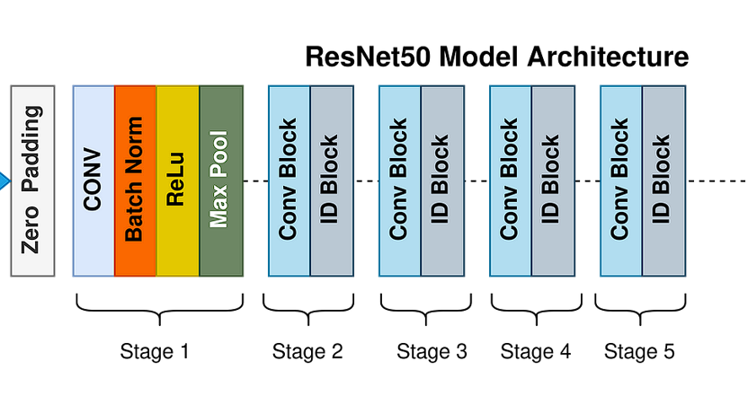
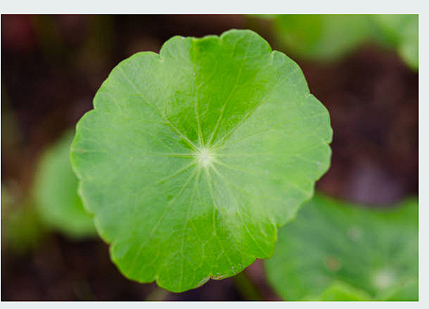
FEATURE EXTRACTION
INPUT (128*128)
OUTPUT
FALTTENING
GLOBAL AVERAGE POOLING
DENSE + SOFTMAX
DENSE + RELU
CLASSIFIER
TRAINED CONVOLUTION BASE
Pretrained network-Frozen Weights
RESNET 50

Slide 3
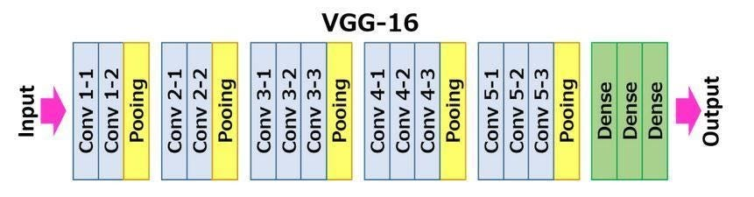
Original Architecture

Slide 4
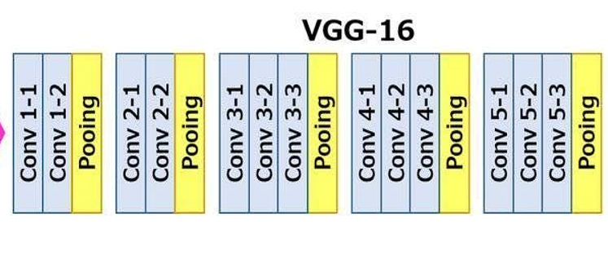
FEATURE EXTRACTION
INPUT 128 * 128
GLOVAL AVERAGE POOLING
DENSE + RELU
OUTPUT
FLATTEN
DENSE + SOFTMAX
TRAINED CONVOLUTION BASE
Pretrained network-Frozen Weights
CLASSIFIER
VGG16

Slide 5
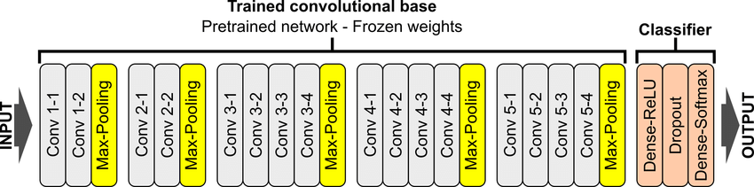
ORIGINAL VGG19

Slide 6
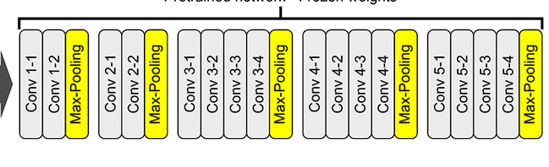
FEATURE EXTRACTION
INPUT 128 * 128
GLOVAL AVERAGE POOLING
DENSE + RELU
OUTPUT
FLATTEN
DENSE + SOFTMAX
TRAINED CONVOLUTION BASE
Pretrained network-Frozen Weights
CLASSIFIER
VGG19

Slide 7
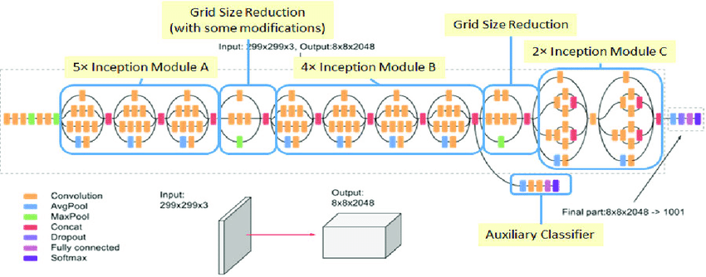
ORIGINAL INCEPTION V3

Slide 8
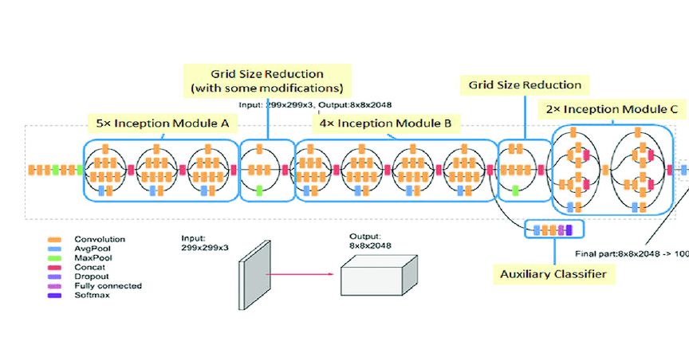
FEATURE EXTRACTION
INPUT 128 * 128
CLASSIFIER
GLOVAL AVERAGE POOLING
OUTPUT
FLATTEN
DENSE + RELU
DENSE + SOFTMAX
TRAINED CONVOLUTION BASE
Pretrained network-Frozen Weights
INCEPTION V3

Slide 9
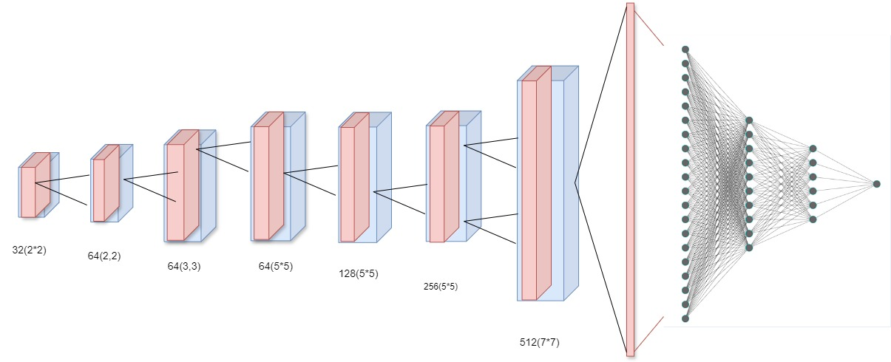
FEATURE EXTRACTION
Classifier
INPUT 128 * 128 * 3
512
CONVOLUTIONAL LAYERS
256
128
Padding same
OUTPUT
Flatten
Fully Connected + Relu + Dropout
Conv2D + Relu
Max Pooling + Drop Out

Slide 10
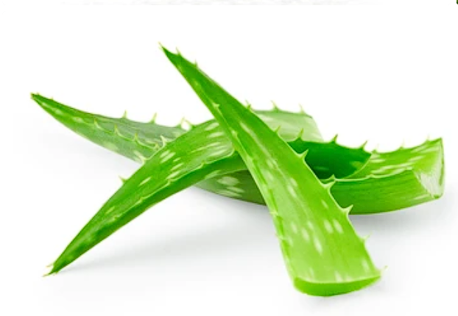
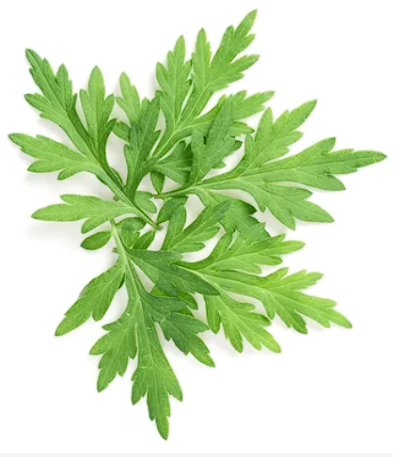
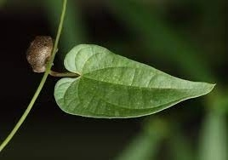
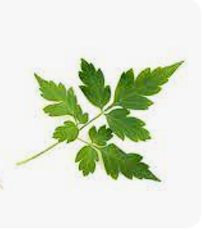
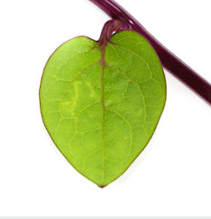
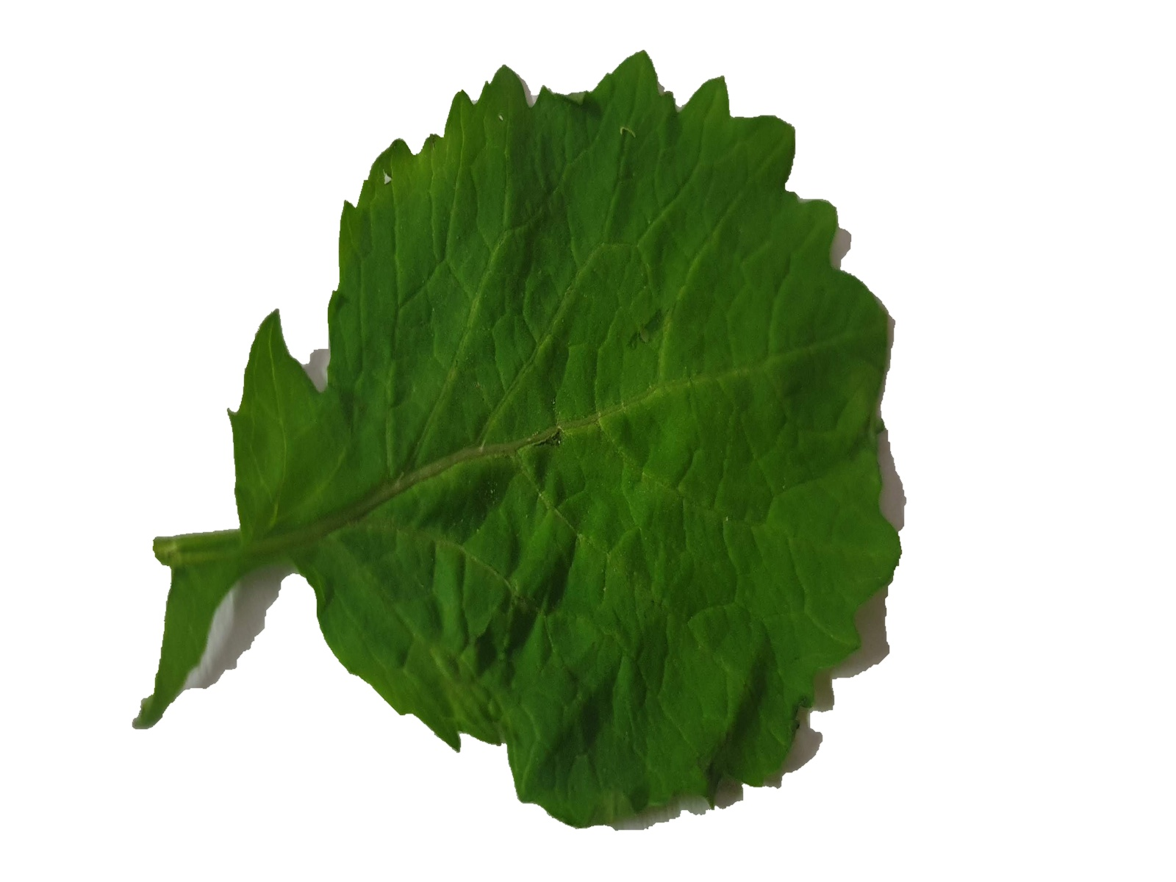
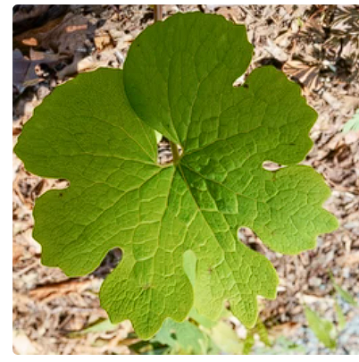
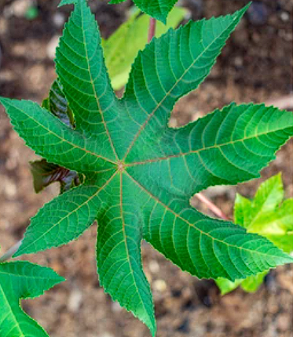
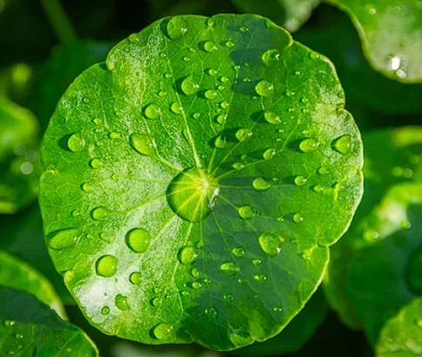
Alovera
Artemisia_Argyii
Chinese Yum
Ballon Vine
Basella_alba
Brassica_Juncea
Blood_Root
Castor
Gotukola

