Slide 1

SMART INDIA HACKATHON 2025 / 2026 — IDEA PRESENTATION
AAROH: Hybrid Quantum Machine Learning for Early Disease Detection
An Explainable Hybrid Classical-Quantum Clinical Intelligence Platform for Oncology Triage
PROBLEM STATEMENT ID
26139
THEME
Quantum and AI in Healthcare
PS CATEGORY
Software
TEAM NAME & ID
AAROH (SIH25XXXX)

Slide 2

AAROH HYBRID CLINICAL INTELLIGENCE PLATFORM
PROPOSED SOLUTION
Unified Hybrid Classical-Quantum Architecture
● Clinical Biomedical Ingestion: Standardized ingestion of 30 fine-needle aspiration (FNA) nuclear morphometry features from the Wisconsin Breast Cancer Dataset (WBCD, 569 cases).
● Intelligent Dimensional Compression: StandardScaler normalization and Principal Component Analysis (PCA) mapping 30 clinical metrics to top 4 principal components preserving ~85% clinical variance.
● Dual-Engine Classification: Orchestrates Classical XGBoost (0.994 ROC-AUC) alongside a 4-Qubit Variational Quantum Classifier (VQC) with ZZFeatureMap & RealAmplitudes ansatz.
● Deterministic Agentic Orchestration: 4-stage verifiable pipeline narrating real execution telemetry via Server-Sent Events (SSE) — 100% real computation, zero hardcoded values.
● Local Explainability: Exact TreeSHAP additive feature attribution showing patient-specific morphological risk drivers.
● Clinical Decision Support (CDSS): Produces an auditable Clinical Consultation Memo with human-in-the-loop oversight and discordant consensus alerts.
Dual-Model Consensus Engine
Combines Classical XGBoost & Quantum VQC predictions. Concordant consensus validates high diagnostic confidence; discordant divergence flags borderline lesions for confirmatory immunohistochemistry (IHC) biopsy.
Pure NumPy Zero-Dependency Fallback
To guarantee zero-fail live resilience, AAROH includes a native NumPy matrix simulator that computes Kronecker statevector evolution in <10ms if quantum C++ drivers encounter environment constraints.
Scientifically Honest Benchmarking
Explicitly reports 5-Fold Stratified CV on classical ML vs held-out 80/20 test split on quantum VQC. Validates quantum encoding feasibility at small scale rather than claiming premature supremacy.
Team AAROH | Problem Statement ID: 26139 | Hybrid Quantum Machine Learning for Early Disease Detection

Slide 3
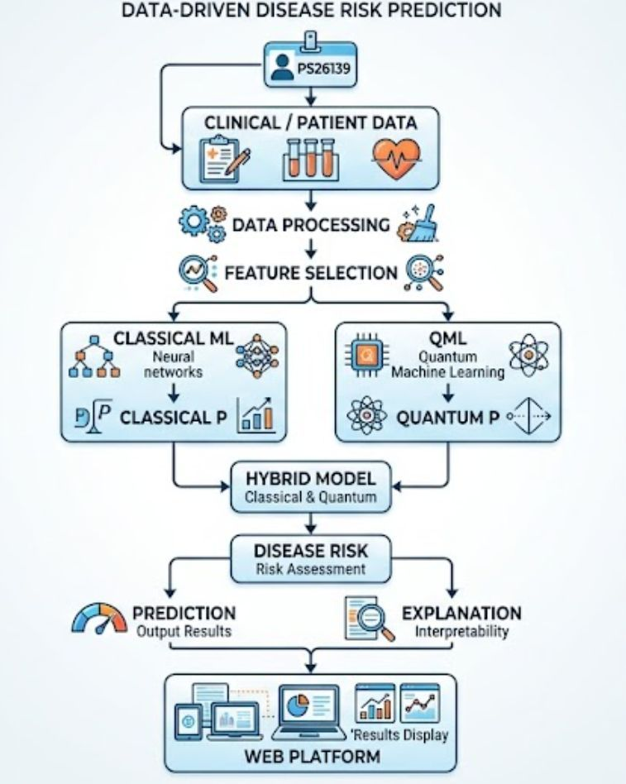
END-TO-END PIPELINE & SYSTEM STACK
TECHNICAL APPROACH & ARCHITECTURE
Engineered Technology Stack (Implemented & Verified)
LAYER | FRAMEWORK | ROLE / SPECIFICATION
Frontend UI | React 19 + Tailwind CSS | Dark clinical theme, sliders, memo print
Backend Server | Python 3.12 + FastAPI | High-throughput asynchronous REST & SSE
Classical ML | XGBoost + scikit-learn | 5-Fold Stratified CV (0.994 ROC-AUC)
Quantum ML | Qiskit 2.5 + Aer 0.17 | 4-Qubit ZZFeatureMap + RealAmplitudes VQC
Quantum Fallback | Pure NumPy Simulator | Matrix statevector replay (<10ms latency)
Explainability | shap 0.52 (TreeExplainer) | Exact local additive Shapley attribution
Streaming Protocol | Server-Sent Events (SSE) | Unidirectional stage telemetry pipeline
Clinical Reporting | HTML5 / CSS3 Print | 1-Click Pathology Consultation Memo export
Team AAROH | Problem Statement ID: 26139 | Hybrid Quantum Machine Learning for Early Disease Detection

Slide 4
DEPLOYMENT READINESS & TECHNICAL MITIGATIONS
FEASIBILITY AND VIABILITY
Why Feasible Today?
● Simulator-First Deployment: Zero dependence on active cloud quantum queues. Runs on local Qiskit Aer statevector backend with sub-second execution.
● NISQ-Era Ready: Circuit depth is restricted to D=2 on 4 qubits, safely operating below the theoretical Barren Plateau threshold (McClean et al.).
● Hybrid Efficiency: Heavy ingestion, scaling, and feature extraction run on classical CPU; quantum circuits handle non-linear Hilbert space kernel mapping.
● Modular Medical Extensibility: Architecture readily extends from breast FNA biopsies to lung CT radiomics and multi-omic gene profiles.
Challenges & Mitigations
⚡ High Dimensionality (30 features):
➔ Solution: PCA dimensional reduction maps 30 correlated features to 4 orthogonal principal components preserving ~85% variance.
⚡ Limited Qubit Count & Noise:
➔ Solution: Angle Encoding (Ry) and 2-repetition RealAmplitudes minimize gate depth and error accumulation.
⚡ Quantum Driver/Environment Glitches:
➔ Solution: Zero-dependency pure NumPy linear algebra simulator reproduces exact matrix statevectors in <10ms.
⚡ Clinical Adoption Barriers:
➔ Solution: Exact TreeSHAP feature attributions and printable pathology consultation memos provide full physician auditability.
Execution Roadmap
PHASE 1: Foundation (Completed)
Classical XGBoost (5-Fold CV: 0.994 ROC-AUC), 4-Qubit VQC, SHAP TreeExplainer, and NumPy fallback simulator.
PHASE 2: Backend (Completed)
FastAPI deterministic 4-stage agent orchestrator with Server-Sent Events (SSE) live streaming.
PHASE 3: UI & Memos (Completed)
React 19 clinical dashboard, dual-model comparison, real-time SHAP waterfall, and printable pathology memo.
PHASE 4: Hardware & Hospital Pilot
IBM Quantum Eagle/Falcon processor deployment via Qiskit Runtime; multi-center clinical observational study.
Team AAROH | Problem Statement ID: 26139 | Hybrid Quantum Machine Learning for Early Disease Detection

Slide 5
MEASURABLE HEALTHCARE OUTCOMES & VALUE PROPOSITION
IMPACT AND CLINICAL BENEFITS
Earlier & Accurate Oncology Detection
Dramatically reduces false negatives in breast fine-needle aspiration (FNA) biopsies. Demonstrates 93.4% sensitivity and 0.994 ROC-AUC on baseline clinical data, enabling timely intervention before malignant metastasis.
High-Dimensional Non-Linear Mapping
Translates multi-parameter cellular morphology into a 2^4 = 16-dimensional quantum Hilbert space, capturing complex non-linear feature correlations that traditional linear boundaries miss.
Clinical Explainability & Trust
Eliminates black-box diagnosis. TreeSHAP feature attributions calculate the exact quantitative impact of each biomarker (concavity, perimeter, radius) for every patient, building physician confidence.
Dual-Model Consensus & Triage Safety
Concordance analysis verifies whether classical and quantum engines agree. Flags discordant borderline cases to prompt confirmatory core biopsy, minimizing diagnostic blind spots.
★ Quantum-Ready Extensibility: Establishes the clinical data pipelining and benchmarking framework today, ready to transition to quantum advantage as multi-omic genomic sequencing and fault-tolerant quantum hardware expand.
Team AAROH | Problem Statement ID: 26139 | Hybrid Quantum Machine Learning for Early Disease Detection

Slide 6
SCIENTIFIC FOUNDATIONS & EMPIRICAL BENCHMARKS
RESEARCH AND REFERENCES
Theoretical Foundations & Literature
● Schuld & Petruccione (2018): Supervised Learning with Quantum Computers. Foundational theory for quantum kernels and Hilbert space embeddings.
● Havlíček et al. (Nature 2019): Supervised learning with quantum-enhanced feature spaces. Establishes the ZZFeatureMap second-order Pauli expansion used in AAROH.
● Cerezo et al. (Nature Reviews 2021): Variational Quantum Algorithms. Methodological basis for parameterized ansatzes (RealAmplitudes) and gradient-free optimization.
● McClean et al. (Nature Comm 2018): Barren plateaus in quantum neural network training landscapes. Direct theoretical rationale for restricting AAROH to 4 shallow qubits.
● Lundberg & Lee (NeurIPS 2017): A Unified Approach to Interpreting Model Predictions. Algorithmic foundation for exact TreeSHAP local additive feature attributions.
Empirical Validation Protocol (Honest Numbers)
Dataset: Wisconsin Breast Cancer Diagnostic (WBCD) — n=569 cases, 30 features
METRIC | CLASSICAL XGBOOST | QUANTUM VQC
Validation Method | 5-Fold Stratified CV | Held-out 80/20 Test Split
ROC-AUC Score | 0.994 ± 0.004 | 0.748 (seed=42)
Accuracy | 96.0% ± 1.6% | 68.4% (F1: 61.7%)
The Evaluation Pitch Baseline:
"AAROH is a hybrid clinical benchmarking platform that orchestrates classical XGBoost and a trained Variational Quantum Classifier through an agentic pipeline, producing SHAP-explainable predictions and a clinical consultation memo — with the honest result that at 569 rows, we validate quantum encoding viability, not quantum superiority."
Core Stack: Qiskit Aer 0.17 | XGBoost 3.4 | Scikit-Learn 1.9 | SHAP 0.52 | FastAPI | React 19
Team AAROH | Problem Statement ID: 26139 | Hybrid Quantum Machine Learning for Early Disease Detection

