Slide 1


Slide 2


Smart inventory and Customer Engagement System
Second Year Project Synopsis
Submitted by
ROLL | NAME
2301010041 | Riya Singh
2301010068 | Nisha
2301010020 | Aditi Saraswat
2301010029 | Vidya Jha
Industry Mentor: Mrs Suman
Faculty Mentor: Ms Lucky
Notes:
New Courses replaced with New Programmes

Slide 3
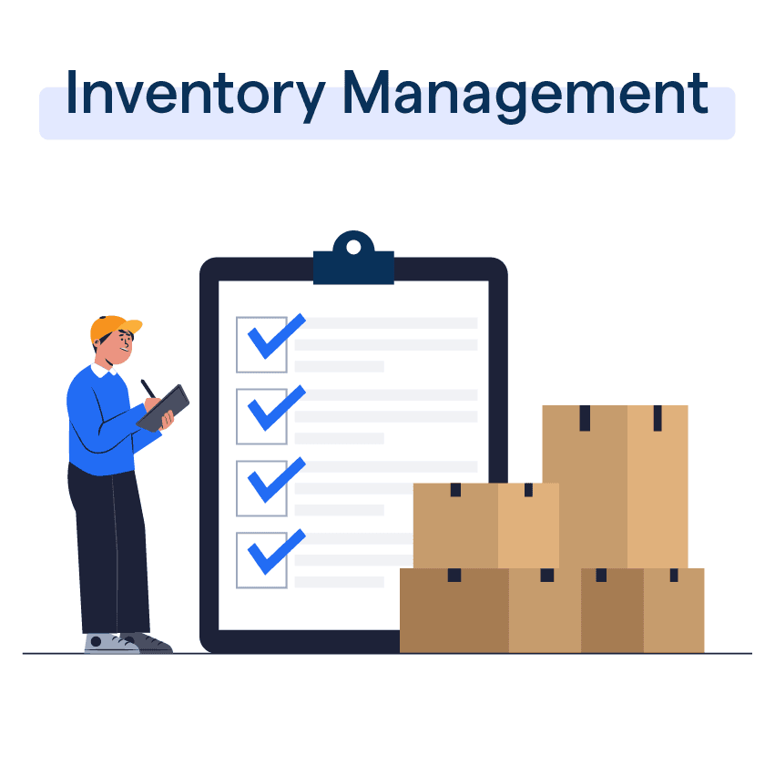

Introduction
The Smart Inventory Management System is a full-stack web application designed to simplify and automate inventory tracking.
It helps manage stock levels, suppliers, transactions, and analytics in real time.
Built with Spring Boot, React.js, and MySQL.
Notes:
New Courses replaced with New Programmes

Slide 4
About the Problem
Problems Identified 1)Small business owners struggle with manual inventory tracking, leading to stock shortages or overstocking. 2)No proper system for tracking customer loyalty and offering personalized discounts.
Issues or Problems 1)Time – consuming stock management results in inefficiencies. 2)Lack of data insights make it difficult to analyse sales trends.
Need of Solution 1)A system that helps in inventory tracking, reduces human errors, and improves decision-making is essential. 2)A loyalty program helps in increasing customer retention and sales.
Existing Solution 1)Large businesses use expensive ERP software that is not feasible for small sores. 2)Some stores use Excel sheets or paper records, which are inefficientand prone to errors.
Notes:
New Courses replaced with New Programmes

Slide 5
Problem Statement
Define the problem clearly Small business lack an integrated system to manage inventory efficiently and engage customers effectively
Why is it important? 1)Manual processes lead to errors, inefficiencies, and lost sales opportunities. 2)Improving customer engagement can significantly increase store profitability.
Expected impact of solving this problem 1)Inventory will be automatically tracked with real time updates. 2)Business owners can make data driven decisions using analytics. 3)Customer engagement will improve, leading to higher retention and revenue growth.
Notes:
New Courses replaced with New Programmes

Slide 6

Objectives
Build a user-friendly inventory platform with:
Real-time stock updates
Automated low-stock alerts
Role-based access (Admin/Manager)
Product analytics (best/worst-selling items)
Notes:
New Courses replaced with New Programmes

Slide 7
Methodology, Tools, and Techniques
Used layered architecture: Frontend, Backend, and Database
2.Technologies:
Frontend: React.js
Backend: Spring Boot (REST APIs)
Database: MySQL
3. JWT used for secure login.
Notes:
New Courses replaced with New Programmes

Slide 8
Tools, Software, and Techniques Used
Category | Technology / Tool
Frontend Development | React
Backend Development | Spring Boot (for REST APIs and business logic)
Database Management | MySQL (for structured data storage)
API Testing | Postman (for testing REST API endpoints)
Version Control | GitHub (for project collaboration and tracking)
Deployment | Firebase / AWS (for hosting and real-time database)
Data Analysis & Visualization | ReCharts(for analytics dashboard)

Slide 9
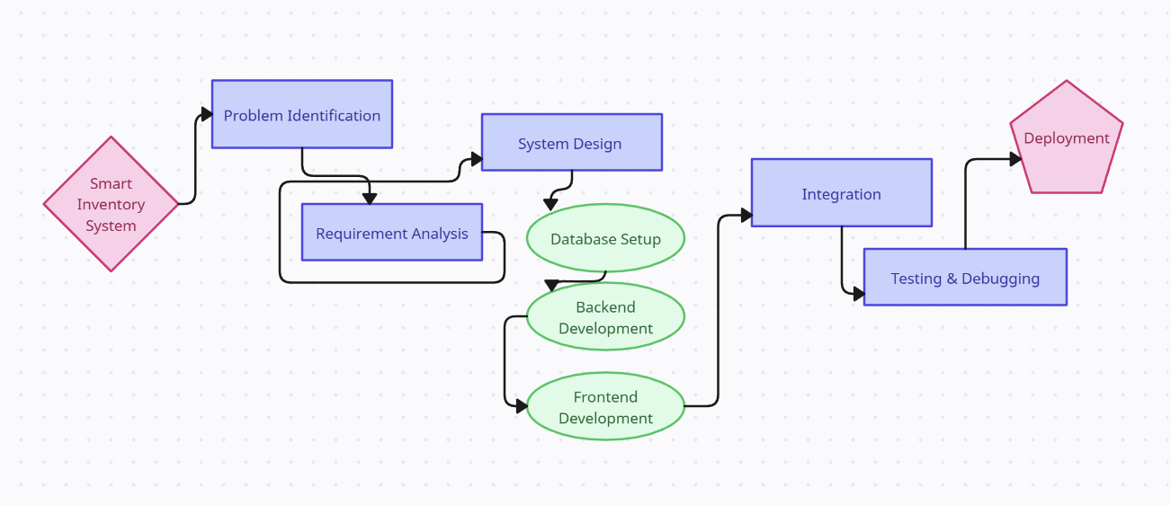
Methodology Flowchart
Notes:
New Courses replaced with New Programmes

Slide 10
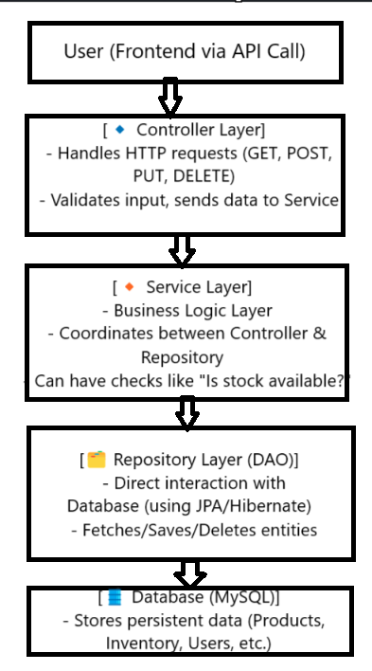
Backend Overview
Built using Spring Boot
Follows RESTful API principles
Implements DTOS, security, and
Exception Handling
Main layers:
Controller
Service
Repository
Notes:
New Courses replaced with New Programmes

Slide 11
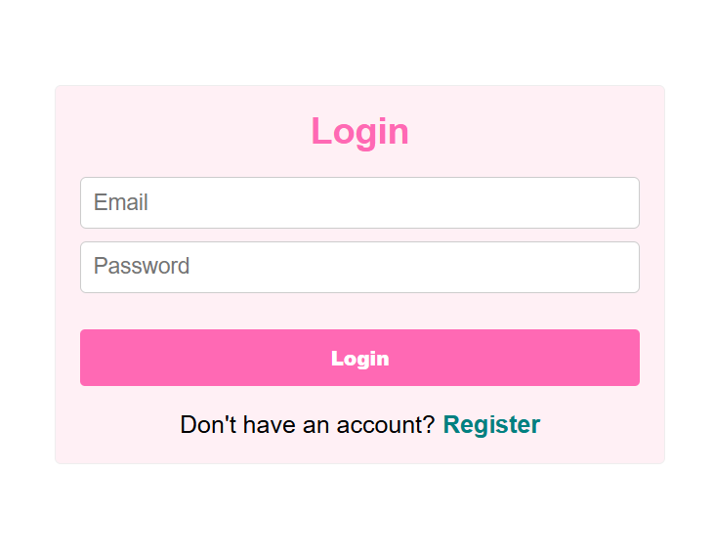
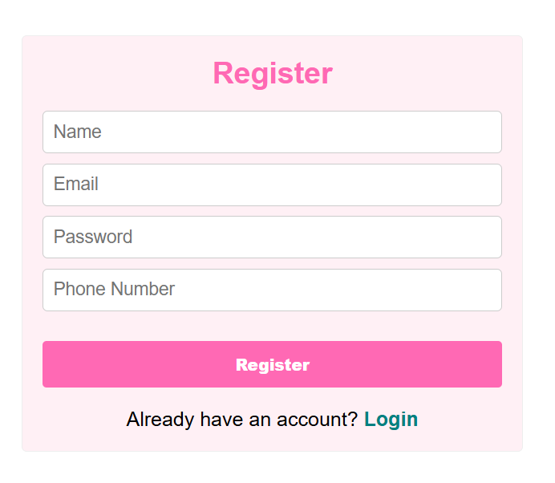
Frontend Overview
Built using React.js
Modular, responsive UI components
Communicates with backend via Axios for API calls
Organized into pages (Dashboard, Inventory, Suppliers)
Notes:
New Courses replaced with New Programmes

Slide 12
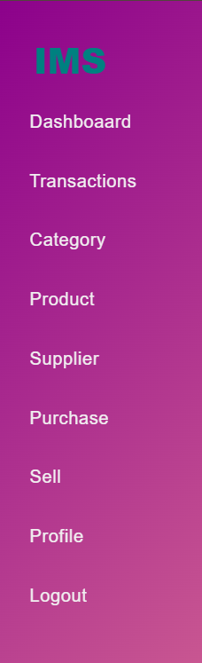
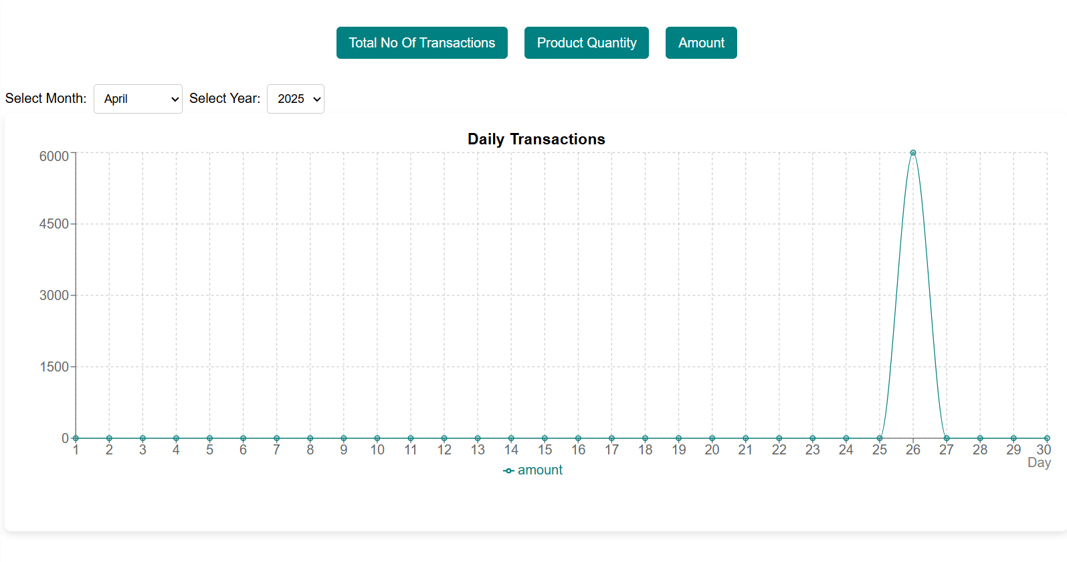
Features
Role-based Login (Admin & Manager)
Add, Edit, Delete Products
Track Inventory and Transactions
Low Stock Alerts
Sales Analysis Charts
Notes:
New Courses replaced with New Programmes

Slide 13
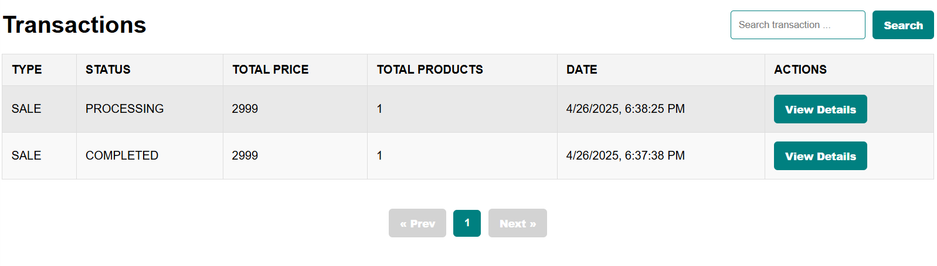
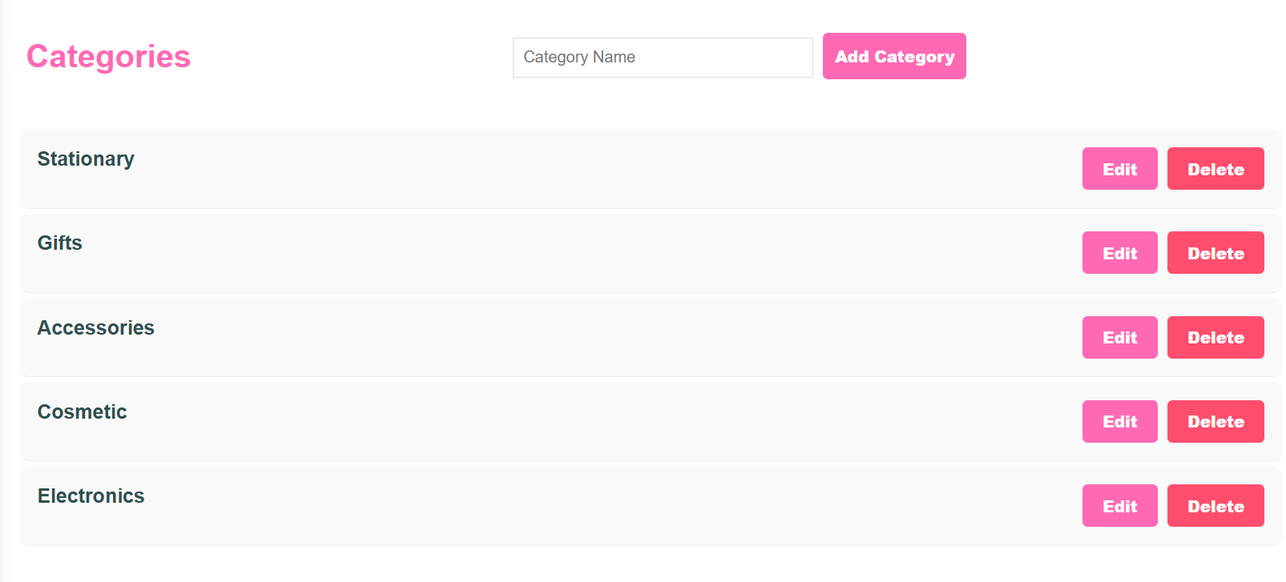
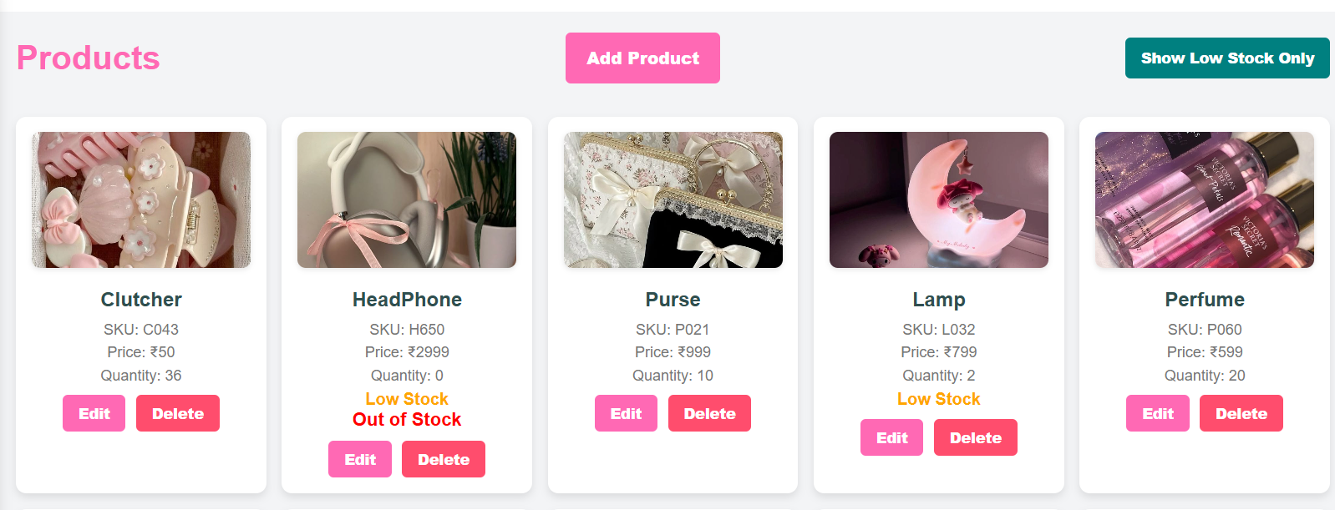

Slide 14
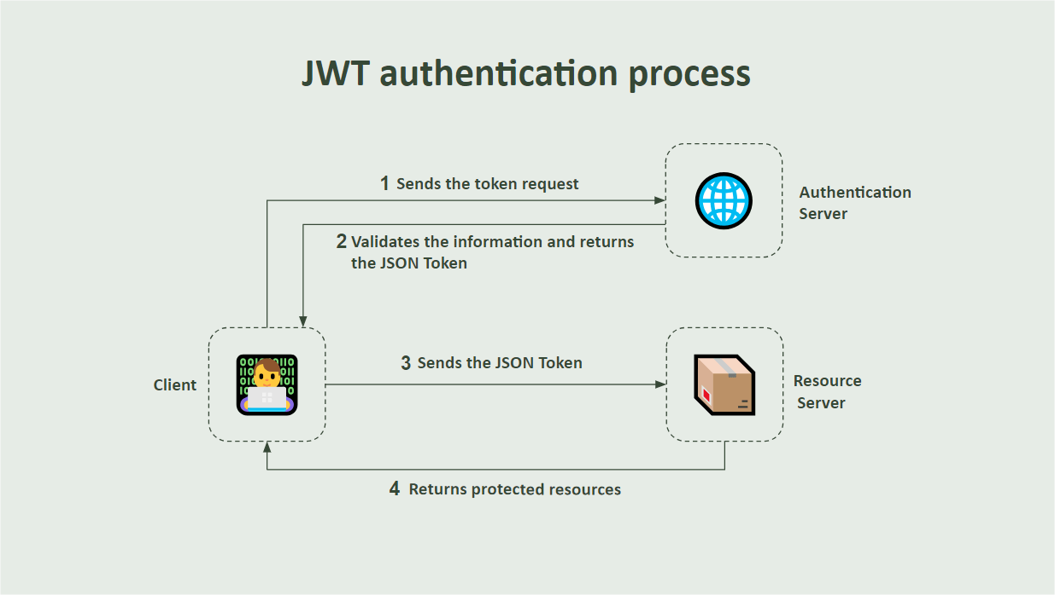
Security Measures
JWT used for secure login
Passwords encrypted using Spring Security
Role-based access:
Admin: Full control
Manager: Limited features
Notes:
New Courses replaced with New Programmes

Slide 15
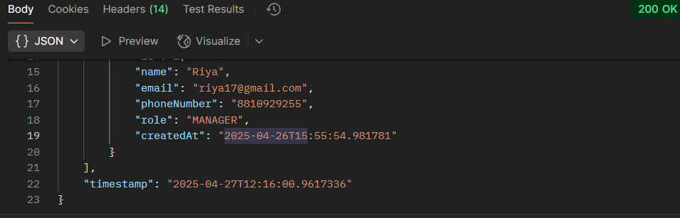
Testing
Manual and Automated Testing
Backend: JUnit Tests
Frontend: Browser-based validation
API tested using Postman
Notes:
New Courses replaced with New Programmes

Slide 16

Cloud integration for scalability
Future Scope
Real-time inventory updates via WebSockets
Mobile app version
Barcode scanning & auto-entry
Cloud integration for scalability
Notes:
New Courses replaced with New Programmes

Slide 17
THANK YOU

