Slide 1

Tailwind CSS Setup
A utility-first CSS framework packed with classes like flex, pt-4, text-center and rotate-90 that can be composed to build any design, directly in your markup.

Slide 2
What is Node.js?
Node.js is a JavaScript runtime built on Chrome's V8 engine.
It allows running JavaScript code outside a browser.
Used for backend development, APIs, and real-time applications.
Non-blocking, event-driven architecture for high performance.
Popular for full-stack development with frameworks like Express.js.

Slide 3
What is npm?
- npm (Node Package Manager) is the default package manager for Node.js.
- It allows developers to install, share, and manage dependencies.
- Provides access to a vast registry of open-source packages.
- Used to automate scripts, manage project dependencies, and build modern web apps.
- Commands: `npm install`, `npm start`, `npm run build`, etc.

Slide 4
Step 1: Initialize an npm Project
Open a terminal and create a new folder for your project.
Open the command prompt in the terminal (ctrl +`)
Run the following command to initialize an npm project:
npm init -y
This creates a `package.json` file with default settings.

Slide 5
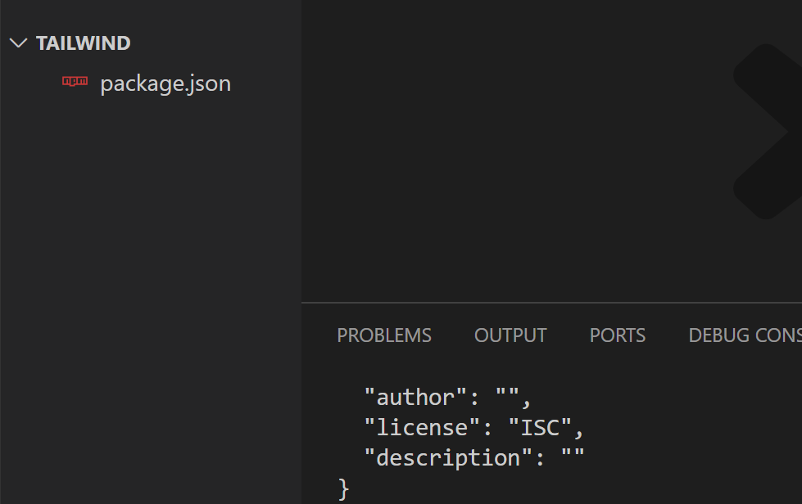

Slide 6
Step 2: Install Tailwind CSS v4
Install Tailwind CSS v4 using npm
Command:
npm install tailwindcss @tailwindcss/cli

Slide 7
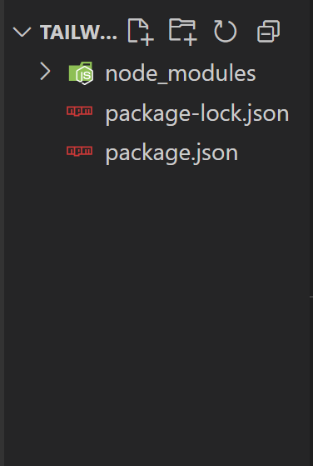
You should get the following files and folder in vs code editor

Slide 8
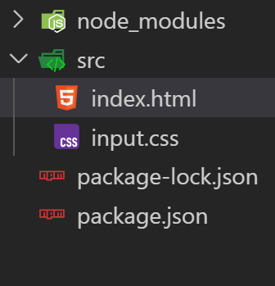
Step 3: Create a Tailwind CSS Input File
Create a folder named src and create the following files
Input.css, index.html

Slide 9
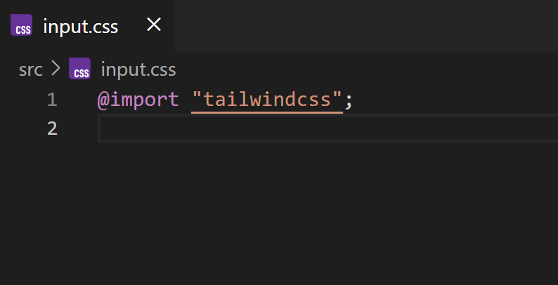
Step 4: Import tailwindcss in input.css

Slide 10
Step 5: Add a Start Script
Open the package.json file
Add a start script with the following command in it
“start”: “npx @tailwindcss/cli -i ./src/input.css -o ./src/output.css --watch”

Slide 11
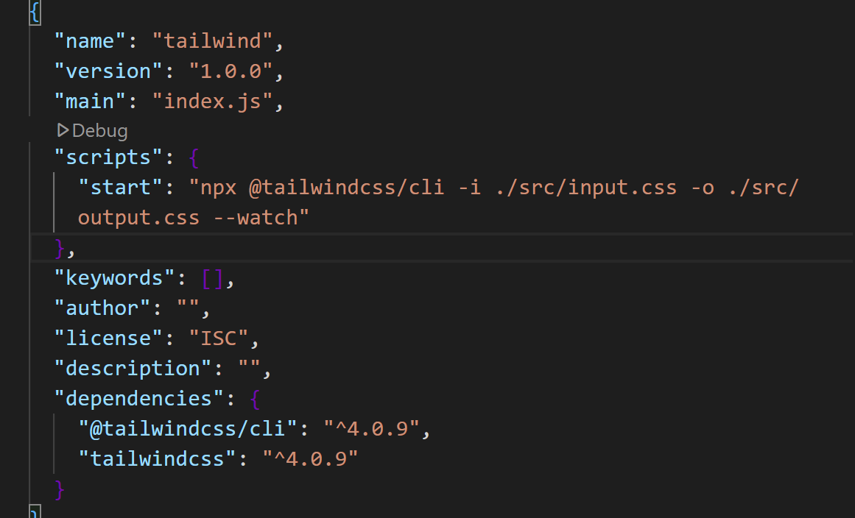
Add start inside package.json file

Slide 12
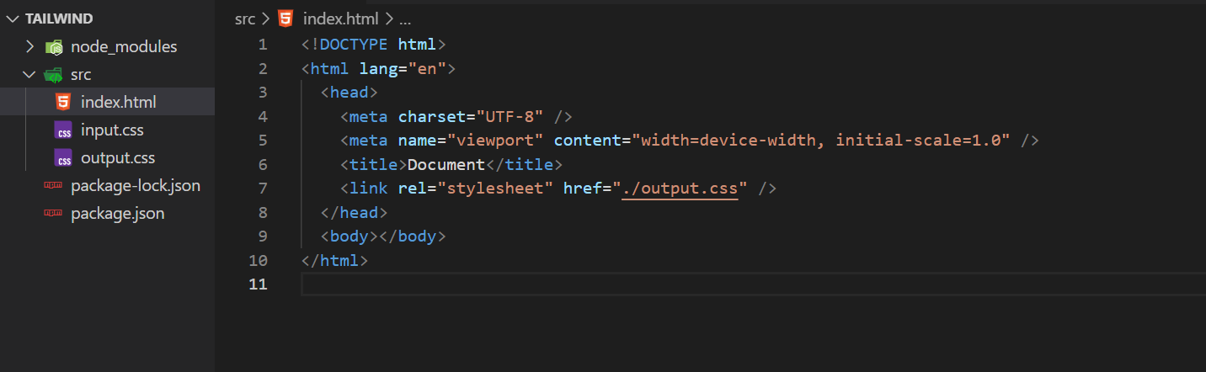
Step 6: Run Tailwind CSS
- Start the Tailwind compiler by running:
npm start
- This generates `output.css` in the src folder, which can be linked in your HTML.

Slide 13
Conclusion
- Node.js allows running JavaScript outside the browser.
- Tailwind CSS v4 can be easily set up using Tailwind CLI.
- Running `npm start` will watch and compile Tailwind styles.
- Now you are ready to build modern, responsive designs! 🚀

