Slide 1

Mini Project (BCS 554)Presentation
on
NoteLink
Supervisor:
Submitted By:
Mr. Saurabh Dwivedi
Group No : 34
Kartik Mohan (2301430100115)
Mohd Adnan Khan. (2301430100139)
Krishna Navneet Kumar (2301430100122)
Assistant Professor
Department of CSE
Kanishka (2301430100112)
Nyasa Samridhi (2301430100157)
Department of Computer Science & Engineering
IMS Engineering College, Ghaziabad
Dr. A.P.J Abdul Kalam Technical University, Lucknow (2025-26)

Slide 2
Problem Statement
Limited Learning Exposure: Students only access notes relevant to their specific institution, missing out on superior or alternative explanations available elsewhere.
Inefficient Search: Valuable resources are hard to find and verify, wasting student time.
Inconsistent Quality: No standardized platform for contribution or rating of shared content.

Slide 3
Objective
Seamless & Secure User Authentication : Allow users to register and log in quickly using Google OAuth or a Phone Number (SMS token).
Structured Note Repository : Implement a database structure that allows users to categorize notes by Subject, Course, Institution, and Year.
Secure File Upload & Storage: Enable authenticated users to upload common file types (PDF, DOCX, etc.) securely to the platform.
Advanced Search and Filtering : Develop a search API that allows users to efficiently find notes based on keywords, categories (O2), and popularity/ratings.
User Profile and Management : Provide users with a dashboard to view their uploaded notes, track downloads, and update profile information.

Slide 4
Literature Survey
[1] This study introduces NoTeeline, a real-time, personalized note-taking system enhanced by large language models (LLMs) that generate concise “micronotes” during live sessions. It improves user engagement and recall by automatically summarizing and organizing key information tailored to individual learning needs.
[2] This research presents NoteLink, a system that connects students’ handwritten notes to specific segments of instructional videos using a simple point-and-shoot interface. It enhances learning by allowing quick access to related video content directly from physical notes, bridging traditional and digital study materials.

Slide 5
Technical Details
Frontend - React (JavaScript / TypeScript)
Backend – API Node.Js with Express.Js
Styling - Talwind CSS
Database – MongoDB (NoSQL)
Authentication - Firebase Auth or Passport.Js / JWT
File Storage - Cloud Storage (AWS)

Slide 6
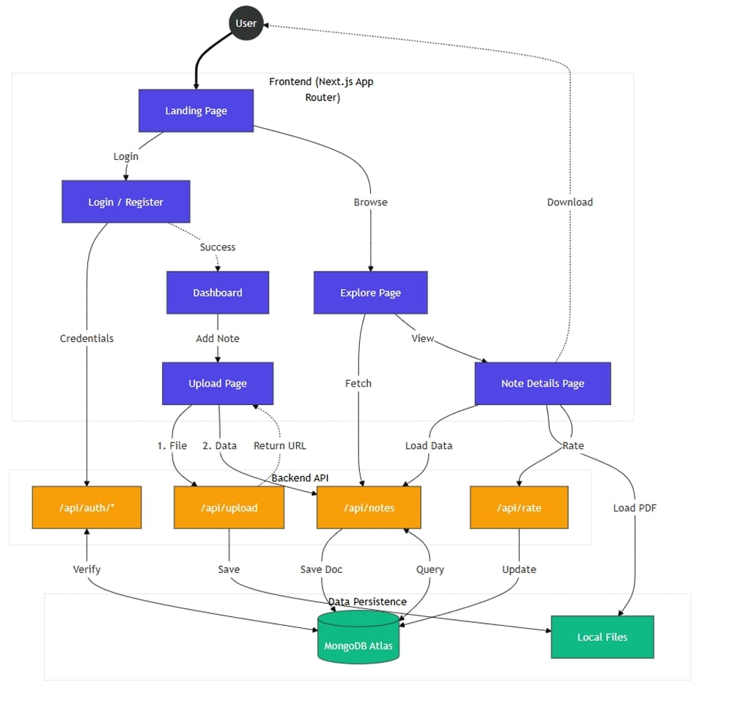
Methodology

Slide 7
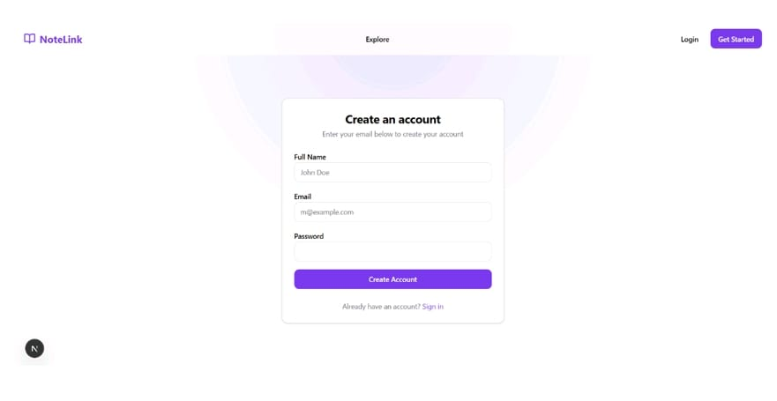
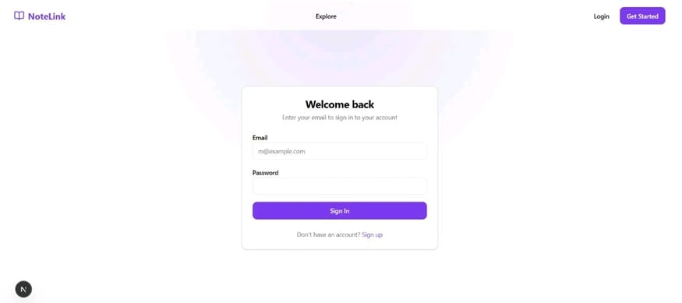
Implementation

Slide 8
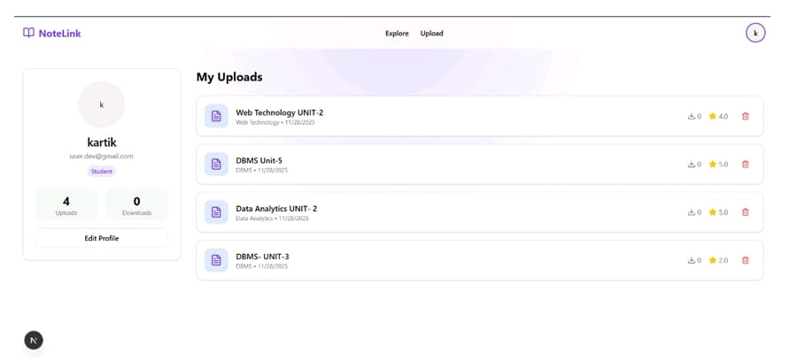
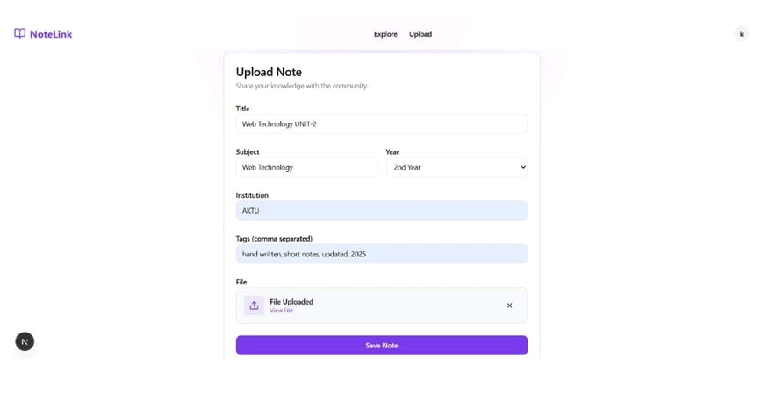
Implementation

Slide 9
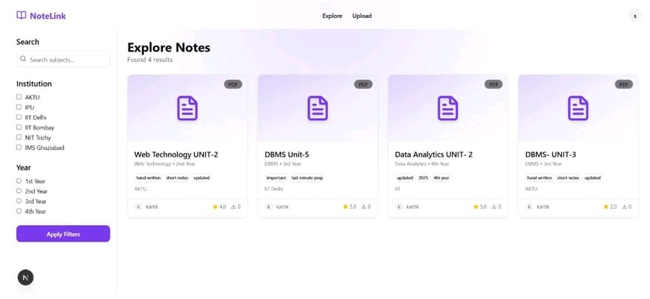
Implementation

Slide 10
References
[1]Huq, F., Samee, A., Lin, D. C. E., Tang, A. X., & Bigham, J. P. (2025, March). NoTeeline: Supporting Real-Time, Personalized Notetaking with LLM-Enhanced Micronotes. In Proceedings of the 30th International Conference on Intelligent User Interfaces (pp. 1064-1081).
[2]Srinivasa, R. J., Dodson, S., Seo, K., Yoon, D., & Fels, S. (2021, September). NoteLink: A Point-and-Shoot Linking Interface between Students' Handwritten Notebooks and Instructional Videos. In 2021 ACM/IEEE Joint Conference on Digital Libraries (JCDL) (pp. 140-149). IEEE.

