Slide 1


SMART INDIA HACKATHON 2024
Problem Statement ID – 1745
Problem Statement Title- De-anonymizing of entities on the onion sites operating on TOR Network
Theme- Blockchain & Cybersecurity
PS Category- Software/Hardware
Team ID-
Team Name (Registered on portal)- TECH GUARDIANS

Slide 2
Decrypting Anonymity Protocol
TECH
GUARDIANS
Proposed Solution
Allocating volunteer entry nodes for real time monitoring data using tools like tor whois, onionite.
Obtain cryptocurrency wallet information of operator from the suspect's computer who purchased in the illegal market (onion site).
Use blockchain explorers tools like Chainalysis to trace transaction histories and fund flows.
Using honey pot sites to trap the people who seeking for illegal information and illegal purchase from onion sites.
Obtain the confidential data by windows registry(IP log, clipboard data).
Combining the overall data from database as report for identifying the operator.

Slide 3
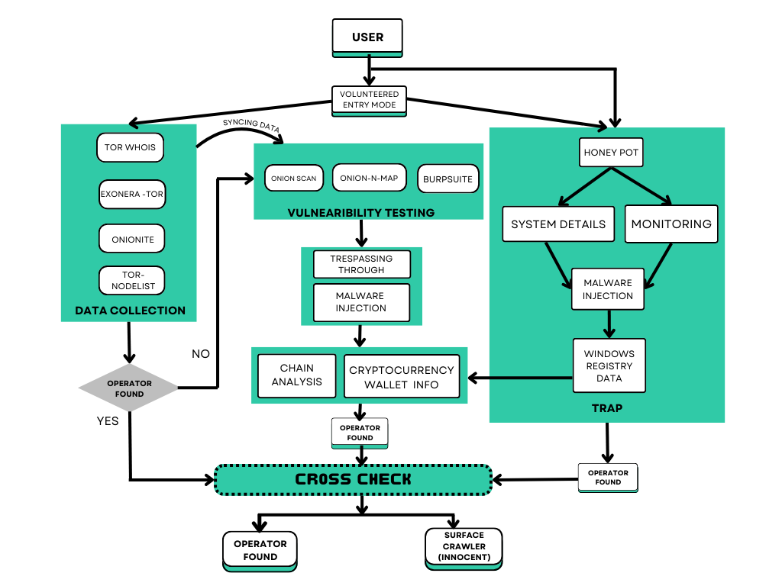
TECHNICAL APPROACH
TECH
GUARDIANS

Slide 4
FEASIBILITY AND VIABILITY
TECH
GUARDIANS
Analysis of the feasibility of the idea
Technical Feasibility: coordination among various tools and methods.
Blockchain Explorers:; widely used and accessible to track the flow of cryptocurrency.
Potential challenges and risks
Complexity: Integrating and managing a number of different tools and data sources is technically challenging.
Risk: Misinterpretation of data, technical failings, or misidentifications.
How to overcome these challenges:
Integration complexity: Streamline the integration of tools and data sources.
Automated Error Checking: Use real-time monitoring systems for timely identification and resolution of any technical failures or discrepancies.
Misidentification: Implement validation checks and cross-reference data from multiple sources to ensure accuracy.

Slide 5
IMPACT AND BENEFITS
TECH
GUARDIANS
Law Enforcement Agencies (LEAs)
Enhanced Investigation Techniques: Identifies suspects via IP addresses.
Improved Evidence Collection: Strengthens prosecutions.
Cybersecurity Professionals
Advanced Threat Detection: Enhances threat response.
Knowledge Enhancement: Boosts expertise and security.
Benefits of the Solution
Deters crime and boosts online safety.
Reduces workload of cybercrime.
Optimizes resource use and supports sustainability.

Slide 6
TECH
GUARDIANS
Details / Links of the reference and research work
https://github.com/dms-codes/ipvoid-com-find-ip
https://youtu.be/dXqD_jUwEGU
https://youtu.be/GR_U0G-QGA0
https://check.torproject.org/torbulkexitlist
https://hackertarget.com/tor-exit-node-visualization
https://github.com/danieleperera/OnionIngestor
https://github.com/DedSecInside/TorBot
https://github.com/k4m4/onioff
https://onionscan.org/
https://github.com/danieleperera/OnionIngestor

Slide 7
IMPORTANT INSTRUCTIONS
Please ensure below pointers are met while submitting the Idea PPT:
Kindly keep the maximum slides limit up to six (6). ( Including the title slide)
Try to avoid paragraphs and post your idea in points /diagrams / Infographics /pictures
Keep your explanation precise and easy to understand
Idea should be unique and novel.
You can only use provided template for making the PPT without changing the idea details pointers (mentioned in previous slides).
You need to save the file in PDF and upload the same on portal. No PPT, Word Doc or any other format will be supported.
Note - You can delete this slide (Important Pointers) when you upload the details of your idea on SIH portal.

