Slide 1
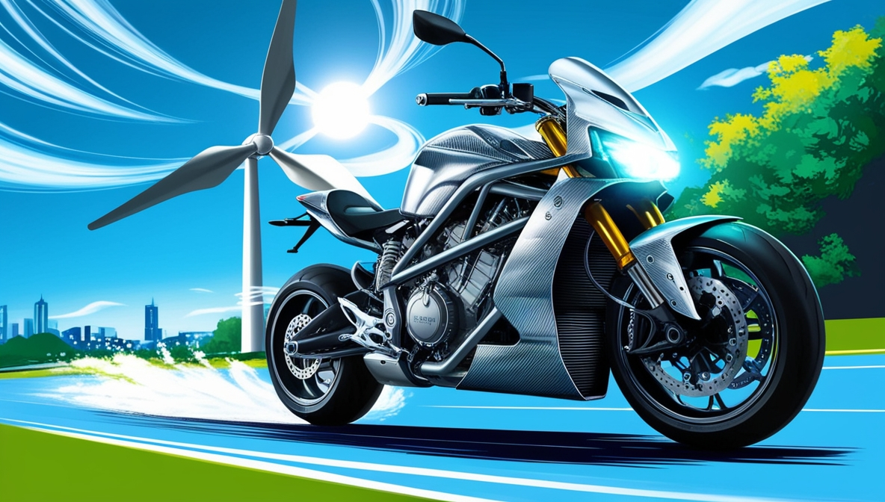
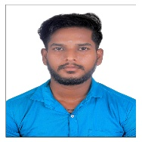



Wind Regenerative System for EV Charging Using Air Pressure
Author 1
Photo
Author 2
Photo
Author 3
Photo
Author 4
Photo
Vasanthan
ThiruKumaran
GuruPrasath
Yogesh
Sri Venkateshwaraa College of Engineering And Technology
Puducherry
Saranya Vadivelu

Slide 2
Challenge Statement
How might we efficiently integrate turbine systems into vehicles to generate electricity without compromising vehicle performance, aerodynamics, or energy efficiency, while harnessing waste energy from natural airflow, mechanical motion, or underutilized systems

Slide 3
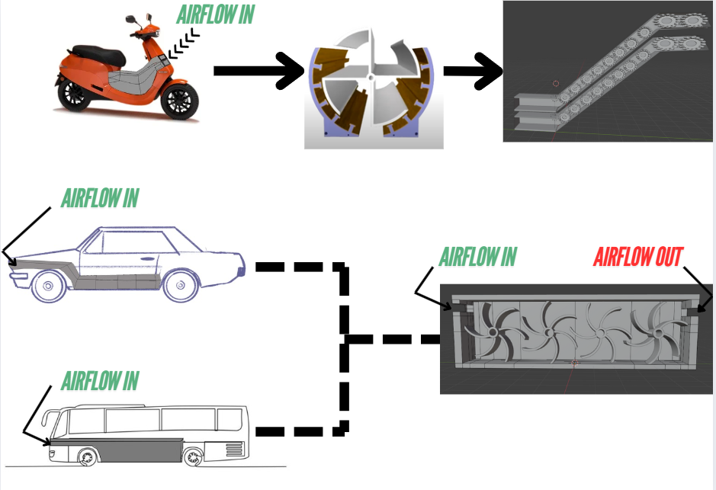
Concept / Solution

Slide 4
Pros and Cons of the solution
Pros
Cons
. Energy Recovery
Turbines can help harness wasted kinetic energy or airflow to generate electricity, particularly when vehicles are moving at high speeds.
implementation on electric scooters or EVs, the recovered energy can recharge the battery, increasing range.
2. Eco-friendly Solution
By producing electricity from renewable motion or wind (aerodynamic drag), it promotes sustainable energy.
Reduces dependence on external power sources for electric vehicles.
3. Extended Battery Life
recharging the batteries while driving reduces the frequency of charging stations usage.
4. Innovative Hybrid Systems
Adding turbines as auxiliary power sources allows a vehicle to operate in hybrid mode, combining traditional batteries and turbine-generated electricity.
5. Useful During High Speeds
Vehicles moving on highways or in consistent motion (e.g., scooters, buses, or cars) produce more wind or mechanical force, making the turbines more efficient.
1. Increased Aerodynamic Drag
For air turbines mounted externally (on buses or cars), wind resistance increases, negatively impacting fuel efficiency or energy consumption restricting vechiles free movement.
2. Added Weight and Complexity
Introducing turbines adds weight to the vehicle and increases mechanical complexity, which might offset the energy gains.
For lightweight vehicles (e.g., scooters), the extra load can reduce performance.
3. Inefficiency at Low Speeds
Turbines require consistent airflow or motion. At low speeds or idle stops, the turbines would generate little to no power.
For city traffic, with frequent stopping, turbines might not be effective.
4. Cost of Implementation
Manufacturing and installing turbines might increase vehicle costs.
Maintenance and repairs for turbines add to the long-term cost burden.
5. Energy Loss (Not Perpetual Motion)
Due to the laws of thermodynamics, extracting energy via turbines might draw power from the main system, making vehicles work harder and negating benefits.
Systems aren't 100% efficient, and energy loss in the process might outweigh the gains.

Slide 5
Technical Description
Turbine Design
Turbine Blades: Multi-bladed turbines are shown, designed to capture maximum airflow while minimizing energy loss and drag.
Arrangement:
In the image, turbines are placed in series within a linear duct or frame, allowing airflow to pass through multiple blades sequentially.
These can be used under vehicle bodies where airflow is concentrated through channels.
Placement and Implementation
For two-wheelers (e.g., scooter): The turbine can be installed just above the battery Compartment at which airflow can be made to pass through chambers.
For buses and cars: Larger turbines can be integrated into undercarriages, or through ducts in strategic zones where airflow or vehicle motion generates natural turbulence.
A multi-turbine array, as depicted in the image, maximizes energy recovery over a larger airflow area.
Energy Capture Mechanism
The spinning turbines convert mechanical rotational energy into electricity through attached generators.
Small-scale alternators are linked to turbines to produce low-voltage output, which can charge auxiliary batteries, capacitors, or power onboard electrical systems such as lights, sensors, and fans.

Slide 6
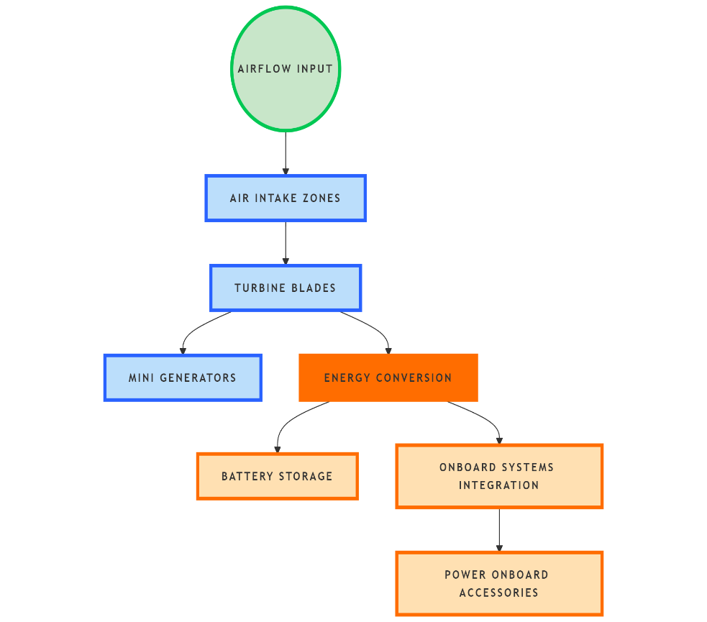
Implementation Plan
Feasibility Study:
Analyze high-velocity airflow zones in vehicles
Define energy targets based on system requirements.
Design & Prototyping:
Turbine blade design (3D modeling + CFD simulation).
Identify optimal placement for minimal drag.
Build lightweight prototypes with generators.
System Integration:
Connect turbines to mini generators for electricity conversion.
Integrate output into batteries or systems via regulators.
Add sensors for real-time performance monitoring.
Testing & Optimization:
Wind tunnel & on-road testing to validate power output.
Refine blade design, placement, and efficiency.
Scaling & Deployment:
Modular components for scooters, cars, and buses.
Pilot trials for real-world validation.
Market as a sustainability-focused product.

Slide 7
Validation / Testing / Analysis
Wind Tunnel Testing:
Test turbine prototypes under controlled airflow to evaluate performance at different wind speeds.
Measure power output, efficiency, and drag forces.
Optimize blade design and turbine placement based on results.
On-Road Testing:
Install prototypes on test vehicles (e.g., electric scooters, buses).
Measure real-world performance in different conditions (highways, city traffic, idle stops).
Analyze data for:
Power generated (kWh).
Energy recovery efficiency (%).
Impact on vehicle aerodynamics and fuel/electric efficiency.
Evaluate performance across speeds:
Highway speeds: Maximum airflow utilization.
Low speeds: Analyze inefficiencies and energy outputs.
Performance Optimization:
Refine blade shape, material, and placement to maximize energy recovery while minimizing drag.
Use control systems to activate turbines only during high-speed conditions to avoid energy loss at low speeds.

Slide 8
Cost Estimate
Item | Unit Cost (INR) | Notes
Turbine + Mounts | ₹5,000 – ₹20,500 | Lightweight, scalable design
Micro-generator | ₹6,500 – ₹25,900 | Compact, efficient design
Electronics & Wiring | ₹4,300 – ₹10,900 | Controllers, voltage stabilizers
Integration | ₹6,300 – ₹12,600 | Labor + vehicle adaptation cost
Total Per Unit | ₹22,300 – ₹67,900 | Cost reduces with scale (~20% drop)

Slide 9
Assumptions
Vehicle Motion and Airflow
Vehicles will frequently travel at moderate to high speeds (e.g., highways), providing sufficient airflow to drive turbines efficiently.
Airflow can be channeled and concentrated through undercarriages or designated ducts to maximize turbine performance.
Aerodynamic Efficiency
The turbine system’s design and placement will minimize aerodynamic drag, ensuring energy losses are negligible compared to the energy recovered.
Power Generation and Use
Recovered energy will primarily power auxiliary systems (e.g., lights, sensors, fans) or partially recharge batteries, enhancing overall vehicle energy efficiency.
Turbine efficiency will be higher at high speeds, with limited performance at low speeds or stops.
Weight and Material Considerations
The system will use lightweight, durable materials (e.g., carbon fiber, aluminum) to avoid significant weight addition.
Turbine installation will fit into available vehicle zones (e.g., undercarriages, battery compartments) without compromising structure or safety.
Environmental Durability
Turbines will function reliably under real-world conditions such as temperature variations, rain, dust, and road debris with minimal maintenance needs.
Economic Viability
Costs of manufacturing and installation will be balanced by long-term benefits like improved energy efficiency and sustainability.
Testing and Optimization
Advanced tools like CFD simulations and wind tunnel testing will validate system design and performance across real-world driving conditions.

Slide 10
References
Electromagnetic suspension : https://nevonprojects.com/power-generation-using-electromagnetic-suspension/
https://sustainenergyres.springeropen.com/articles/10.1186/s40807-020-00062-7
https://www.sciencedirect.com/science/article/abs/pii/S2213138822002910

