Slide 1

Math-E-Manifesto

Slide 2
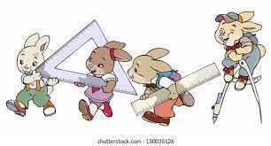

















Mathematics with Engineering drawing
Name – Sandeep Reddy

Slide 3
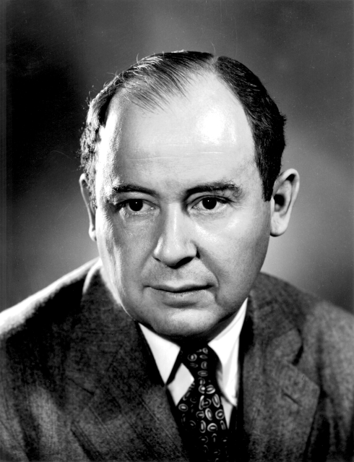
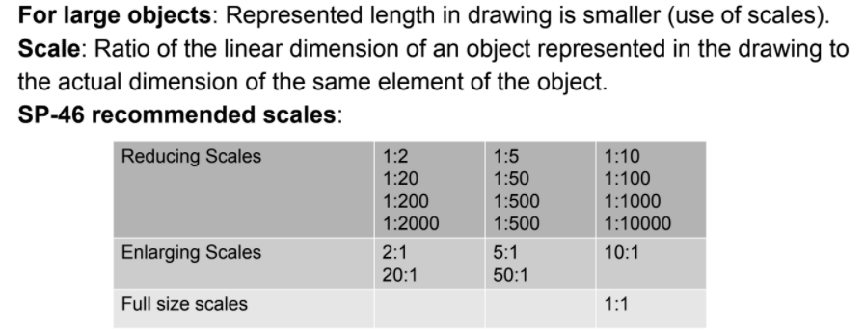
John von Neumann : "If people do not believe that mathematics is simple, it is only because they do not realize how complicated life is."
From this we can See that people are trying to make things as simple as possible using tools like mathematics. And one of the branches of mathematics is geometry , and if we slightly extend this we might relate to ENGINEERING DRAWING which is helping and helps us in many ways.
The complexity of solution in many problems of math can be decreased with the help of engineering drawing. Especially if we are dealing with huge dimensions ( mountains, roads, cables , railway tracks in practical purposes ) this will be helping a lot to visualize and get approximate data. An engineering drawing is a type of technical drawing that is used to convey information of different objects shapes etc.
D

Slide 4
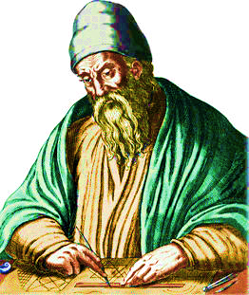
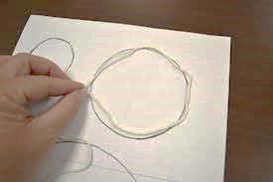
There is no place in Euclid where he talks about the length of anything but a line segment. We know now that this in fact potentially a very difficult matter, because there are continuous bounded curves which we have deal with.
The simple curve which we deal most common in mathematics is circle. We know that circumference of a circle is given by formulae 2πr ( r is radius of circle and π= 22/7 ). If we go to the very basic level, if we orient a thread along the circumference of circle and measure the length of thread we will get the circumference of circle approximately. It is obvious that in practical aligning a thread along the circumference of a circle is not so easy task, it is only a basic example of using drawing

Slide 5
.
A
Lets say, If the angle is 30 degrees in a right angled triangle then we can get length of the sides by solving 50cos(30°) and 50 sin(30°) . Since 30° is standard angle we can easily get the values.
50sin(30°)=25
50 CM
30°
B
C
50cos(30°)≈43.3
A
If we have the angle 23° , we don’t know the value of cos(23°) and sin(23°) since 23° is not the standard angle, so we may have to use electronic device or follow a sequence of complex steps to find the values.
50 CM
50sin(23°)=?
23°
C
B
50cos(23°)= ?
A
50 CM
But with help of drawing we can easily get the length of sides of triangle with construction, with the help of protractor, compass and ruler.
19.5
23°
B
C
46

Slide 6
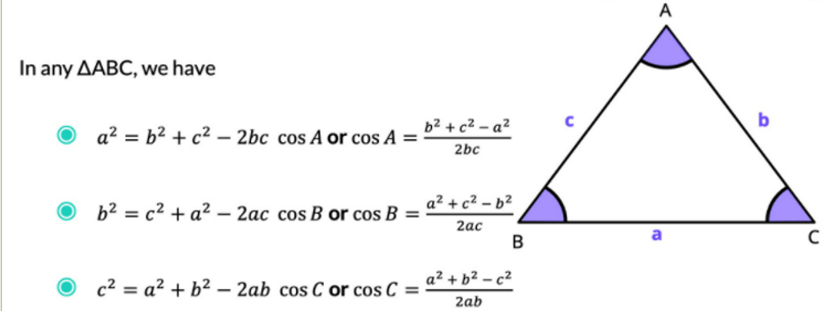
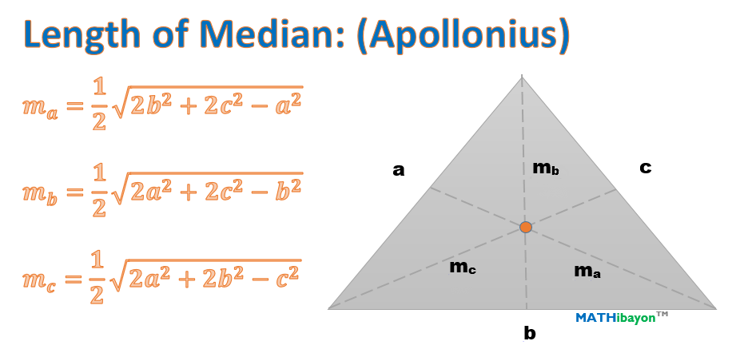
We can find angles if sides ae given and vice versa
We can easily get the length of the side ( which is not given ) with the help of drawing if we are given with 2 sides and the angle between the given 2 sides which we do by cosine theorem.
We can get the length of altitudes, medians, circumradius, inradius etc.. Very easily by construction without applying formulae.
We can extend this type of calulation in hexagons and polygons etc which are few problems in maths

Slide 7

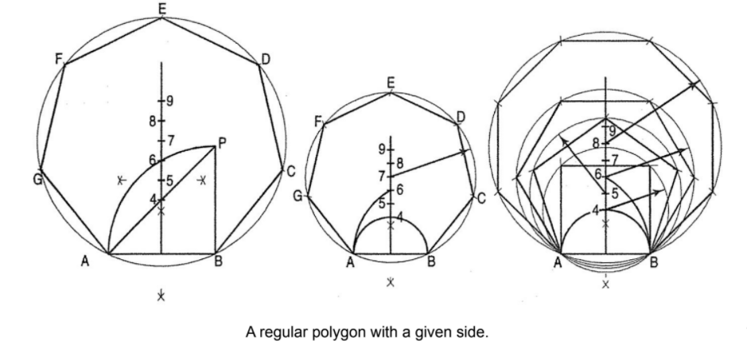
This technique can be extended to polygons, solid visualization which will be helping in math.
An example if the length of a side of a regular polygon is given we can construct circumcircle and hence get the circumradius.
If the length of the sides of the polygon is s, The circumradius Rc = (s/2) sec [90(n-2)/n].

Slide 8
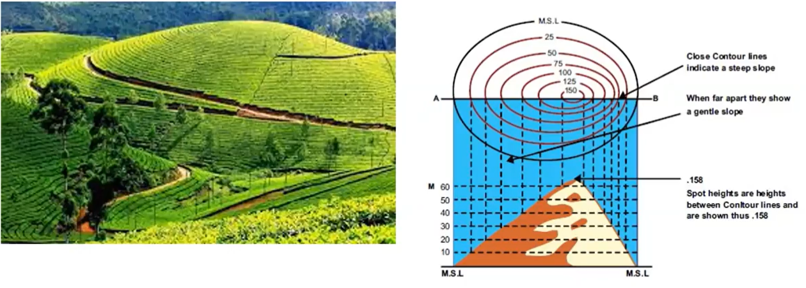
Area of cultivation of TEA ESTATE
With the help of orthographic projection in engineering drawing we can draw front view and top view on piece of paper we can draw contour lines ( lines having same altitude usually measured from mean sea level (MSL) )we can get the area of cultivation ( like tea ) which is very difficult by math ( by integration )

Slide 9
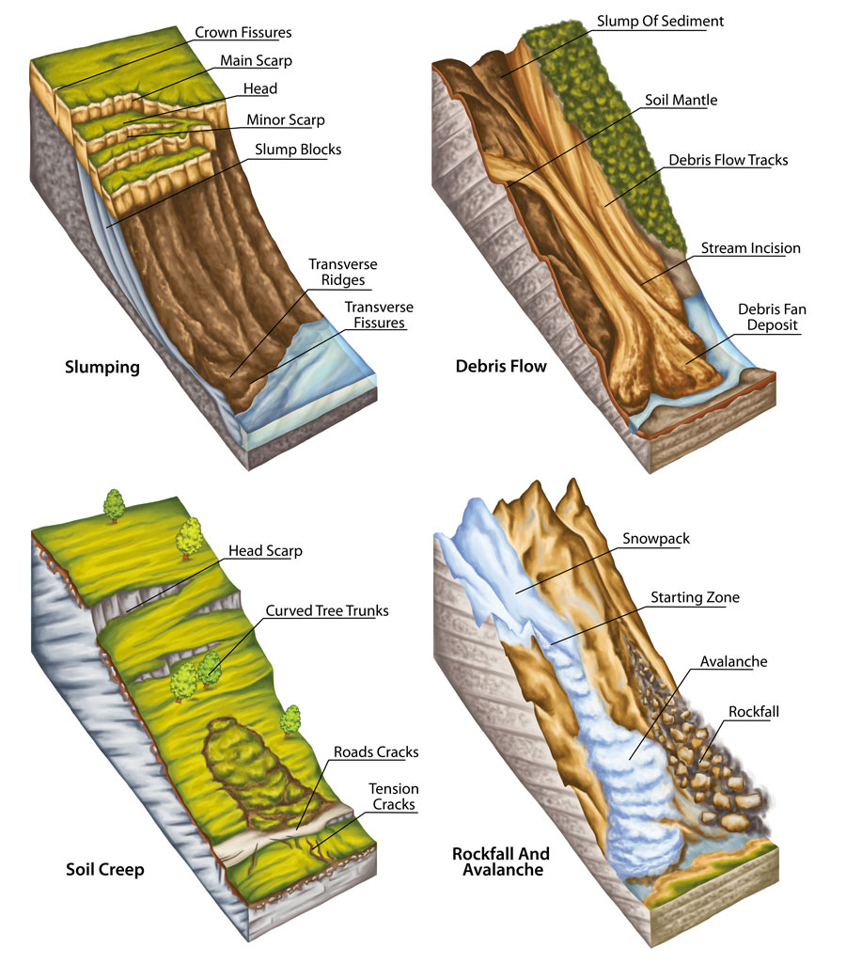
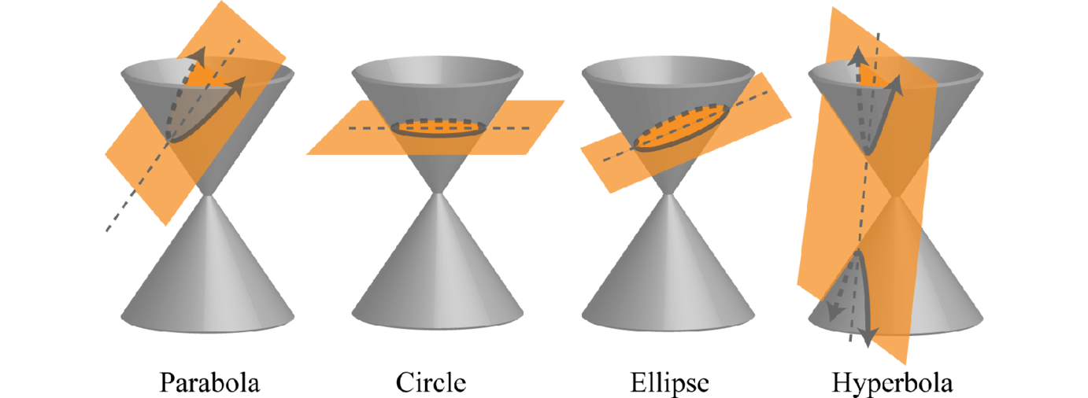
Land slides
Sectional views is one of the topics which helps us to visualize the removed part, and calculate the portion of mountain or hill which is remaining.

Slide 10
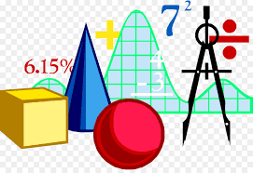

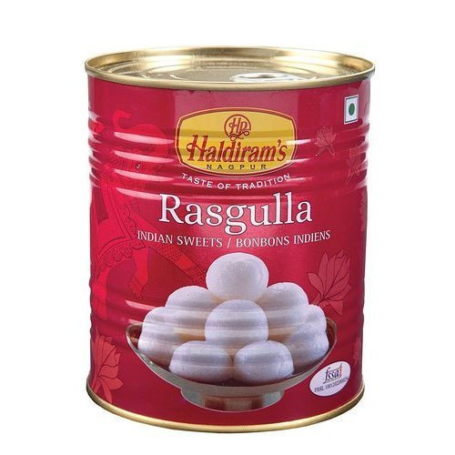

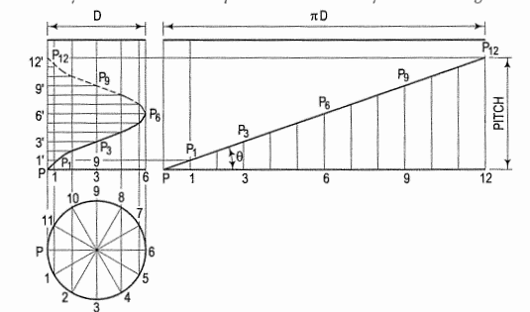

Shortest distance between two points , lines
In math we usually deal with the problems shortest distance between 2 lines or 2 points.
It is very obvious if the 2 points are on flat surface, the shortest distance between them is length of line connecting the two points. But it is not the case when the 2 points are on curved surface. Here engineering drawing helps us to track the trajectory of shortest distance between these points .
If we consider a cylindrical sweet tin containing a hole at the top, the ant at the bottom will try to go near the hole. Of course the ant wishes to go near the hole as soon as possible. It is possible by choosing shortest possible path from initial position to the hole. And it is not the straight line since both the points are on curved surface (cylinder). The trajectory will be a kind of helix which can tracked by engineering curves.

Slide 11
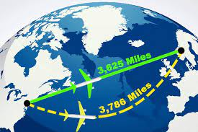

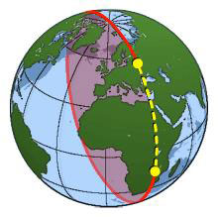
Airways
If we assume earth as a sphere, then shortest distance any two points on earth is not the straight line joining them, these can be extended practical scenario where two places are connected by airways.
Choosing shortest path is very important in the case of airways, to save time, expenses and fuel (energy). The shortest distance between any two points on the surface of a sphere is called the Great Circle, a part of which is shown in the diagram as a dashed line. This circle is concentric with the center of the sphere. These can be tracked by engineering curves and also sectional views of sphere.

Slide 12

“ One thing Engineering Drawing has taught me is seeing life from different perspectives” – from Saahitya (literally means literature in Sanskrit)
THE END

