Slide 1
COMP4004
Week 1: Introduction to Programming
Arantza Aldea and David Sutton

Slide 2
Programming Languages and Python

Slide 3
Computer Programs
Programs must be analytically correct
Programs rarely work the first time they are programmed.
Programmers must perform the following on a continual basis:
  analyse
  experiment
  correct
  Redesign
Programming languages have strict rules, known as syntax, that must be carefully followed.

Slide 4
Programming Languages
Common Language Elements
There are some concepts that are common to virtually all programming languages
Common concepts:
  Key words
  Operators
  Punctuation
  Programmer-defined identifiers
  Strict syntactic rules.

Slide 5
The Python Programming Language
Simple and easy to use
Powerful
Object-Oriented
Platform-independent ("write once, run anywhere")
Rich library (packages)
Interaction with other languages
Free and Open source

Slide 6
Variables

Slide 7
Variable Naming - Guidelines
Variables are used to store information.
We have a lot of freedom in choosing the names but:
  A variable name can only contain numbers, letters and underscores
  A variable name cannot begin with a number
  A variable name cannot contain blank spaces
Choose descriptive names
  Average_height √
  abc ×
Be aware of name length
  highest_value √
  theHighestValueThatHasBeenEnteredSoFar ×

Slide 8

First Programming Problem
Can I write a program that reads a person's weight and height and outputs their body-mass index (weight divided by height squared)?
We will start looking at this problem in this week’s classes, and resolve it completely in the week 2 class.

Slide 9
Solving Problem #1 (BMI Calculation)
We need a program that allows the user to enter their weight (in kg), and their height (cm) and which will then output their BMI, calculate as weight/(height/100) ²
This requires us to
  Design and code the program
  Test the program

Slide 10
Design and Coding
We need a program that will
  Allow the user to enter their weight and height
  Calculate and output the corresponding BMI.
There are many programming languages that we could use to code this program, but the one we will use in this module is Python.

Slide 11
Simplifying Problems
Problem Solving and Programming Tip #1
If you are faced with a complex problem, it often helps to find a simpler version of the same problem and solve that instead, then see if your solution to the simpler problem will help you to solve the more complex one.
In this context the word “complex” is relative. A programming problem that is simple for an experienced programmer may well be complex for a novice.

Slide 12
Simplifying the BMI Problem
If we wanted to simplify the problem of writing our BMI program there are a number of things we could do:
Rather than allowing the user to enter their weight and height, we could simply calculate the BMI for a particular weight and height, for example 78 kg and 169 cm. This is the simplified version we shall address first.

Slide 13
The BMI Program in Python (Simplified)
This is an assignment statement. The value 78 is assigned to the variable weight.
weight = 78
height = 169
bmi = weight/(height/100)**2
print('Your BMI is ', bmi)
Once a variable has been assigned a value, it can appear on the right-hand side of an assignment statement
This is an output statement. When it is executed the text ‘Your BMI is’ is shown to the user, followed by the value of the variable bmi

Slide 14
Assignment Statements
The right hand side of an assignment statement is an expression. This is some combination of numbers, operators, and variables that has a value.
The left hand side of an assignment statement is a variable.*
bmi = weight/(height/100)**2
* Or more generally the left hand side is something to which we can assign a value. Later in the semester we will meet other things that fit this description.

Slide 15
Naming Variables
Problem Solving and Programming Tip #2
Give variables names that tell the reader how they are used in a program.
It is usually not a good idea to use single characters as variable names. The program we have been looking at in the last few slides would probably be understandable if we had used w and h as variable names rather than weight and height, but if the program was longer, readers might find it hard to work out whether w describe a weight, or some other quantity that began with 'w'.
(There are some circumstances where a single character variable name might be acceptable, and we will meet them later in the module.)

Slide 16
Arithmetic in Python
Python expressions may contain the following arithmetic operators:
+ | Addition
- | Subtraction
* | Multiplication
/ | Division
** | Exponentiation (i.e. raising one number to the power of another)
// | Floor division (divide two numbers and round the result down)
% | Modulus (remainder after one number is divided by another)

Slide 17
Floor Division and Modulus
The operator // divides one number by another and then rounds down to the nearest integer. This sometimes described as floor division.
Example: 17//5 will evaluate to 3, whereas 17/5 evaluates to 3.4
The operator % calculates the remainder after one number is (floor) divided by another.
Example: 28%12 evaluates to 4 and 28//12 evaluates to 2 because 12 goes 2 times into 28, with remainder 4.

Slide 18
Types and Input Statements

Slide 19
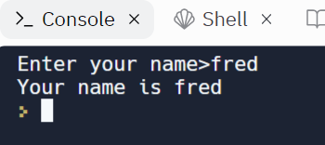
Input Statements
The input function allows us to write an expression whose value is whatever the user types in response to the prompt
This is a prompt that will be displayed to the user
answer = input('Enter your name>')
print('Your name is ', answer)

Slide 20
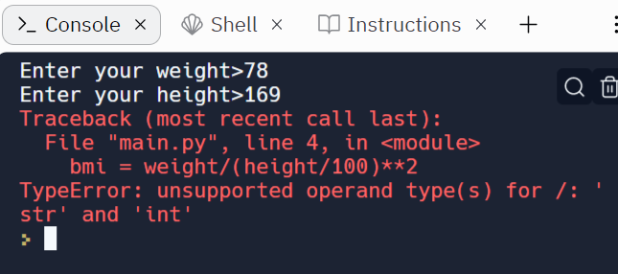
An INCORRECT Version of the BMI Program
weight = input('Enter your weight>')
height = input('Enter your height>')
bmi = weight/(height/100)**2
print('Your BMI is ', bmi)
Running the program produces this!

Slide 21
Types in Python
The reason why the program on the previous slide did not work is that expressions in Python have a type as well as a value
This expression is of type str. This means that if the user types 78 the value of the expression is the text '78' not the number 78
weight = input('Enter your weight>')
height = input('Enter your height>')
bmi = weight/(height/100)**2
Arithmetic can only be performed on values of type int (whole numbers) or float (numbers with a decimal point). You can’t divide or multiply text strings.

Slide 22
Types in Python
Types in Python include
str | Text strings. Examples include ‘hello’ and ‘3’ . Note that ‘3’ is of type str, but 3 is of type int. Strings can be enclosed in either single quotes or double quotes so "hello" has the same type as 'hello'.
int | Whole numbers. Examples include 4 and 56
float | Numbers with a decimal point. Note that 3.0 is treated as a float, not an int.
list | We will meet these types later in the module.
dictionary

Slide 23
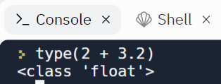
Types of Expressions
Expressions in Python have types.
The type of an expression is inferred from the types of its constituent parts. In the case of a numerical expression, anything that would yield a floating point result, for example 2 + 3.2 has type float.
The type of an expression can be found by using the type function.

Slide 24
Correct BMI Program (Except that it doesn’t handle height of zero correctly)
Use the int function to convert the user’s input from a str to an int
weight = int(input('Enter your weight>'))
height = int(input('Enter your height>'))
bmi = weight/(height/100)**2
print('Your BMI is ', bmi)
In next week’s classes we will learn how to correctly handle the case where the height is zero

Slide 25
Errors - Syntactic and Semantic
A syntactic error occurs when you have not followed the syntax of the programming language you are using for source code. This is like making a grammatical mistake in a natural language, say English. Syntactic errors are picked up in compilation.
bmi = weight/(100height)**2
A semantic error occurs when your program does something it was not meant (specified) to do, if you run it. This is like not saying the right thing in English.
bmi = weight/(100height)*2
If our program multiplies the height by two instead of calculating its square then it has a semantic error. The error is probably in the design stage.

Slide 26
Introduction to Testing

Slide 27
Introduction to Testing
In this presentation we explain how we can test the BMI program developed earlier, and set out some general guidelines for testing.

Slide 28
Test Driven Development
Problem Solving and Programming Tip #3
It is often helpful to decide how you are going to test a program before you think about how you will code it.
Designing tests before coding often helps you clarify your ideas about what a program is supposed to do (as perceived by the user).
It also keeps you honest, because it stops you from, consciously or unconsciously, picking tests that you know your program will pass.

Slide 29
Test Plans
A test plan sets out the tests to which you will subject your program. For each test, you would usually specify
  Input values to be supplied to the program
  The expected output
After the test has been performed you add the actual output, which will tell you whether the test was passed or not
Problem Solving and Programming Tip #4
When writing tests, specify exactly what input values are to be provided, and exactly what output you expect. Avoid saying things such as "Enter two numbers and check that the result is correct".

Slide 30
First Attempt
Input |  | Expected Output | Actual Output | Test Passed?
Weight | Height
120 | 120 | 83.3
Not a good test because a program could mix up weight and height and still pass it.
Input |  | Expected Output | Actual Output | Test Passed?
Weight | Height
50 | 120 | 34.7

Slide 31
Second Attempt
Input |  | Expected Output | Actual Output | Test Passed?
Weight | Height
50 | 120 | 34.7
200 | 240 | 34.7
Not a good pair of tests because they both have the same result. The program could just be repeating the result of the previous calculation and still pass the tests.
Input |  | Expected Output | Actual Output | Test Passed?
Weight | Height
50 | 120 | 34.7
74 | 190 | 20.4

Slide 32
Third Attempt (Almost There?)
Input |  | Expected Output | Actual Output | Test Passed?
Weight | Height
50 | 120 | 34.7
74 | 190 | 20.4
67 | 0 | ???
Hang on though! Entering a height of zero will mean that the formula for BMI requires us to divide by zero. We haven’t said what happens in this case. Options include:
  The program could output something like “N/A”.
  The program could ask the user to re-enter the height.
  We could simply not specify what happens in this case.

Slide 33
Login to Codio

Slide 34
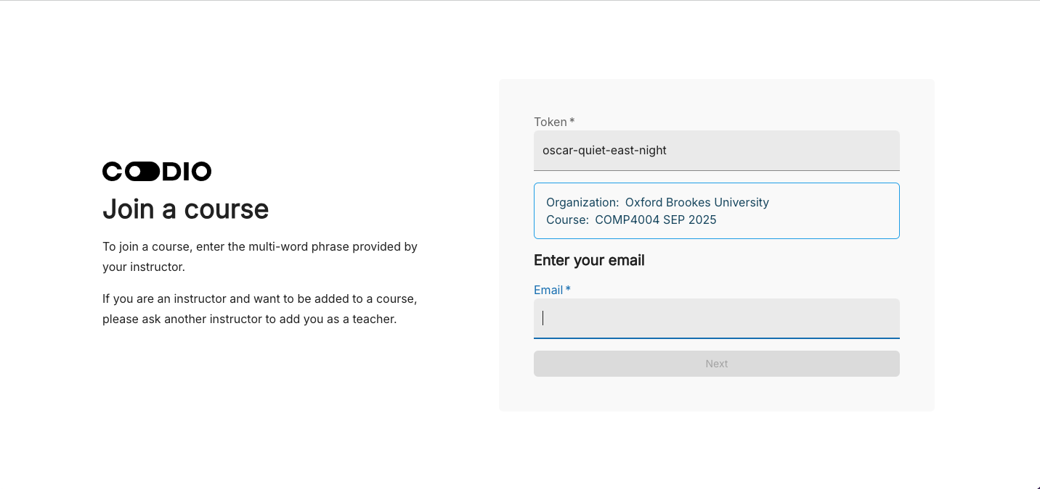
Instructions on Moodle
Link to Codio site for COMP4004
Login to Codio using your Brookes email address

Slide 35
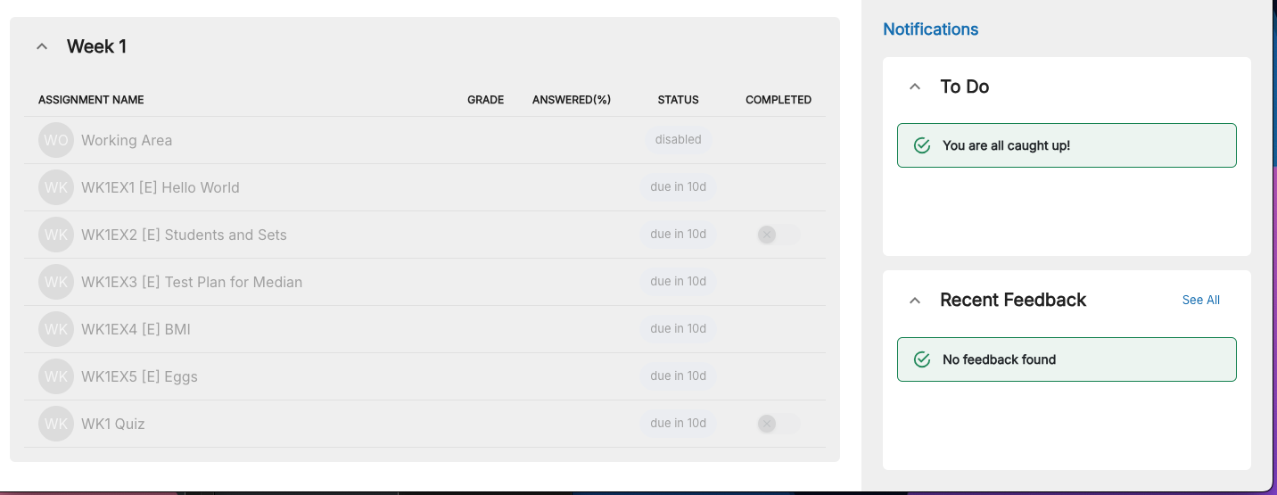
Codio
Fill your name and surname and Codio will send you a verification code
Once you have connected you will see the list of exercises that you will do in the first lab

Slide 36
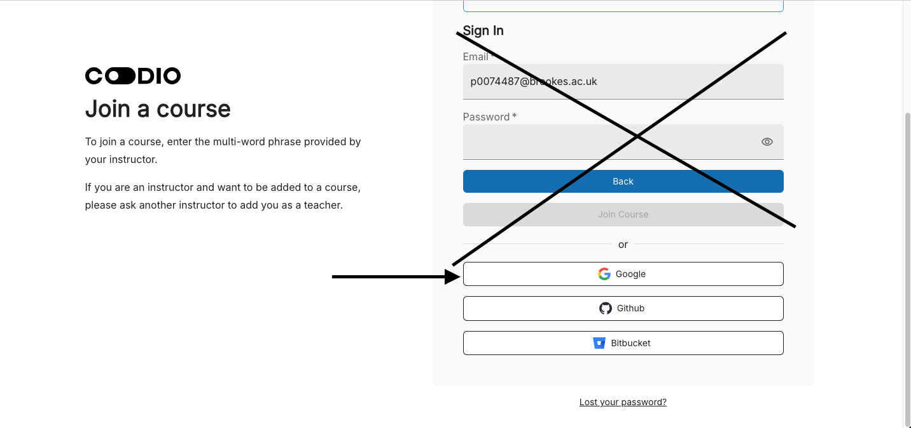
Login
Next time do not fill the sign In section just connect with Google

Slide 37
Summary
Introduction to the Module
Introduction to Programming
  Variables
  Assignments
  Basic Operations
  Testing
Ready for the lab

Slide 38
Next
Login to Codio
First exercises
Quiz
More exercises on Thursday
Finish all the exercises by Sunday
Next week:
  Boolean Expressions and Conditions

