Slide 1
Augmented Reality at work
The future in efficiency and collaboration

Slide 2
Contents
Difference AR / VR
Possible application areas
Advantages and challenges
Real life examples
Prospects for the future
Sources and further information

Slide 3
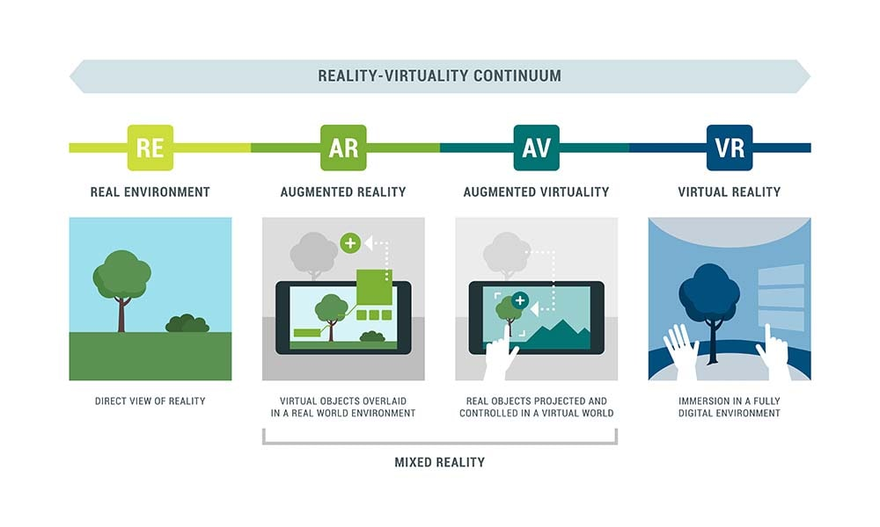
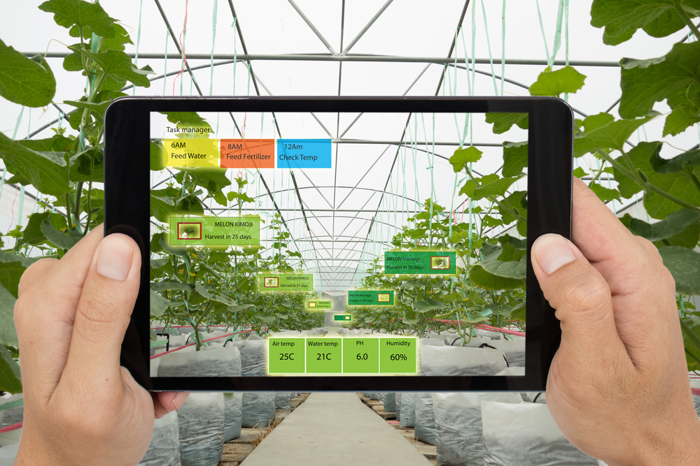
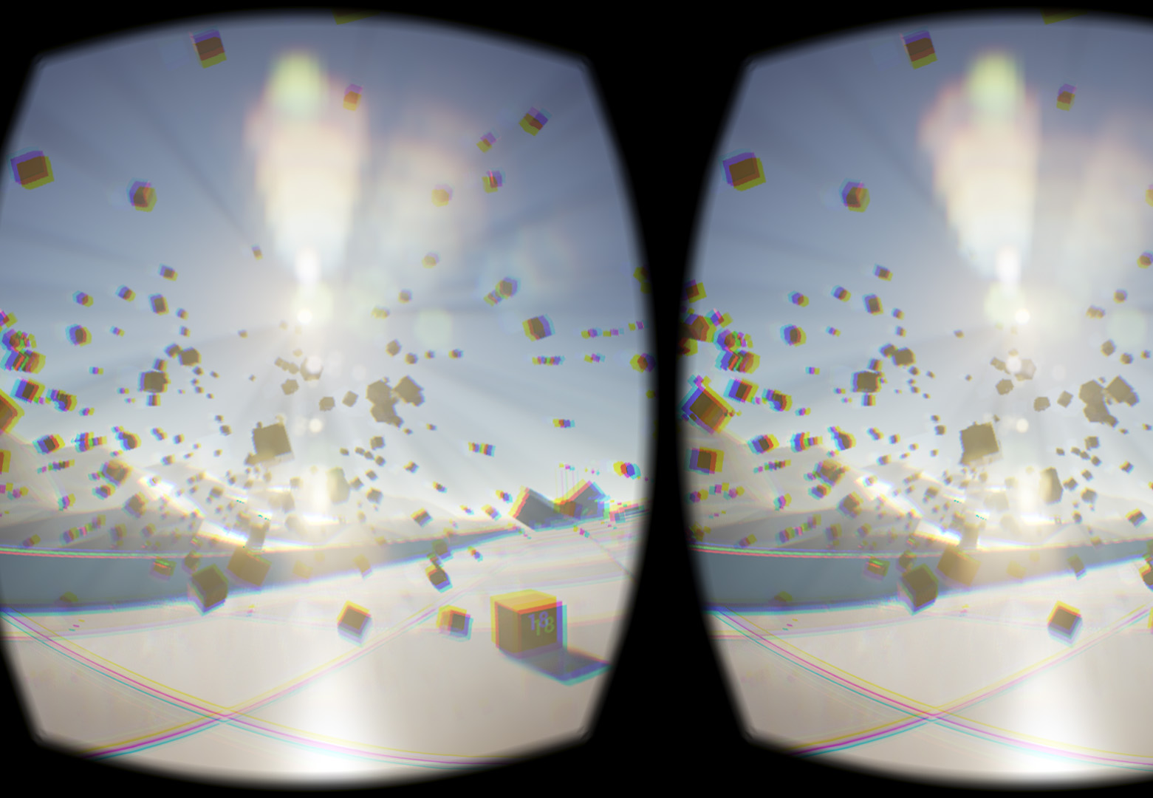
Difference AR / VR
Augmented Reality (AR):
Expanding the real world with digital information or objects
Virtual Reality (VR):
Fully virtual environment

Slide 4
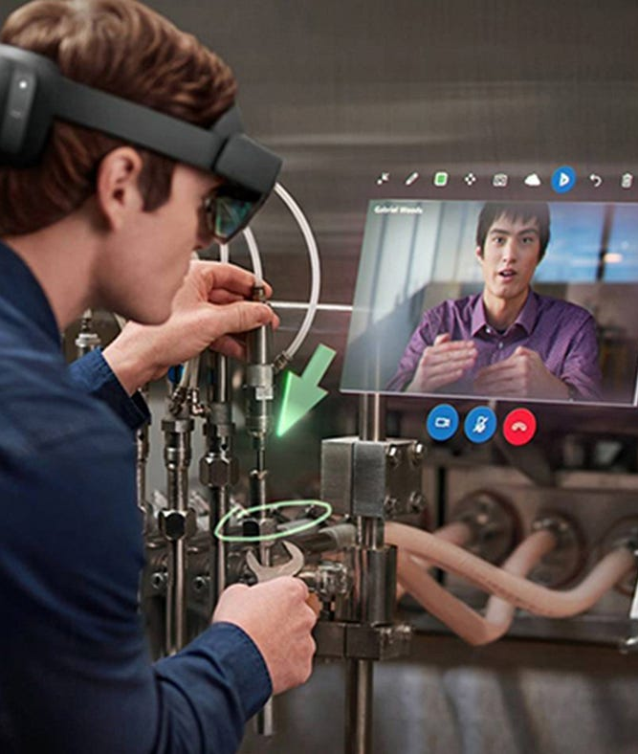
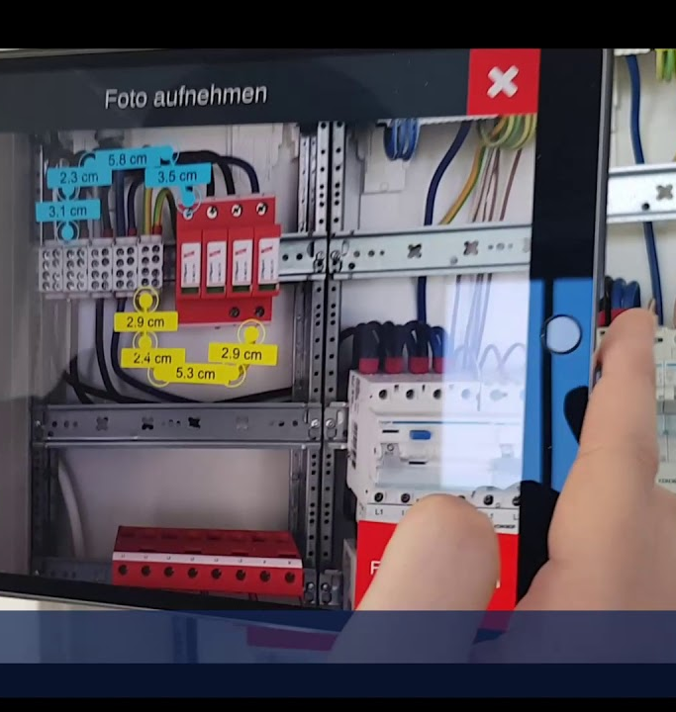
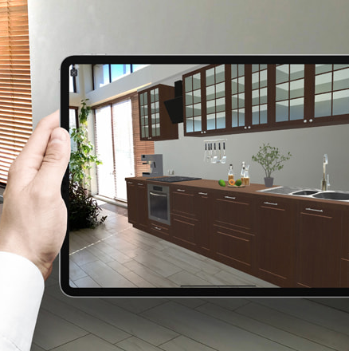
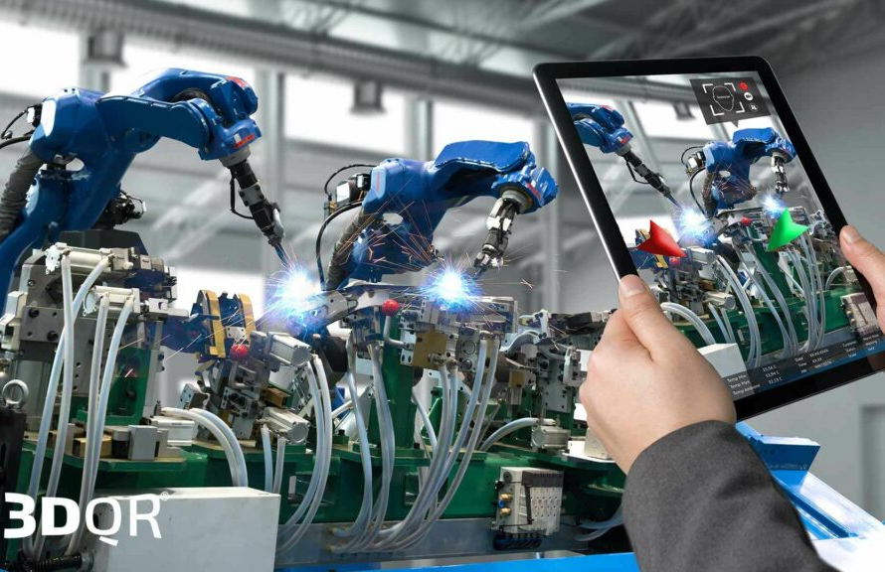
Possible application areas
Training and education
Maintenance and repair
Visualization and design
Collaboration

Slide 5
Advantages and challenges of Augmented Reality
Advantages
Challenges
Increased efficiency, error reduction and time savings
Improved learning and training experience
Better basis for decision-making through visualization
Data protection and security
Acceptance and introduction in companies
Technical complexity and costs

Slide 6
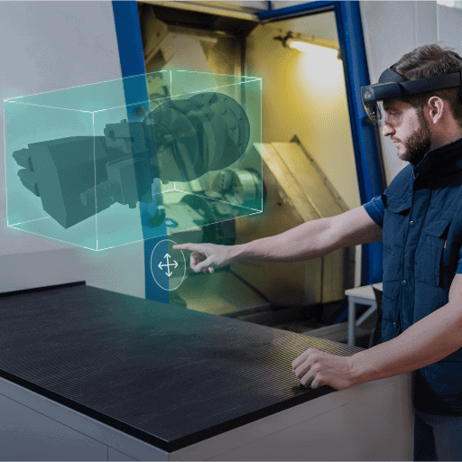
Real Life Examples
Industrie 4.0
visualize guided processes
Used to identify things in front of you
Can be used to send informations in front of you to other devices/persons
remote assistance
guides you with videos, 3D Animations and realtime data

Slide 7

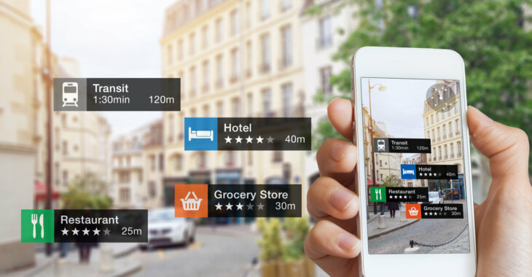
Prospects for the future
AR in Marketing
Visualise interesting informations to the customer
Visual demonstation of the product
AR in Manifacturing
Visualise important information
Visual representation of parts

Slide 8
Sources and further information
https://www.innovae.com/en/industry-40-augmented-and-virtual-reality/
https://www.loewenstark.com/wissen/augmented-reality/
https://www.adtance.com/de/blog/2023/was-ist-augmented-reality

