Slide 1
Functional Machine Learning Library
Group-6
Ajay chhajed (IMT2019006)
Anirudh Gupta (IMT2019008)
Dhruv Sharma (IMT2019027)
Vismaya Solanki (IMT2019095)

Slide 2
Work done
We also implemented a Simple Neural Network model and tested it against a hardcoded dataset.
Implemented Simple linear regression and tested it against synthetic data.
We studied OWL library of OCAML.

Slide 3
Linear Regression

Slide 4
Neural Network
A neural network is a form of machine learning model with layers that are organised in a hierarchical framework.
Each layer is made up of a collection of fixed units or neurons with flexible characteristics that may be adjusted during training. Data is sent into the network, and each layer builds on the output of the one before it as an input layer. After that, the procedure is continued until an output layer is achieved.
The modelling problem determines how a network’s output is interpreted.
The multi-class issue, in which there are N prediction classes, is a popular one. The neural network’s next task is to determine which class the incoming data belongs to. As a result, The output is interpreted as a probability in this scenario.

Slide 5
Neural Network
Input Layer Hidden Layer Output Layer
i1
h1
i2
O1
h2
i3

Slide 6
OCAML OWL
Owl is an Ocaml library with many advanced numerical functions generalized for n-dimensional vectors
Compared to other numerical libraries, Owl is much faster as it used algorithmic differentiation and distributed computing .
The functions in Ndarray and Matrix modules can be divided into following three groups:
1) The first group contains the vectorised mathematical functions such as sin, cos, relu, and etc. This group of functions are mostly implemented in C code to achieve the best performance.
2) The second group contains the high-level functionality to manipulate arrays and matrices, e.g., slicing, tile, repeat, padding, and etc.
3) The third group contains the linear algebra functions specifically for matrices.

Slide 7
Composable Services - Enables fast development of modern data analytics using type-safe functional programming
Classic Analytics - Implements a comprehensive set of classic analytic functions.
Core Layer - It is the building block of the whole numerical system and the capability of distributed computing

Slide 8
Algorithmic Differentiation
Owl’s algorithmic differentiation module implements both forward and backward mode and supports arbitrarily higher-order derivatives. Algodiff.Generic is implemented as a functor that takes previously mentioned Matrix and Ndarry module as inputs, it supports both single and double precisions.
Algorithmic differentiation/Auto-differentiation, is a set of techniques to evaluate the derivative by exploiting the fact that every program, executes a sequence of elementary arithmetic operations (addition, subtraction, multiplication, division, etc.) and elementary functions (exp, log, cos, sin etc). By applying the chain rule repeatedly to these operations, derivatives of arbitrary order can be computed automatically, accurately to working precision.

Slide 9
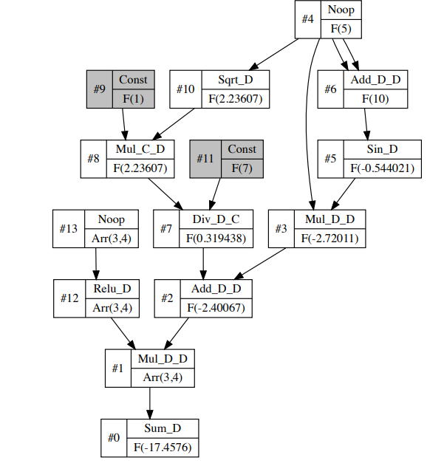
Computation Graph generated by Autodiff
Computational graphs are a way of evaluating a mathematical expression
Here is the computation graph generated for a simple math function :
let f x y = Maths.((x * sin (x + x) +
( F 1. * sqrt x) / F 7.) *
(relu y) |> sum)

Slide 10
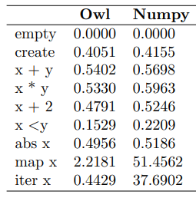
Performance Test
The table presents the results, i.e., the average time (in seconds) needed to finish the tested operations. We can see Owl achieves the best performance in these tests due to the optimizations done in Ocaml with the help of vectorization.

Slide 11
Results of Comparison
Linear Regression Time taken to train on same amount of data :
Ocaml took 0.015625s to train on data.
Python took approximately same time to train on same amount of data.

Slide 12
Comparison of SNN on OCAML and Python
Time taken by Ocaml was 0.5398s
Time taken by python was 0.561s
We can see Ocaml implementation was marginally faster.

Slide 13
Linear regression in OWL (In-built)
Linear regression: linear ~i x y fits the measurements x and the observations y into a linear model.
x is a m by n row-based matrix and each row represents one measurement. y is a m by 1 matrix and each number is an observation.
The parameters will be returned as a column vector. ~i indicates whether to include intercept, the default value is false. The intercept will be the first element in the returned parameters.

Slide 14
Conclusion
In this project we got hands on experience of coding in Ocaml, implementing SNN was a challenging task.
We implemented Linear regression and tested against synthetic data.
We studied OWL library of OCAML and the variety of tasks it can perform.
Overall it was an enriching project.

