Slide 1
SMIT Events Info Page
By:
Team Name: stillVariables
Team No:44

Slide 2
Problem Statement:
College life is full of fun and great events. Having an app to streamline all the upcoming events will help a lot of students to plan their schedule properly and efficiently. Make a web app for managing all the events happening in college

Slide 3
Solution
An application where organizing team in SMIT can add and delete events whenever required and user will be notified in the main page.
The application will contain description of the event along with a countdown timer to show the exact time and days remaining for the event.
When the event gets over, the application will show that it has expired.

Slide 4
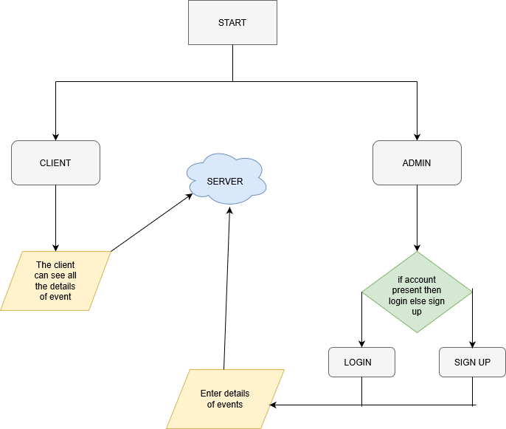
WORKFLOW DIAGRAM

Slide 5
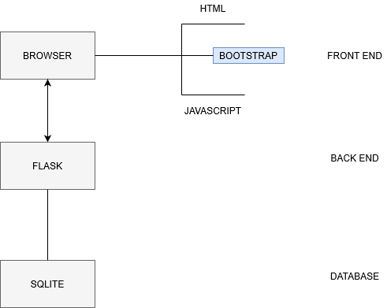
TECHNOLOGY STACK

Slide 6
USE CASE
Students are not often aware of the events happening in SMIT. This web application will give all the details of the events happening and going to happen.
Organizers don’t need to write long texts in whatsapp and texts wont get lost in whatsapp groups. This application will manage these and also provide a timer.
Expired events can also be viewed.

Slide 7
GET TO KNOW THE DEVELOPERS
SHUBHAM SINGH (www.github.com/workdone0)
PRAMIT PUJARA (www.github.com/pujara0999)
DEBORSHI DEB((www.github.com/DebDx)

