Slide 1

T&P Info page
Team 48
Ayushi Prasad | Ayushi | Swagat Panda

Slide 2
Contents
Acknowledgement
Technologies Used
Description
Working
Conclusion

Slide 3
Acknowledgement
We would like to thank D’coders who gave us this amazing opportunity to learn and showcase our skills.
We learnt a lot of new things while doing this project and it was a wonderful experience. Special thanks to all the seniors who helped us in every possible way.
Thank You

Slide 4
Technologies Used
HTML
CSS
Bootstrap
PHP

Slide 5
Description
PlaceMate.
Your ultimate placement guide
Here we present our website, which is a perfect tool for managing placement drives in colleges.
Need for a T&P web app –
Keeping a track of upcoming, ongoing and previous drives is the most important task for the T&P department of a college and placeMate performs this task beautifully and has some added advantages.
Features –
1. Provides detailed description of the companies visiting the college for placement drives.
2. Separate databases to store the names of companies along with their drives' starting and end dates
3. The database can be accessed only by the administrator
4. Finally users can see the updated database on the web app itself via the "placement details" dropdown menu
5. The database is fully secured as it is accessible only by the admin.

Slide 6
Working

Slide 7

Home
Consists of 4 tabs
Home
Companies
Login
Placement Details

Slide 8

Login
Valid username and password must be entered which is stored in the database called ‘record’

Slide 9
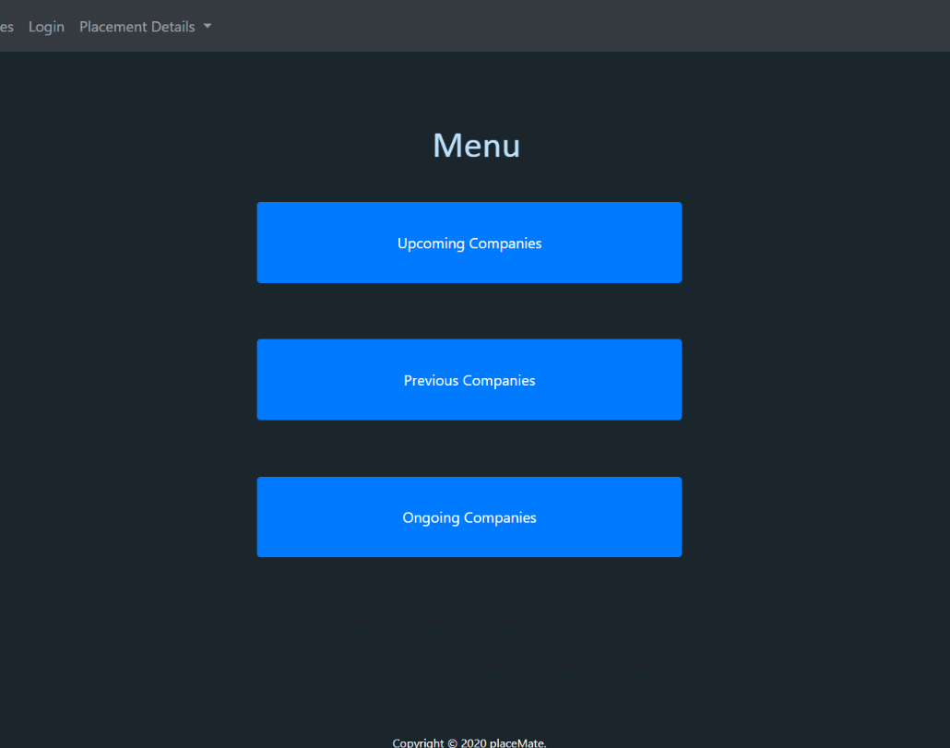
Menu
Select from menu to enter data into the respective databases

Slide 10
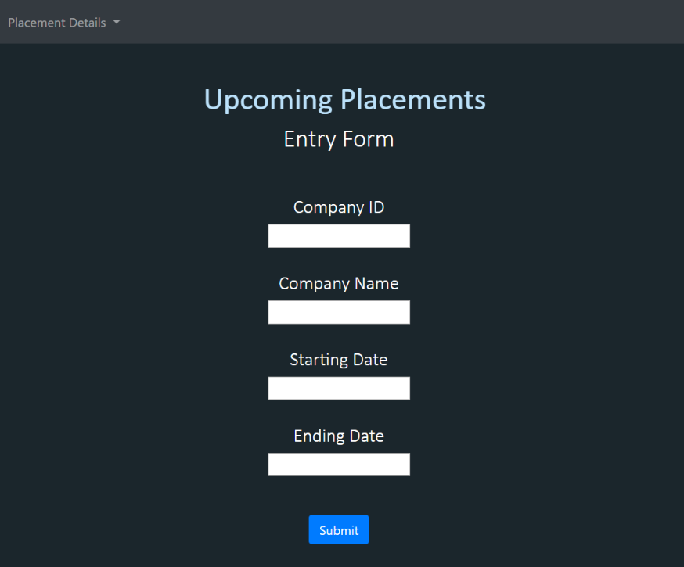
Data Entry Form
Enter Data in the respective fields and click submit to store data into the database

Slide 11
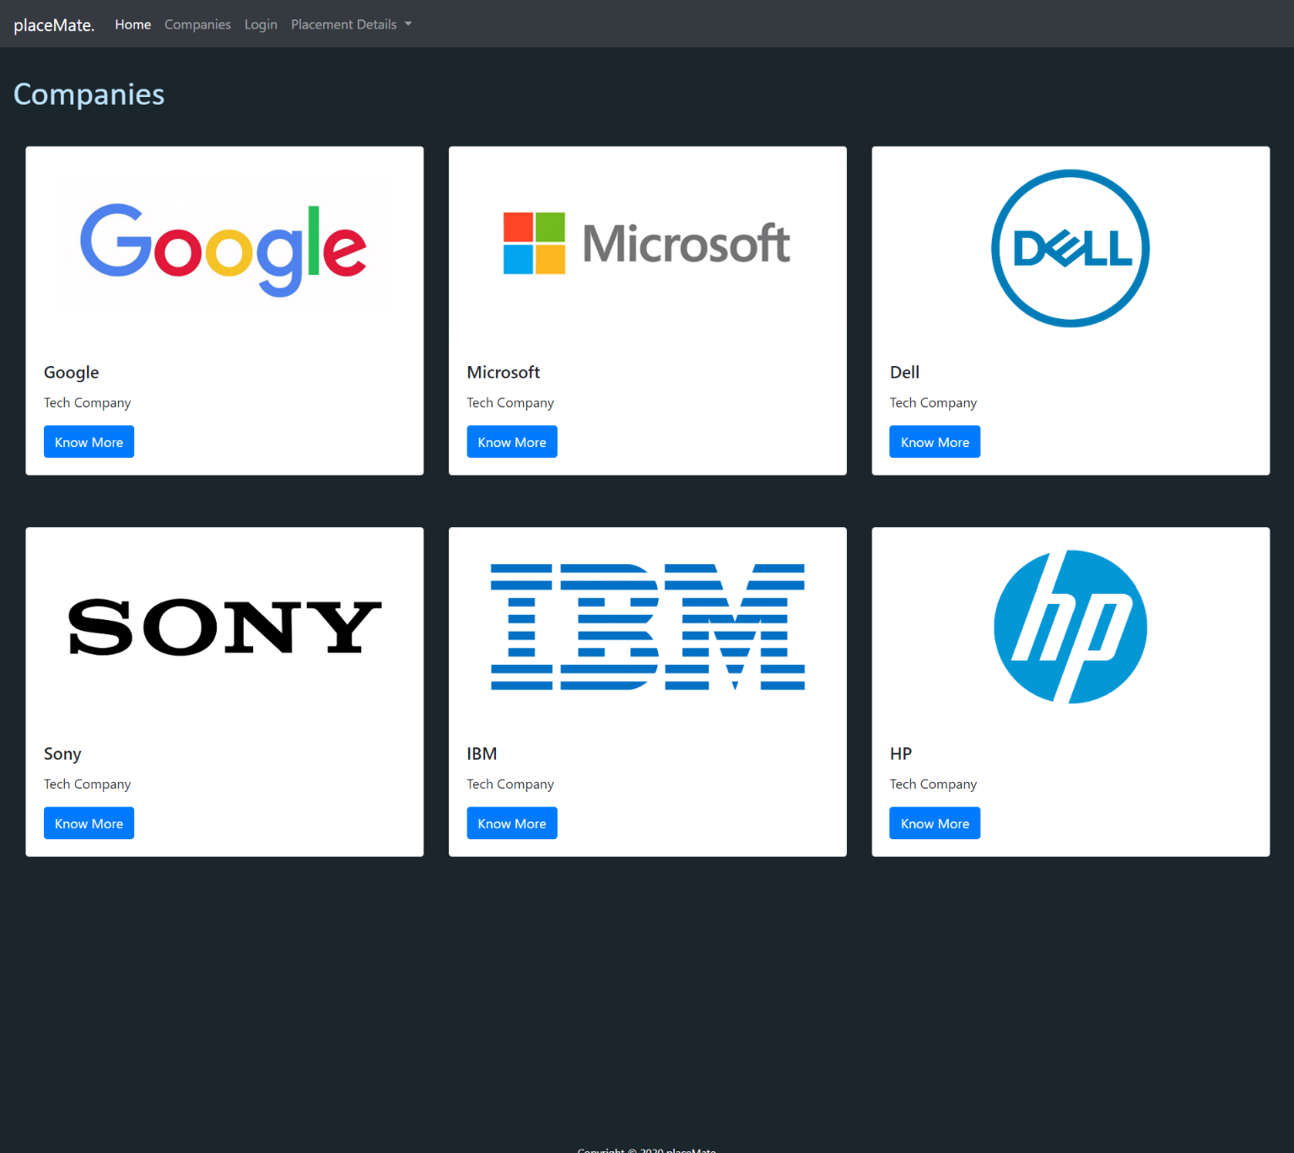
Companies
This is a static page that gives information about different companies
Each of them are hyperlinked and have separate pages

Slide 12

Placement Details
This is a drop-down menu that links to three separate pages which gives information about Ongoing, Upcoming & Previous placement details to the user

Slide 13
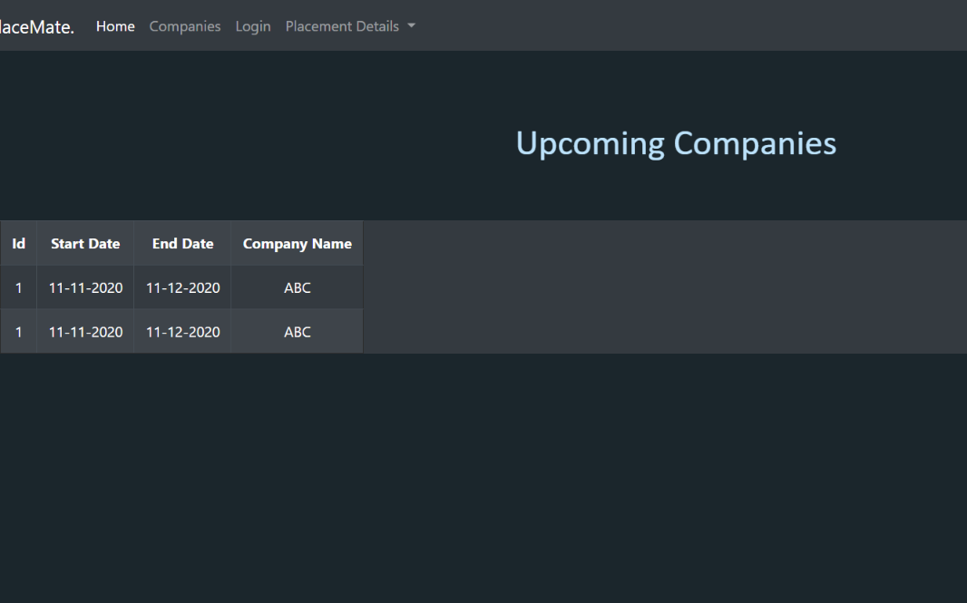
Placement Details
This page fetches data from the database which is controlled by the admin

Slide 14
Conclusion
A sincere effort of the team, the web app ‘PlaceMate.’ makes the job of managing this huge task easy and efficient. With easy navigation and access, it is the proven ultimate tool and a boon for the "training and placement department" of a college.
What guides students towards their future ?
T&P CELL and
What guides T&P ?
"PlaceMate. the ultimate placement guide !“

Slide 15
Thank You.

