Slide 1
How Does Energy Change?

Slide 2
Example 1 – A Vacuum

Slide 3
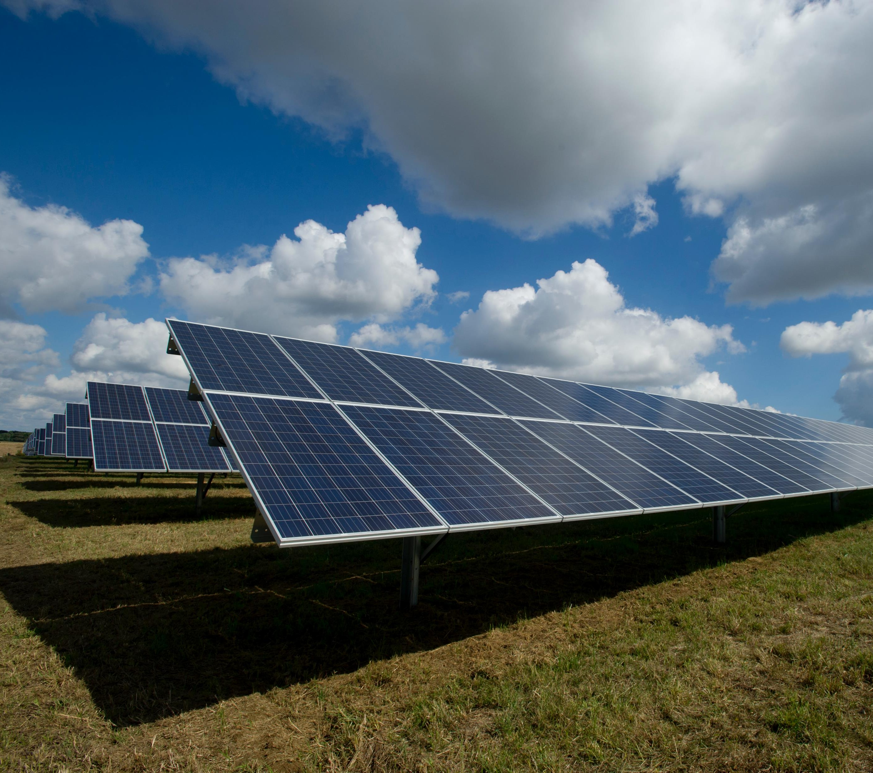
Solar Energy → Electrical Energy
Solar energy is converted into electrical energy with solar panels. Solar energy is also called solar power. It is a renewable resource. This means that can be replenished, unlike gasoline and other fossil fuels.
Photo by American Public Power Association on Unsplash

Slide 4
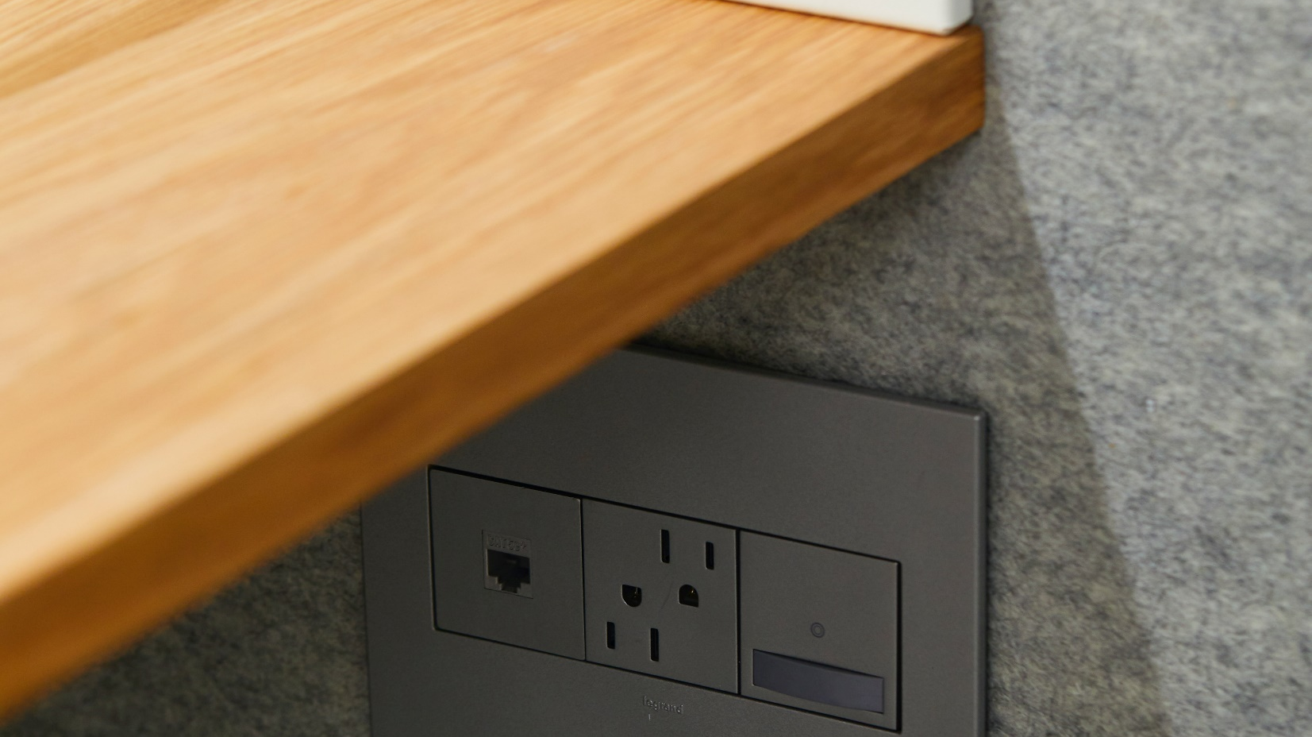
Electrical Energy → Light Energy
Electrical energy flows through the electrical wires into the vacuum cleaner which then converts the electrical energy into the kinetic energy of the vacuum’s motor.
Photo by ROOM on Unsplash

Slide 5
Example 2 – A Car

Slide 6
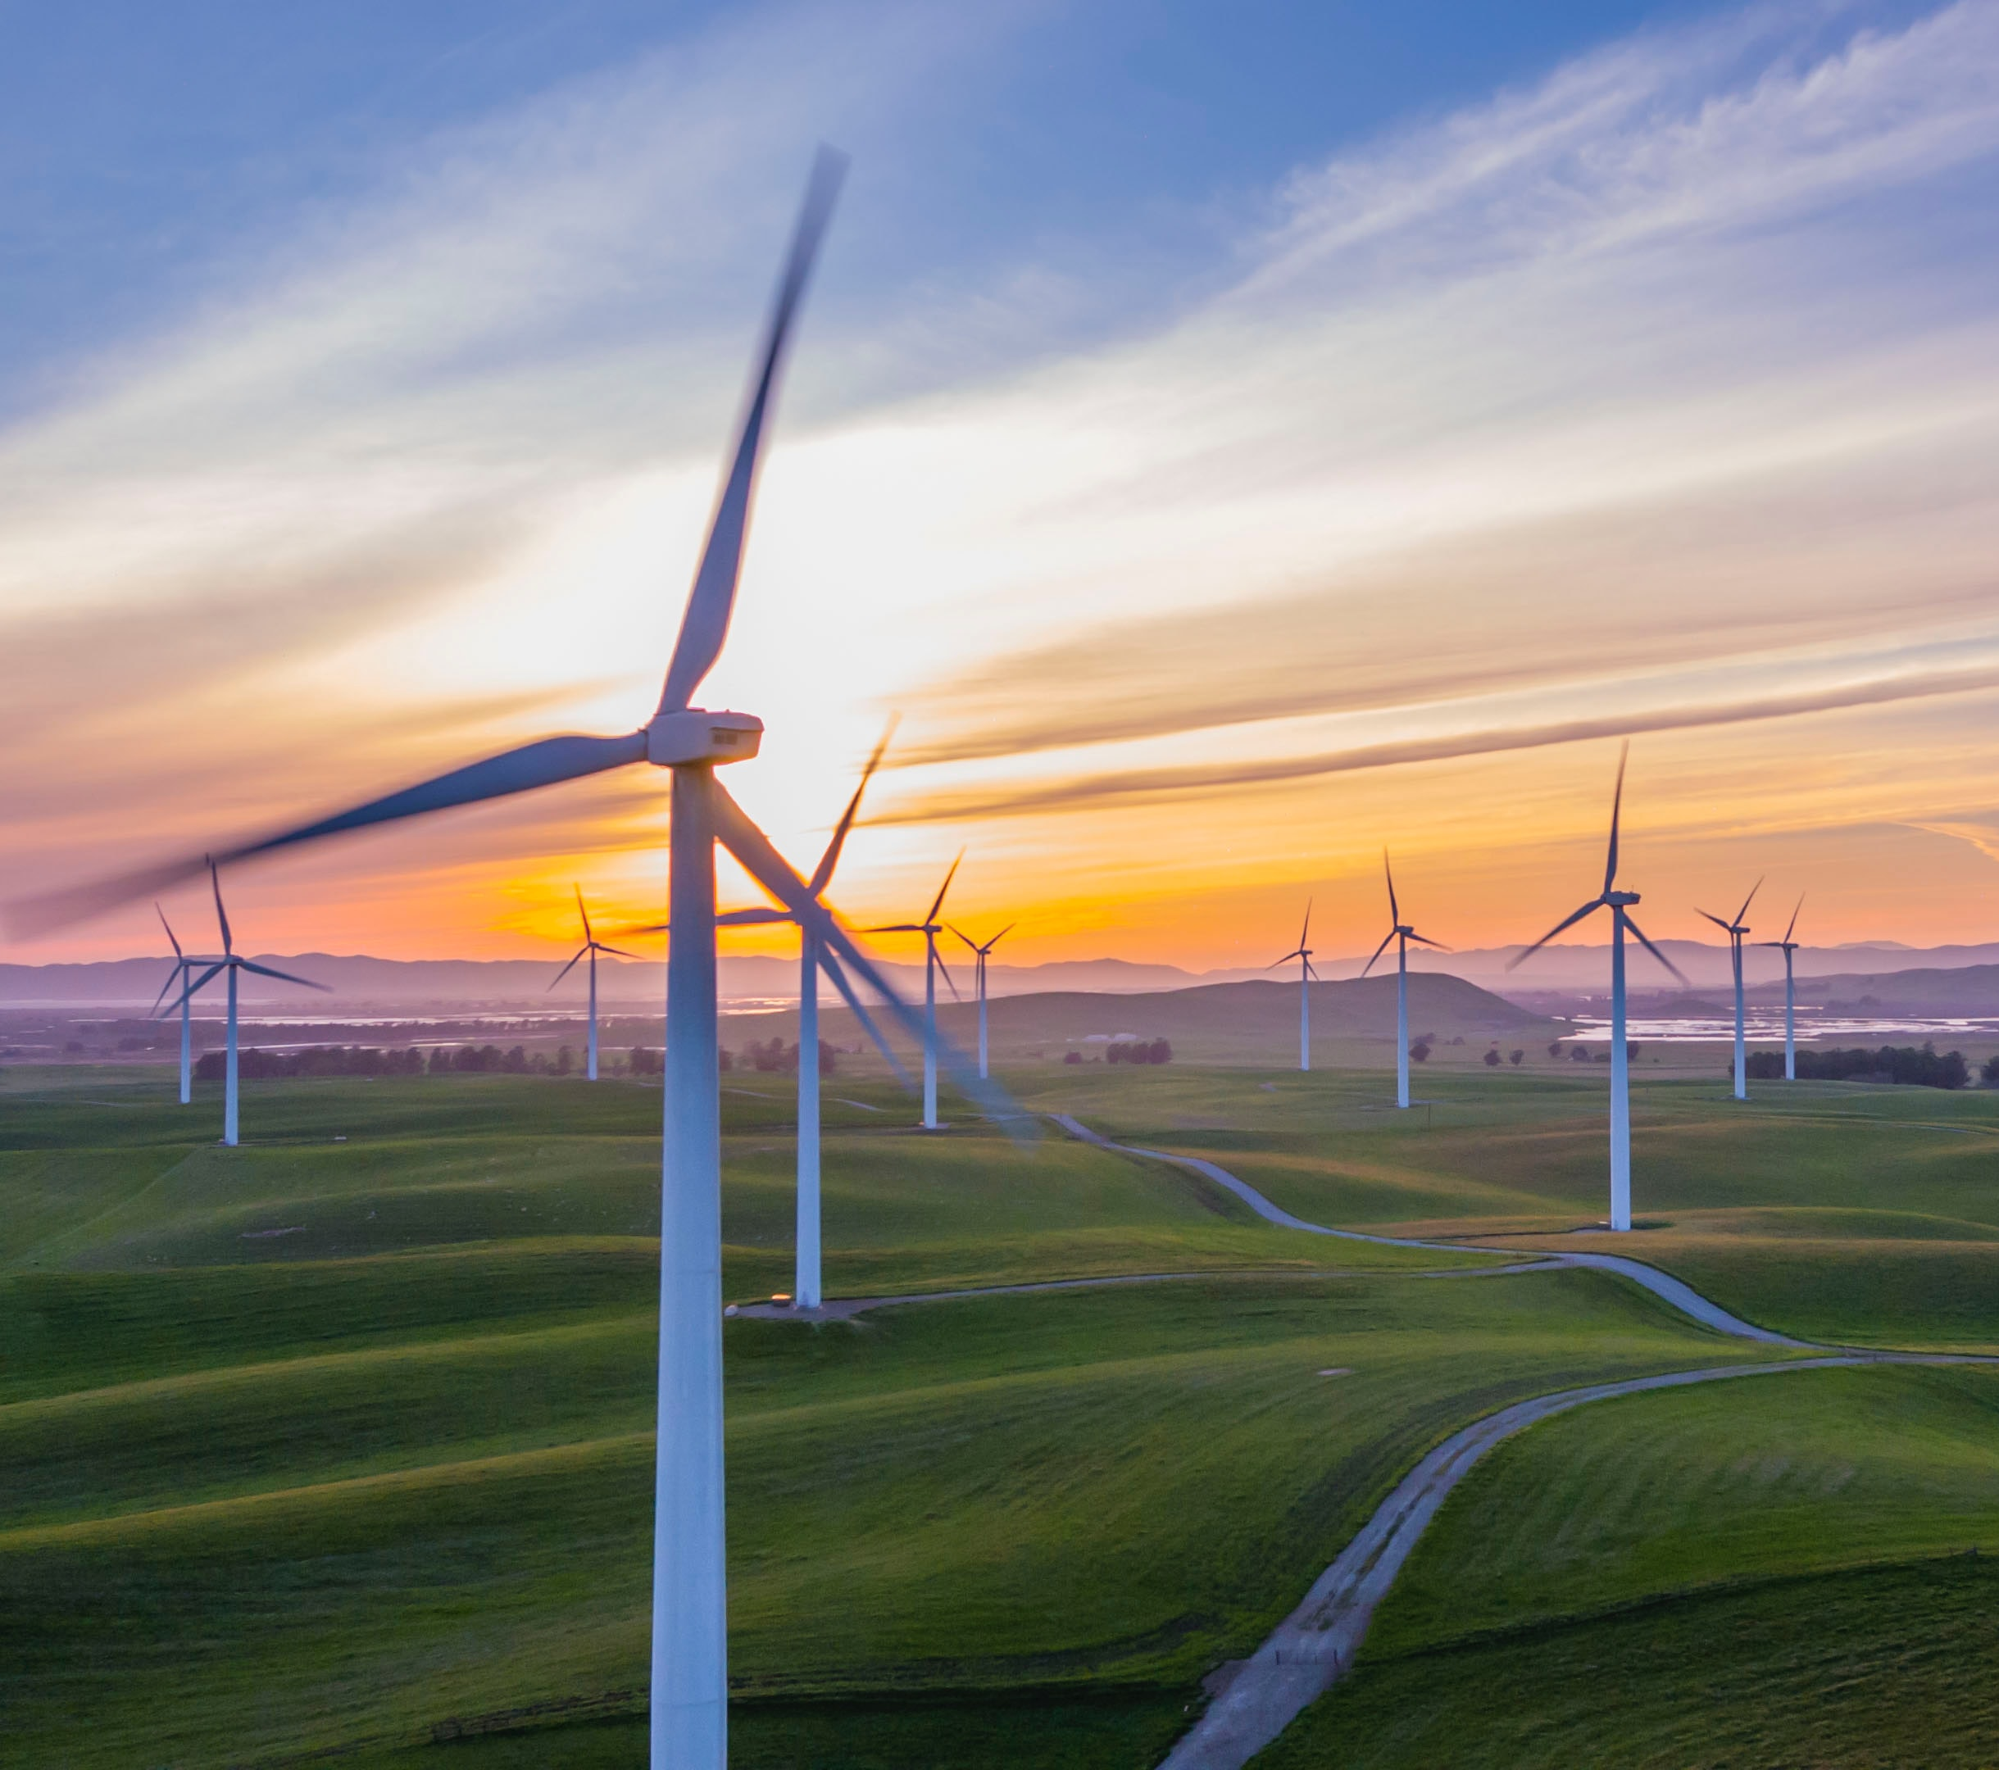
Wind Energy→ Electrical Energy
The wind energy of the wind is taken in by wind turbines and becomes electrical energy. Wind energy is a renewable resource.
Photo by RawFilm on Unsplash

Slide 7
Electrical Energy → Light Energy
Electrical energy flows through the electrical wires into the lamp where the lamp converts it into light energy.
Photo by Clint Patterson on Unsplash

