Slide 1
MERN stack website development
By: Nikoloz Muladze

Slide 2
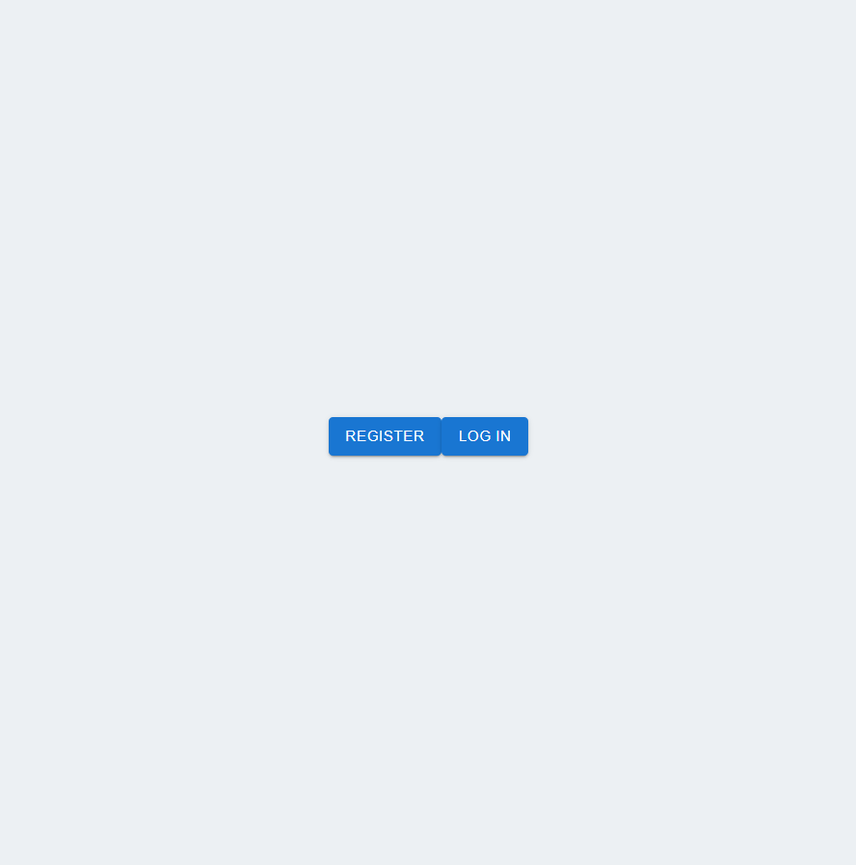
Landing Page

Slide 3
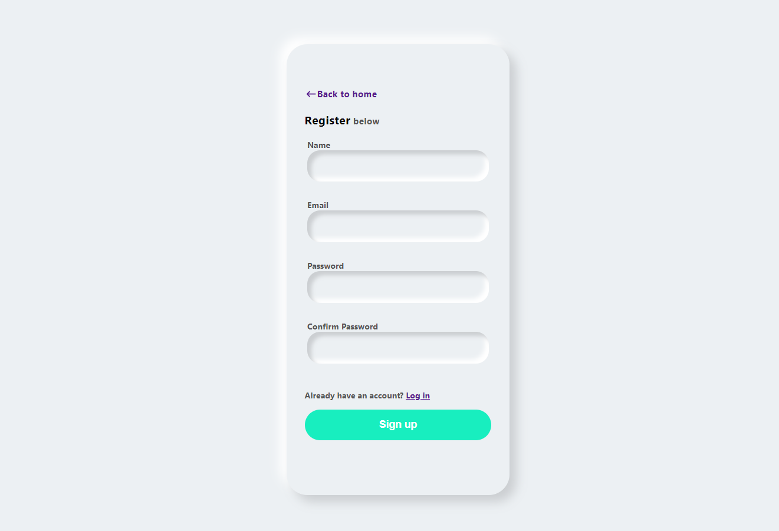
Register Page

Slide 4
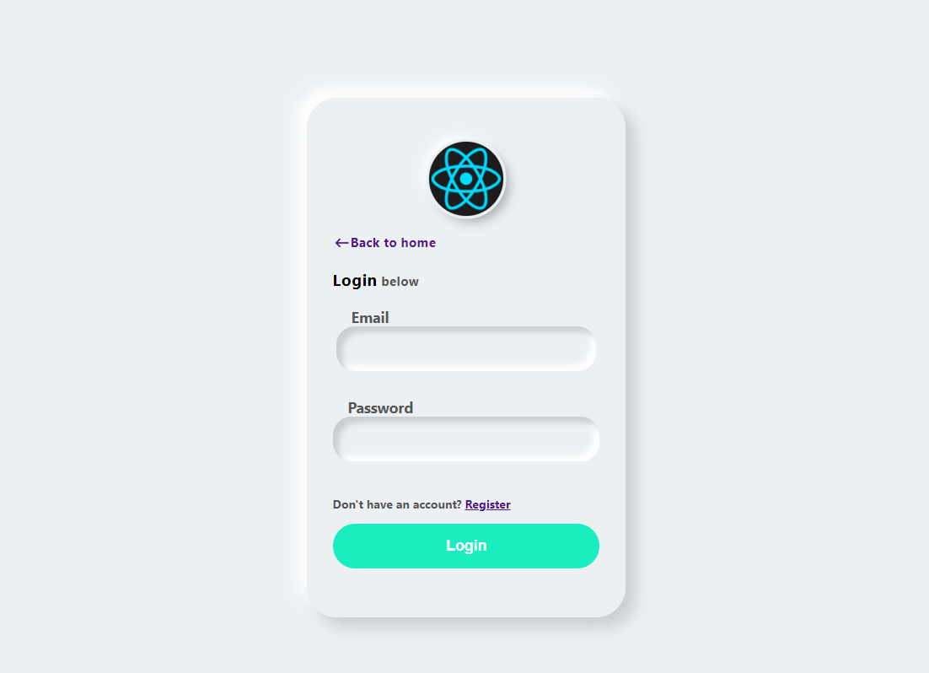
Login Page

Slide 5
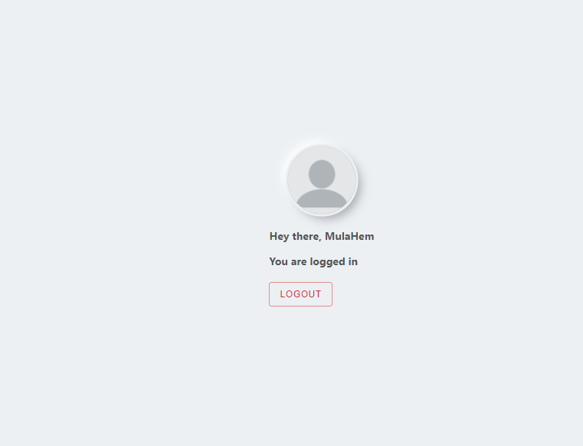
Profile Page

