Slide 1



contactzzz
http://ece.codefactory.live/
Team

Slide 2

OVERVIEW
Development Process
Planning
Design
Production
Testing
Content Structure
Lessons Learned
Q&A
Notes:
© Copyright Showeet.com – Free PowerPoint Templates

Slide 3
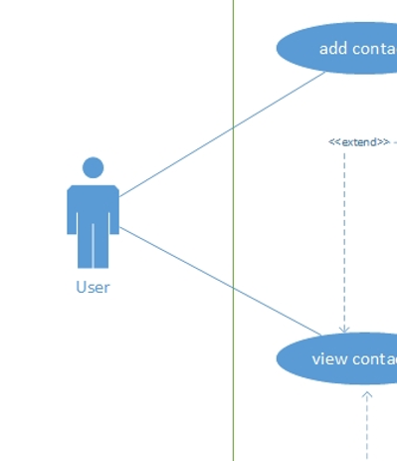
Plannıng
Requirements: MoSCoW method
Use Case Diagram
Stack: Angular, Jquery, Bootstrap, Firebase, SCSS
Rules for Development: e.g camelCase
Daily Status Updates
Notes:
© Copyright Showeet.com – Free PowerPoint Templates

Slide 4
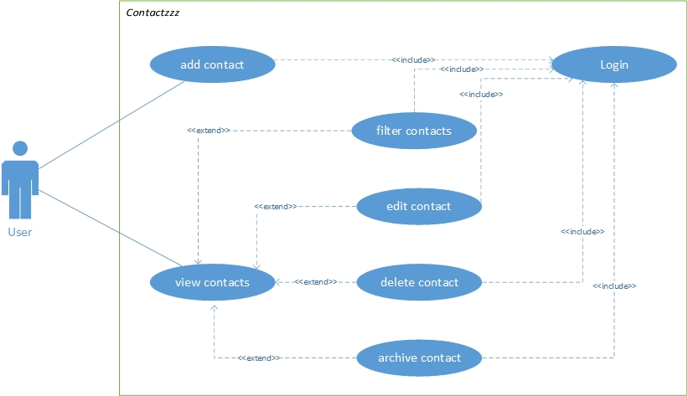
Use Case Diagram
Notes:
© Copyright Showeet.com – Free PowerPoint Templates

Slide 5
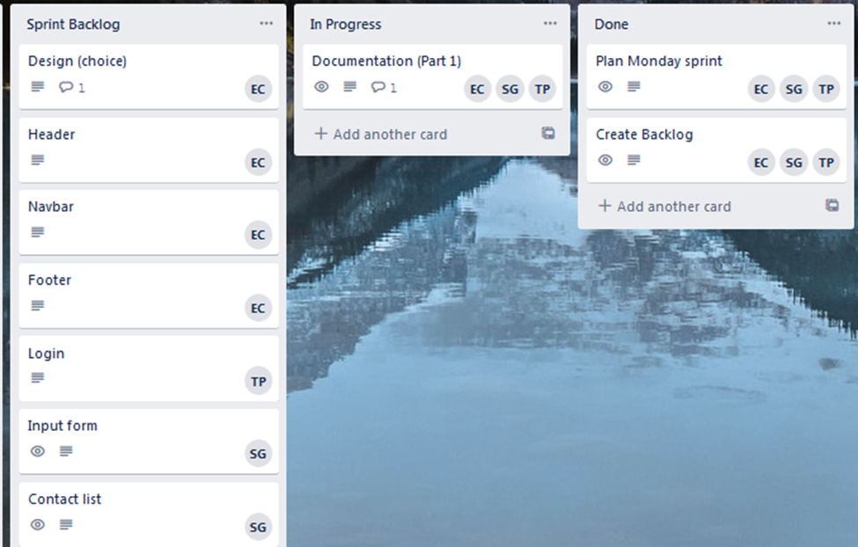
Daily Status Updates
Notes:
© Copyright Showeet.com – Free PowerPoint Templates

Slide 6

desıgn
Consider The Product’s Goal / intention of users
Color palette :
https://colorhunt.co/palette/165812
copyright restrictions:
https://www.flaticon.com/
https://www.pexels.com/
Notes:
© Copyright Showeet.com – Free PowerPoint Templates

Slide 7

LeSSONS LEARNED
Avoide assumptions - Communicate better
Take more time for Planning
Don’t underestimate the complexity of Angular
Notes:
© Copyright Showeet.com – Free PowerPoint Templates

Slide 8
Large Image slide
ANY QUESTIONS?
THANK YOU
Notes:
© Copyright Showeet.com – Free PowerPoint Templates

Slide 9
Large Image slide
THANK YOU
THANK YOU
Notes:
© Copyright Showeet.com – Free PowerPoint Templates

