Slide 1
NP-Hotel Exception Class
Java Hotel Software Projekt
@ Codefactory 2019/2020

Slide 2
The Team
Steven Markhardt
Markus Kaspar
Max Drewitz
Roman Springer (Teamleader)
How the team works
MoSCoW method and Agile principles (very agile)
Daily meetings
Diferent sprints (1 to n Days)

Slide 3
Project 3 – Hotel Management System
Software for use by the hotel employees.
Planing and research the needs
define components of application
Define tasks/sprints

Slide 4
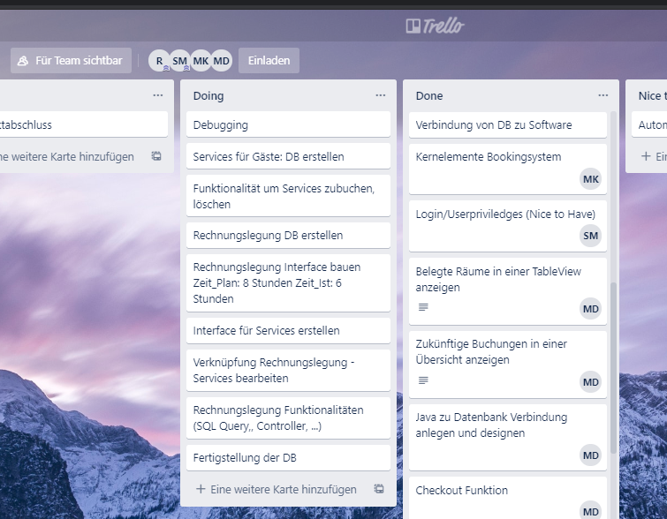
Task record -for the overview
To do, doing, done

Slide 5
allocation of components/tasks
Steven Markhardt: database, user, login
Markus Kaspar: booking function
Max Drewitz: main function, overview, troublshooting
Roman Springer: GUI, extra Services, invoic function

Slide 6
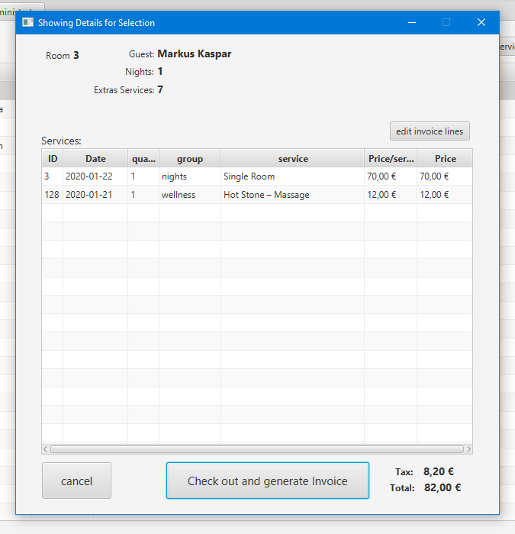
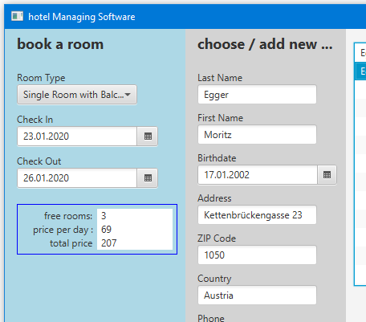
Some features

Slide 7
We lerarned:
….
If there was more time:
….

