Slide 1
Null Pointer Hotel Exception Class
Java Hotel Software Projekt
@ CodeFactory 2019/2020

Slide 2
The Team
Steven Markhardt
Markus Kaspar
Max Drewitz
Roman Springer (Teamleader)
How the team works
MoSCoW method and Agile principles (very agile)
Daily meetings
Different sprints (1 to n Days)

Slide 3
Project 3 – Hotel Management System
Software to be used by the hotel employees.
Planning and research the needs
define components of application
Define tasks/sprints

Slide 4
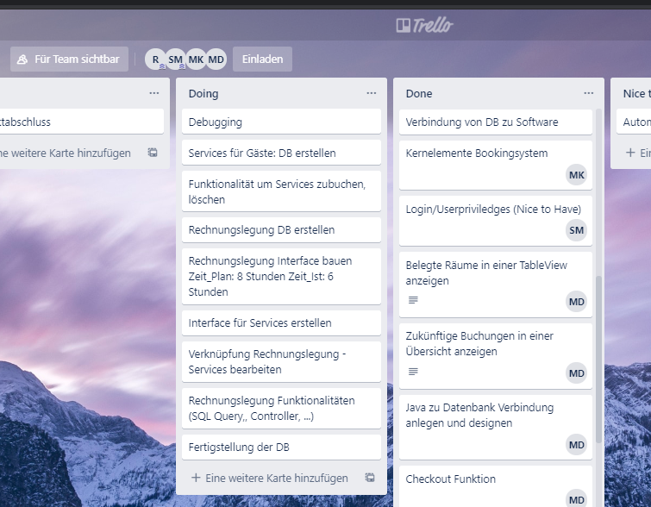
Task record - for the overview
To do, doing, done

Slide 5
allocation of components/tasks
Steven Markhardt: database, admin functions, user, login
Markus Kaspar: booking function, autocomplete from DB,
Max Drewitz: main function, overview, troubleshooting
Roman Springer: GUI, extra Services, invoice function

Slide 6
Before we continue..
A Day at Null Pointer Hotels!
Featuring: Receptionist Markus Intern: Roman Manager: Steven Guest A: Max Guest B: Steven Guest C: Max

Slide 7
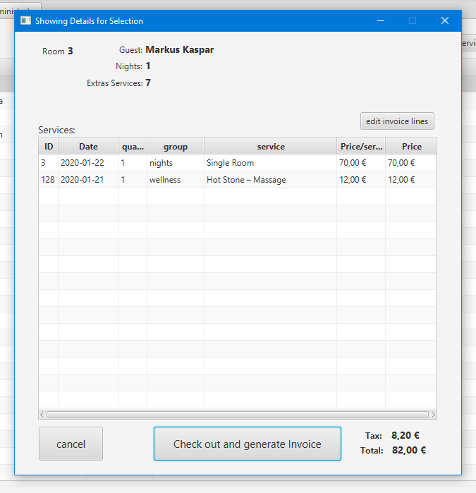
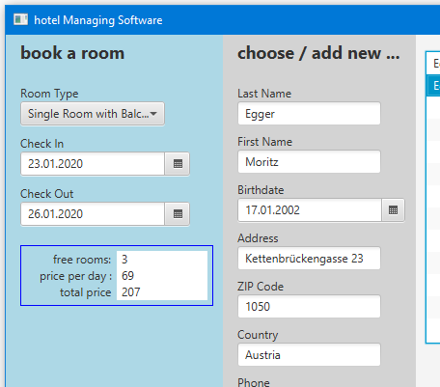
Some features

Slide 8
We learned:
Exception (Red Code) Handling
SQL Queries.
„A good DB spares you a lot of work. So we did a lot of work.“
Trying to avoid Merge Conflicts and still getting them.
If there was more time:
Printing invoice as file and/or printable.
Add bookings directly to the calendar.
Specific invoices for companies who book multiple rooms.
Variable Prices for different holidays/seasons.
Onlinebooking (Spring)

