Slide 1

BANGALORE INSTITUTE OF TECHNOLOGY
DEPARTMENT OF INFORMATION SCIENCE AND ENGINEERING
K.R.ROAD, V.V.PURAM, BANGALORE – 560004
Project Phase I Presentation (BIS685)
on
“CodeNCollab: A Virtual Coding Environment”
Presented By
NAME | USN
Praveen N Patil Namith Nagesh B C Rakesh S | 1BI22IS083 1BI22IS067 1BI22IS066 1BI22IS089
Under the Guidance of:
Prof. Priya N.V
Assistant Professor

Slide 2
Contents
Abstract
Introduction
Objective and Motivation
Literature Survey
Drawbacks of Existing Systems
Problem Statement
Proposed Solution
Analysis Modeling
System Architecture
Software Requirement Specification
Reference

Slide 3
Abstract
CodeNCollab is a cloud-based collaborative platform that enables programmers to code together in real-time with integrated code editing, live chat, video conferencing, and secure multi-language execution in a sandboxed Docker environment. It follows a room-based model allowing users to join sessions using unique identifiers, promoting multi-user collaboration and dynamic activity tracking. With features like code import/export and session-based storage, CodeNCollab ensures effective project management, code reusability, and seamless team workflow from any location.

Slide 4
Introduction
Why We Built CodeNCollab
While existing tools offer video calls or screen sharing, they often fall short when it comes to real-time coding collaboration. We built CodeNCollab to bridge this gap — combining code editing, live communication, and seamless teamwork in a single, unified platform. It’s designed to recreate the experience of working side-by-side, even when you're miles apart.
What Makes CodeNCollab Special
Whether you're a developer building something cool, a student learning to code, or a mentor guiding your team, CodeNCollab gives you the tools to stay connected and productive. With a fast, modern interface and built-in chat, video calls, and real-time code tracking, it's a secure and flexible space that fits right into today’s remote-first coding culture.

Slide 5
Objective and Motivation
Objective
To develop a real-time collaborative coding platform that integrates live code editing, video conferencing, and chat — enabling seamless teamwork, remote mentorship, and interactive learning in a unified, secure environment.
Motivation
While traditional tools support communication or code sharing,they often lack true real-time collaboration. CodeNCollab was born from the need to recreate the energy of side-by-side coding in a remote world — empowering developers, students, and mentors to connect, code, and create together, no matter the distance.

Slide 6
LITERATURE SURVEY
SI. No | year | Author(s) | Focus of the paper | Key Points in Coverage | Techniques(s) used | Parameters Analyzed | Research Gaps
1 | 2023 | Feng, L., Yen, R., You, Y., Fan, M., Zhao, J., and Lu, Z | Prompt collaboration in coding | Introduces CoPrompt for sharing prompts | CoPrompt system | Collaboration quality | Limited to NL-based coding
2 | 2023 | Xinyue Chen Li, S., Liu, S., Fowler. | Transcript-based coding meetings | Uses MeetScript for live transcripts | Interactive transcripts | Engagement, decisions | Not tailored for coding platforms
3 | 2023 | Dong, Y., Jiang, X., Jin, Z. | Multi-agent code generation | Agents collaborate using roles | ChatGPT + role prompts | Output quality | Focused only on LLMs
4 | 2024 | Gaikwad, A., Agrawal, M., Goyal | Real-time AI code collaboration | AI-assisted multi-user editor | AI + code editor integration | Performance, usability | User metrics not detailed
5 | 2021 | Lin Shi et al. | Live developer chat analysis | Studies dev chats on Gitter | Empirical log analysis | Interaction types | Platform-specific only

Slide 7
LITERATURE SURVEY
SI. No | year | Author(s) | Focus of the paper | Key Points in Coverage | Techniques(s) used | Parameters Analyzed | Research Gaps
6 | 2023 | Fathima, G., Kaif, M., and Nadeem. | Online code execution platform | CODEGEN with multi-lang & real-time run | React-based system | Language support, UI | React-bound implementation
7 | 2023 | Rajeev Verma. | Web IDE with real-time features | Discusses sync & latency | Collaborative editing logic | Latency, conflict mgmt | No real-user validation
8 | 2023 | Meenal Kaur. | Multi-user collaborative editors | Examines collab protocols | Shared editing protocols | Sync accuracy | Adoption not evaluated
9 | 2023 | Ann Yi Wong. | Security in Docker containers | Threat modeling for sandboxing | Docker attack analysis | Vulnerabilities, fixes | Generalized to container tech only
10 | 2023 | Karthik Sinha. | Docker container risks | Evaluates Docker’s flaws | Security audit | Isolation, attack surface | Not focused on collab tools

Slide 8
Drawbacks of Existing Systems
Lack of Real-Time Code Collaboration
Fragmented Communication
No Synchronized Learning or Mentoring
Security & Privacy Concerns
Limited Collaboration Features
Poor Developer Experience in Remote Settings

Slide 9
Problem Statement
In modern software development, teams often struggle with fragmented workflows caused by switching between multiple tools for code writing, execution, communication, and collaboration. This leads to reduced productivity, miscommunication, version control issues, and delays in development. There is a lack of a unified platform that enables developers to collaboratively write, execute, and review code in real-time while also allowing seamless communication through built-in chat and video features.

Slide 10
Proposed Solution
Real-time Code Collaboration: Enable multi-user synchronous code editing with live cursors and language support using Monaco/CodeMirror and WebSockets.
Built-in Video Calling: Integrate WebRTC-powered video within coding sessions for seamless communication.
Live Chat System: Offer real-time in-session chat with support for code snippets, mentions, and threaded messages.
File Sharing: Allow users to upload, preview, and manage files securely with role-based read/write access.
Inline Commenting: Enable threaded comments on specific code lines, supporting collaboration and code reviews.
Responsive UI: Build a fast, clean interface using React.js + TailwindCSS with support for dark/light mode and mobile devices.

Slide 11
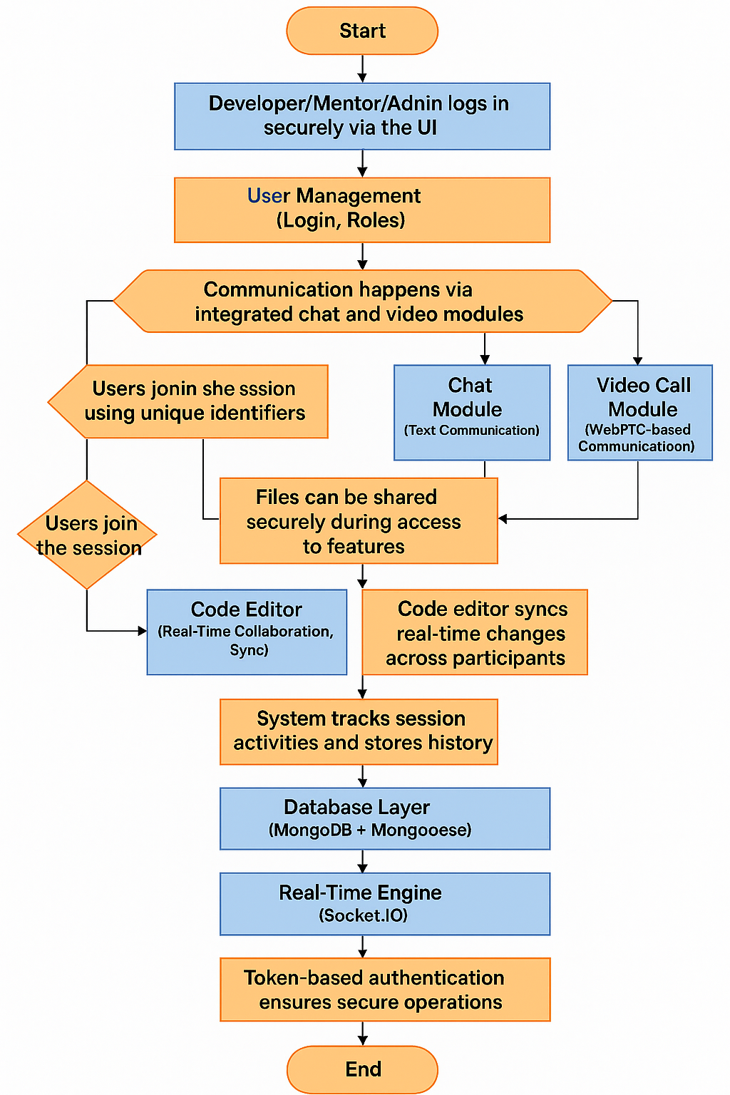
Proposed Solution
Authentication & Security: Use OAuth2 (Google/GitHub) and JWT tokens for secure login and role-based access control.
Scalable Backend: Develop backend APIs using Node.js/FastAPI, and use Socket.IO/WebRTC for real-time features.
DevOps & Deployment: Containerize with Docker, deploy using Kubernetes, and implement CI/CD with GitHub Actions

Slide 12
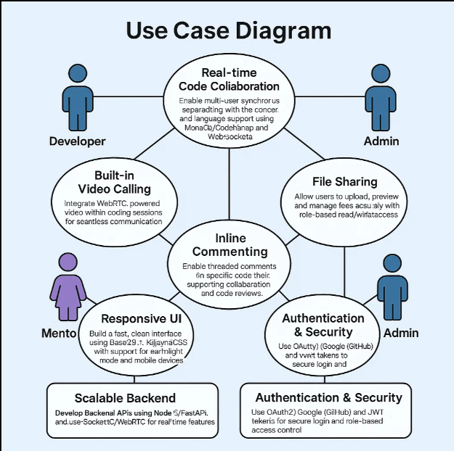
Analysis Modeling
Core Functions:
Collaborative coding
Session creation/joining
Real-time editing, video conferencing
Chat, file sharing, activity tracking
Secure login
Token-based authentication
Architecture Components:
User Management (Login, Roles)
Code Editor (Real-Time Collaboration, Sync)
Chat Module (Text Communication)
Video Call Module (WebRTC-based Communication)
File Sharing Module
Security Layer (RBAC, JWT/Auth)
Database Layer (MongoDB + Mongoose)
Real-Time Engine (Socket.IO)

Slide 13
Analysis Modeling
Workflow:
Developer/Mentor/Admin logs in securely via the UI
Mentor creates a session and invites mentees
Users join the session using unique identifiers
Communication happens via integrated chat and video modules
Files can be shared securely during the session
Role-based controls manage access to features
Code editor syncs real-time changes across participants
System tracks session activities and stores history
Token-based authentication ensures secure operations

Slide 14
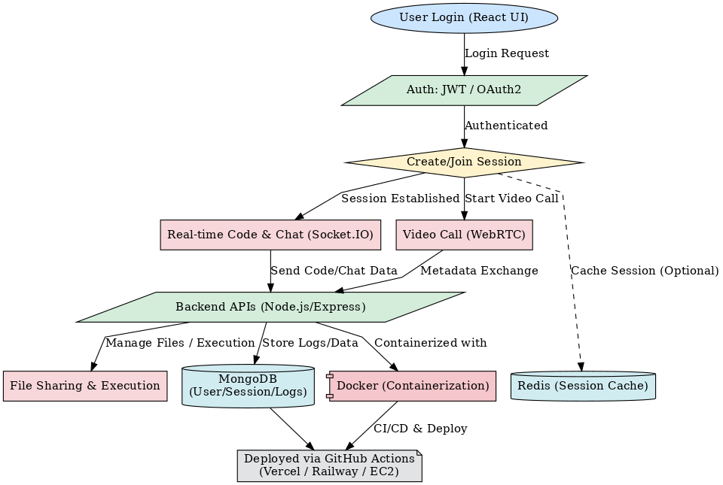
System Architecture

Slide 15
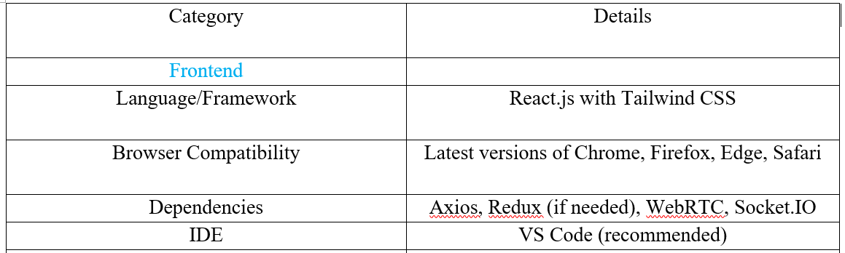
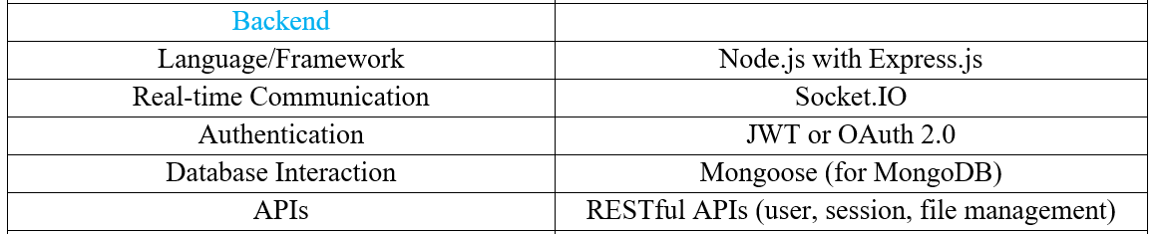
Software Requirement Specification

Slide 16
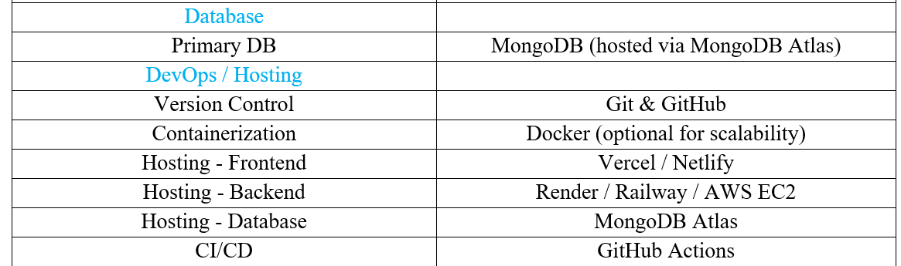
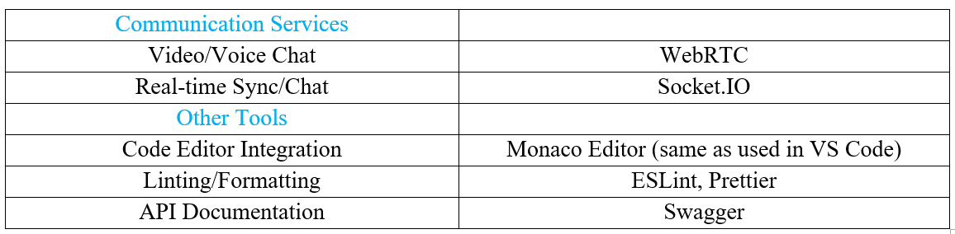
Software Requirement Specification

Slide 17
REFERENCES
[1] Feng, L., Yen, R., You, Y., Fan, M., Zhao, J., and Lu, Z. “CoPrompt: Supporting Prompt Sharing and Referring in Collaborative Natural Language Programming.” arXiv, vol. 2310.09235, arXiv, 2023, https://arxiv.org/abs/2310.09235.
[2] Chen, X., Li, S., Liu, S., Fowler, R., and Wang, X. “MeetScript: Designing Transcript-Based Interactions to Support Active Participation in Group Video Meetings.” Proceedings of the ACM on Human-Computer Interaction, vol. 7, no. CSCW2, Article 254, ACM, 2023, https://doi.org/10.1145/3610397.
[3] Dong, Y., Jiang, X., Jin, Z., and Li, G. “Self-Collaboration Code Generation via ChatGPT.” ACM Transactions on Software Engineering and Methodology (TOSEM), ACM, 2023, https://doi.org/10.1145/3645669.
[4] Gaikwad, A., Agrawal, M., Goyal, J., Goyal, M., and Vinod, D. F. “A Collaborative Code Platform with Advanced AI Features and Real-Time Collaboration Tools.” International Journal for Research in Applied Science and Engineering Technology, vol. 12, no. 5, 1234–1242, IJRASET, 2024, https://doi.org/10.22214/ijraset.2024.
[5] Shi, L., Chen, X., Yang, Y., Jiang, H., Jiang, Z., Niu, N., and Wang, Q. “A First Look at Developers' Live Chat on Gitter.” Proceedings of the 29th ACM Joint Meeting on European Software Engineering Conference and Symposium on the Foundations of Software Engineering (ESEC/FSE '21), ACM, 2021, pp. 573–584.
.

Slide 18
REFERENCES
[6] Fathima, G., Kaif, M., and Nadeem, M. “CODEGEN: A React-Based Online Coding Workspace with Advanced Features and Real-Time Execution.” International Journal of Computer Applications, vol. 175, no. 3, pp. 25–31, Foundation of Computer Science, 2023, https://doi.org/10.5120/ijca2023922770.
[7] Verma, R., Nalisnick, E., and Naesseth, C. A. “Real-Time Collaborative Coding in a Web IDE.” Proceedings of the 15th International Conference on Cooperative Design, Visualization and Engineering, Springer, 2023, pp. 45–52.
[8] Kaur, M., Azrour, M., and Sinha, K. “Collaborative Virtual Reality Application for Interior Design.” Proceedings of the 10th International Conference on Virtual Reality and Visualization, IEEE, 2023, pp. 67–74.
[9] Wong, A. Y., Chekole, E. G., Ochoa, M., and Zhou, J. “On the Security of Containers: Threat Modeling, Attack Analysis, and Mitigation Strategies.” Computers & Security, vol. 128, article no. 103140, Elsevier, 2023, https://doi.org/10.1016/j.cose.2022.103140.
[10] Sinha, K., Swaminathan, K., Tambe, T., Zhang, J. J., and Buyuktosunoglu, A. “From Code to Container: Understanding the Importance of Container Images.” Proceedings of the IEEE Symposium on Security and Privacy, IEEE, 2024, pp. 112–125

