Slide 1

BANGALORE INSTITUTE OF TECHNOLOGY
DEPARTMENT OF INFORMATION SCIENCE AND ENGINEERING
K.R.ROAD, V.V.PURAM, BANGALORE – 560004
Project Phase I Presentation (BIS685)
on
“CodeNCollab: A virtual coding environment”
Presented By
NAME | USN
Praveen N Patil Namith Nagesh B C Rakesh S | 1BI22IS083 1BI22IS067 1BI22IS066 1BI22IS089
Under the Guidance of:
Prof. PriyaN.V
Assistant Professor

Slide 2
Contents
Abstract
Introduction
Literature Survey
Problem Statement
Project Planning-Gant Chart
Reference

Slide 3
Abstract
CodeNCollab is a cloud-based collaborative platform that enables programmers to code together in real-time with integrated code editing, live chat, video conferencing, and secure multi-language execution in a sandboxed Docker environment. It follows a room-based model allowing users to join sessions using unique identifiers, promoting multi-user collaboration and dynamic activity tracking. With features like code import/export and session-based storage, CodeNCollab ensures effective project management, code reusability, and seamless team workflow from any location.

Slide 4
Introduction
Why We Built CodeNCollab
While existing tools offer video calls or screen sharing, they often fall short when it comes to real-time coding collaboration. We built CodeNCollab to bridge this gap — combining code editing, live communication, and seamless teamwork in a single, unified platform. It’s designed to recreate the experience of working side-by-side, even when you're miles apart.
What Makes CodeNCollab Special
Whether you're a developer building something cool, a student learning to code, or a mentor guiding your team, CodeNCollab gives you the tools to stay connected and productive. With a fast, modern interface and built-in chat, video calls, and real-time code tracking, it's a secure and flexible space that fits right into today’s remote-first coding culture.

Slide 5
LITERATURE SURVEY
SI. No | year | Author(s) | Focus of the paper | Key Points in Coverage | Techniques(s) used | Parameters Analyzed | Research Gaps
1 | 2023 | Li Feng et al. | Prompt collaboration in coding | Introduces CoPrompt for sharing prompts | CoPrompt system | Collaboration quality | Limited to NL-based coding
2 | 2023 | Xinyue Chen et al. | Transcript-based coding meetings | Uses MeetScript for live transcripts | Interactive transcripts | Engagement, decisions | Not tailored for coding platforms
3 | 2023 | Yihong Dong et al. | Multi-agent code generation | Agents collaborate using roles | ChatGPT + role prompts | Output quality | Focused only on LLMs
4 | 2024 | Aarti Gaikwad et al. | Real-time AI code collaboration | AI-assisted multi-user editor | AI + code editor integration | Performance, usability | User metrics not detailed
5 | 2021 | Lin Shi et al. | Live developer chat analysis | Studies dev chats on Gitter | Empirical log analysis | Interaction types | Platform-specific only

Slide 6
LITERATURE SURVEY
SI. No | year | Author(s) | Focus of the paper | Key Points in Coverage | Techniques(s) used | Parameters Analyzed | Research Gaps
6 | 2023 | Fathima G et al. | Online code execution platform | CODEGEN with multi-lang & real-time run | React-based system | Language support, UI | React-bound implementation
7 | 2023 | Rajeev Verma et al. | Web IDE with real-time features | Discusses sync & latency | Collaborative editing logic | Latency, conflict mgmt | No real-user validation
8 | 2023 | Meenal Kaur et al. | Multi-user collaborative editors | Examines collab protocols | Shared editing protocols | Sync accuracy | Adoption not evaluated
9 | 2023 | Ann Yi Wong et al. | Security in Docker containers | Threat modeling for sandboxing | Docker attack analysis | Vulnerabilities, fixes | Generalized to container tech only
10 | 2023 | Karthik Sinha et al. | Docker container risks | Evaluates Docker’s flaws | Security audit | Isolation, attack surface | Not focused on collab tools

Slide 7
Problem Statement
CodeNCollab addresses the need for a platform where developers can write, execute, and review code together in real-time while communicating through built-in chat and video. It provides a dedicated space that ensures smooth interaction, instant updates, and secure code sharing—all without disrupting the flow of work. By bringing together collaboration, communication, and execution under one roof, CodeNCollab creates a focused and connected environment for truly effective team coding.

Slide 8
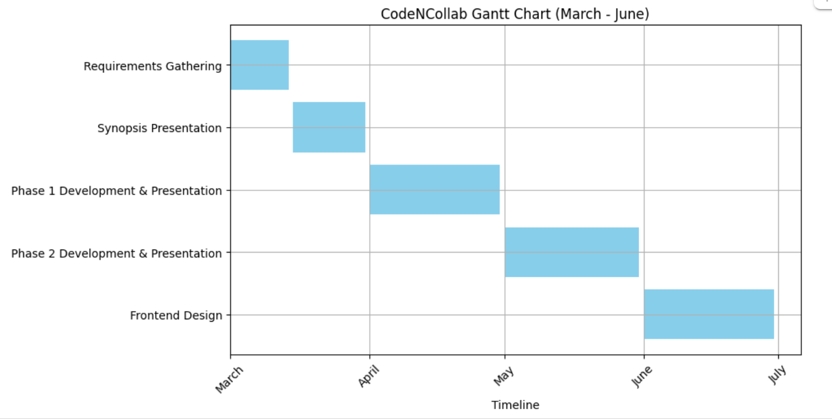
Project Planning

Slide 9
REFERENCES
[1] Feng, L., Yen, R., You, Y., Fan, M., Zhao, J., and Lu, Z. “CoPrompt: Supporting Prompt Sharing and Referring in Collaborative Natural Language Programming.” arXiv, vol. 2310.09235, arXiv, 2023, https://arxiv.org/abs/2310.09235.
[2] Chen, X., Li, S., Liu, S., Fowler, R., and Wang, X. “MeetScript: Designing Transcript-Based Interactions to Support Active Participation in Group Video Meetings.” Proceedings of the ACM on Human-Computer Interaction, vol. 7, no. CSCW2, Article 254, ACM, 2023, https://doi.org/10.1145/3610397.
[3] Dong, Y., Jiang, X., Jin, Z., and Li, G. “Self-Collaboration Code Generation via ChatGPT.” ACM Transactions on Software Engineering and Methodology (TOSEM), ACM, 2023, https://doi.org/10.1145/3645669.
[4] Gaikwad, A., Agrawal, M., Goyal, J., Goyal, M., and Vinod, D. F. “A Collaborative Code Platform with Advanced AI Features and Real-Time Collaboration Tools.” International Journal for Research in Applied Science and Engineering Technology, vol. 12, no. 5, 1234–1242, IJRASET, 2024, https://doi.org/10.22214/ijraset.2024.
[5] Shi, L., Chen, X., Yang, Y., Jiang, H., Jiang, Z., Niu, N., and Wang, Q. “A First Look at Developers' Live Chat on Gitter.” Proceedings of the 29th ACM Joint Meeting on European Software Engineering Conference and Symposium on the Foundations of Software Engineering (ESEC/FSE '21), ACM, 2021, pp. 573–584.
.

Slide 10
REFERENCES
[6] Fathima, G., Kaif, M., and Nadeem, M. “CODEGEN: A React-Based Online Coding Workspace with Advanced Features and Real-Time Execution.” International Journal of Computer Applications, vol. 175, no. 3, pp. 25–31, Foundation of Computer Science, 2023, https://doi.org/10.5120/ijca2023922770.
[7] Verma, R., Nalisnick, E., and Naesseth, C. A. “Real-Time Collaborative Coding in a Web IDE.” Proceedings of the 15th International Conference on Cooperative Design, Visualization and Engineering, Springer, 2023, pp. 45–52.
[8] Kaur, M., Azrour, M., and Sinha, K. “Collaborative Virtual Reality Application for Interior Design.” Proceedings of the 10th International Conference on Virtual Reality and Visualization, IEEE, 2023, pp. 67–74.
[9] Wong, A. Y., Chekole, E. G., Ochoa, M., and Zhou, J. “On the Security of Containers: Threat Modeling, Attack Analysis, and Mitigation Strategies.” Computers & Security, vol. 128, article no. 103140, Elsevier, 2023, https://doi.org/10.1016/j.cose.2022.103140.
[10] Sinha, K., Swaminathan, K., Tambe, T., Zhang, J. J., and Buyuktosunoglu, A. “From Code to Container: Understanding the Importance of Container Images.” Proceedings of the IEEE Symposium on Security and Privacy, IEEE, 2024, pp. 112–125

Slide 11
