Slide 1
Advanced Encryption Standard_01
Instructor: Dr. Wei (Lisa) Li
Department of Computer Science, GSU

Slide 2
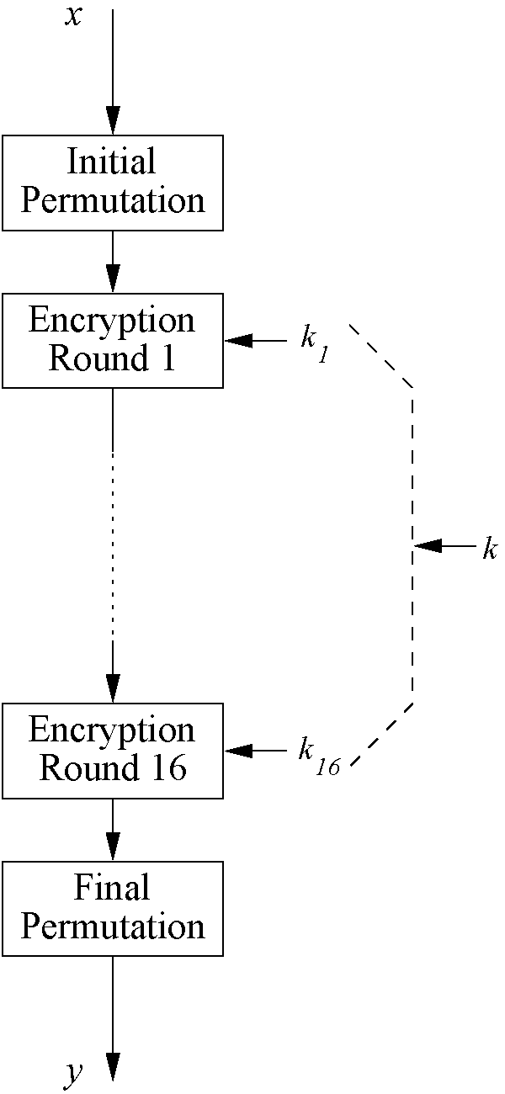
Review of DES
Encrypts blocks of size 64 bits in Feistal network
Uses a key of size 56 bits
Symmetric cipher: uses same key for encryption and decryption
Uses 16 rounds which all perform the identical operation
Different subkey in each round derived from main key

Slide 3
Some Basic Facts
DES is not secure
3DES is three times slower than DES
AES is the most widely used symmetric cipher today
The algorithm for AES was chosen by the US National Institute of Standards and Technology (NIST) in a multi-year selection process
The requirements for all AES candidate submissions were:
Block cipher with 128-bit block size
Three supported key lengths: 128, 192 and 256 bit
Security relative to other submitted algorithms
Efficiency in software and hardware

Slide 4
Chronology of the AES Selection
The need for a new block cipher announced by NIST in January, 1997
15 candidates algorithms accepted in August, 1998
5 finalists announced in August, 1999:
Mars – IBM Corporation
RC6 – RSA Laboratories
Rijndael – J. Daemen & V. Rijmen
Serpent – Eli Biham et al.
Twofish – B. Schneier et al.
In October 2000, Rijndael was chosen as the AES
AES was formally approved as a US federal standard in November 2001

Slide 5
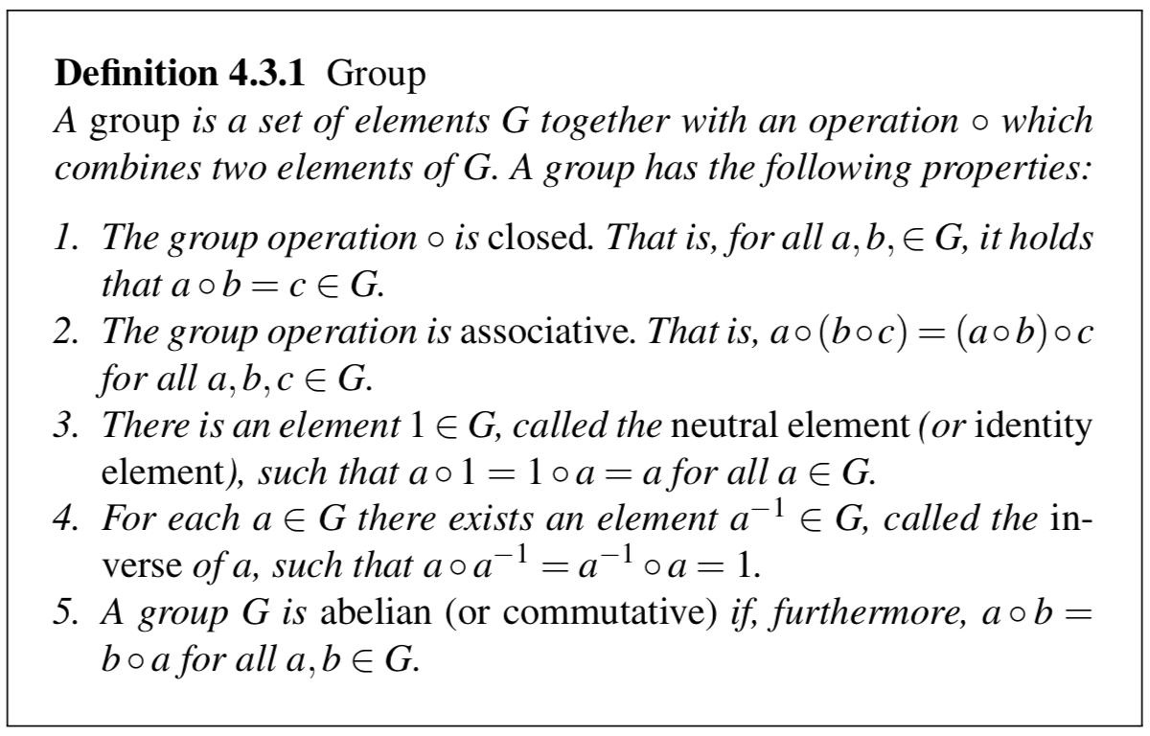
Preliminary: Group
E.g., ring Z_{m}={0,1,…,m-1} and addition modulo m with neutral element 0

Slide 6
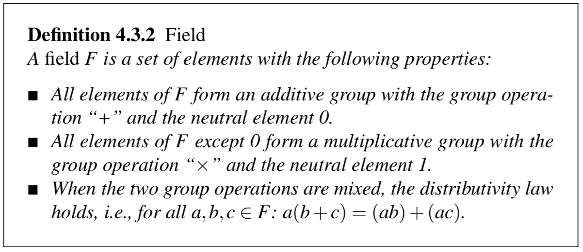
Preliminary: Field
Field is a set structure that can support all four basic arithmetic operations (i.e., addition, subtraction, multiplication, division)
E.g., the set of real number, R, is a field with neutral element 0 for the additive group and neutral element 1 for the multiplicative group

Slide 7
Preliminary: Prime Field
An integer ring Z_{p} (denoted as GF(p)) is a prime field or Galois field with a prime number of elements, if:
p is a prime
All elements of GF(p) have an inverse
Arithmetic in GF(p) is done modulo p
Remarks:
The inverse a⁻¹ of a number a is defined such that:
a a⁻¹ ≡ 1 mod m
The inverse of a number a mod m only exists if and only if:
gcd (a, m) = 1

Slide 8
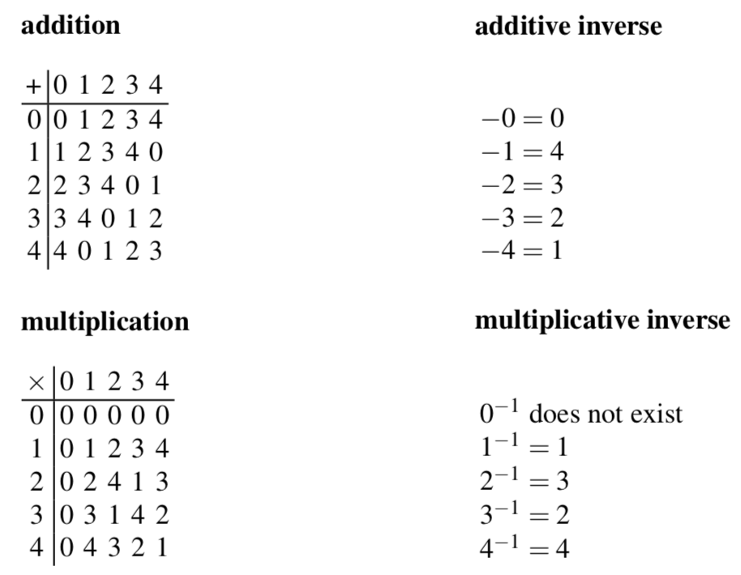
Example: Prime Field
GF(5) = Z₅ = {0,1,2,3,4}

Slide 9
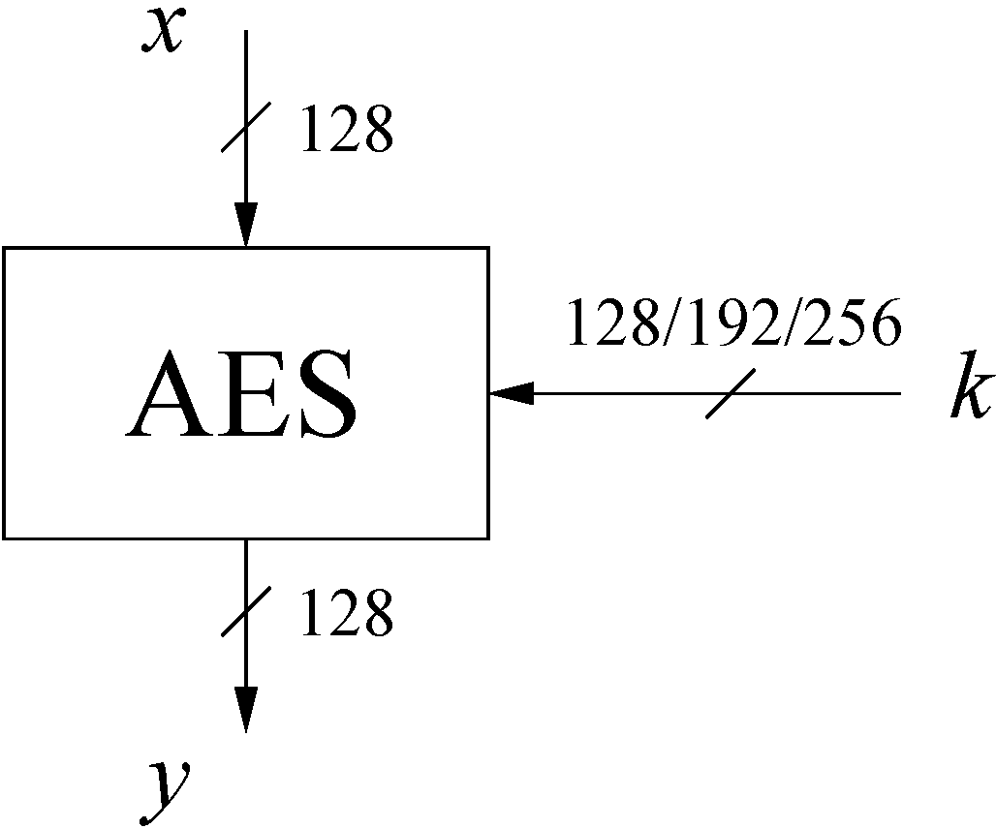
AES: Overview (1)
The number of rounds depends on the chosen key length:
Key length (bits) | Number of rounds
128 | 10
192 | 12
256 | 14

Slide 10
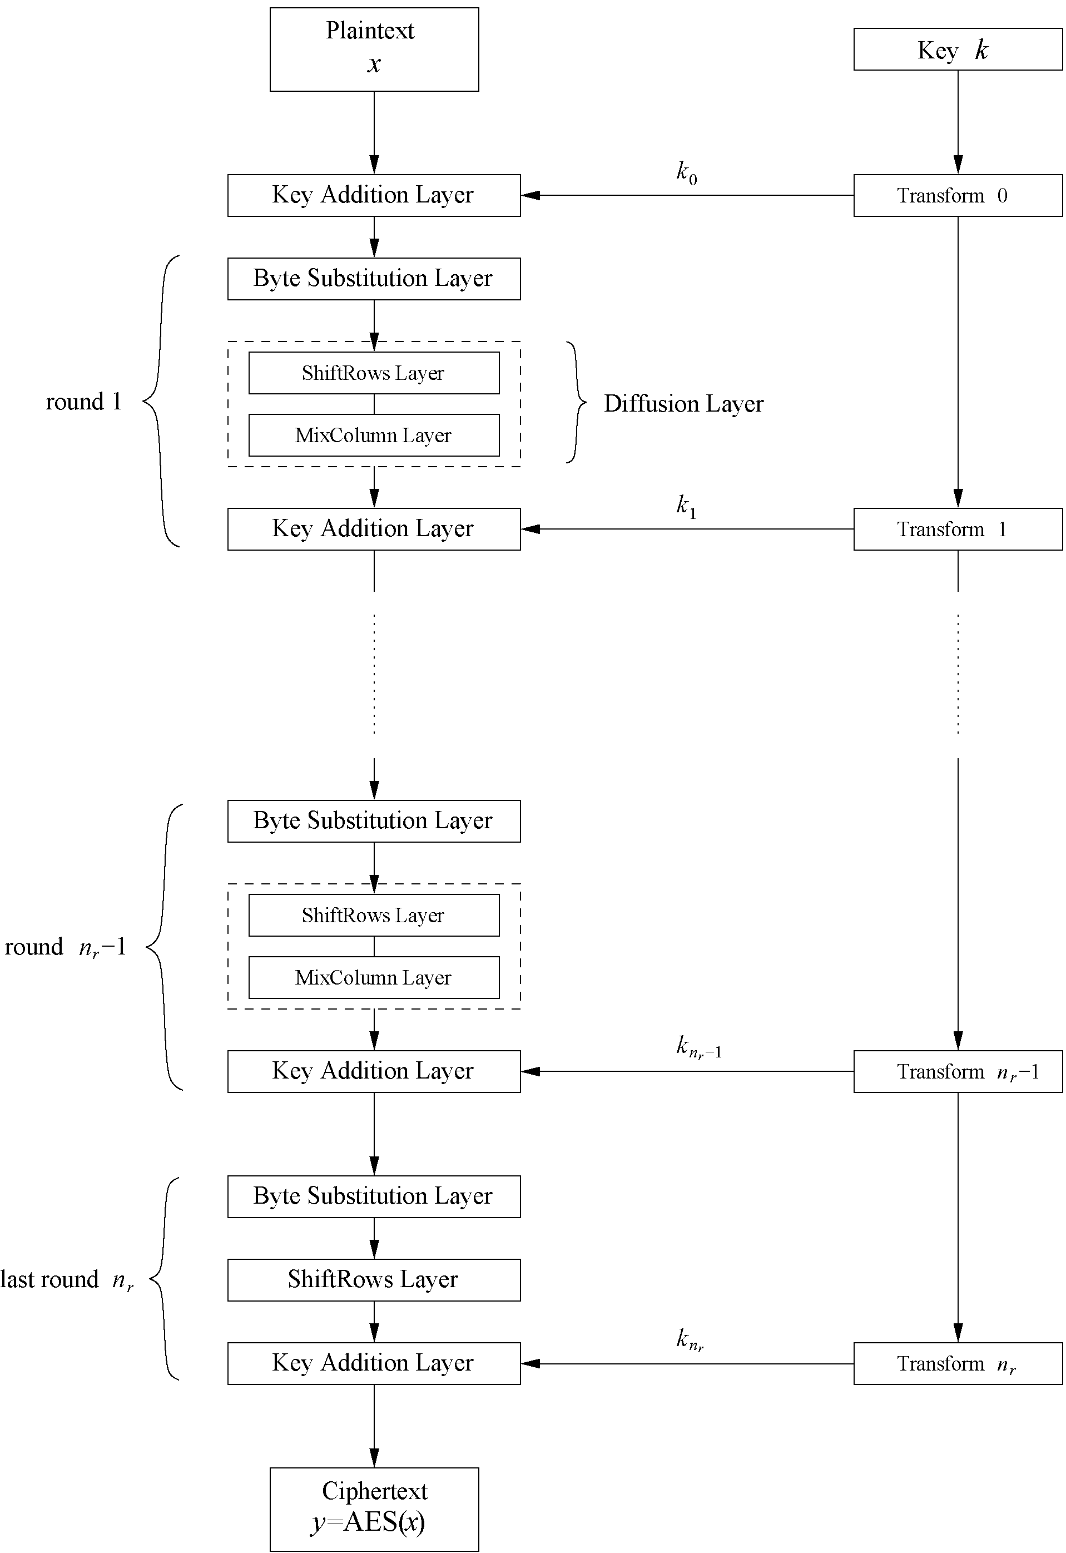
AES: Overview (2)
Iterated cipher with 10/12/14 rounds
The whole block is encrpted in each round
Each round consists of “Layers”

Slide 11
Internal Structure of AES (1)
AES is a byte-oriented cipher (1 byte = 8 bits)
The state A (i.e., the 128-bit data path) can be arranged in a 4x4 matrix:
with A₀,…, A₁₅ denoting the 16-byte input of AES
A₀ | A₄ | A₈ | A₁₂
A₁ | A₅ | A₉ | A₁₃
A₂ | A₆ | A₁₀ | A₁₄
A₃ | A₇ | A₁₁ | A₁₅

Slide 12
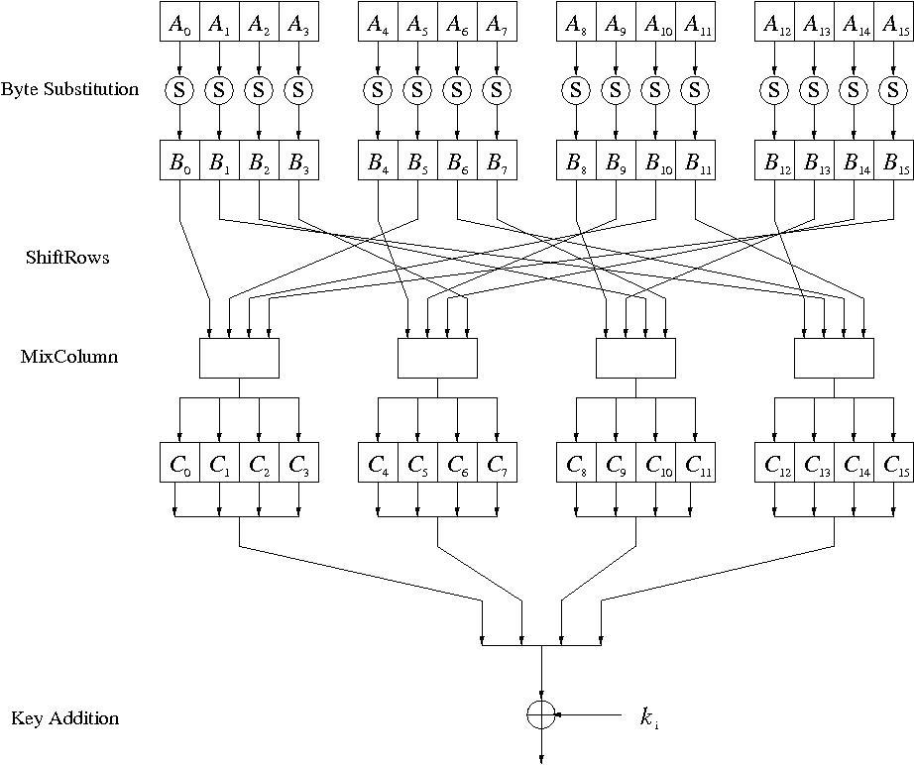
Internal Structure of AES (2)
Round function for rounds 1,2,…,n_{r-1}:
Note: In the last round, the MixColumn tansformation layer is omitted
Three Layers

Slide 13
Byte Substitution Layer
The Byte Substitution layer consists of 16
S-Boxes with the following properties:
the S-Boxes are
Identical: ByteSub(A_{i}) = B_{i}
Only nonlinear elements of AES, i.e., ByteSub(A_{i}) + ByteSub(A_{j}) ≠ ByteSub(A_{i} + A_{j}), for i,j = 0,…,15
bijective, i.e., there exists a one-to-one mapping of input and output bytes ⇒ S-Box can be uniquely reversed
In software implementations, the S-Box is usually realized as a lookup table

Slide 14
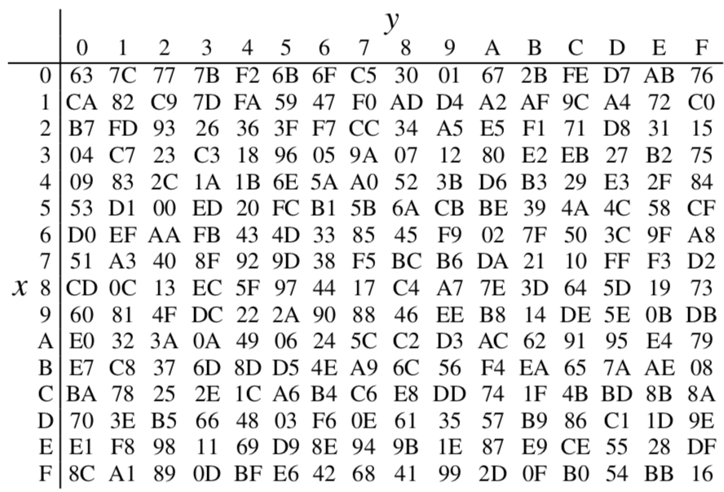
Example: S-Boxes
Realize S-Box as a 256-by-8 bit lookup table
Substitution values are in hexadecimal form
For example,
A_{i} = (11000010)₂
= (C2)_{hex}
S(A_{i}) = S((C2)_{hex})
= (25)_{hex}
= (00100101)₂
= B_{i}

Slide 15
Diffusion Layer
Provides diffusion over all input state bits
Consists of two sublayers:
ShiftRows Sublayer: Permutation of the data on a byte level
MixColumn Sublayer: Matrix operation which combines (“mixes”) blocks of four bytes
Performs a linear operation on state matrices A, B, i.e., DIFF(A) + DIFF(B) = DIFF(A + B)

Slide 16
Diffusion Layer: ShiftRows Sublayer
Rows of the state matrix are shifted cyclically:
Input matrix
Output matrix
B₀ | B₄ | B₈ | B₁₂
B₁ | B₅ | B₉ | B₁₃
B₂ | B₆ | B₁₀ | B₁₄
B₃ | B₇ | B₁₁ | B₁₅
B₀ | B₄ | B₈ | B₁₂
B₅ | B₉ | B₁₃ | B₁
B₁₀ | B₁₄ | B₂ | B₆
B₁₅ | B₃ | B₇ | B₁₁
no shift
← one position left shift
← two positions left shift
← three positions left shift

Slide 17
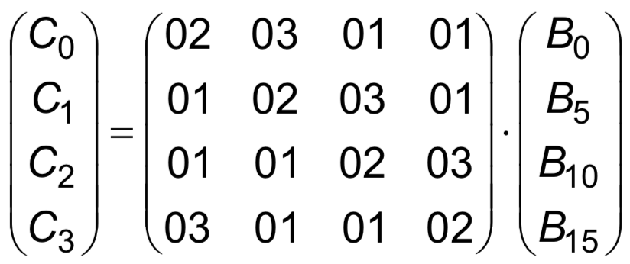
Diffusion Layer: MixColumn Sublayer
Linear transformation which mixes each
column of the state matrix
Each 4-byte column is considered as a vector and multiplied by a fixed 4x4 matrix, e.g.,
where 01, 02 and 03 are given in hexadecimal notation
All arithmetic is done in the Galois field GF(2⁸), containing 256 elements

