Slide 1
Public Key_02
Instructor: Dr. Wei (Lisa) Li
Department of Computer Science, GSU

Slide 2
Essential Number Theory for
Public-Key Algorithms

Slide 3
Euclidean Algorithm (1)
Compute the greatest common divisor gcd (r_{0,} r₁) of two integers r₀ and r₁
gcd is easy for small numbers: 1. factor r₀ and r₁ 2. gcd = highest common factor
Example: r₀ = 84 = 2 . 2 . 3 . 7 r₁ = 30 = 2 . 3 . 5
→ The gcd is the product of all common prime factors: 2 . 3 = 6 = gcd (30,84)
But: Factoring is complicated (and often infeasible) for large numbers

Slide 4
Euclidean Algorithm (2)
Observation: gcd (r_{0,} r₁) = gcd (r₀ - r₁, r₁)
→ Core idea:
Reduce the problem of finding the gcd of two given numbers to that of the gcd of two smaller numbers
Repeat process recursively
The final gcd (r_{i,} 0) = r_{i} is the answer to the original problem !

Slide 5
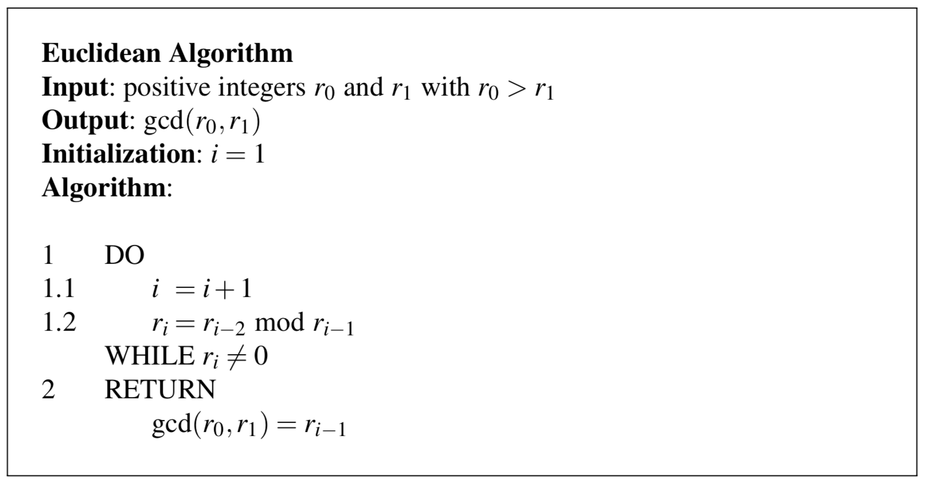
Eudlidean Algorithm (3)
Remark of WHILE loop:
gcd (r_{0,} r₁) = gcd (r₀ - r₁, r₁) = gcd (r₀ - 2r₁, r₁)
= …= gcd (r₀ -m r₁, r₁)
gcd (r_{0,} r₁) = gcd (r₀ mod r_{1,} r₁)
gcd (r_{0,} r₁) = gcd (r_{i-1,} 0) = r_{i-1}

Slide 6
Example 1: Eudlidean Algorithm
Example 1: gcd (r_{0,} r₁) for r₀ = 27 and r₁ = 21
Note: very efficient method even for long numbers. The complexity grows linearly with the number of bits

Slide 7
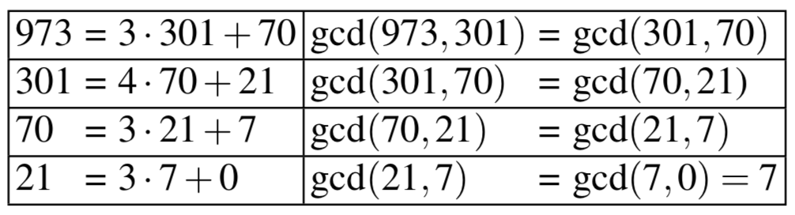
Example 2: Eudlidean Algorithm
Example 2: gcd (r_{0,} r₁) for r₀ = 973 and r₁ = 301. The gcd can be computed as follows.
Note: Reduce the problem of finding the gcd of two larger numbers to the of the gcd of two smaller numbers.

Slide 8
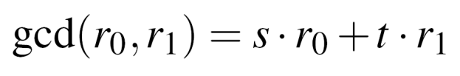
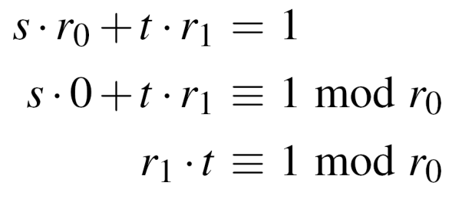
Extended Euclidean Algorithm (1)
Extend the Euclidean algorithm to find modular inverse of r₁ mod r₀
EEA computes s,t, and the gcd :
Take the relation mod r₀
→ Compare with the definition of modular inverse: t is the inverse of r₁ mod r₀
Note that gcd (r_{0,} r₁) = 1 in order for the inverse to exist

Slide 9
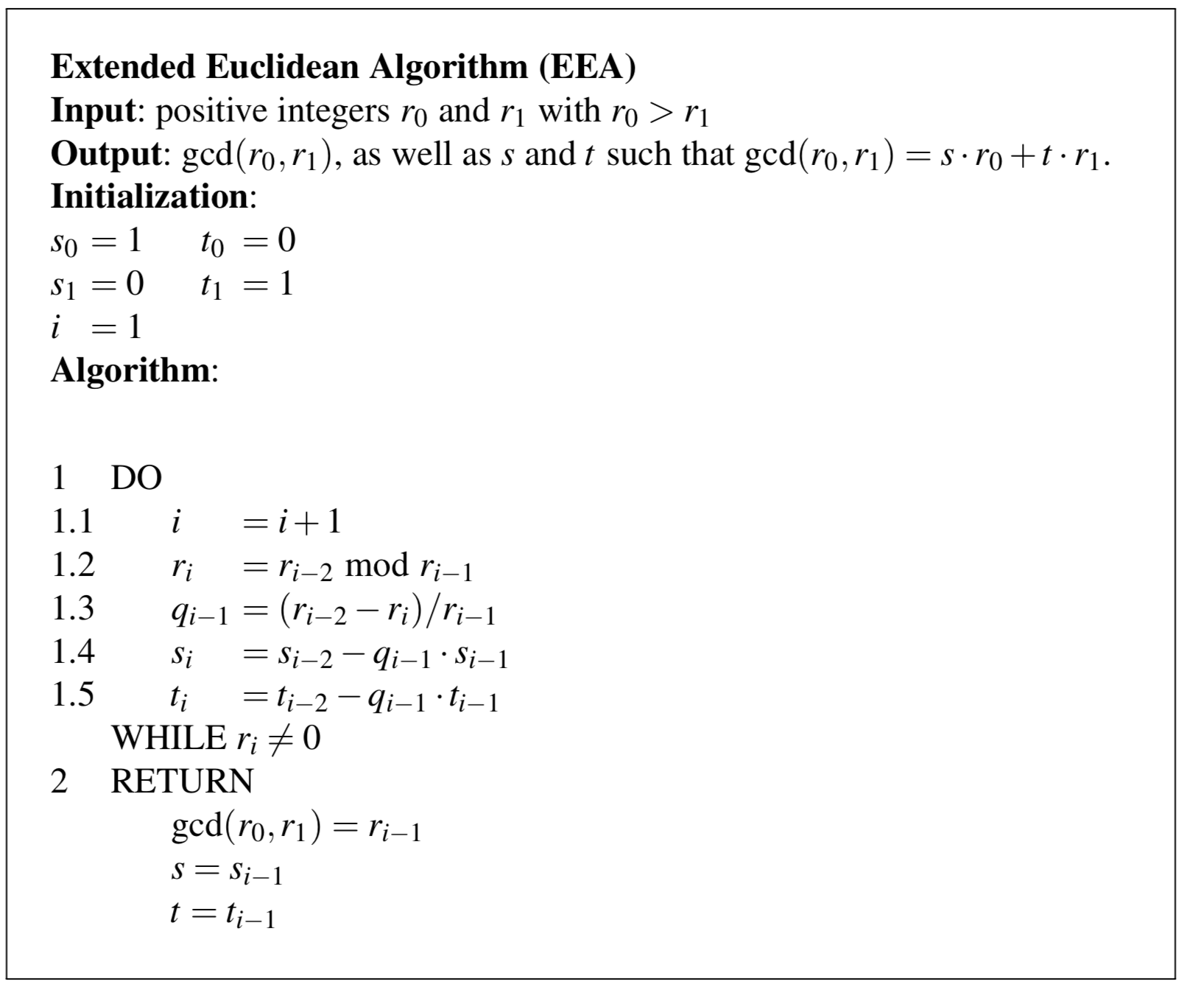
Extended Euclidean Algorithm (2)
Remark of WHILE loop:
gcd (r_{0,} r₁) = gcd (r₀ mod r_{1,} r₁)
r₂ = r₀ mod r₁, r₀ = q₁r₁ + r₂
r_{i-2} = q_{i-1}r_{i-1} + r_{i}
r_{i} = r_{i-2} - q_{i-1}r_{i-1} = [s_{i}]r₀ + [t_{i}]r₁

Slide 10
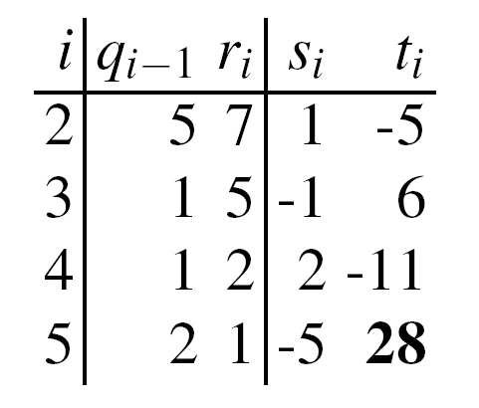
Example: EEA
Calculate the modular Inverse of 12 mod 67:
From magic table follows
Hence 28 is the inverse of 12 mod 67.
Check: 28・12 = 336 ≡ 1 mod 67
✓

Slide 11
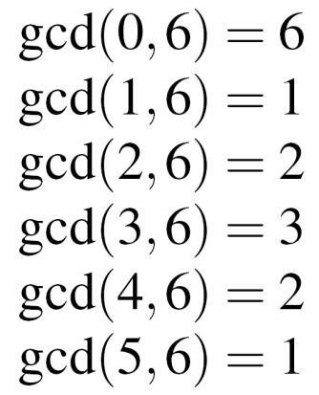
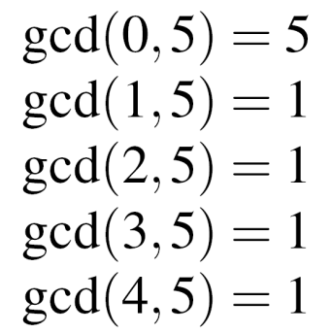
Euler's Phi Function (1)
New problem, important for public-key systems, e.g., RSA: Given the set of the m integers {0, 1, 2, …, m -1}, How many numbers in the set are relatively prime to m ?
Answer: Euler‘s Phi function Φ(m)
Example for the sets {0,1,2,3,4,5} (m=6) and {0,1,2,3,4} (m=5)
→ 1 and 5 relatively prime to m=6, → Φ(5) = 4 hence Φ(6) = 2
Testing one gcd per number in the set is extremely slow for large m.

Slide 12
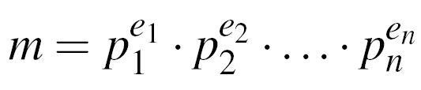
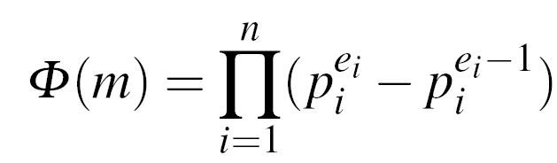
Euler‘s Phi Function (2)
If canonical factorization of m known: (where p_{i} primes and e_{i} positive integers)
then calculate Phi according to the relation:
Phi especially easy for e_{i} = 1, e.g., m = p . q → Φ(m) = (p-1) . (q-1)
Example m = 899 = 29 . 31: Φ(899) = (29-1) . (31-1) = 28 . 30 = 840
Note: Finding Φ(m) is computationally easy if factorization of m is known (otherwise the calculation of Φ(m) becomes computationally infeasible for large numbers)

Slide 13
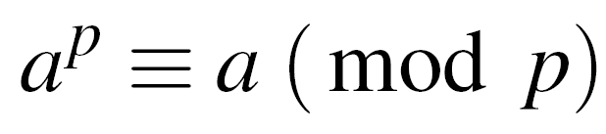
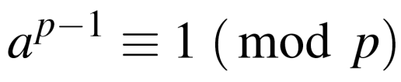

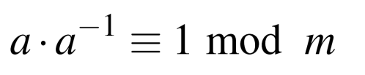
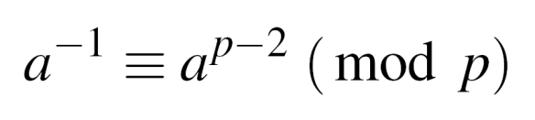


Fermat‘s Little Theorem
Given a prime p and an integer a:
Can be rewritten as:
Use: Find modular inverse, if p is prime. Rewrite to
Comparing with definition of the modular inverse:
→ is the modular inverse modulo a prime p
Example: a = 2, p = 7
Fermat‘s Little Theorem works only modulo a prime p
✓

Slide 14
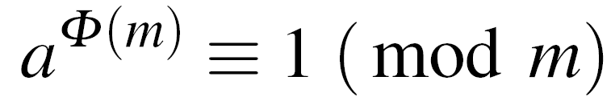

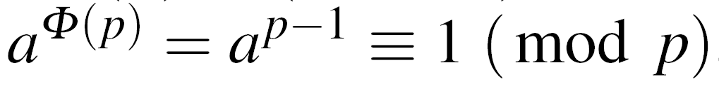
Euler‘s Theorem
Generalization of Fermat‘s little theorem to any integer modulus
Given two relatively prime integers a and m :
Example: m=12, a=5
1. Calculate Euler‘s Phi Function
2. Verify Euler‘s Theorem
Fermat‘s little theorem = special case of Euler‘s Theorem
For a prime p:
→ Fermat:

Slide 15
Lessons Learned
Public-key algorithms have capabilities that symmetric ciphers don’t have, in particular digital signature and key establishment functions.
Public-key algorithms are computationally intensive (a nice way of saying that they are slow), and hence are poorly suited for bulk data encryption.
Only three families of public-key schemes are widely used. This is considerably fewer than in the case of symmetric algorithms.
The extended Euclidean algorithm allows us to compute modular inverses quickly, which is important for almost all public-key schemes.
Euler’s phi function gives us the number of elements smaller than an integer n that are relatively prime to n. This is important for the RSA crypto scheme.

