Slide 1
Datacenter Networks
Presented by: Krishangee Bora, Wasfi Momen, and Swapnil Pandey

Slide 2
Introduction
Today, datacenters manage huge data flows across the world that lead to oversubscription, efficiency loss, and missed deadlines.
One problem is the need to fairly schedule jobs across a geo-distributed network.
Previous research has shown many attempts but require either hardware modifications or lack variables that need to be addressed.
Another problem lies in the unique congestion control of different, competitive flows within a datacenter.
In the past, managing congestion meant switch modifications or breaking of transport layer protocols.
Notes:
Previous research: Iridium assumed inter-datacenter connections were congestion-free, Flutter optimized for tasks of a single job but not multiple jobs [Chen et al., 8]

Slide 3
Introduction (cont.)
Both solutions presented deal with two main concepts: performance isolation and objective scheduling.
TCP only manages congestion between flows.
Datacenter A needs to consider the resources and jobs of Datacenter B.
Let us look at the first problem of fairly scheduling jobs....
DC 2
DC 3
DC 1
DC 4

Slide 4
Placeholder (Delete Later)
Order
Wasfi
Krishangee
Swapnil
Wasfi
Krishangee
Wasfi
Swapnil
Krishangee
If we can cut the first paper down to few slides then put 2nd paper in the first problem section as well
Layout:
TCP bad, need to account for other flows; Assumption of intra-datacenter
One problem is the scheduling of tasks
Model of problem
Constraints on their own slide
Lexmin
SCO
TUC
Algorithm with highlight and diagram at each line
Implemented in Apache Spark
One problem is the congestion control for different application tasks
Assumption of Clos-only networks, weight assigned by admin
Latency, Deadline, Completion Sensitive explanation and their proposed solutions
Explanation of UCC and PCC aka the SCC
ECN bit + weight is how to modify flows congestion
Connection of first paper: can be modeled as a uitl func of computation time of task + computatation task of the longest task time (as by Chen PhD)
Implementation
Modeling a utility function in python
Color | Name
 | Fade Black (#050401)
 | American Orange (#FE8900)
 | Anti-Flash White (#F0F0F1)
 | Permanent Geranium Lake (#D92B2B)
 | #009DDC
 | #FF5978
Speaking
Give high-level concept
Give problem statement
Give solution
Link to math
Notes:
Two problems: Performance Isolation and Multi-objective.
These two problems can be represented in math as the lexicographical, separate convex objective, and totally unimodular linear constraints to provide cost minimization for problems.

Slide 5
Scheduling Jobs Fairly
Our objective is to iteratively optimize the worst-performing tasks of each job.
To do this, the authors create a structure to rank jobs based on their slowest task by three problems:
The Lexmin Problem
Separable Convex Objective
Totally Unimodular Constraints
We can optimize the objective by using a linear programming model.
Notes:
A job is made up of many parallel, independent tasks.

Slide 6
Scheduling Jobs Fairly: Lexmin Problem
What is the lexmin problem?
Consider a set of data centres
Each doing a function
The network transfer time is determined by both the amount of data to be read, and the bandwidth on the link the data traverses.
What is network transfer time?
Network transfer time contains := read input data and execution time

Slide 7
Scheduling Jobs Fairly: Lexmin Problem
Primary Agenda :-
Obtain optimal task without exceeding resource capabilities
Guiding Principle:-
Demarcate according to worst performance with respect to completion time

Slide 8
Scheduling Jobs Fairly: Lexmin Problem
Explanation At an overview :-
A job k completes when its slowest task finishes
As the computing slots in all the datacenters are shared by tasks from multiple jobs, we would like to obtain an optimal task assignment without exceeding the resource capacities.
To be more specific, our scheduler would decide the assignment of all the tasks, aiming to optimize the worst performance

Slide 9
Scheduling Jobs Fairly: Lexmin Problem (Contd.)
This is executed repeatedly until the completion times have been optimized for all the jobs.
Such an objective can be rigorously formulated as a lexicographical minimization problem.

Slide 10
Explanation in terms of mathematical definitions
Consider a simple array.
We want to say array[i]'s task will be smaller than array[i+1].
The lexmin abstracts the tasks into alpha and beta where alpha will be <= beta.
This intuitively means anything in alpha can be in beta, but not everything in beta can be in alpha
This is similar to a datacenter. Smaller/Faster tasks can be sent to a more robust datacenter but bigger/slower tasks can't be sent to a smaller datacenter.
So we can describe alpha and beta as our inclusive/exclusive sets. Can be an indicator function in the LP problem.

Slide 11
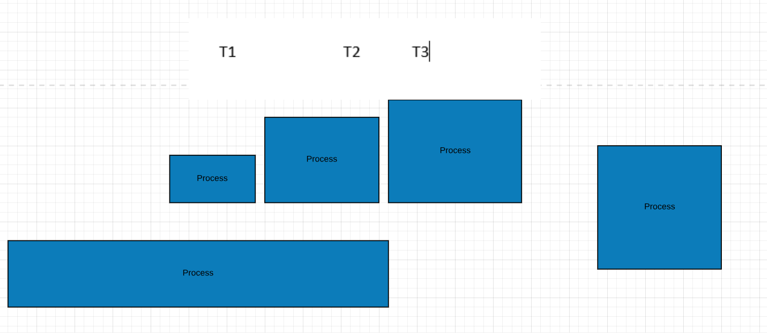
Diagrammatic explaination for lex min

Slide 12
The following is an abstraction of the algorithm and used for understanding SCO only. This is not how it works in the algo.
Here we have a Job of three different tasks. T1 is less than T2 which is less than T3.
Lets say T2's variables were computed and sent to the datacenter first. Our tasks queue is empty so we just add it in.
It is both the max and min task time at this point
So now we get T3 which is greater than T2. We compare T2 and T3 by lexmin a<b and by SCO to see T3's variables and greater than T2.
T3 is assigned as the new max and slower than T2.
Finally, T1 is brought in. It is seen as the fastest task since we compare to T3 and T2.
T1 is assigned as the min and faster than T2 and T3.
The algo then decides which task to allocate. T3 might be sent to more robust datacenter. T1 might be sent to a weaker datacenter.
Job K­₁ | 𝜏₁ < 𝜏₂ < 𝜏₃
max |  | min
𝜏₂
max | 𝜏₃ | 𝜏₂ | min
𝜏₃
max | 𝜏₃ | 𝜏₂ | 𝜏₁ | min
𝜏₁

Slide 13
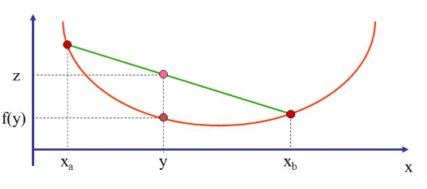
Separable Convex Objective
SCO provides the structure to provide an optimal solution for all the variables of the objective.
The lexmin provided a ranking of tasks, the SCO provides a ranking of the variables (you need to prove that not only the tasks are rankable, but the variables of the tasks too like execution time.
The great part about SCO is that we can optimize and guarantee descending order of impact of each task. Aka each task's execution time T is definitively less than the one next to it. T1<= T2 <= T3
Not only that, but we can guarantee that the task that is worst performing will always be known. Aka array[0] will contain the worst performing task.
What do we understand by Convex function?
Convex functions are largely known to be incorporated in optimization problem where we need to minimize or maximize certain tasks which are defined by discrete properties/constraints.
This particular problems can be characterized under Convex Optimization problems - which tells us that if we have a convex objective and a convex domain then there has to be at most one optimal solution.
By definition: for Convex function local minimum = global minimum

Slide 14
Separable Convex Objective(cont.)
Provide a generic structure to provide an optimal solution for all the variables of the objective.
As we have seen in Lexmin problem, it provides sorting/sequencing of tasks based on bandwidth usage and network transfer time, however the Separable Convex Objective also provide ordering of certain tasks based on variables like Computation time or execution time.
This sorting ensures us that by the end of process we’ll get an array of tasks in descending order with respect to their execution time (1st element of this array would have the largest completion time and so on).
Let us understand it better with a simple diagram-

Slide 15
Same diagram from lexmin. Instead here we consider variable updates instead of task arrival.
Here, let us say there is some congestion happening so the network transfer time is longer.
The task time needs to be updated since it is longer, we do this by incrementing phi.
Phi is just another variable representing task time. It helps in LP problem to separate variables you want to compare to each other.
You don't want to compare the network transfer time of every task to every other task, so instead you compare just the tasks themselves as a variable.
Job K­₁ | 𝜏₁ < 𝜏₂ < 𝜏₃
φ = network transfer time + execution time
max | 𝜏₃ | 𝜏₂ | 𝜏₁ | min
+ φ₁
max | 𝜏₃ | 𝜏₁ | 𝜏₂ | min

Slide 16
Scheduling Jobs Fairly: Totally Unimodular Problem
TMC gives the mechanism to decide whether a task should be assigned to the a datacenter.
In LP problems, we steer clear or real numbers, only integers.
0,1 can be an indicator of whether or not to include a value (aka constraint) to ranking of the lexmin and SCO objectives.
Now that we have the setup of ranking both each tasks and the task's variables (e.g. execution time). We need to satisfy the constraints that:
No task shall take no more than the total amount of computational resources in a datacenter
Each task can only be assigned to one datacenter
We can use the property of totally unimodular matrices decide whether a task should be assigned to a datacenter.
1 0 1
0 1 0
0 0 1
Notes:
TMC gives the mechanism to decide whether a task should be assigned to the a datacenter.
In LP problems, we steer clear or real numbers, only integers.
0,1 can be an indicator of whether or not to include a value (aka constraint) to ranking of the lexmin and SCO objectives.

Slide 17
A totally unimodular matrix is just a matrix that:
has elements and determinant in {-1, 0, 1}
Has subset of each row R1 and R2 where R2 - R1 <= 1.
Each cell in the matrix is a task. 0 for assigned already and 1 for not assigned.
We want to assign a task to a datacenter, but we must:
Make sure the number of tasks assigned does not exceed the computation slots of the DC
Make sure every task is assigned to at least one datacenter.
Take this matrix. The total sum is 4 tasks. So we could assign all to DC2, but that's unfair.
Lets try looking at the sum of each row.
2
1 0 1
0 1 0
0 0 1
DC 1
1
DC 3
Each binary number is either an assigned (0) or unassigned (1) task of worst completion time.
4
DC 2
𝜏₁₁ | 𝜏₁₃ | 𝜏₂₂ | 𝜏₃₃
Notes:
A totally unimodular matrix is just a matrix that:
has elements and determinant in {-1, 0, 1}
Has subset of each row R1 and R2 where R2 - R1 <= 1.
Each cell in the matrix is a task. 0 for assigned already and 1 for not assigned.
We want to assign a task to a datacenter, but we must:
Make sure the number of tasks assigned does not exceed the computation slots of the DC
Make sure every task is assigned to at least one datacenter.
Take this matrix. The total sum is 4 tasks. So we could assign all to DC2, but that's unfair.
Lets try looking at the sum of each row.

Slide 18
𝜏₂₂
Great! Now the sum of each row shows us we can assign a row subset to each datacenter.
That way, we don't exceed the compute slots of any datacenters.
What if row subset is > any compute slots? What if total sum exceeds total compute cost of all datacenters put together?
If that happens, you're breaking a constraint of compute slots which means holy crap you have another problem entirely. (Using too much compute power)
Can solve this by waiting for a timeout, reallocate. Or split the task into several tasks.
𝜏₃₃
2
1 0 1
0 1 0
0 0 1
2
1 1
DC 1
1
DC 3
4
DC 2
𝜏₁₁ | 𝜏₁₃
Notes:
Great! Now the sum of each row shows us we can assign a row subset to each datacenter.
That way, we don't exceed the compute slots of any datacenters.
What if row subset is > any compute slots? What if total sum exceeds total compute cost of all datacenters put together?
If that happens, you're breaking a constraint of compute slots which means holy crap you have another problem entirely. (Using too much compute power)
Can solve this by waiting for a timeout, reallocate. Or split the task into several tasks.

Slide 19
Stack congestion control
What is it :-
here a distributed host based allocation design whereby
UCC manages competition amongst divisions ,
PCC optimises its performance objective

Slide 20
Are all flows the same ?
No,
flows have different objectives
Why so?
varying service requirements
for example few may be focussed on vm’s ,containers and java processes.

Slide 21
Types of flows
1)Latency sensitive :-
means service is in queue after queue copies of tasks in multiple servers .
Agenda:- difference in computational time can be adjusted
2)deadline sensitive:-
current distributed resource access models provide varying degrees of resource control: from limited or none in grid batch systems to explicit in cloud systems.
Agenda :- orchestration possible at reasonable costs on batch queue grid and cloud systems with or without explicit resource control.
3)completion sensitive :-all the flows which share the same performance objective is classified as one tenant
Agenda :- minimising average flow completion time leads to improvemnet in performance

Slide 22
Types of flows (contd..)
Agenda :- orchestration possible at reasonable costs on batch queue grid and cloud systems with or without explicit resource control.
3)completion sensitive :-
all the flows which share the same performance objective is classified as one tenant
Agenda :- minimising average flow completion time leads to improvement in performance

Slide 23
Aim of SCO
to achieve performance isolation ,admins can assign weights to different divisions that share underlying nature
Limitiations
different approaches may detect congestion differently
difference in priority of cs and ds
fst pass may offer optimization but needs an ideally scalable control plane and time synchronization

Slide 24
Challenges and solutions
Challenge 1 :-
Achieve weighted bandwidth allocation by controlling active flows within each division in a distributed transparent way
Solution :-SCC introduces tenant-objective tunnel
Challenge 2
how to support 2 congestion control mechanisms
Solution :- Congestion signal
b)Control Law

Slide 25
Implementation
Modeling a utility function in python
Chen's (Scheduling Jobs) paper is actually a PhD thesis that expands a lot for the problem.
Actually addresses congestion between flows like the second (Stacked Congestion Control) paper.
We want to create a utility function across the tasks of each datacenter. This can be computed for every task along with their constraints.
Optimize for utility vs minimizing worst completion time jobs
Utility use case examples
Economic incentive
Earthquake scenario

Slide 26
Same diagram as SCO. Here we simply trade phi for a utility variable alpha.
Note that this is not a simple exchange mathematically. You will need to scale alpha accordingly to keep max-min fairness still at play.
Need to craft a special utility function for this.
Job K­₁ | 𝜏₁ < 𝜏₂ < 𝜏₃ | Uk (αk) = log αk, ∀k∈K
ɑ = utility parameter
max | 𝜏₃ | 𝜏₂ | 𝜏₁ | min
+ɑ₁
max | 𝜏₃ | 𝜏₁ | 𝜏₂ | min
Notes:
Same diagram as SCO. Here we simply trade phi for a utility variable alpha.
Note that this is not a simple exchange mathematically. You will need to scale alpha accordingly to keep max-min fairness still at play.
Need to craft a special utility function for this.

