Slide 1
Computer Networks:
Domain Name System
Notes:
1

Slide 2

Domain Name System
The domain name system (DNS) is an application-layer protocol for mapping domain names to IP addresses
DNS
www.example.com
208.77.188.166
http://www.example.com
My Example Blog Spot
http://208.77.188.166
My Example Blog Spot
Vacation
Savings
Vacation
Savings
Notes:
2
2

Slide 3

Domain Name System
DNS provides a distributed database over the internet that stores various resource records, including:
Address (A) record: IP address associated with a host name
Mail exchange(MX) record: mail server of a domain
Name server (NS) record: authoritative server for a domain
Example DNS entries from http://www.maradns.org/tutorial/recordtypes.html
Notes:
3
3

Slide 4
Name Servers
Domain names:
Two or more labels, separated by dots (e.g., cs166.net)
Rightmost label is the top-level domain (TLD)
Hierarchy of authoritative name servers
Information about root domain
Information about its subdomains (A records) or references to other name servers (NS records)
The authoritative name server hierarchy matches the domain hierarchy: root servers point to DNS servers for TLDs, etc.
Root servers, and servers for TLDs change infrequently
DNS servers refer to other DNS servers by name, not by IP: sometimes must bootstrap by providing an IP along with a name, called a glue record

Slide 5
DNS Tree
A xxx.com ###########
A xxx.com ###########
A xxx.com ###########
A xxx.com ###########
A xxx.com ###########
A xxx.com ###########
A xxx.com ###########
A xxx.com ###########
A xxx.com ###########
A xxx.com ###########
A xxx.com ###########
A xxx.com ###########
A xxx.com ###########
A xxx.com ###########
A xxx.com ###########
A xxx.com ###########
A xxx.com ###########
A xxx.edu ###########
A xxx.edu ###########
A xxx.edu ###########
A xxx.edu ###########
A xxx.edu ###########
A xxx.edu ###########
A xxx.edu ###########
A xxx.edu ###########
A xxx.edu ###########
A xxx.edu ###########
A xxx.edu ###########
A xxx.edu ###########
A xxx.edu ###########
A xxx.edu ###########
com
edu
...
...
...
google.com
microsoft.com
stanford.edu
brown.edu
A google.com 66.249.91.104
A xxx.google.com ###########
A xxx.google.com ###########
A xxx.google.com ###########
A xxx.google.com ###########
A xxx.google.com ###########
A xxx.google.com ###########
A xxx.google.com ###########
A xxx.google.com ###########
A xxx.google.com ###########
A xxx.google.com ###########
A xxx.google.com ###########
A xxx.google.com ###########
A xxx.google.com ###########
Amicrosoft.com 207.46.232.182
A xxx.microsoft.com ###########
A xxx.microsoft.com ###########
A xxx.microsoft.com ###########
A xxx.microsoft.com ###########
A xxx.microsoft.com ###########
A xxx.microsoft.com ###########
A xxx.microsoft.com ###########
A xxx.microsoft.com ###########
A xxx.microsoft.com ###########
A xxx.microsoft.com ###########
A xxx.microsoft.com ###########
A xxx.microsoft.com ###########
A xxx.microsoft.com ###########
A xxx.microsoft.com ###########
A xxx.microsoft.com ###########
A stanford.edu 171.67.216.18
A xxx.stanford.edu 171.67.###.###
A xxx.stanford.edu 171.67.###.###
A xxx.stanford.edu 171.67.###.###
A xxx.stanford.edu 171.67.###.###
A xxx.stanford.edu 171.67.###.###
A xxx.stanford.edu 171.67.###.###
A xxx.stanford.edu 171.67.###.###
A xxx.stanford.edu 171.67.###.###
A xxx.stanford.edu 171.67.###.###
A xxx.stanford.edu 171.67.###.###
A xxx.stanford.edu 171.67.###.###
A xxx.stanford.edu 171.67.###.###
A xxx.stanford.edu 171.67.###.###
A brown.edu 128.148.128.180
A xxx.brown.edu 128.148.###.###
A xxx.brown.edu 128.148.###.###
A xxx.brown.edu 128.148.###.###
A xxx.brown.edu 128.148.###.###
A xxx.brown.edu 128.148.###.###
A xxx.brown.edu 128.148.###.###
A xxx.brown.edu 128.148.###.###
A xxx.brown.edu 128.148.###.###
A xxx.brown.edu 128.148.###.###
A xxx.brown.edu 128.148.###.###
A xxx.brown.edu 128.148.###.###
A xxx.brown.edu 128.148.###.###
A xxx.brown.edu 128.148.###.###
A xxx.brown.edu 128.148.###.###
cs.brown.edu
A cs.brown.edu 128.148.32.110
A xxx.brown.edu 128.148.32.###
A xxx.brown.edu 128.148.32.###
A xxx.brown.edu 128.148.32.###
A xxx.brown.edu 128.148.32.###
A xxx.brown.edu 128.148.32.###
A xxx.brown.edu 128.148.32.###
A xxx.brown.edu 128.148.32.###
A xxx.brown.edu 128.148.32.###
A xxx.brown.edu 128.148.32.###
resource records

Slide 6
Namespace Management
ICANN: Internet Corporation for Assigned Names and Numbers
ICANN has the overall responsibility for managing DNS. It controls the root domain, delegating control over each top-level domain to a domain name registry
Along with a small set of general TLDs, every country has its own TLD -- (cTLDS) – controlled by the government.
ICANN is the governing body for all general TLDs
Until 1999 all .com, .net and .org registries were handled by Network Solutions Incorporated.
After November, 1999, ICANN and NSI had to allow for a shared registration system and there are currently over 500 registrars in the market
Also since 1999, ICANN has created additional gTLDs including some which are sponsored by consortiums or groups of companies.
Notes:
6
6

Slide 7
Top Level Domains
Started in 1984
Originally supposed to be named by function
.com for commercial websites, .mil for military
Eventually agreed upon unrestricted TLDs for .com, .net, .org, .info
In 1994 started allowing country TLDs such as .it, .us
Tried to move back to hierarchy of purpose in 2000 with creation of .aero, .museum, etc.

Slide 8
Name Resolution
Zone: collection of connected nodes with the same authoritative DNS server
Resolution method when answer not in cache:
root
name server
Where is www.example.com?
ISP DNS
Server
Try com nameserver
Client
Where is www.example.com?
Where is www.example.com?
com
name server
Try example.com nameserver
208.77.188.166
Where is www.example.com?
208.77.188.166
example.com
name server

Slide 9
Recursive Name Resolution
Server B
Resolver
cache
Server A
referral
Local Machine
query
Resolver
query
Application
Resolver
answer
answer
cache
cache

Slide 10
Iterative Name Resolution
. (root)
Resolver
cache
1
answer
query
.com
Local Name Server
Resolver
2
query
Application
Resolver
answer
google.com
cache
cache
query
Resolver
answer
3
cache

Slide 11
Authoritative Name Servers
Control distributed among authoritative name servers (ANSs)
Responsible for specific domains
Can designate other ANS for subdomains
ANS can be master or slave
Master contains original zone table
Slaves are replicas, automatically updating
Makes DNS fault tolerant, automatically distributes load
ANS must be installed as a NS in parents' zone

Slide 12
Dynamic Resolution
Many large providers have more than one authoritative name server for a domain
Problem: need to locate the instance of domain geographically closest to user
Proposed solution: include first 3 octets of requester's IP in recursive requests to allow better service
Content distribution networks already do adaptive DNS routing

Slide 13
DNS Caching
There would be too much network traffic if a path in the DNS tree would be traversed for each query
Root zone would be rapidly overloaded
DNS servers cache results for a specified amount of time
Specified by ANS reply's time-to-live field
Operating systems and browsers also maintain resolvers and DNS caches
View in Windows with command ipconfig /displaydns
Associated privacy issues
DNS queries are typically issued over UDP on port 53
16-bit request identifier in payload

Slide 14
DNS Caching
Step 1: query yourdomain.org
Local Machine
Local NS
Authoritative
Name Server
Resolver
Application
Resolver
query
query
cache
cache
Step 2: receive reply and cache at local NS and host
Local Machine
Local NS
Authoritative
Name Server
answer
Resolver
answer
Application
Resolver
cache
cache

Slide 15
DNS Caching (con'd)
Step 3: use cached results rather than querying the ANS
Local NS
Local Machine 1
Application
Resolver
Resolver
cache
cache
query
Local Machine 2
Application
Resolver
answer
cache
Step 4: Evict cache entries upon ttl expiration

Slide 16
Pharming: DNS Hijacking
Changing IP associated with a server maliciously:
208.77.188.166
74.208.31.63
Normal
DNS
Pharming
attack
www.example.com
www.example.com
http://www.example.com
My Premium Blog Spot
http://www.example.com
My Premium Blog Spot
userID:
password:
userID:
password:
Phishing: the different web sites look the same.

Slide 17
DNS Cache Poisoning
Basic idea: give DNS servers false records and get it cached
DNS uses a 16-bit request identifier to pair queries with answers
Cache may be poisoned when a name server:
Disregards identifiers
Has predictable ids
Accepts unsolicited DNS records
Notes:
17
17
There are 3 main different ways to do DNS cache poisoning. The first relies on redirecting the nameserver of the attacker's domain to the nameserver of the target domain, and then assigning this target nameserver a fake IP address. The second variant relies on redirecting the nameserver of another, unrelated domain to a fake nameserver. The third variant just involves “racing” the real nameserver to give an answer.

Slide 18
DNS Cache Poisoning Prevention
Use random identifiers for queries
Always check identifiers
Port randomization for DNS requests
Deploy DNSSEC
Challenging because it is still being deployed and requires reciprocity
Notes:
18
18
There are 3 main different ways to do DNS cache poisoning. The first relies on redirecting the nameserver of the attacker's domain to the nameserver of the target domain, and then assigning this target nameserver a fake IP address. The second variant relies on redirecting the nameserver of another, unrelated domain to a fake nameserver. The third variant just involves “racing” the real nameserver to give an answer.

Slide 19
DNSSEC
Guarantees:
Authenticity of DNS answer origin
Integrity of reply
Authenticity of denial of existence
Accomplishes this by signing DNS replies at each step of the way
Uses public-key cryptography to sign responses
Typically use trust anchors, entries in the OS to bootstrap the process
Notes:
19

Slide 20
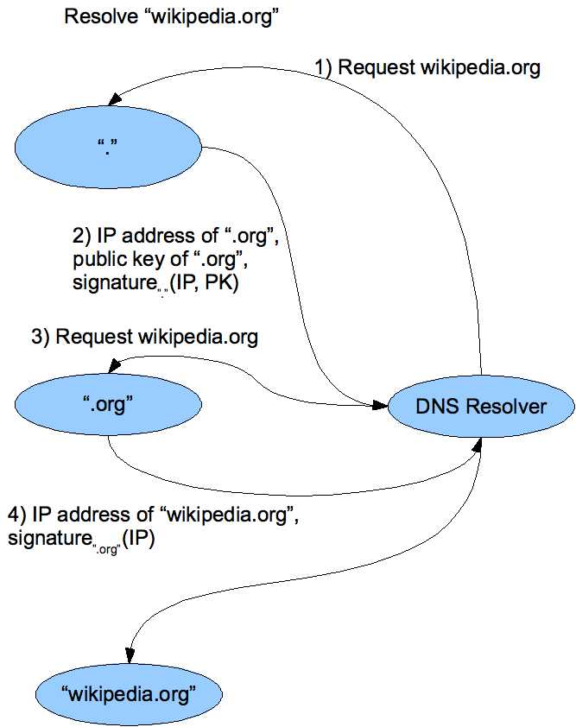
DNS Signing
Notes:
20

Slide 21
DNSSEC Deployment
As the internet becomes regarded as critical infrastructure there is a push to secure DNS
NIST is in the process of deploying it on root servers now
May add considerable load to dns servers with packet sizes considerably larger than 512 byte size of UDP packets
There are political concerns with the US controlling the root level of DNS

Slide 22
Firewalls, Tunnels, and Network Intrusion Detection

Slide 23
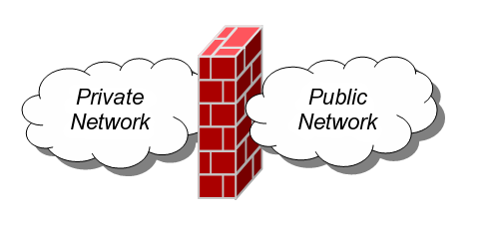
Firewalls
A firewall is an integrated collection of security measures designed to prevent unauthorized electronic access to a networked computer system.
A network firewall is similar to firewalls in building construction, because in both cases they are intended to isolate one "network" or "compartment" from another.

Slide 24
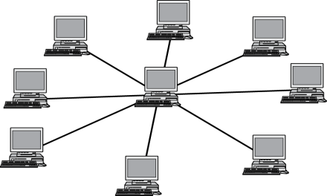




Firewall Policies
To protect private networks and individual machines from the dangers of the greater Internet, a firewall can be employed to filter incoming or outgoing traffic based on a predefined set of rules called firewall policies.
Trusted internal network
Firewall policies
Untrusted
Internet
Firewall

Slide 25
Policy Actions
Packets flowing through a firewall can have one of three outcomes:
Accepted: permitted through the firewall
Dropped: not allowed through with no indication of failure
Rejected: not allowed through, accompanied by an attempt to inform the source that the packet was rejected
Policies used by the firewall to handle packets are based on several properties of the packets being inspected, including the protocol used, such as:
TCP or UDP
the source and destination IP addresses
the source and destination ports
the application-level payload of the packet (e.g., whether it contains a virus).

Slide 26
Blacklists and White Lists
There are two fundamental approaches to creating firewall policies (or rulesets) to effectively minimize vulnerability to the outside world while maintaining the desired functionality for the machines in the trusted internal network (or individual computer).
Blacklist approach
All packets are allowed through except those that fit the rules defined specifically in a blacklist.
This type of configuration is more flexible in ensuring that service to the internal network is not disrupted by the firewall, but is naïve from a security perspective in that it assumes the network administrator can enumerate all of the properties of malicious traffic.
Whitelist approach
A safer approach to defining a firewall ruleset is the default-deny policy, in which packets are dropped or rejected unless they are specifically allowed by the firewall.

Slide 27
Firewall Types
packet filters (stateless)
If a packet matches the packet filter's set of rules, the packet filter will drop or accept it
"stateful" filters
it maintains records of all connections passing through it and can determine if a packet is either the start of a new connection, a part of an existing connection, or is an invalid packet.
application layer
It works like a proxy it can “understand” certain applications and protocols.
It may inspect the contents of the traffic, blocking what it views as inappropriate content (i.e. websites, viruses, vulnerabilities, ...)

Slide 28

Stateless Firewalls
A stateless firewall doesn’t maintain any remembered context (or “state”) with respect to the packets it is processing. Instead, it treats each packet attempting to travel through it in isolation without considering packets that it has processed previously.
SYN
Seq = x
Port=80
Client
SYN-ACK
Seq = y
Ack = x + 1
ACK
Seq = x + 1
Ack = y + 1
Trusted internal
network
Server
Firewall
Allow outbound SYN packets, destination port=80
Allow inbound SYN-ACK packets, source port=80

Slide 29

Stateless Restrictions
Stateless firewalls may have to be fairly restrictive in order to prevent most attacks.
Client
(blocked)
SYN
Seq = y
Port=80
Attacker
Trusted internal
network
Firewall
Allow outbound SYN packets, destination port=80
Drop inbound SYN packets,
Allow inbound SYN-ACK packets, source port=80

Slide 30
Statefull Firewalls
Stateful firewalls can tell when packets are part of legitimate sessions originating within a trusted network.
Stateful firewalls maintain tables containing information on each active connection, including the IP addresses, ports, and sequence numbers of packets.
Using these tables, stateful firewalls can allow only inbound TCP packets that are in response to a connection initiated from within the internal network.

Slide 31
Statefull Firewall Example
Allow only requested TCP connections:
76.120.54.101
SYN
Seq = x
Port=80
Server
128.34.78.55
Client
SYN-ACK
Seq = y
Ack = x + 1
ACK
Seq = x + 1
Ack = y + 1
Trusted internal
network
(blocked)
SYN-ACK
Seq = y
Port=80
Attacker
Allow outbound TCP sessions,
destination port=80
Firewall
Established TCP session:
(128.34.78.55, 76.120.54.101)
Firewall state table

Slide 32
Tunnels
The contents of TCP packets are not normally encrypted, so if someone is eavesdropping on a TCP connection, he can often see the complete contents of the payloads in this session.
One way to prevent such eavesdropping without changing the software performing the communication is to use a tunneling protocol.
In such a protocol, the communication between a client and server is automatically encrypted, so that useful eavesdropping is infeasible.

Slide 33
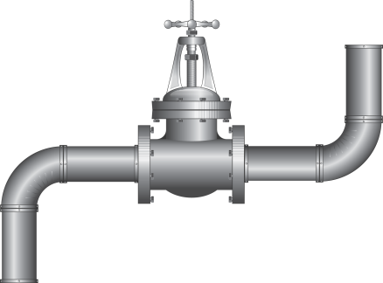
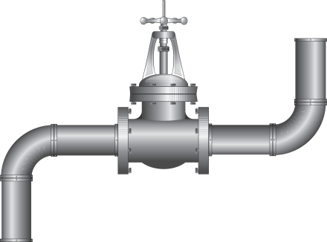
Tunneling Prevents Eavesdropping
Packets sent over the Internet are automatically encrypted.
Client
Server
Tunneling protocol
(does end-to-end encryption and decryption)
Untrusted Internet
TCP/IP
TCP/IP
Payloads are encrypted here

Slide 34
Secure Shell (SSH)
A secure interactive command session:
The client connects to the server via a TCP session.
The client and server exchange information on administrative details, such as supported encryption methods and their protocol version, each choosing a set of protocols that the other supports.
The client and server initiate a secret-key exchange to establish a shared secret session key, which is used to encrypt their communication (but not for authentication). This session key is used in conjunction with a chosen block cipher (typically AES, 3DES) to encrypt all further communications.
The server sends the client a list of acceptable forms of authentication, which the client will try in sequence. The most common mechanism is to use a password or the following public-key authentication method:
If public-key authentication is the selected mechanism, the client sends the server its public key.
The server then checks if this key is stored in its list of authorized keys. If so, the server encrypts a challenge using the client’s public key and sends it to the client.
The client decrypts the challenge with its private key and responds to the server, proving its identity.
Once authentication has been successfully completed, the server lets the client access appropriate resources, such as a command prompt.

Slide 35
IPSec
IPSec defines a set of protocols to provide confidentiality and authenticity for IP packets
Each protocol can operate in one of two modes, transport mode or tunnel mode.
In transport mode, additional IPsec header information is inserted before the data of the original packet, and only the payload of the packet is encrypted or authenticated.
In tunnel mode, a new packet is constructed with IPsec header information, and the entire original packet, including its header, is encapsulated as the payload of the new packet.

Slide 36
Virtual Private Networking (VPN)
Virtual private networking (VPN) is a technology that allows private networks to be safely extended over long physical distances by making use of a public network, such as the Internet, as a means of transport.
VPN provides guarantees of data confidentiality, integrity, and authentication, despite the use of an untrusted network for transmission.
There are two primary types of VPNs, remote access VPN and site-to-site VPN.

Slide 37
Types of VPNs
Remote access VPNs allow authorized clients to access a private network that is referred to as an intranet.
For example, an organization may wish to allow employees access to the company network remotely but make it appear as though they are local to their system and even the Internet itself.
To accomplish this, the organization sets up a VPN endpoint, known as a network access server, or NAS. Clients typically install VPN client software on their machines, which handle negotiating a connection to the NAS and facilitating communication.
Site-to-site VPN solutions are designed to provide a secure bridge between two or more physically distant networks.
Before VPN, organizations wishing to safely bridge their private networks purchased expensive leased lines to directly connect their intranets with cabling.

Slide 38
Intrusion Detection Systems
Intrusion
Actions aimed at compromising the security of the target (confidentiality, integrity, availability of computing/networking resources)
Intrusion detection
The identification through intrusion signatures and report of intrusion activities
Intrusion prevention
The process of both detecting intrusion activities and managing automatic responsive actions throughout the network

Slide 39





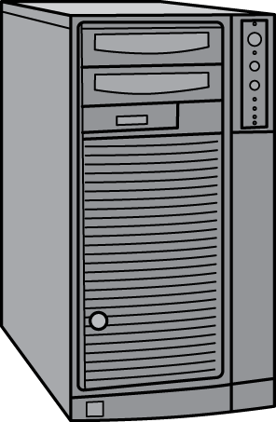
IDS Components
The IDS manager compiles data from the IDS sensors to determine if an intrusion has occurred.
This determination is based on a set of site policies, which are rules and conditions that define probable intrusions.
If an IDS manager detects an intrusion, then it sounds an alarm.
Untrusted Internet
IDS Manager
router
IDS Sensor
IDS Sensor
Firewall
router
router

Slide 40
Intrusions
An IDS is designed to detect a number of threats, including the following:
masquerader: an attacker who is falsely using the identity and/or credentials of a legitimate user to gain access to a computer system or network
Misfeasor: a legitimate user who performs actions he is not authorized to do
Clandestine user: a user who tries to block or cover up his actions by deleting audit files and/or system logs
In addition, an IDS is designed to detect automated attacks and threats, including the following:
port scans: information gathering intended to determine which ports on a host are open for TCP connections
Denial-of-service attacks: network attacks meant to overwhelm a host and shut out legitimate accesses
Malware attacks: replicating malicious software attacks, such as Trojan horses, computer worms, viruses, etc.
ARP spoofing: an attempt to redirect IP traffic in a local-area network
DNS cache poisoning: a pharming attack directed at changing a host’s DNS cache to create a falsified domain-name/IP-address association

Slide 41




Possible Alarm Outcomes
Alarms can be sounded (positive) or not (negative)
Intrusion Attack
No Intrusion Attack
Alarm
Sounded
True Positive
False Positive
No
Alarm
Sounded
False Negative
True Negative

Slide 42
The Base-Rate Fallacy
It is difficult to create an intrusion detection system with the desirable properties of having both a high true-positive rate and a low false-negative rate.
If the number of actual intrusions is relatively small compared to the amount of data being analyzed, then the effectiveness of an intrusion detection system can be reduced.
In particular, the effectiveness of some IDSs can be misinterpreted due to a statistical error known as the base-rate fallacy.
This type of error occurs when the probability of some conditional event is assessed without considering the “base rate” of that event.

Slide 43
Base-Rate Fallacy Example
Suppose an IDS is 99% accurate, having a 1% chance of false positives or false negatives. Suppose further…
An intrusion detection system generates 1,000,100 log entries.
Only 100 of the 1,000,100 entries correspond to actual malicious events.
Because of the success rate of the IDS, of the 100 malicious events, 99 will be detected as malicious, which means we have 1 false negative.
Nevertheless, of the 1,000,000 benign events, 10,000 will be mistakenly identified as malicious. That is, we have 10,000 false positives!
Thus, there will be 10,099 alarms sounded, 10,000 of which are false alarms. That is, roughly 99% of our alarms are false alarms.

Slide 44
IDS Data
In an influential 1987 paper, Dorothy Denning identified several fields that should be included in IDS event records:
Subject: the initiator of an action on the target
Object: the resource being targeted, such as a file, command, device, or network protocol
Action: the operation being performed by the subject towards the object
Exception-condition: any error message or exception condition that was raised by this action
Resource-usage: quantitative items that were expended by the system performing or responding to this action
Time-stamp: a unique identifier for the moment in time when this action was initiated

Slide 45
Types of Intrusion Detection Systems
Rule-Based Intrusion Detection
Rules identify the types of actions that match certain known profiles for an intrusion attack, in which case the rule would encode a signature for such an attack. Thus, if the IDS manager sees an event that matches the signature for such a rule, it would immediately sound an alarm, possibly even indicating the particular type of attack that is suspected.
Statistical Intrusion Detection
A profile is built, which is a statistical representation of the typical ways that a user acts or a host is used; hence, it can be used to determine when a user or host is acting in highly unusual, anomalous ways.
Once a user profile is in place, the IDS manager can determine thresholds for anomalous behaviors and then sound an alarm any time a user or host deviates significantly from the stored profile for that person or machine.

Slide 46
Wireless Networks

Slide 47
Welcome to Wireless
Radio waves
No need to be physically plugged into the network
Remote access
Coverage
Personal Area Network (PAN)
Local Area Network (LAN)
Metropolitan Area Network (MAN)
Security concerns
Radio signals leaking outside buildings
Detection of unauthorized devices
Intercepting wireless communications
Man-in-the-middle attacks
Verification of users
Restricting access

Slide 48
Types of Wireless Networks
Infrastructure
Client machines establish a radio connection to a special network device, called access point
Access points connected to a wired network, which provides a gateway to the internet
Most common type of wireless network
Peer-to-peer
Multiple peer machines connect to each other
Typically used in ad-hoc networks and internet connection sharing
Access Point
Client
Wired LAN
Client
Client
Peer
Peer
Peer
Peer

Slide 49
SSID
Multiple wireless networks can coexist
Each network is identified by a 32-character service set ID (SSID)
Typical default SSID of access point is manufacturer’s name
SSIDs often broadcasted to enable discovery of the network by prospective clients
SSIDs are not signed, thus enabling a simple spoofing attack
Place a rogue access point in a public location (e.g., cafe, airport)
Use the SSID of an ISP
Set up a login page similar to the one of the ISP
Wait for clients to connect to rogue access point and authenticate
Possibly forward session to ISP network
Facilitated by automatic connection defaults

Slide 50
Eavesdropping and Spoofing
All wireless network traffic can be eavesdropped
MAC-based authentication typically used to identify approved machines in corporate network
MAC spoofing attacks possible, as in wired networks
Sessions kept active after brief disconnects
If ISP client does not explicitly end a session, MAC spoofing allows to take over that session

Slide 51
Captive Portal
Protocol
DHCP provides IP address
Name server maps everything to authentication server
Firewall blocks all other traffic
Any URL is redirected to authentication page
After authentication, regular network services reinstated
Client identified by MAC address
Used by wireless ISPs
Security issues
A MAC spoofing and session stealing attack may be performed if client does not actively disconnect
A tunneling attack can bypass captive portal if DNS traffic beyond firewall is not blocked before authentication

Slide 52
Wardriving and Warchalking
Driving around looking for wireless local area networks
Some use GPS devices to log locations, post online
Software such as NetStumbler for Windows, KisMac for Macs and Kismet for Linux are easily available online
Use antennas to increase range
Legality is unclear when no information is transmitted, and no network services are used
Warchalking involves leaving chalk marks (derived from hobo symbols) on the side walk marking wireless networks and associated information

Slide 53
Wired Equivalent Privacy
Goals
Confidentiality: eavesdropping is prevented
Data integrity: packets cannot be tampered with
Access control: only properly encrypted packets are routed
Design constraints
Inexpensive hardware implementation with 90’s technology
Compliance with early U.S. export control regulations on encryption devices (40-bit keys)
Implementation and limitations
Encrypts the body of each frame at the data-link level
Legacy IEEE 802.11 standard to be avoided

Slide 54
WEP Protocol
Setup
Access point and client share 40-bit key K
The key never changes during a WEP session
Encryption
Compute CRC-32 checksum of message M (payload of frame)
Pick 24-bit initialization vector V
Using the RC4 stream cipher, generate key stream S(K,V)
Create ciphertext C = (M || crc(M)) ⊕ S(K,V)
Client authentication
Access point sends unencrypted random challenge to client
Client responds with encrypted challenge
Transmission
Send V || C
Message
CRC
⊕
Key Stream

Slide 55
Message Modification Attack
Message modification
Given an arbitrary string Δ, we want to replace message M with M′ = M ⊕ Δ
Man-in-the middle replaces ciphertext C with C′ = C ⊕ (Δ || crc(Δ))
Targeted text replacement
Possible if we know position of text in message
E.g., change date in email
Reason of vulnerability
CRC checksum distributes over XOR
Not a cryptographic hash function

Slide 56
IP Redirection Attack
Attacker convinces access point to decrypt packet
Method
Eavesdrop inbound IP packet
Resend packet to external machine controlled by attacker
Receive packet decrypted by access point
Repeat with outbound packets
Guess destination address
Within LAN subnet
Change destination address
Modify original destination D to external machine D′ controlled by attacker
Use above message modification method
Change packet checksum
Difference between new checksum and old known x′ − x = (D′_{H} + D′_{L}) − (D_{H} + D_{L})
Guess x′ ⊕ x
Success after few attempts

Slide 57
Reused Initialization Vectors
Repeated IV implies reused key stream
Attacker obtains XOR of two messages
Attacker can recover both message and key stream
Recovered key stream can be used by attacker to inject traffic
Default IV
Several flawed implementations of IV generation
E.g., start at zero when device turned on and then repeatedly increment by one
Random IV
Small length (24 bits) leads to repetition in a short amount of time even randomly generated
E.g., collision expected with high probability after 2¹² ≈ 4,000 transmissions

Slide 58
Authentication Spoofing
Attacker wants to spoof a legitimate client
Does not know the secret key K
Can eavesdrop authentication messages
Attack
Obtain challenge R and encrypted challenge C = (R || crc(R)) ⊕ S(K,V)
Compute key stream S(K,V) = (R || crc(R)) ⊕ C
Reuse key stream S(K,V) when challenged from access point

Slide 59
DEMO: Wardriving and WEP CRACKING

Slide 60


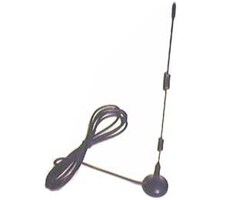
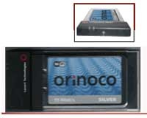

Wardriving Tools
Netstumbler wifi scanner
Antenna for db gain
Wireless card with plug and monitor mode
GPS (optional)

Slide 61
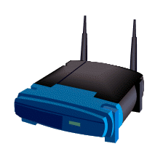


Wardriving Setup
The access point and client are using WEP encryption
The hacker is sniffing using wardriving tools
Hacker
WEP-protected WLAN

Slide 62
Slow Attack: WEP Sniffing
To crack a 64-bit WEP key you can capture:
50,000 to 200,000 packets containing Initialization Vectors (IVs)
Only about ¼ of the packets contain IVs
So you need 200,000 to 800,000 packets
It can take a long time (typically several hours or even days) to capture that many packets

Slide 63
Fast Attack: Packet Injection
The hacker injects packets to create a more “interesting” packet
Special wireless card driver is necessary to perform injection
Hacker
WEP-protected WLAN

Slide 64
Initialization vector (IV)
One for each packet, a 24-bit value
Sent in the cleartext part of the message!
Small space of initialization vectors guarantees reuse of the same key stream
IV Collision:
Attack the XOR of the two plaintext messages
IV is often very predictable and introduces a lot of redundancy

Slide 65
Injection Method
Suppose attacker knows one plaintext for one encrypted message, X
RC4(X) ⊕ X ⊕ Y = RC4(Y)
constructing a new message calculating the CRC32
Even without a complete knowledge of the packet, it is possible to flip selected bits in a message and successfully adjust the encrypted CRC
We know ARP, reinject it:
ARP will normally rebroadcast and generate IVs

Slide 66
Reference
Nikita Borisov, Ian Goldberg, David Wagner, Intercepting Mobile Communications: The Insecurity of 802.11. MOBICOM, 2001.

Slide 67
Wi-Fi Protected Access (WPA)
WEP became widely known as insecure
In 2005, FBI publically cracked a WEP key in only 3 minutes!
Wi-Fi Protected Access (WPA) proposed in 2003
Improves on WEP in several ways:
Larger secret key (128 bits) and initialization data (48 bits)
Supports various types of authentication besides a shared secret, such as username/password
Dynamically changes keys as session continues
Cryptographic method to check integrity
Frame counter to prevent replay attacks

Slide 68
WPA2
WPA was an intermediate stepping-stone
Final version: IEEE 802.11i, aka WPA2
Improvements over WPA are incremental rather than changes in philosophy:
Uses AES instead of RC4
Handles encryption, key management, and integrity
MAC provided by Counter Mode with Cipher Block Chaining (CCMP) used in conjunction with AES
WPA2 needs recent hardware to operate properly, but this will get better over time

Slide 69
WPA2 Encryption
Counter Mode with Cipher Block Chaining Message Authentication Code Protocol
Compute a 64-bit message integrity code (MIC) on the plaintext header and the payload using the Michael algorithm
Encrypt the payload and MIC
Michael is not a strong cryptographic hash function
Header
Payload
MIC
Authenticated
Encrypted

Slide 70
Alternatives and Add-Ons
WEP, WPA, and WPA2 all protect your traffic only up to the access point
No security provided beyond access point
Other methods can encrypt end-to-end:
SSL, SSH, VPN, PGP, and so on
End-to-end encryption is often simpler than setting up network-level encryption
Most of these solutions require per-application configuration

