Slide 1

Pre-Knowledge for Pcap Parser in Java
for CSc 4222/6222: Introduction of Cyber Security

Slide 2
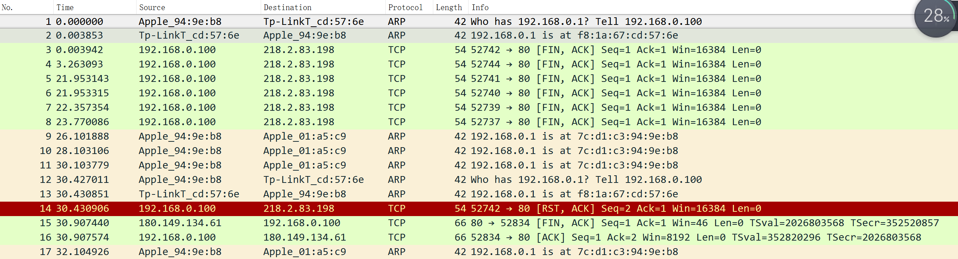
Information Included in Pcap
Read .pcap file by WireShark:

Slide 3
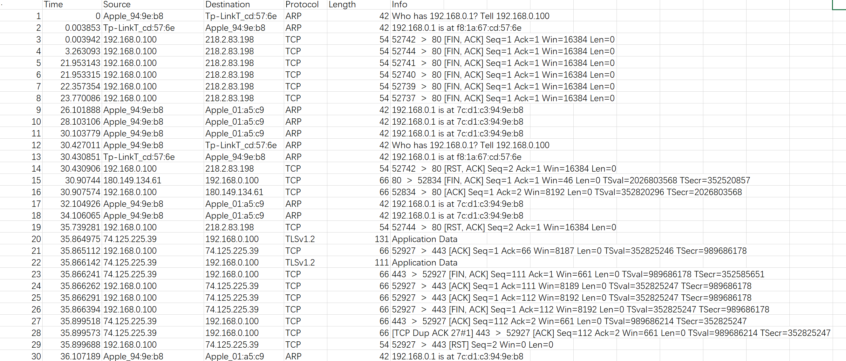
Information Included in Pcap
Transform .pcap file into .csv:
1, 0, Apple_94:93:b8, Tp-LinkT_cd:57:6e, ARP, 42, Who has 192.16...

Slide 4
Information Included in Pcap
We can read the following information included in a .pcap file by our eyes:
Packets No.
Arriving time
Source IP
Destination IP
Protocol
Length
Info

Slide 5
ARP Spoofing Attack
What is ARP Spoofing Attack?
User A
I’m 192.168.0.103
Received a packet from 192.168.0.103
192.168.0.100
Server
7c:d1:c3:94:9e:be
?
?
Sent an ACK to 192.168.0.103
User B
?
Received an ACK from Server
?
192.168.0.103
What should be checked to avoid an ARP Spoofing Attack?
d8:96:95:01:a5:c9
Source IP Address
Source Mac Address
ARP spoofing Attack Detection in Java:
If(srcip != 192.168.0.100 && srcmac ==7c:d1:c3:94:9e:be)

Slide 6
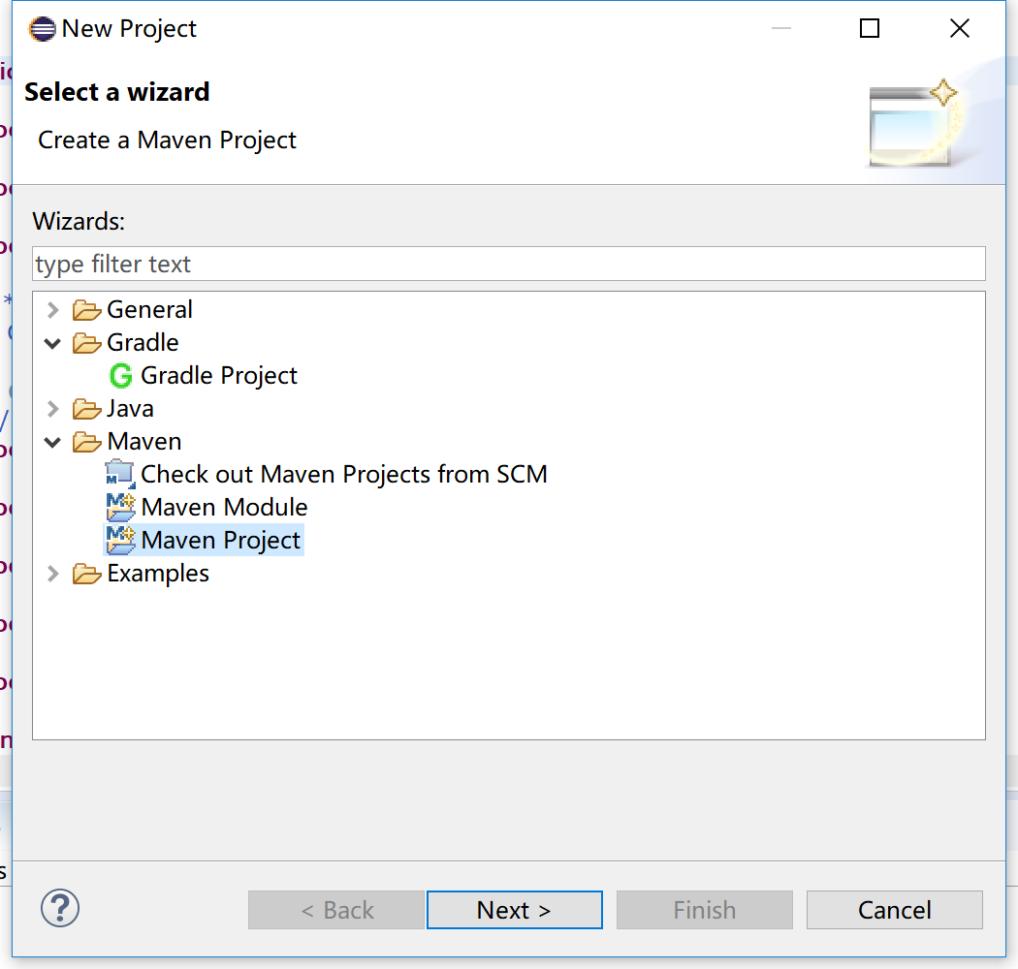
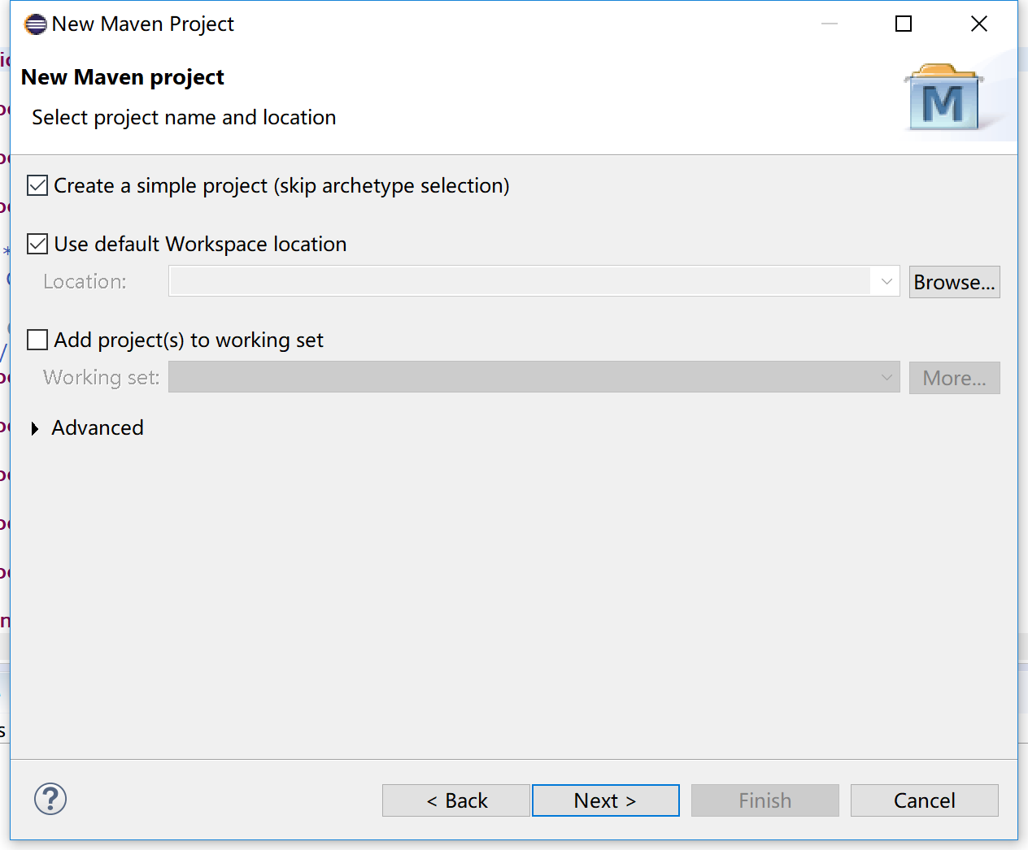
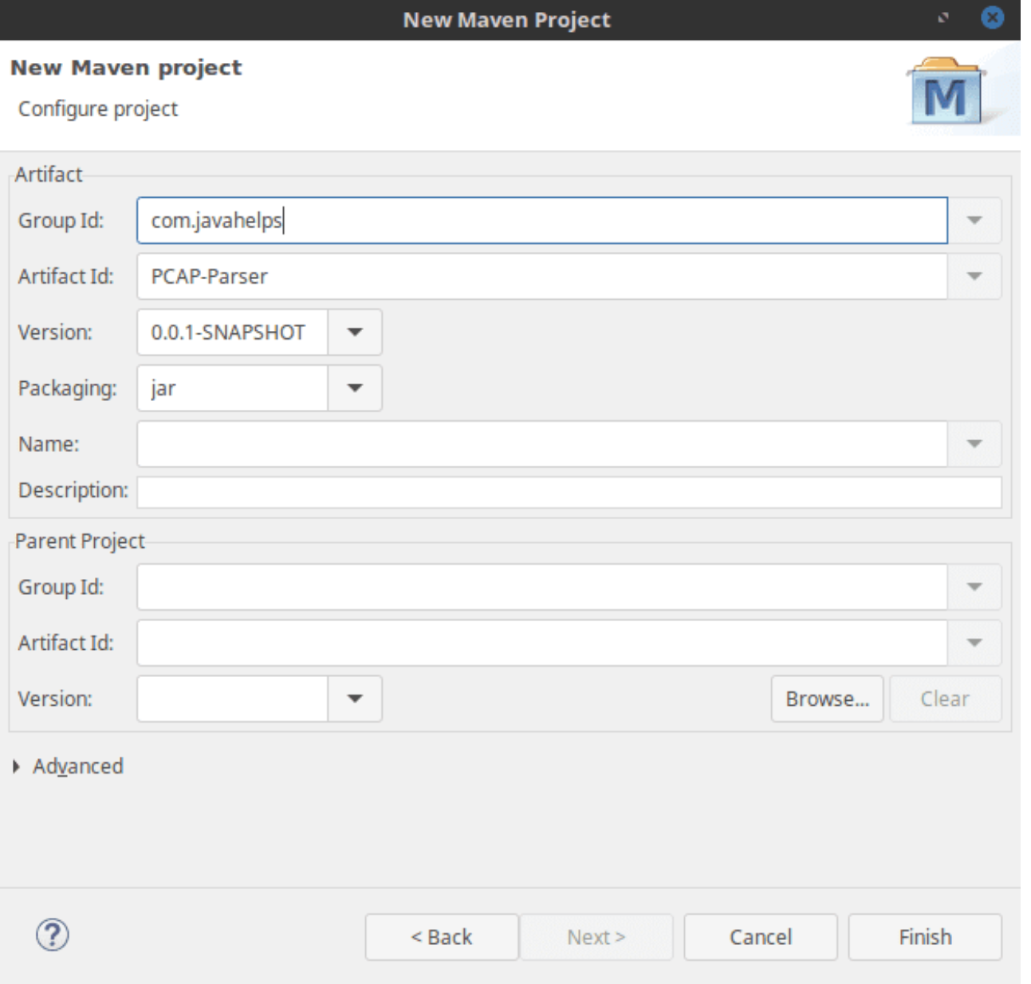
PCAP4J: A .Pacp file Parser for Java
Guidance Link: https://www.javahelps.com/2017/08/parse-pcap-files-in-java.html
1. Create a Maven Project

Slide 7
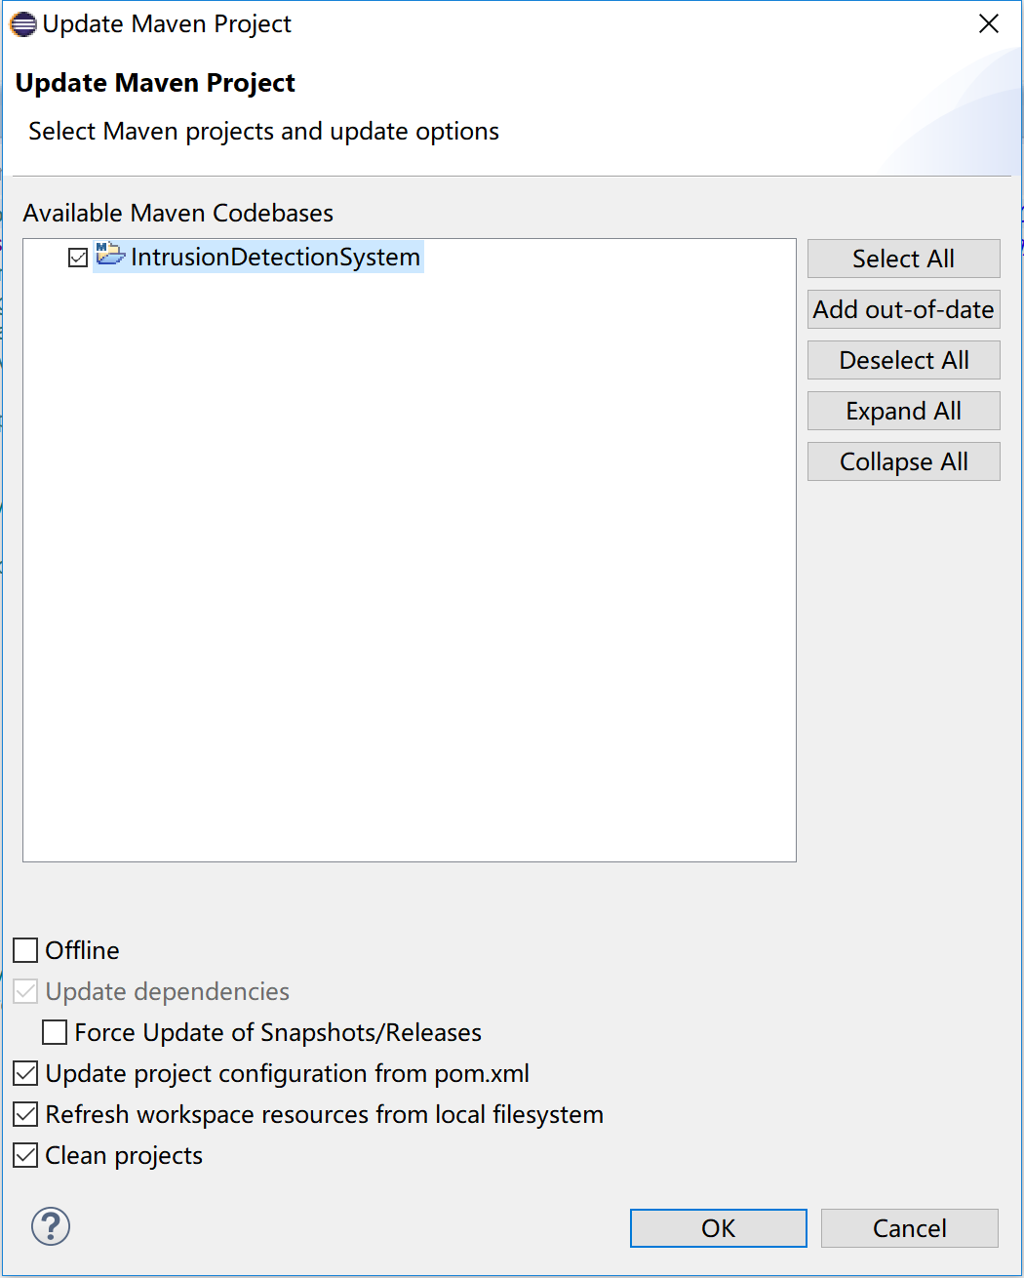
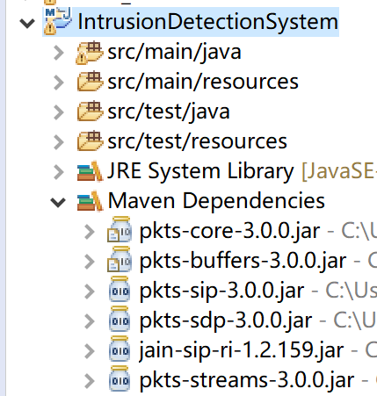
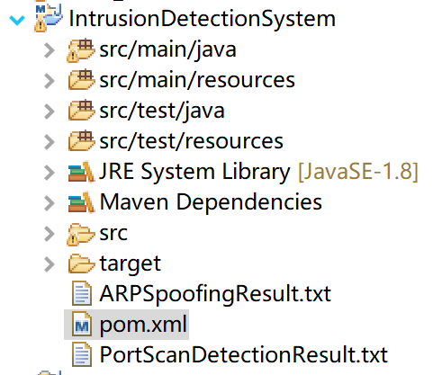
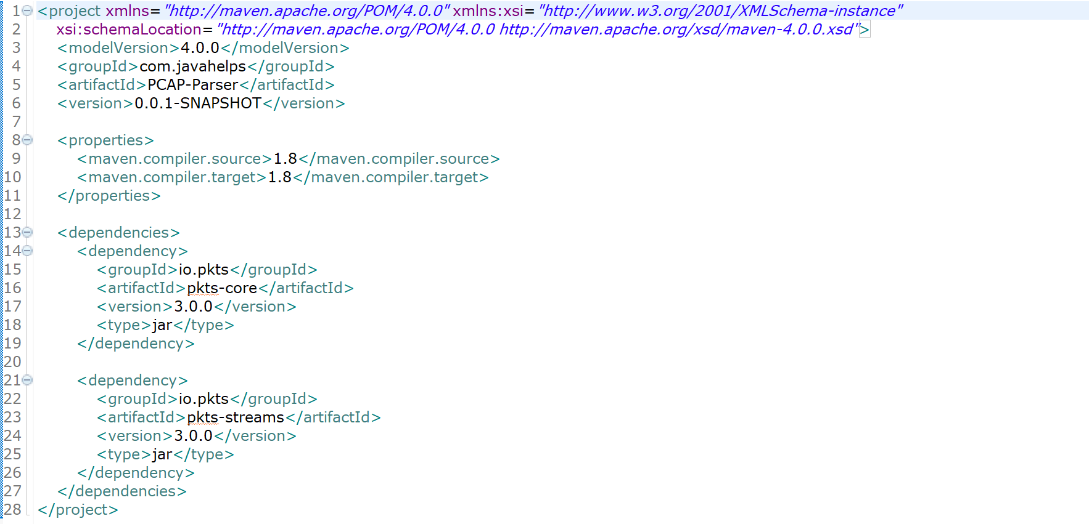
PCAP4J: A .Pacp file Parser for Java
Guidance Link: https://www.javahelps.com/2017/08/parse-pcap-files-in-java.html
2. Input the Dependencies

Slide 8
Implementation of ARP Spoofing Detection
3. Input .pcap file
final Pcap pcap = Pcap.openStream(FileAddress);
4. Read each row of the .pcap file
pcap.loop(new PacketHandler() {
public boolean nextPacket(Packet packet) throws IOException {
Put codes here for additional actions
return true;
}
});

Slide 9
Implementation of ARP Spoofing Detection
3. Input .pcap file
final Pcap pcap = Pcap.openStream(FileAddress);
4. Read each row of the .pcap file
pcap.loop(new PacketHandler() {
public boolean nextPacket(Packet packet) throws IOException {
Put codes here for additional actions
return true;
}
});

Slide 10
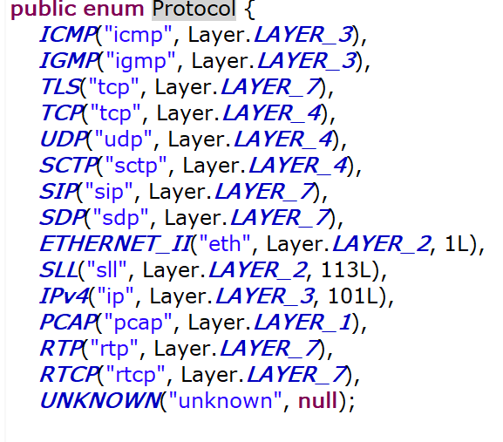
Implementation of ARP Spoofing Detection
5. Required actions for ARP Spoofing Detection
pcap.loop(new PacketHandler() {
public boolean nextPacket(Packet packet) throws IOException {
if (packet.hasProtocol(Protocol.IPv4)) {
MACPacket mac = (MACPacket) packet.getPacket(Protocol.ETHERNET_II);
String srcmac = mac.getSourceMacAddress();
IPPacket ipa = (IPPacket) packet.getPacket(Protocol.IPv4);
String ipd = ipa.getSourceIP();
Put codes here for additional actions
}
return true;
}
});

Slide 11
Implementation of ARP Spoofing Detection
5. ARP Spoofing Detection Judgment
pcap.loop(new PacketHandler() {
public boolean nextPacket(Packet packet) throws IOException {
if (packet.hasProtocol(Protocol.IPv4)) {
MACPacket mac = (MACPacket) packet.getPacket(Protocol.ETHERNET_II);
String srcmac = mac.getSourceMacAddress();
IPPacket ipa = (IPPacket) packet.getPacket(Protocol.IPv4);
String ipd = ipa.getSourceIP();
if(!ipd.matches("192.168.0.100") && srcmac.matches("7C:D1:C3:94:9E:B8")){
Put codes here for additional actions
}
}
return true;
}
});

Slide 12
Port Scan
What is ARP Spoofing Attack?
Huge number of connections
User A
…
User B
What should be checked to detect a Port Scan?
…
Source IP Address
Destination IP Address
Destination Port No.
192.168.0.100
192.168.0.103
7c:d1:c3:94:9e:be
d8:96:95:01:a5:c9

Slide 13
Implementation of PortScan Detection
1. Read each row of the .pcap file
pcap.loop(new PacketHandler() {
public boolean nextPacket(Packet packet) throws IOException {
Put codes here for additional actions
}
return true;
}
});

Slide 14
Implementation of PortScan Detection
ArrayList<String> SourceIP = new ArrayList<String>();
ArrayList<String> DestinationIP = new ArrayList<String>();
2. Collect all Source IPs and Destination IPs
pcap.loop(new PacketHandler() {
public boolean nextPacket(Packet packet) throws IOException {
if (packet.hasProtocol(Protocol.TCP)) {
TCPPacket tcppacket = (TCPPacket) packet.getPacket(Protocol.TCP);
String scrIP = tcppacket.getSourceIP();
if(!SourceIP.contains(tcppacket.getSourceIP())){
SourceIP.add(tcppacket.getSourceIP());}
if(!DestinationIP.contains(tcppacket.getDestinationIP())){
DestinationIP.add(tcppacket.getDestinationIP());}
}
return true;
}
});

Slide 15
Implementation of PortScan Detection
ArrayList<Integer> Port = new ArrayList<Integer>();
3. Collect scanned Ports for each pair of Source IP and Destination IP
pcap.loop(new PacketHandler() {
public boolean nextPacket(Packet packet) throws IOException {
if(packet.hasProtocol(Protocol.TCP)){
TCPPacket tcppacket = (TCPPacket) packet.getPacket(Protocol.TCP);
String tcpsrc = tcppacket.getSourceIP();
String tcpdest = tcppacket.getDestinationIP();
if(tcpsrc.matches(scrip)&&tcpdest.equals(desip)){
if(!Port.contains(tcppacket.getDestinationPort())){
Port.add(tcppacket.getDestinationPort());
}
}
}
return true;
}
});

Slide 16
Implementation of PortScan Detection
4. Port Scan Detection
if(Port.size()>100){
Output a file includes all violated source IP, victim Des IP and packet No.
}

