Slide 1
Cryptography

Slide 2
Symmetric Cryptosystem
Scenario
Alice wants to send a message (plaintext P) to Bob.
The communication channel is insecure and can be eavesdropped
If Alice and Bob have previously agreed on a symmetric encryption scheme and a secret key K, the message can be sent encrypted (ciphertext C)
Issues
What is a good symmetric encryption scheme?
What is the complexity of encrypting/decrypting?
What is the size of the ciphertext, relative to the plaintext?
P
encrypt
C
decrypt
P
K
K

Slide 3
Basics
Notation
Secret key K
Encryption function E_{K}(P)
Decryption function D_{K}(C)
Plaintext length typically the same as ciphertext length
Encryption and decryption are permutation functions (bijections) on the set of all n-bit arrays
Efficiency
functions E_{K} and D_{K} should have efficient algorithms
Consistency
Decrypting the ciphertext yields the plaintext
D_{K}(E_{K}(P)) = P

Slide 4




Attacks
Attacker may have
collection of ciphertexts (ciphertext only attack)
collection of plaintext/ciphertext pairs (known plaintext attack)
collection of plaintext/ciphertext pairs for plaintexts selected by the attacker (chosen plaintext attack)
collection of plaintext/ciphertext pairs for ciphertexts selected by the attacker (chosen ciphertext attack)
Plaintext
Encryption
Algorithm
Ciphertext
Hi, Bob.
Don’t invite Eve to the party!
Love, Alice
(a)
key
Eve
Plaintext
Encryption
Algorithm
Ciphertext
Hi, Bob.
Don’t invite Eve to the party!
Love, Alice
(b)
key
Plaintext
Eve
Ciphertext
ABCDEFG
HIJKLMNO
PQRSTUV
WXYZ.
Encryption
Algorithm
(c)
key
Plaintext
Eve
Ciphertext
Encryption
Algorithm
IJCGA, CAN DO HIFFA GOT TIME.
(d)
001101
110111
key
Eve
Eve

Slide 5
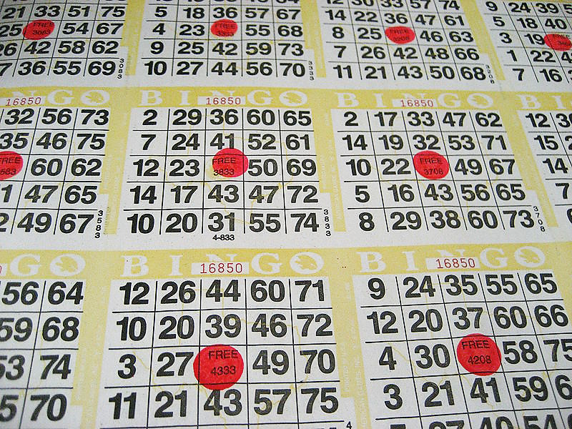
Brute-Force Attack
Try all possible keys K and determine if D_{K}(C) is a likely plaintext
Requires some knowledge of the structure of the plaintext (e.g., PDF file or email message)
Key should be a sufficiently long random value to make exhaustive search attacks unfeasible
Image by Michael Cote from http://commons.wikimedia.org/wiki/File:Bingo_cards.jpg

Slide 6
Encrypting English Text
English text typically represented with 8-bit ASCII encoding
A message with t characters corresponds to an n-bit array, with n = 8t
Redundancy due to repeated words and patterns
E.g., “th”, “ing”
English plaintexts are a very small subset of all n-bit arrays
Plaintexts n-bit strings
English text
Ciphertext of English text
Ciphertexts n-bit strings

Slide 7
Entropy of Natural Language
Information content (entropy) of English: 1.25 bits per character
t-character arrays that are English text:
(2^{1.25})^{t} = 2^{1.25 t}
n-bit arrays that are English text:
2^{1.25 n/8} ≈ 2^{0.16 n}
For a natural language, constant α < 1 such that there are 2^{αn} messages among all n-bit arrays
Fraction (probability) of valid messages
2^{αn} / 2^{n} = 1 / 2^{(1−α)n}
Brute-force decryption
Try all possible 2^{k} decryption keys
Stop when valid plaintext recognized
Given a ciphertext, there are 2^{k} possible plaintexts
Expected number of valid plaintexts
2^{k} / 2^{(1−α)n}
Expected unique valid plaintext , (no spurious keys) achieved at unicity distance
n = k / (1−α)
For English text and 256-bit keys, unicity distance is 304 bits

Slide 8
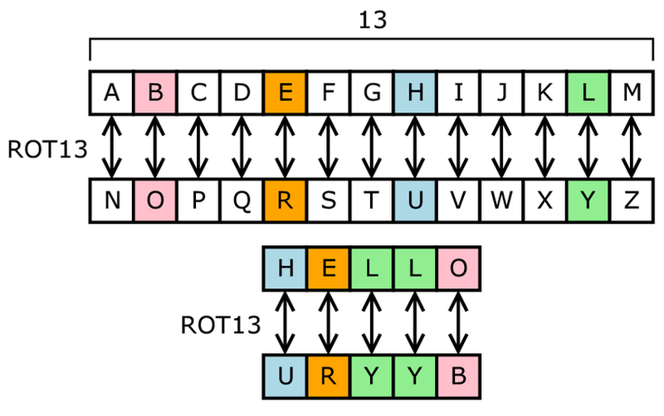
Substitution Ciphers
One popular substitution “cipher” for some Internet posts is ROT13.
Each letter is uniquely replaced by another.
There are 26! possible substitution ciphers.
There are more than 4.03 x 10²⁶ such ciphers.
Public domain image from http://en.wikipedia.org/wiki/File:ROT13.png

Slide 9
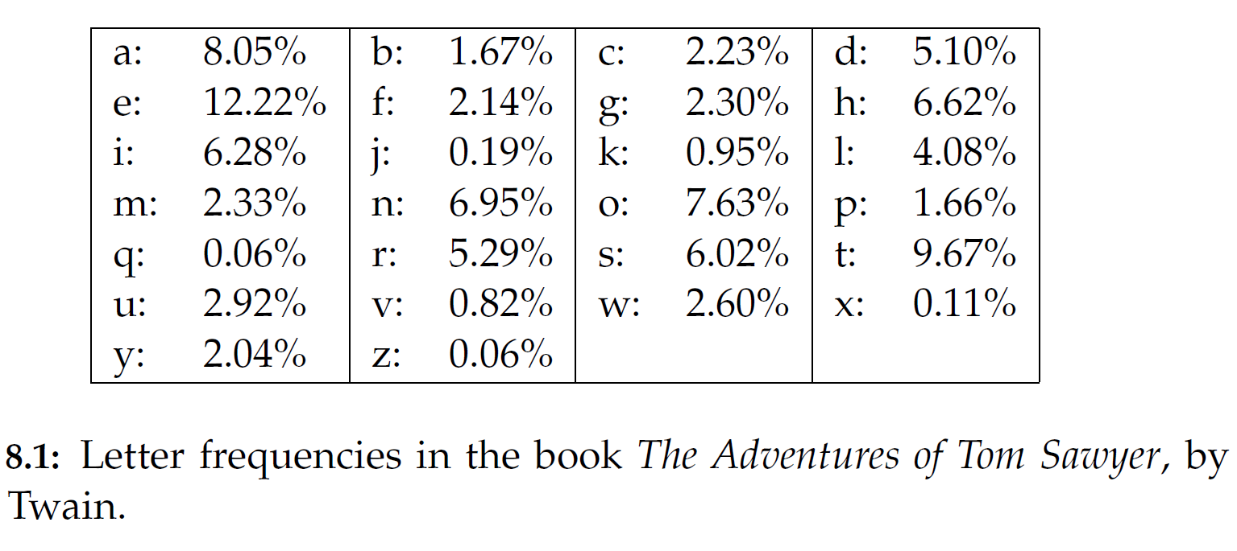
Frequency Analysis
Letters in a natural language, like English, are not uniformly distributed.
Knowledge of letter frequencies, including pairs and triples can be used in cryptologic attacks against substitution ciphers.

Slide 10
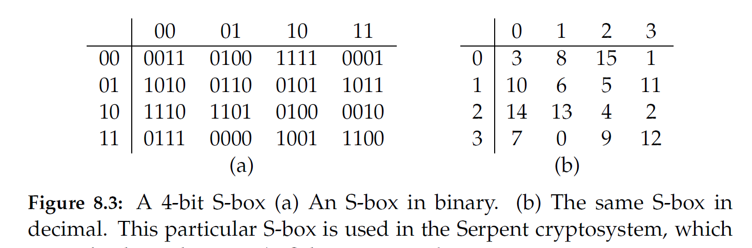
Substitution Boxes
Substitution can also be done on binary numbers.
Such substitutions are usually described by substitution boxes, or S-boxes.

Slide 11
One-Time Pads
There is one type of substitution cipher that is absolutely unbreakable.
The one-time pad was invented in 1917 by Joseph Mauborgne and Gilbert Vernam
We use a block of shift keys, (k₁, k₂, . . . , k_{n}), to encrypt a plaintext, M, of length n, with each shift key being chosen uniformly at random.
Since each shift is random, every ciphertext is equally likely for any plaintext.

Slide 12
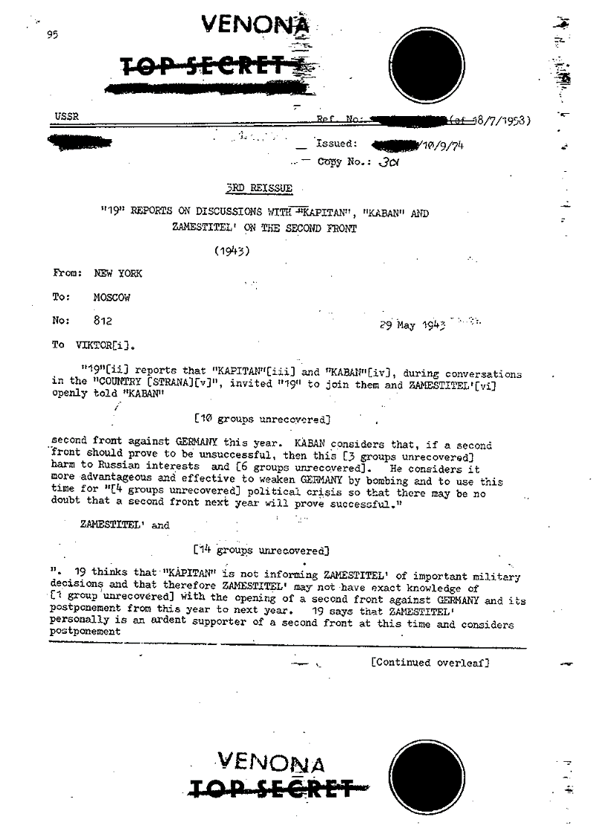
Weaknesses of the One-Time Pad
In spite of their perfect security, one-time pads have some weaknesses
The key has to be as long as the plaintext
Keys can never be reused
Repeated use of one-time pads allowed the U.S. to break some of the communications of Soviet spies during the Cold War.
Public domain declassified government image from
https://www.cia.gov/library/center-for-the-study-of-intelligence/csi-publications/books-and-monographs/venona-soviet-espionage-and-the-american-response-1939-1957/part2.htm

Slide 13
Block Ciphers
In a block cipher:
Plaintext and ciphertext have fixed length b (e.g., 128 bits)
A plaintext of length n is partitioned into a sequence of m blocks, P[0], …, P[m−1], where n ≤ bm < n + b
Each message is divided into a sequence of blocks and encrypted or decrypted in terms of its blocks.
Requires padding
with extra bits.
Plaintext
Blocks of
plaintext

Slide 14
Padding
Block ciphers require the length n of the plaintext to be a multiple of the block size b
Padding the last block needs to be unambiguous (cannot just add zeroes)
When the block size and plaintext length are a multiple of 8, a common padding method (PKCS5) is a sequence of identical bytes, each indicating the length (in bytes) of the padding
Example for b = 128 (16 bytes)
Plaintext: “Roberto” (7 bytes)
Padded plaintext: “Roberto999999999” (16 bytes), where 9 denotes the number and not the character
We need to always pad the last block, which may consist only of padding

Slide 15
Block Ciphers in Practice
Data Encryption Standard (DES)
Developed by IBM and adopted by NIST in 1977
64-bit blocks and 56-bit keys
Small key space makes exhaustive search attack feasible since late 90s
Triple DES (3DES)
Nested application of DES with three different keys KA, KB, and KC
Effective key length is 168 bits, making exhaustive search attacks unfeasible
C = E_{KC}(D_{KB}(E_{KA}(P))); P = D_{KA}(E_{KB}(D_{KC}(C)))
Equivalent to DES when KA=KB=KC (backward compatible)
Advanced Encryption Standard (AES)
Selected by NIST in 2001 through open international competition and public discussion
128-bit blocks and several possible key lengths: 128, 192 and 256 bits
Exhaustive search attack not currently possible
AES-256 is the symmetric encryption algorithm of choice

Slide 16
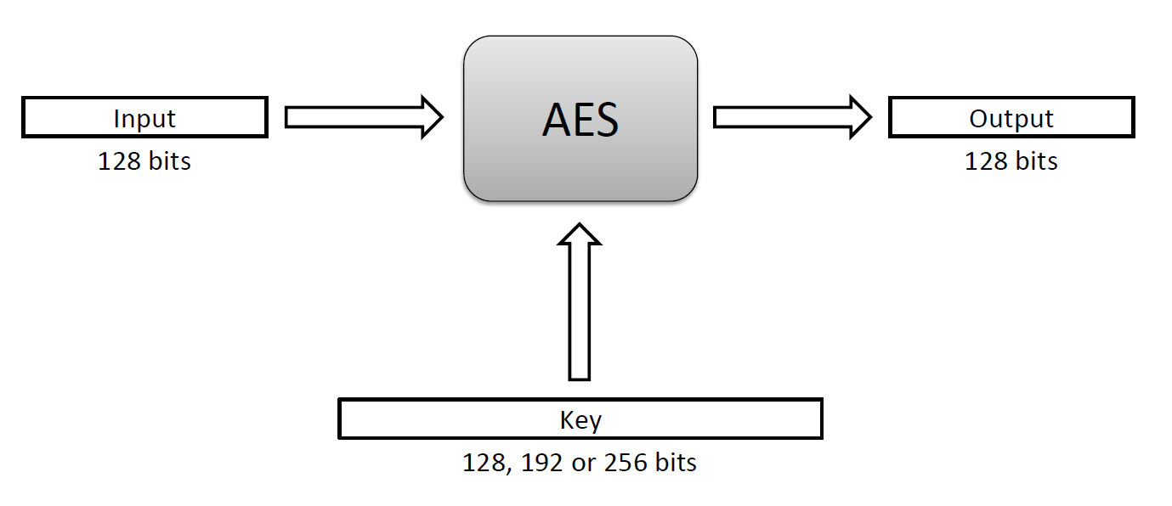
The Advanced Encryption Standard (AES)
In 1997, the U.S. National Institute for Standards and Technology (NIST) put out a public call for a replacement to DES.
It narrowed down the list of submissions to five finalists, and ultimately chose an algorithm that is now known as the Advanced Encryption Standard (AES).
AES is a block cipher that operates on 128-bit blocks. It is designed to be used with keys that are 128, 192, or 256 bits long, yielding ciphers known as AES-128, AES-192, and AES-256.

Slide 17
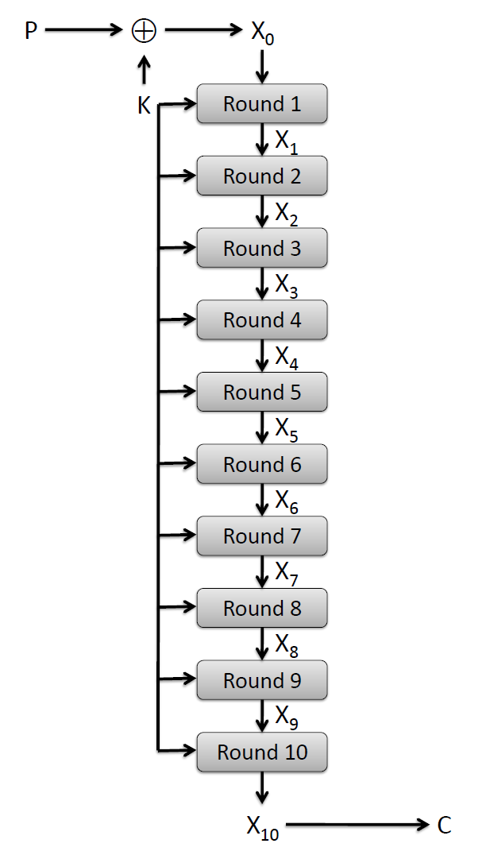
AES Round Structure
The 128-bit version of the AES encryption algorithm proceeds in ten rounds.
Each round performs an invertible transformation on a 128-bit array, called state.
The initial state X₀ is the XOR of the plaintext P with the key K:
X₀ = P XOR K.
Round i (i = 1, …, 10) receives state X_{i-1} as input and produces state X_{i}.
The ciphertext C is the output of the final round: C = X₁₀.

Slide 18
AES Rounds
Each round is built from four basic steps:
SubBytes step: an S-box substitution step
ShiftRows step: a permutation step
MixColumns step: a matrix multiplication step
AddRoundKey step: an XOR step with a round key derived from the 128-bit encryption key

Slide 19
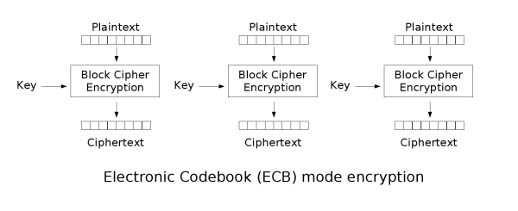
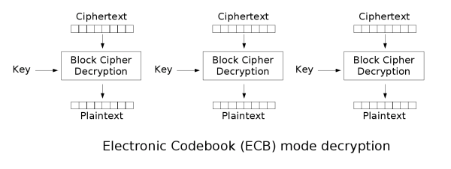
Block Cipher Modes
A block cipher mode describes the way a block cipher encrypts and decrypts a sequence of message blocks.
Electronic Code Book (ECB) Mode (is the simplest):
Block P[i] encrypted into ciphertext block C[i] = E_{K}(P[i])
Block C[i] decrypted into plaintext block M[i] = D_{K}(C[i])
Public domain images from http://en.wikipedia.org/wiki/File:Ecb_encryption.png and http://en.wikipedia.org/wiki/File:Ecb_decryption.png

Slide 20
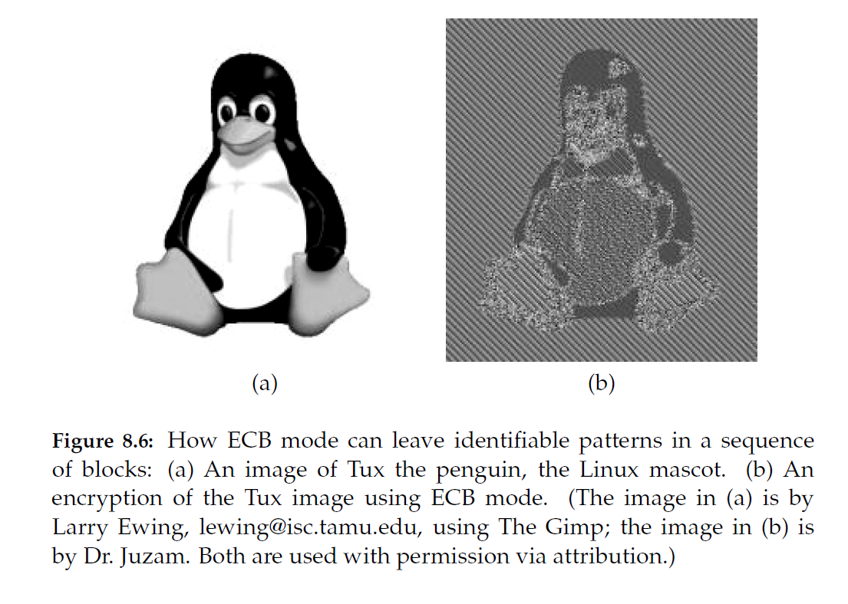
Strengths and Weaknesses of ECB
Weakness:
Documents and images are not suitable for ECB encryption since patters in the plaintext are repeated in the ciphertext:
Strengths:
Is very simple
Allows for parallel encryptions of the blocks of a plaintext
Can tolerate the loss or damage of a block

Slide 21
Cipher Block Chaining (CBC) Mode
In Cipher Block Chaining (CBC) Mode
The previous ciphertext block is combined with the current plaintext block C[i] = E_{K} (C[i −1] ⊕ P[i])
C[−1] = V, a random block separately transmitted encrypted (known as the initialization vector)
Decryption: P[i] = C[i −1] ⊕ D_{K} (C[i])
CBC Encryption:
CBC Decryption:
P[0]
P[1]
P[2]
P[3]
P[0]
P[1]
P[2]
P[3]
V
V
E_{K}
E_{K}
E_{K}
E_{K}
D_{K}
D_{K}
D_{K}
D_{K}
C[0]
C[1]
C[2]
C[3]
C[0]
C[1]
C[2]
C[3]

Slide 22
Strengths and Weaknesses of CBC
Strengths:
Doesn’t show patterns in the plaintext
Is the most common mode
Is fast and relatively simple
Weaknesses:
CBC requires the reliable transmission of all the blocks sequentially
CBC is not suitable for applications that allow packet losses (e.g., music and video streaming)

Slide 23
Java AES Encryption Example
Source
http://java.sun.com/javase/6/docs/technotes/guides/security/crypto/CryptoSpec.html
Generate an AES key
KeyGenerator keygen = KeyGenerator.getInstance("AES"); SecretKey aesKey = keygen.generateKey();
Create a cipher object for AES in ECB mode and PKCS5 padding
Cipher aesCipher; aesCipher = Cipher.getInstance("AES/ECB/PKCS5Padding");
Encrypt
aesCipher.init(Cipher.ENCRYPT_MODE, aesKey); byte[] plaintext = "My secret message".getBytes(); byte[] ciphertext = aesCipher.doFinal(plaintext);
Decrypt
aesCipher.init(Cipher.DECRYPT_MODE, aesKey); byte[] plaintext1 = aesCipher.doFinal(ciphertext);

Slide 24
Stream Cipher
Key stream
Pseudo-random sequence of bits S = S[0], S[1], S[2], …
Can be generated on-line one bit (or byte) at the time
Stream cipher
XOR the plaintext with the key stream C[i] = S[i] ⊕ P[i]
Suitable for plaintext of arbitrary length generated on the fly, e.g., media stream
Synchronous stream cipher
Key stream obtained only from the secret key K
Works for unreliable channels if plaintext has packets with sequence numbers
Self-synchronizing stream cipher
Key stream obtained from the secret key and q previous ciphertexts
Lost packets cause a delay of q steps before decryption resumes

Slide 25
Key Stream Generation
RC4
Designed in 1987 by Ron Rivest for RSA Security
Trade secret until 1994
Uses keys with up to 2,048 bits
Simple algorithm
Block cipher in counter mode (CTR)
Use a block cipher with block size b
The secret key is a pair (K,t), where K a is key and t (counter) is a b-bit value
The key stream is the concatenation of ciphertexts
E_{K} (t), E_{K} (t + 1), E_{K} (t + 2), …
Can use a shorter counter concatenated with a random value
Synchronous stream cipher

Slide 26
Attacks on Stream Ciphers
Repetition attack
if key stream reused, attacker obtains XOR of two plaintexts
Insertion attack [Bayer Metzger, TODS 1976]
retransmission of the plaintext with
a chosen byte inserted by attacker
using the same key stream
e.g., email message resent with new message number
P | P[i] | P[i+1] | P[i+2] | P[i+3]
S | S[i] | S[i+1] | S[i+2] | S[i+3]
C | C[i] | C[i+1] | C[i+2] | C[i+3]
Original
P | P[i] | X | P[i+1] | P[i+2]
S | S[i] | S[i+1] | S[i+2] | S[i+3]
C | C[i] | C′[i+1] | C′[i+2] | C′[i+3]
Retransmission

Slide 27
Public Key Encryption

Slide 28
Facts About Numbers
Prime number p:
p is an integer
p ≥ 2
The only divisors of p are 1 and p
Examples
2, 7, 19 are primes
−3, 0, 1, 6 are not primes
Prime decomposition of a positive integer n:
n = p₁e1 × … × p_{k}^{e}k
Example:
200 = 2³ × 5²
Fundamental Theorem of Arithmetic
The prime decomposition of a positive integer is unique

Slide 29
Greatest Common Divisor
The greatest common divisor (GCD) of two positive integers a and b, denoted gcd(a, b), is the largest positive integer that divides both a and b
The above definition is extended to arbitrary integers
Examples:
gcd(18, 30) = 6 gcd(0, 20) = 20 gcd(−21, 49) = 7
Two integers a and b are said to be relatively prime if
gcd(a, b) = 1
Example:
Integers 15 and 28 are relatively prime

Slide 30
Modular Arithmetic
Modulo operator for a positive integer n
r = a mod n
equivalent to
a = r + kn
and
r = a − ⎣a/n⎦ n
Example:
29 mod 13 = 3 13 mod 13 = 0 −1 mod 13 = 12
29 = 3 + 2×13 13 = 0 + 1×13 12 = −1 + 1×13
Modulo and GCD:
gcd(a, b) = gcd(b, a mod b)
Example:
gcd(21, 12) = 3 gcd(12, 21 mod 12) = gcd(12, 9) = 3

Slide 31
Euclid’s GCD Algorithm
Euclid’s algorithm for computing the GCD repeatedly applies the formula
gcd(a, b) = gcd(b, a mod b)
Example
gcd(412, 260) = 4
Algorithm EuclidGCD(a, b)
Input integers a and b
Output gcd(a, b)
if b = 0
return a
else
return EuclidGCD(b, a mod b)
a | 412 | 260 | 152 | 108 | 44 | 20 | 4
b | 260 | 152 | 108 | 44 | 20 | 4 | 0

Slide 32
Analysis
Let a_{i} and b_{i} be the arguments of the i-th recursive call of algorithm EuclidGCD
We have
a_{i + 2} = b_{i + 1} = a_{i} mod a_{i + 1} < a_{i + 1}
Sequence a₁, a₂, …, a_{n} decreases exponentially, namely
a_{i + 2} ≤ ½ a_{i} for i > 1
Case 1 a_{i + 1} ≤ ½ a_{i} a_{i + 2} < a_{i + 1} ≤ ½ a_{i}
Case 2 a_{i + 1} > ½ a_{i} a_{i + 2} = a_{i} mod a_{i + 1} = a_{i} − a_{i + 1} ≤ ½ a_{i}
Thus, the maximum number of recursive calls of algorithm EuclidGCD(a. b) is
1 + 2 log max(a. b)
Algorithm EuclidGCD(a, b) executes O(log max(a, b)) arithmetic operations
The running time can also be expressed as O(log min(a, b))

Slide 33
Multiplicative Inverses (1)
The residues modulo a positive integer n are the set
Z_{n} = {0, 1, 2, …, (n − 1)}
Let x and y be two elements of Z_{n} such that
xy mod n = 1
We say that y is the multiplicative inverse of x in Z_{n} and we write y = x⁻¹
Example:
Multiplicative inverses of the residues modulo 11
x | 0 | 1 | 2 | 3 | 4 | 5 | 6 | 7 | 8 | 9 | 10
x⁻¹ |  | 1 | 6 | 4 | 3 | 9 | 2 | 8 | 7 | 5 | 10

Slide 34
Multiplicative Inverses (2)
Theorem
An element x of Z_{n} has a multiplicative inverse if and only if x and n are relatively prime
Example
The elements of Z₁₀ with a multiplicative inverse are 1, 3, 7, 9
Corollary
If is p is prime, every nonzero residue in Z_{p} has a multiplicative inverse
Theorem
A variation of Euclid’s GCD algorithm computes the multiplicative inverse of an element x of Z_{n} or determines that it does not exist
x | 0 | 1 | 2 | 3 | 4 | 5 | 6 | 7 | 8 | 9
x⁻¹ |  | 1 |  | 7 |  |  |  | 3 |  | 9

Slide 35
Example: Measuring Lengths
Consider a stick of length a and a stick of length b such that a and b are relatively prime
Given two integers i and j, we can measure length n = ia + jb
We show that any integer n can be written as n = ia + jb for some integers i and j
Let s be the inverse of a in Z_{b} We have sa mod b = 1
There exists integer t such that sa + tb = 1
Pick i = ns and j = nt
Thus, given two sticks of relatively prime integer lengths, we can measure any integer length
Example, measure length 2 with sticks of length 3 and 7
3
3
3
3
7
7

Slide 36
Example: Double Hashing
Consider a hash table whose size n is a prime
In open addressing with double hashing, an operation on key x probes the following locations modulo n
i, i + d, i + 2d, i + 3d, …, i + (n – 1)d
where i = h₁(x) and d = h₂(x)
We show that each table location is probed by this sequence once
Suppose (i + jd) mod n = (i + kd) mod n for some integers j and k in the range [0, n – 1]
We have (j − k)d mod n = 0
Since n is prime, we have that n and d are relatively prime
Thus, d has an inverse d⁻ ¹ in Z_{n}
Multiplying each side by d⁻ ¹, we obtain (j − k) mod n = 0
We conclude that j = k

Slide 37
Powers
Let p be a prime
The sequences of successive powers of the elements of Z_{p} exhibit repeating subsequences
The sizes of the repeating subsequences and the number of their repetitions are the divisors of p − 1
Example (p = 7)
x | x² | x³ | x⁴ | x⁵ | x⁶
1 | 1 | 1 | 1 | 1 | 1
2 | 4 | 1 | 2 | 4 | 1
3 | 2 | 6 | 4 | 5 | 1
4 | 2 | 1 | 4 | 2 | 1
5 | 4 | 6 | 2 | 3 | 1
6 | 1 | 6 | 1 | 6 | 1

Slide 38
Fermat’s Little Theorem
Theorem
Let p be a prime. For each nonzero residue x of Z_{p}, we have x^{p − 1} mod p = 1
Example (p = 5):
1⁴ mod 5 = 1 2⁴ mod 5 = 16 mod 5 = 1
3⁴ mod 5 = 81 mod 5 = 1 4⁴ mod 5 = 256 mod 5 = 1
Corollary
Let p be a prime. For each nonzero residue x of Z_{p}, the multiplicative inverse of x is x^{p − 2} mod p
Proof
x(x^{p − 2} mod p) mod p = xx^{p − 2} mod p = x^{p − 1} mod p = 1

Slide 39
Euler’s Theorem
The multiplicative group for Z_{n}, denoted with Z*_{n}, is the subset of elements of Z_{n} relatively prime with n
The totient function of n, denoted with φ(n), is the size of Z*_{n}
Example
Z*₁₀ = { 1, 3, 7, 9 } φ(10) = 4
If p is prime, we have
Z*_{p} = {1, 2, …, (p − 1)} φ(p) = p − 1
Euler’s Theorem
For each element x of Z*_{n}, we have x^{φ(n)} mod n = 1
Example (n = 10)
3^{φ(10)} mod 10 = 3⁴ mod 10 = 81 mod 10 = 1
7^{φ(10)} mod 10 = 7⁴ mod 10 = 2401 mod 10 = 1
9^{φ(10)} mod 10 = 9⁴ mod 10 = 6561 mod 10 = 1

Slide 40
RSA Cryptosystem
Setup:
n = pq, with p and q primes
e relatively prime to φ(n) = (p − 1) (q − 1)
d inverse of e in Z_{φ(n)}
Keys:
Public key: K_{E} = (n, e)
Private key: K_{D} = d
Encryption:
Plaintext M in Z_{n}
C = Me mod n
Decryption:
M = C^{d} mod n
Example
Setup:
p = 7, q = 17
n = 7⋅17 = 119
φ(n) = 6⋅16 = 96
e = 5
d = 77
Keys:
public key: (119, 5)
private key: 77
Encryption:
M = 19
C = 19⁵ mod 119 = 66
Decryption:
C = 66⁷⁷ mod 119 = 19

Slide 41
Complete RSA Example
Setup:
p = 5, q = 11
n = 5⋅11 = 55
φ(n) = 4⋅10 = 40
e = 3
d = 27 (3⋅27 = 81 = 2⋅40 + 1)
Encryption
C = M³ mod 55
Decryption
M = C²⁷ mod 55

Slide 42
Security
Security of RSA based on difficulty of factoring
Widely believed
Best known algorithm takes exponential time
RSA Security factoring challenge (discontinued)
In 1999, 512-bit challenge factored in 4 months using 35.7 CPU-years
160 175-400 MHz SGI and Sun
8 250 MHz SGI Origin
120 300-450 MHz Pentium II
4 500 MHz Digital/Compaq
In 2005, a team of researchers factored the RSA-640 challenge number using 30 2.2GHz CPU years
In 2004, the prize for factoring RSA-2048 was $200,000
Current practice is 2,048-bit keys
Estimated resources needed to factor a number within one year
Length (bits) | PCs | Memory
430 | 1 | 128MB
760 | 215,000 | 4GB
1,020 | 342×10⁶ | 170GB
1,620 | 1.6×10¹⁵ | 120TB

Slide 43
Correctness
We show the correctness of the RSA cryptosystem for the case when the plaintext M does not divide n
Namely, we show that
(Me)^{d} mod n = M
Since ed mod φ(n) = 1, there is an integer k such that
ed = kφ(n) + 1
Since M does not divide n, by Euler’s theorem we have
M^{φ(n)} mod n = 1
Thus, we obtain
(Me)^{d} mod n =
M^{ed} mod n =
M^{kφ(n) + 1} mod n = MM^{kφ(n)} mod n =
M (M^{φ(n)})^{k} mod n =
M (M^{φ(n)} mod n)^{k} mod n =
M (1)^{k} mod n =
M mod n =
M
Proof of correctness can be extended to the case when the plaintext M divides n

Slide 44
Algorithmic Issues
The implementation of the RSA cryptosystem requires various algorithms
Overall
Representation of integers of arbitrarily large size and arithmetic operations on them
Encryption
Modular power
Decryption
Modular power
Setup
Generation of random numbers with a given number of bits (to generate candidates p and q)
Primality testing (to check that candidates p and q are prime)
Computation of the GCD (to verify that e and φ(n) are relatively prime)
Computation of the multiplicative inverse (to compute d from e)

Slide 45
Modular Power
The repeated squaring algorithm speeds up the computation of a modular power a^{p} mod n
Write the exponent p in binary
p = p_{b − 1} p_{b − 2} … p₁ p₀
Start with
Q₁ = a^{pb − 1} mod n
Repeatedly compute
Q_{i} = ((Q_{i − 1})² mod n)a^{pb − i} mod n
We obtain
Q_{b} = a^{p} mod n
The repeated squaring algorithm performs O (log p) arithmetic operations
Example
3¹⁸ mod 19 (18 = 10010)
Q₁ = 3¹ mod 19 = 3
Q₂ = (3² mod 19)3⁰ mod 19 = 9
Q₃ = (9² mod 19)3⁰ mod 19 = 81 mod 19 = 5
Q₄ = (5² mod 19)3¹ mod 19 = (25 mod 19)3 mod 19 = 18 mod 19 = 18
Q₅ = (18² mod 19)3⁰ mod 19 = (324 mod 19) mod 19 = 17⋅19 + 1 mod 19 = 1
p_{5 - i} | 1 | 0 | 0 | 1 | 0
2^{p5 - i} | 3 | 1 | 1 | 3 | 1
Q_{i} | 3 | 9 | 5 | 18 | 1

Slide 46
Modular Inverse
Theorem
Given positive integers a and b, let d be the smallest positive integer such that
d = ia + jb
for some integers i and j.
We have
d = gcd(a,b)
Example
a = 21
b = 15
d = 3
i = 3, j = −4
3 = 3⋅21 + (−4)⋅15 = 63 − 60 = 3
Given positive integers a and b, the extended Euclid’s algorithm computes a triplet (d,i,j) such that
d = gcd(a,b)
d = ia + jb
To test the existence of and compute the inverse of x ∈ Z_{n}, we execute the extended Euclid’s algorithm on the input pair (x,n)
Let (d,i,j) be the triplet returned
d = ix + jn
Case 1: d = 1
i is the inverse of x in Z_{n}
Case 2: d > 1
x has no inverse in Z_{n}

Slide 47
Pseudoprimality Testing
The number of primes less than or equal to n is about n / ln n
Thus, we expect to find a prime among O(b) randomly generated numbers with b bits each
Testing whether a number is prime (primality testing) is a difficult problem, though polynomial-time algorithms exist
An integer n ≥ 2 is said to be a base-x pseudoprime if
x^{n − 1} mod n = 1 (Fermat’s little theorem)
Composite base-x pseudoprimes are rare:
A random 100-bit integer is a composite base-2 pseudoprime with probability less than 10⁻¹³
The smallest composite base-2 pseudoprime is 341
Base-x pseudoprimality testing for an integer n:
Check whether x^{n − 1} mod n = 1
Can be performed efficiently with the repeated squaring algorithm

Slide 48
Randomized Primality Testing
Compositeness witness function witness(x, n) with error probability q for a random variable x
Case 1: n is prime
witness(x, n) = false always
Case 2: n is composite
witness(x, n) = true in most cases, false with small probability q < 1
Algorithm RandPrimeTest tests whether n is prime by repeatedly evaluating witness(x, n)
A variation of base- x pseudoprimality provides a suitable compositeness witness function for randomized primality testing (Rabin-Miller algorithm)
Algorithm RandPrimeTest(n, k)
Input integer n,confidence parameter k and composite witness function witness(x,n) with error probability q
Output an indication of whether n is composite or prime with probability 2^{−k}
t ← k/log₂(1/q)
for i ← 1 to t
x ← random()
if witness(x, n) = true
return “n is composite”
return “n is prime”

Slide 49
Cryptographic Hash Functions

Slide 50
Hash Functions
A hash function h maps a plaintext x to a fixed-length value x = h(P) called hash value or digest of P
A collision is a pair of plaintexts P and Q that map to the same hash value, h(P) = h(Q)
Collisions are unavoidable
For efficiency, the computation of the hash function should take time proportional to the length of the input plaintext
Hash table
Search data structure based on storing items in locations associated with their hash value
Chaining or open addressing deal with collisions
Domain of hash values proportional to the expected number of items to be stored
The hash function should spread plaintexts uniformly over the possible hash values to achieve constant expected search time

Slide 51
Cryptographic Hash Functions
A cryptographic hash function satisfies additional properties
Preimage resistance (aka one-way)
Given a hash value x, it is hard to find a plaintext P such that h(P) = x
Second preimage resistance (aka weak collision resistance)
Given a plaintext P, it is hard to find a plaintext Q such that h(Q) = h(P)
Collision resistance (aka strong collision resistance)
It is hard to find a pair of plaintexts P and Q such that h(Q) = h(P)
Collision resistance implies second preimage resistance
Hash values of at least 256 bits recommended to defend against brute-force attacks
A random oracle is a theoretical model for a cryptographic hash function from a finite input domain P to a finite output domain X
Pick randomly and uniformly a function h: P→ X over all possible such functions
Provide only oracle access to h: one can obtain hash values for given plaintexts, but no other information about the function h itself

Slide 52
Birthday Attack
The brute-force birthday attack aims at finding a collision for a hash function h
Randomly generate a sequence of plaintexts X₁, X₂, X₃,…
For each X_{i} compute y_{i} = h(X_{i}) and test whether y_{i} = y_{j} for some j < i
Stop as soon as a collision has been found
If there are m possible hash values, the probability that the i-th plaintext does not collide with any of the previous i −1 plaintexts is 1 − (i − 1)/m
The probability F_{k} that the attack fails (no collisions) after k plaintexts is
F_{k} = (1 − 1/m) (1 − 2/m) (1 − 3/m) … (1 − (k − 1)/m)
Using the standard approximation 1 − x ≈ e^{−x}
F_{k} ≈ e−(1/m + 2/m + 3/m + … + (k−1)/m) = e^{−k(k−1)/2m}
The attack succeeds/fails with probability ½ when F_{k} = ½ , that is,
e^{−k(k−1)/2m} = ½
k ≈ 1.17 m^{½}
We conclude that a hash function with b-bit values provides about b/2 bits of security

Slide 53
Message-Digest Algorithm 5 (MD5)
Developed by Ron Rivest in 1991
Uses 128-bit hash values
Still widely used in legacy applications although considered insecure
Various severe vulnerabilities discovered
Chosen-prefix collisions attacks found by Marc Stevens, Arjen Lenstra and Benne de Weger
Start with two arbitrary plaintexts P and Q
One can compute suffixes S1 and S2 such that P||S1 and Q||S2 collide under MD5 by making 250 hash evaluations
Using this approach, a pair of different executable files or PDF documents with the same MD5 hash can be computed

Slide 54
Secure Hash Algorithm (SHA)
Developed by NSA and approved as a federal standard by NIST
SHA-0 and SHA-1 (1993)
160-bits
Considered insecure
Still found in legacy applications
Vulnerabilities less severe than those of MD5
SHA-2 family (2002)
256 bits (SHA-256) or 512 bits (SHA-512)
Still considered secure despite published attack techniques
Public competition for SHA-3 announced in 2007

Slide 55
Iterated Hash Function
A compression function works on input values of fixed length
An iterated hash function extends a compression function to inputs of arbitrary length
padding, initialization vector, and chain of compression functions
inherits collision resistance of compression function
MD5 and SHA are iterated hash functions
P₁
P₂
P₃
P₄
IV
||
||
||
||
digest

Slide 56
Data Integrity: Applications of Cryptographic Hash Functions

Slide 57
Message Authentication Code (MAC)
Cryptographic hash function h(K,M) with two inputs:
Secret key K
Message M
Message integrity with MAC
Sequence of messages transmitted over insecure channel
Secret key K shared by sender and recipient
Sender computes MAC c = h(K,M) and transmits it along with message M
Receiver recomputes MAC from received message and compares it with received MAC
Attacker cannot compute correct MAC for a forged message
More efficient than signing each message
Secret key can be sent in a separate encrypted and signed message
Compute d = h(K,M′)
Accept if d = c′
Compute c = h(K,M)
M
c
M′
c′
sent message
received message

Slide 58
HMAC
Building a MAC from a cryptographic hash function is not immediate
Because of the iterative construction of standard hash functions, the following MAC constructions are insecure:
h(K⎟⎜M)
h(M⎟⎜K)
h(K⎟⎜M⎟⎜K)
HMAC provides a secure construction:
h(K ⊕ A⎟⎜h(K ⊕ B ⎟⎜M))
A and B are constants
Internet standard used, e.g., in IPSEC
HMAC security is the same as that of the underlying cryptographic hash function

Slide 59
Securing a Communication Channel
Assuring both integrity and confidentiality of messages transmitted over an insecure channel
Sign and encrypt
The encrypted pair (message, signature) is transmitted
MAC and encrypt
The encrypted pair (message, MAC) is transmitted
Secret key for MAC can be sent in separate message
More efficient than sign and encrypt
MAC is shorter and faster to compute than signature and verification
Alternatively, signing or applying MAC could be done on encrypted message
M
sig
M
MAC
encrypted
encrypted

Slide 60
Hash Chain
Repeated cryptographic hashing starting from a random value r
x_{n} = r
x_{i} = h(x_{i +1}) for i = n−1 … 1
Sequence x₁ x_{2 …} x_{n} is pseudo-random
Applications
One-time passwords
Incremental micropayments (PayWord)
Key property for security is preimage resistance of hash function
hash
x₁
x₂
x₃
x₄
x₅
x₆
reveal

Slide 61
Validation Chain
Validation chain over a sequence of plaintexts p₁, p₂ , …, p_{n}
x_{n+1}= 0
x_{i} = h(p_{i} || x_{i+1} ) for i = n … 1
Incremental stream authentication [Gennaro Rohatgi]
transmit signed x₁
transmit packets (p₁, x₂), (p₂, x₃), …, (p_{n−1}, x_{n}), (p_{n}, x_{n+1})
each packet contains the hash of the next packet
the integrity of the first hash implies the integrity of the rest
any prefix of the stream is signed and cannot be repudiated
constant overhead (one hash per plaintext)
one signature (slow), n hash computations (fast)
offline method, requires reliable transmission
sig, x₁
p₁, x₂
p₂, x₃
p₃, x₄
p₄, x₅
p₅, 0

Slide 62
Hash Tree
Balanced binary tree defining a hierarchical hashing scheme over a set of items
a = h(x₁, x₂)
b = h(x₃, x₄)
c = h(a, b)
…
The root hash is a hierarchical digest of entire set
[Merkle]
c
a
b
x₁
x₂
x₃
x₄
x₅
x₆
x₇
x₈

Slide 63
Hash Tree Authentication
Assumptions
Collision resistant hash function
Root hash is known
Membership proof of an item
path from the item to the root (L/R sequence) plus hash values of sibling nodes
logarithmic size and verification time
Example
g = h(h(a, h(x₃, x₄)), d)
The proof of x₄ is the sequence [(x₃, L), (a , L), (d, R)]
g
c
d
a
b
e
f
x₁
x₂
x₃
x₄
x₅
x₆
x₇
x₈

Slide 64
Stream Authentication with Packet Losses
Sequence of plaintexts to be transmitted p₁, p₂ , …, p_{n}
Build a hash tree on top of items (i, p_{i})
Transmit the signed root hash
For each item p_{i}, transmit packet (i, p_{i}, proof(i,p_{i}))
Logarithmic space overhead and verification time per packet
Lost packets do not prevent authentication of future packets
Off-line scheme

