Slide 1
Stream Ciphers
Instructor: Dr. Wei (Lisa) Li
Department of Computer Science, GSU

Slide 2
Stream Ciphers in Cryptology
Cryptology
Cryptography
Cryptanalysis
Symmetric Ciphers
Asymmetric Ciphers
Protocols
Block Ciphers
Stream Ciphers
Stream Ciphers were invented in 1917 by Gilbert Vernam

Slide 3
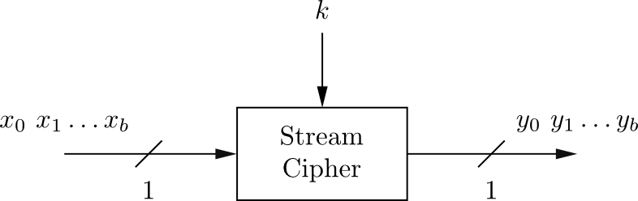
Key Idea of Stream Ciphers
Encrypt bits individually
Usually small and fast → common in embedded devices (e.g., A5/1 for GSM phones)

Slide 4
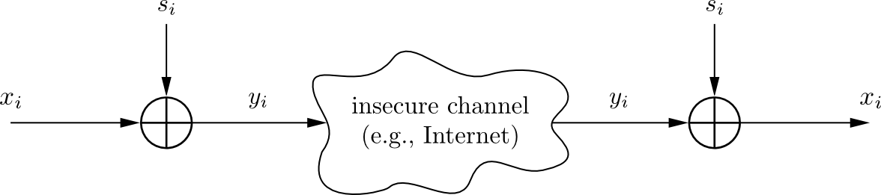
Encryption & Decryption
Plaintext x_{i}, ciphertext y_{i} and key stream s_{i} consist of individual bits
Encryption and decryption are simple additions modulo 2 (aka XOR)
Encryption and decryption are the same functions
Encryption: y_{i} = e_{si}(x_{i} ) = x_{i} + s_{i} mod 2, x_{i} , y_{i} , s_{i} ∈ {0,1}
Decryption: x_{i} = e_{si}(y_{i} ) = y_{i} + s_{i} mod 2

Slide 5
Why is Modulo 2 Addition?
Modulo 2 addition is equivalent to XOR operation
For perfectly random key stream s_{i} , each ciphertext output bit has a 50% chance to be 0 or 1
→ Good statistic property for ciphertext
Inverting XOR is simple, since it is the same XOR operation
x_{i} | s_{i} | y_{i}
0 | 0 | 0
0 | 1 | 1
1 | 0 | 1
1 | 1 | 0

Slide 6
Example
Encryption of the letter A by Alice
A is given in ASCII code as 65₁₀ = 1000001₂.
Let's assume that the first key stream bits are
⇒ z₁, ... , z₇ = 0101101
Encryption by Alice:
plaintext x_{i}: 1000001 = A (ASCII symbol)
key stream z_{i}: 0101101
ciphertext y_{i}: 1101100 = l (ASCII symbol)
Decryption by Bob:
ciphertext y_{i}: 1101100 = I (ASCII symbol)
key stream z_{i}: 0101101
plaintext x_{i}: 1000001= A (ASCII symbol)

Slide 7
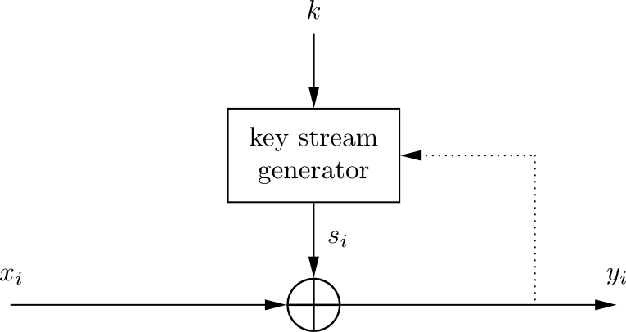
Stream Cipher: Synchronous vs. Asynchronous
Security of stream cipher depends entirely on the key stream s_{i} :
Should be random , i.e., Pr(s_{i} = 0) = Pr(s_{i} = 1) = 0.5
Must be reproducible by sender and receiver
Synchronous Stream Cipher
Key stream depends only on the key (and possibly an initialization vector IV)
Asynchronous Stream Cipher
Key stream depends also on the ciphertext (dotted feedback enabled)

Slide 8
Stream Cipher: Throughput
Performance comparison of symmetric ciphers (Pentium4):
Cipher | Key length | Mbit/s
DES | 56 | 36.95
3DES | 112 | 13.32
AES | 128 | 51.19
RC4 (stream cipher) | (choosable) | 211.34
Notes:
Example: Encryption of the letter „A“ by Alice.
„A“ is given in ASCII code as 65₁₀ = 1000001₂.
Let's assume that the first key stream bits are
⇒ z1, ... , z7 = 0101101
Encryption by Alice:
plaintext xi: 1000001 = „A“ (ASCII symbol)
key stream zi: 0101101
ciphertext yi: 1101100 = „l“ (ASCII symbol)
Decryption by Bob:
ciphertext yi: 1101100 = „l“ (ASCII symbol)
key stream zi: 0101101
plaintext xi: 1000001 = „A“ (ASCII symbol)

Slide 9
Random Number Generators (RNGs)
RNG
True RNG
Cryptographically Secure RNG
Pseudorandom NG

Slide 10
True RNGs
Based on physical random processes: coin flipping, dice rolling, semiconductor noise, radioactive decay, mouse movement, clock jitter of digital circuits
Output stream s_{i} should have good statistical properties: Pr(s_{i} = 0) = Pr(s_{i} = 1) = 50% (often achieved by post-processing)
Output can neither be predicted nor be reproduced

Slide 11
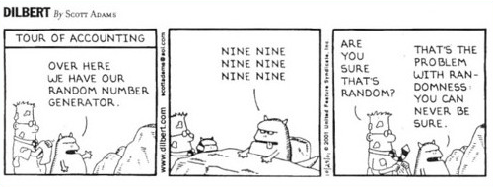
True RNGs (cont.)
Typically used for generation of keys, nonces (used only-once values) and for many other purposes

Slide 12
Pseudo RNG
Generate sequences from initial seed value
Typically, output stream has good statistical properties
Output can be reproduced and can be predicted
Often computed in a recursive way:

Slide 13
Pseudo RNG (cont.)
Example: rand() function in ANSI C:
Most PRNGs have bad cryptographic properties!

Slide 14
Example: a Simple PRNG
Simple PRNG: Linear Congruential Generator
Assumptions:
Unknown A, B and S₀ as key
Size of A, B and S_{i} to be 100 bit
300 bit of output are known, i.e. S₁, S₂ and S₃

Slide 15
Cryptanalyzing a Simple PRNG
→ Directly reveals A and B. All S_{i} can be computed easily!
Bad cryptographic properties due to the linearity of most PRNGs!

Slide 16
Cryptographically Secure PRNG
Special PRNG with additional property:
Output must be unpredictable
More precisely: Given n consecutive bits of output s_{i} , the following output bits s_{n+1} cannot be predicted (in polynomial time).
Needed in cryptography, in particular for stream ciphers
Remark: There are almost no other applications that need unpredictability, whereas many, many (technical) systems need PRNGs.

Slide 17
One-Time Pad (OTP)
A cryptosystem is unconditionally secure if it cannot be broken even with infinite computational resources
One-Time Pad
A cryptosystem developed by Mauborgne that is based on Vernam’s stream cipher:
Properties: Let the plaintext, ciphertext and key consist of individual bits x_{i}, y_{i}, k_{i} ∈ {0,1}.
Encryption: e_{ki}(x_{i}) = x_{i} ⊕ k_{i}. Decryption: d_{ki}(y_{i}) = y_{i} ⊕ k_{i}
OTP is unconditionally secure if and only if the key k_{i}. is used once!

Slide 18
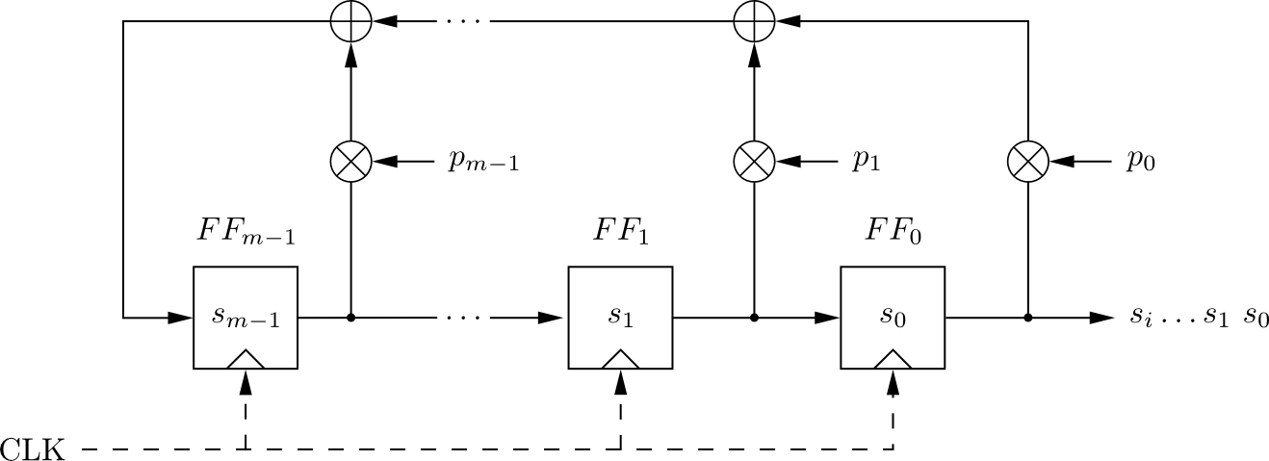
Linear Feedback Shift Registers (LFSRs)
Concatenated flip-flops (FF), i.e., a shift register together with a feedback path
Feedback computes fresh input by XOR of certain state bits
Degree m given by number of storage elements
If p_{i} = 1, the feedback connection is present (“closed switch), otherwise there is not feedback from this flip-flop (“open switch”)

Slide 19
Linear Feedback Shift Registers (LFSRs)
Output can be computed as:
Output sequence repeats periodically due to its linear recurrence
Maximum output length: 2^{m}-1 (because m-bit vector can only assume 2^{m}-1 non-zero states)

Slide 20
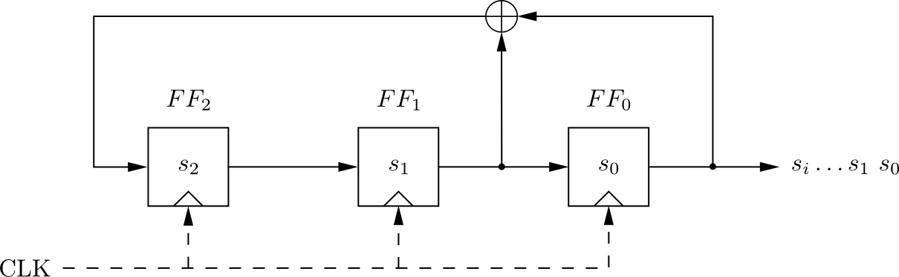
Linear Feedback Shift Registers (LFSRs): Example with m=3
clk | FF₂ | FF₁ | FF₀=s_{i}
0 | 1 | 0 | 0
1 | 0 | 1 | 0
2 | 1 | 0 | 1
3 | 1 | 1 | 0
4 | 1 | 1 | 1
5 | 0 | 1 | 1
6 | 0 | 0 | 1
7 | 1 | 0 | 0
8 | 0 | 1 | 0
LFSR output described by recursive equation:
Maximum output length (of 2³-1=7) achieved only for certain feedback configurations, .e.g., the one shown here.

Slide 21
Security of LFSRs
LFSRs typically described by polynomials:
Single LFSRs generate highly predictable output
If 2^{m} output bits of an LFSR of degree m are known, the feedback coefficients p_{i} of the LFSR can be found by solving a system of linear equations*
Because of this many stream ciphers use combinations of LFSRs

