Slide 1
Data Encryption Standard_01
Instructor: Dr. Wei (Lisa) Li
Department of Computer Science, GSU

Slide 2
DES in the Field of Cryptology
Cryptology
Cryptography
Cryptanalysis
Symmetric Ciphers
Asymmetric Ciphers
Protocols
Block Ciphers
Stream Ciphers
You are here!

Slide 3
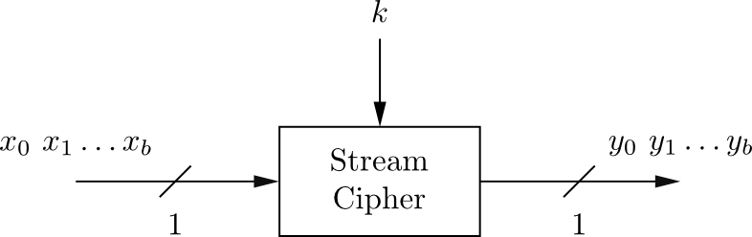
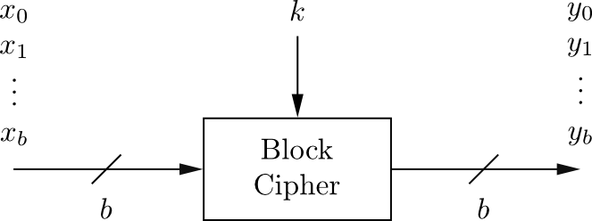
Block Cipher vs. Stream Cipher
Stream Ciphers
Encrypt bits individually
Usually small and fast → common in embedded devices
Block Ciphers:
Always encrypt a full block (several bits)
Are common for Internet applications

Slide 4
Block Cipher: Confusion & Diffusion
Claude Shannon: There are two primitive operations with which strong encryption algorithms can be built:
Confusion: An encryption operation where the relationship between key and ciphertext is obscured. Today, a common element for achieving confusion is substitution, which is found in both DES and AES.
Diffusion: An encryption operation where the influence of one plaintext symbol is spread over many ciphertext symbols with the goal of hiding statistical properties of the plaintext. A simple diffusion element is the bit permutation, which is frequently used within DES.
Both operations by themselves cannot provide security. The idea is to concatenate confusion and diffusion elements to build so called product ciphers.

Slide 5
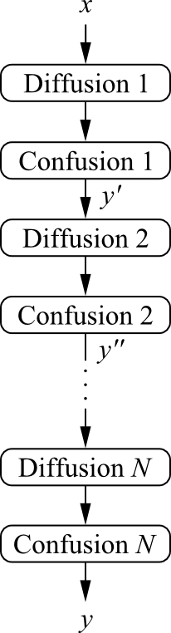

Product Ciphers
Most of today‘s block ciphers are product ciphers as they consist of rounds which are applied repeatedly to the data.
Can reach excellent diffusion: changing of one bit of plaintext results on average in the change of half the output bits.
Example:
single bit flip
many bit flips

Slide 6
DES Facts
Data Encryption Standard (DES) encrypts blocks of size 64 bit.
Developed by IBM based on the cipher Lucifer under influence of the National Security Agency (NSA), the design criteria for DES have not been published
Standardized 1977 by the National Bureau of Standards (NBS) today called National Institute of Standards and Technology (NIST)
Most popular block cipher for most of the last 30 years.
By far best studied symmetric algorithm.
Nowadays considered insecure due to the small key length of 56 bit.
But: 3DES yields very secure cipher, still widely used today.
Replaced by the Advanced Encryption Standard (AES) in 2000

Slide 7
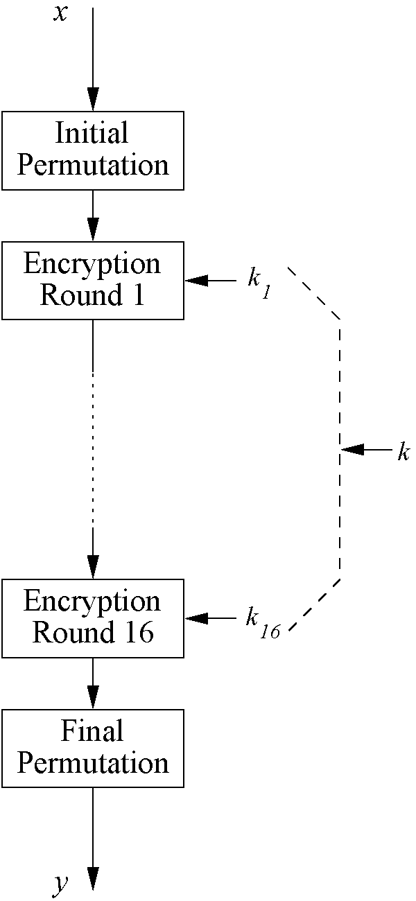
Overview of DES
Encrypts blocks of size 64 bits
Uses a key of size 56 bits
Symmetric cipher: uses same key for encryption and decryption
Uses 16 rounds which all perform the identical operation
Different subkey in each round derived from main key

Slide 8
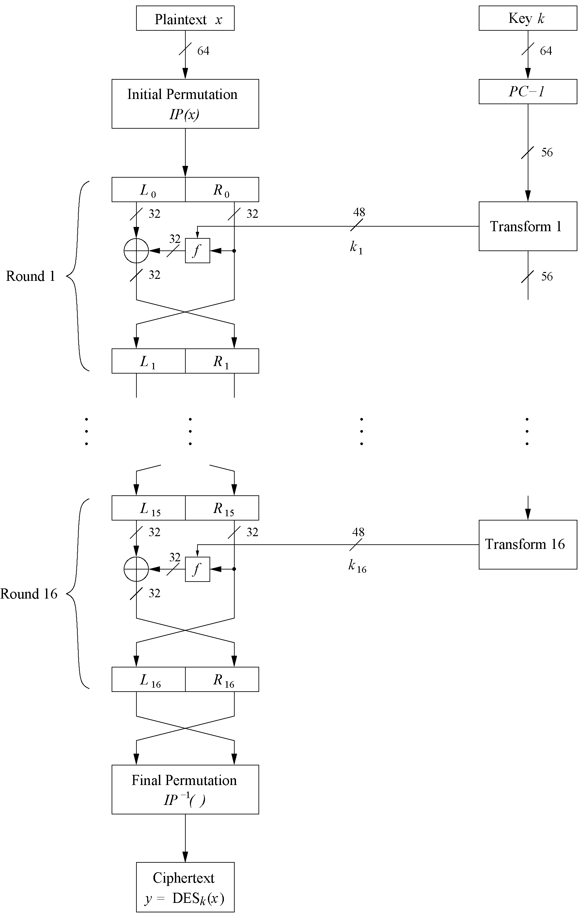
DES Feistel Network (1)
DES structure is a Feistel network
Advantage: encryption and decryption differ only in keyschedule

Slide 9
DES Feistel Network (2)
Bitwise initial permutation, then 16 rounds
Plaintext is split into 32-bit halves L_{i} and R_{i}
R_{i} is fed into the function f, the output of which is then XORed with L_{i}
Left and right half are swapped

Slide 10
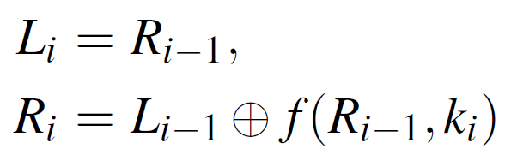
DES Feistel Network (3)
Each round i can be expressed as:

Slide 11
DES Feistel Network (4)
L and R swapped again at the end of the cipher, i.e., after round 16 followed by a final permutation

Slide 12
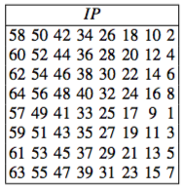
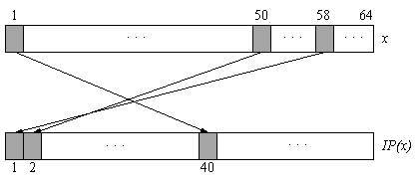
Initial Permutation (IP)
Bitwise permutations

Slide 13
f-function in DES (1)
f-Function inputs: R_{i-1} and round key k_{i}

Slide 14
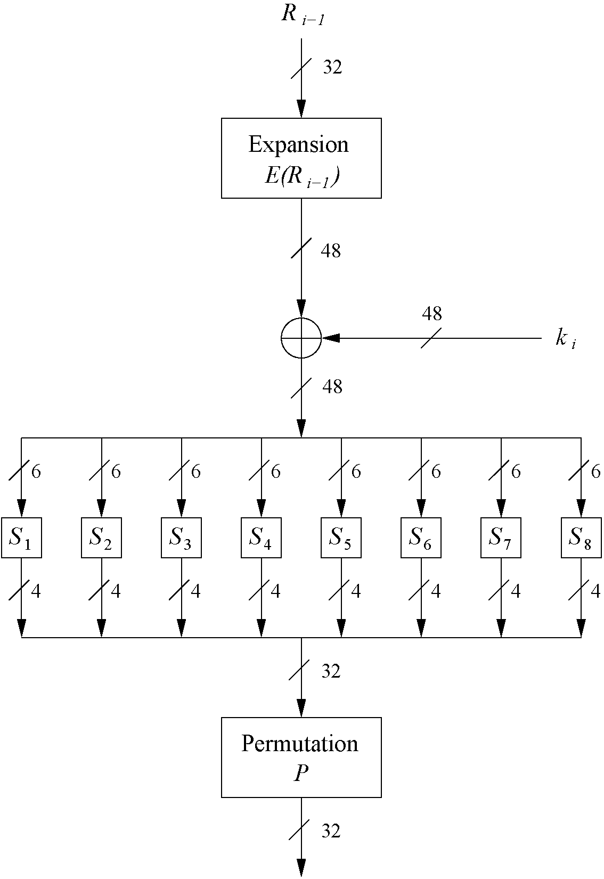
f-function in DES (2)
4 Steps:
Expansion E
XOR with round key
S-box substitution
Permutation

Slide 15
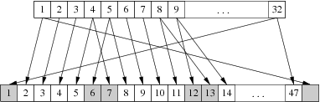
Expansion Function E
!
main purpose: increases diffusion

Slide 16
Round Key
XOR Round Key
Bitwise XOR of the round key and the output of the expansion function E
Round keys are derived from the main key in the DES keyschedule (in a few slides)

Slide 17
DES S-Boxes
S-Box substitution
Eight substitution tables
6 bits of input, 4 bits of output
Non-linear and resistant to differential cryptanalysis
Crucial element for DES security!

Slide 18
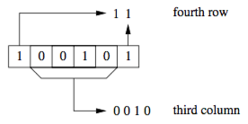
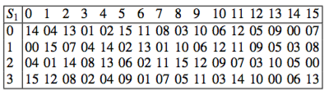
Example: S-Boxes
S-box input b = (100101)₂ indicates the row 11₂ = 3 (i.e., fourth row, numbering starts with 00₂) and the column 0010₂ = 2 (i.e., the third column). If the input b is fed into S-box 1, the output is S₁(37 = 100101₂) = 8 = 1000₂.

Slide 19
Permutation P
Bitwise permutation
Introduces diffusion
Output bits of one S-Box effect several S-Boxes in next round
Diffusion by E, S-Boxes and P guarantees that after Round 5
every bit is a function of each
key bit and each plaintext bit

Slide 20
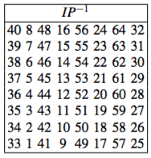
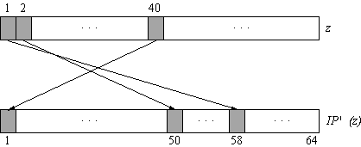
Final Permutation (IP⁻¹)
Bitwise permutations
Inverse operations of initial permutation (IP)

Slide 21
Homework 1
Posted in iCollege
Due date: Wednesday, 02/14
Weekly Reading
Ch.2 of the textbook

