Slide 1
Advanced Encryption Standard_02
Instructor: Dr. Wei (Lisa) Li
Department of Computer Science, GSU

Slide 2
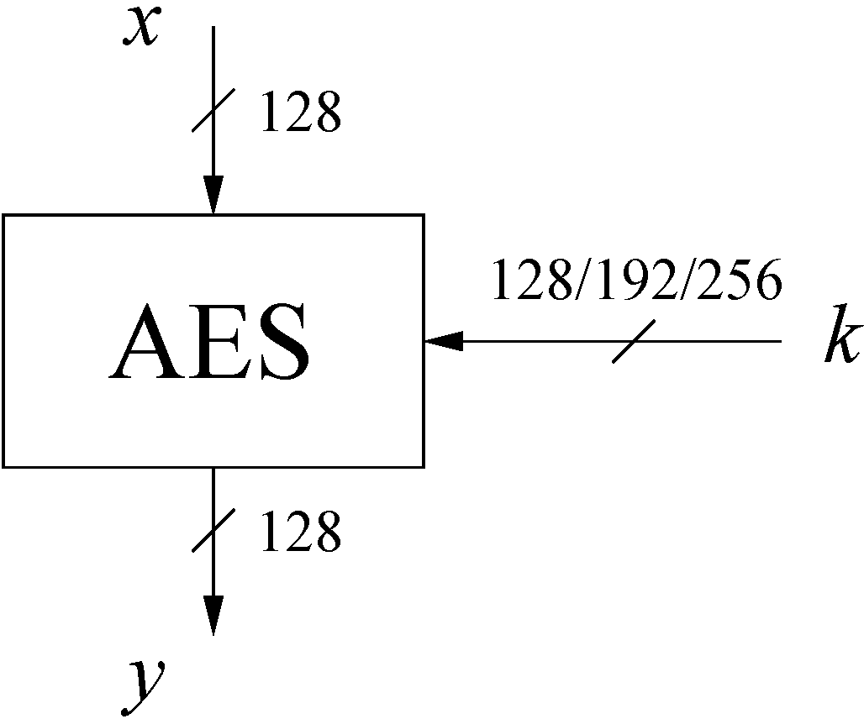
AES: Overview (1)
The number of rounds depends on the chosen key length:
Key length (bits) | Number of rounds
128 | 10
192 | 12
256 | 14

Slide 3
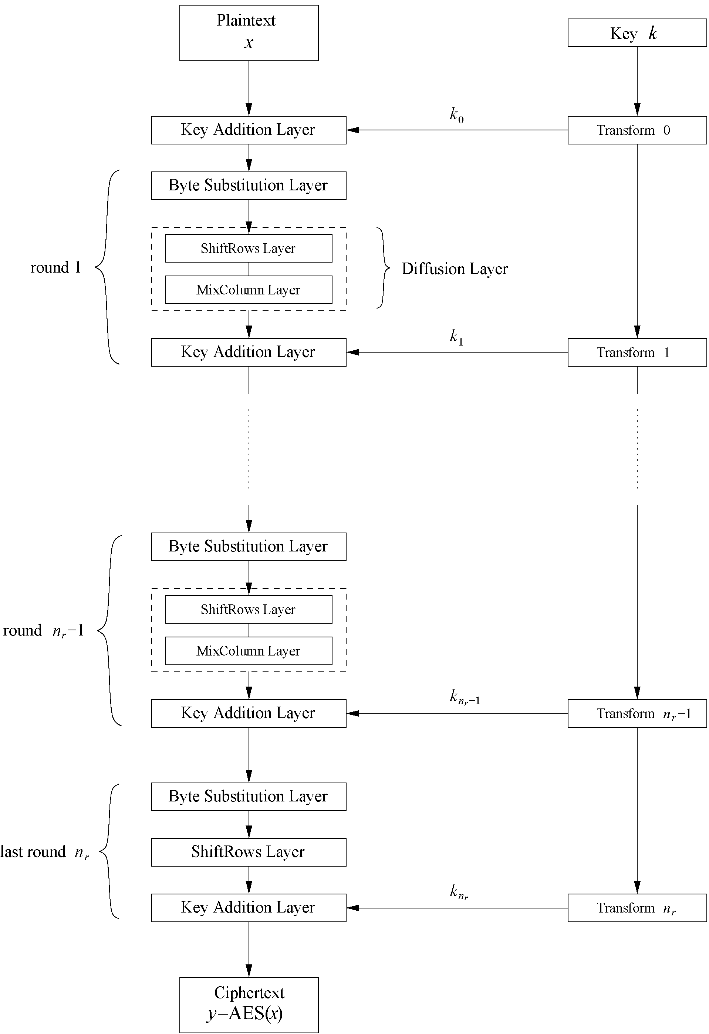
AES: Overview (2)
Iterated cipher with 10/12/14 rounds
Each round consists of “Layers”

Slide 4
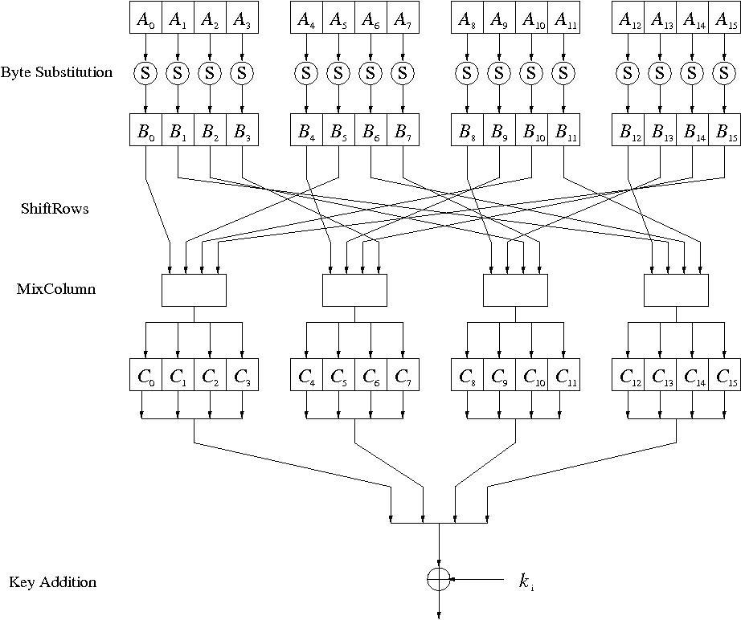
Key Addition Layer
Inputs:
16-byte state matrix C
16-byte subkey k_{i}
Output: C ⊕ k_{i}
The subkeys are generated in the key schedule

Slide 5
Key Schedule (1)
Subkeys are derived recursively from the original 128/192/256-bit input key
Each round has 1 subkey, plus 1 subkey at the beginning of AES
Key whitening: Subkey is used both at the input and output of AES ⇒ # subkeys = # rounds + 1
There are different key schedules for the different key sizes
Key length (bits) | Number of rounds | Number of subkeys
128 | 10 | 11
192 | 12 | 13
256 | 14 | 15

Slide 6
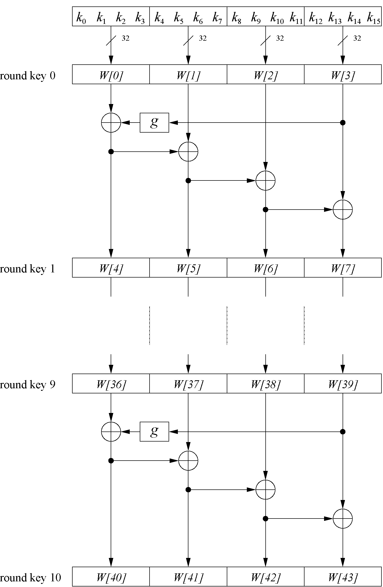
Key Schedule (2)
Word-oriented: 1 word = 32 bits
The length of k_{i} is 1 byte (i.e., 8 bits)
Each k_{i} is derived recursively based on k_{i-1}
11 subkeys are stored inthe key expansion array W[0]…W[3], W[4]…W[7], … , W[40]…W[43]
Subkey of round 0, W[0]…W[3], is the original AES key
Example: Key schedule for 128-bit key AES

Slide 7
Key Schedule (3)
Leftmost word of a subkey at round i, W[4i]:
W[4i] = W[4(i-1)] ⊕ g(W[4i - 1])
g() is a nonlineaer function
i = 1, 2, 3, …, 10
Remaining three words of a subkey:
W[4i+j] = W[4i + j - 1] ⊕ W[4(i-1) + j]
i = 1, 2, 3, …, 10
j = 1, 2, 3
leftmost word of subkey at roud i-1
rightmost word of subkey at roud i-1
the (j-1)th of subkey at roud i
the j-th word of subkey at roud i-1
Example: Key schedule for 128-bit key AES

Slide 8
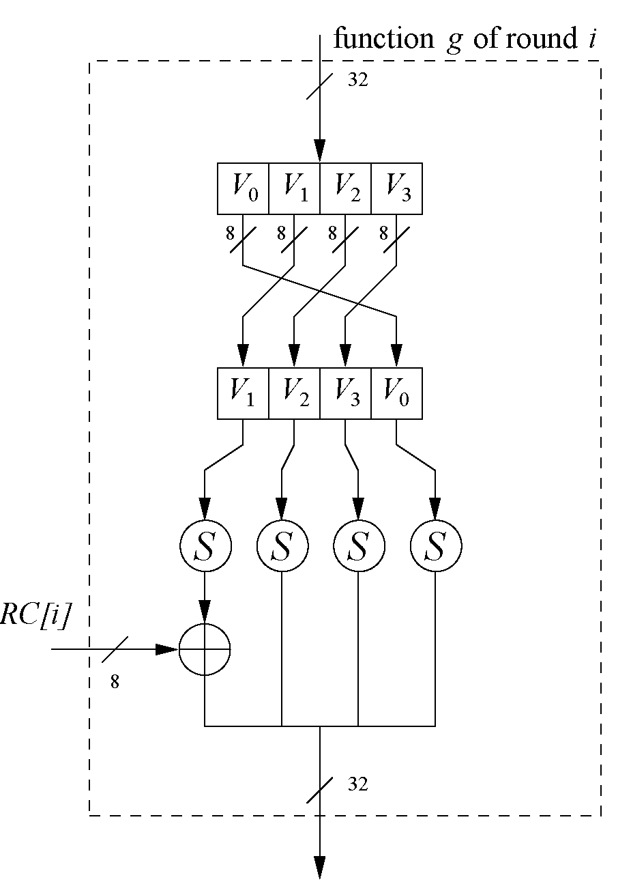
Key Schedule (4)
Function g() rotates its four input bytes and performs a bytewise S-Box substitution
⇒ Add nonlinearity to key schedule
The round coefficient RC is only added to the leftmost byte and varies from round to round
⇒ Remove symmetry in AES RC[1] = x⁰ = (00000001)₂ RC[2] = x¹ = (00000010)₂ RC[3] = x² = (00000100)₂ ... RC[10] = x⁹ = (00110110)₂
x^{i} represents an element in a Galois field

Slide 9
AES: Layer Structure
Iterated cipher with 10/12/14 rounds
Each round consists of “Layers”

Slide 10
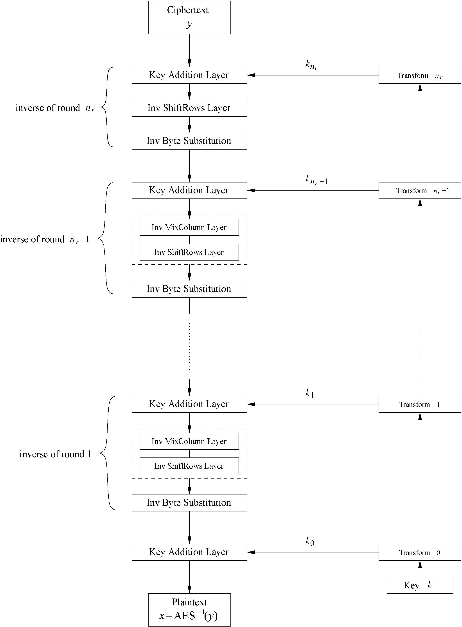
AES Decryption (1)
AES is NOT based on a Feistel network
⇒ All layers must be inverted for decryption:
MixColumn layer
→ Inv MixColumn layer
ShiftRows layer
→ Inv ShiftRows layer
Byte Substitution layer
→ Inv Byte Substitution layer
Key Addition layer is its own inverse

Slide 11
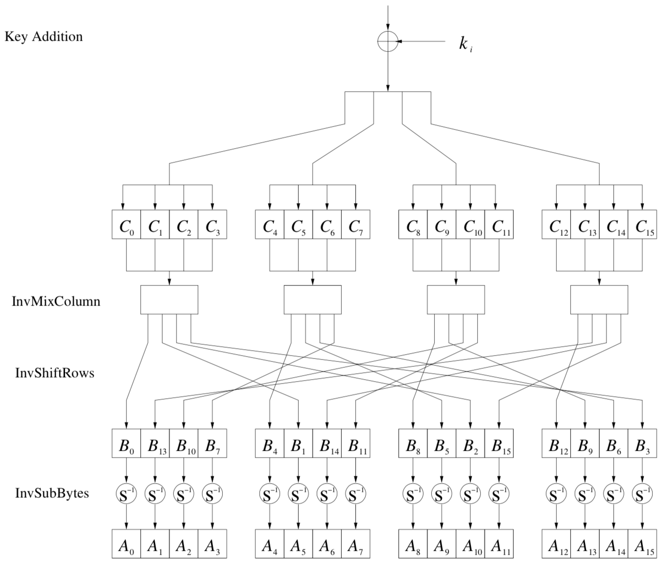
AES Decryption (2)
Inverse layers of the general AES decryption round

Slide 12
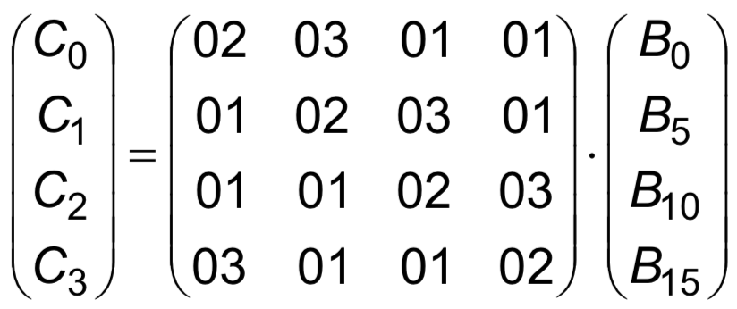
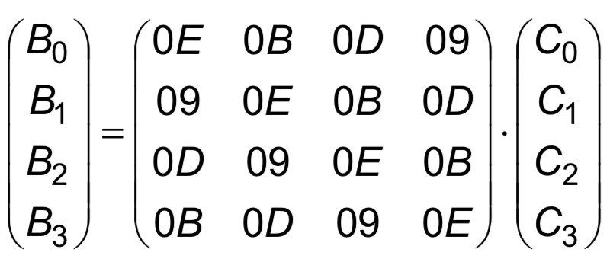
AES Decryption (3)
Inv MixColumn layer:
To reverse the MixColumn operation, each column of the state matrix C must be multiplied with the inverse of the 4x4 matrix, e.g.,
where 09, 0B, 0D and 0E are given in hexadecimal notation
Again, all arithmetic is done in the Galois field GF(2⁸)
→

Slide 13
AES Decryption (4)
ShiftRows layer:
All rows of the state matrix B are shifted to the opposite direction:
Input matrix
Output matrix
B₀ | B₄ | B₈ | B₁₂
B₁ | B₅ | B₉ | B₁₃
B₂ | B₆ | B₁₀ | B₁₄
B₃ | B₇ | B₁₁ | B₁₅
B₀ | B₄ | B₈ | B₁₂
B₁₃ | B₁ | B₅ | B₉
B₁₀ | B₁₄ | B₂ | B₆
B₇ | B₁₁ | B₁₅ | B₃
no shift
→ one position right shift
→ two positions right shift
→ three positions right shift

Slide 14
AES Decryption (5)
Inv Byte Substitution layer:
Since the S-Box is bijective, it is possible to construct an inverse, such that
A_{i} = S⁻¹(B_{i}) = S⁻¹(S(A_{i}))
⇒ The inverse S-Box is used for decryption. It is usually realized as a lookup table

Slide 15
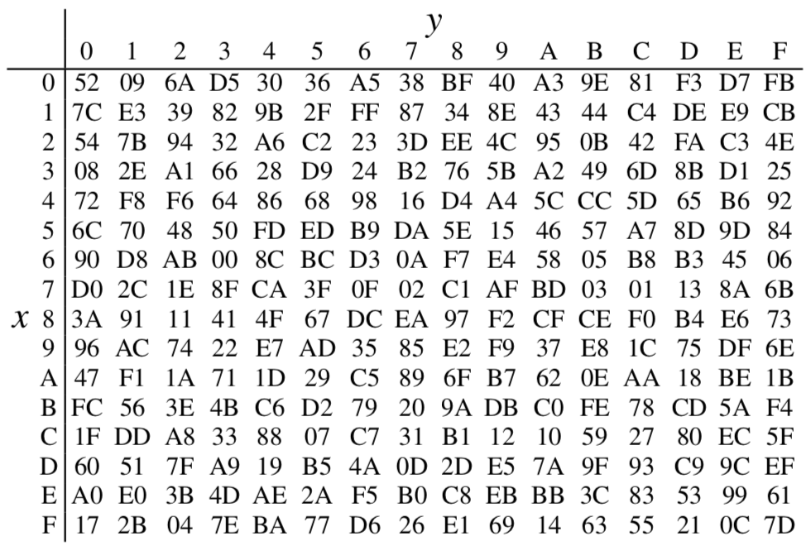
Example: Inverse S-Boxes
Realize inverse S-Box as a 256-by-8 bit lookup table
Substitution values are in hexadecimal form for input byte (xy)
For example:
B_{i} = (00100101)₂
S⁻¹(B_{i}) = S⁻¹((25)_{hex})
= (C2)_{hex}
= (11000010)₂
= A_{i}

Slide 16
AES Decryption (6)
Decryption key schedule:
Subkeys are needed in reversed order (compared to encryption):
K^{d}_{i} = K^{e}_{(n-i)}
where K^{d}_{i} is subkey of i-th round in decryption, K^{e}_{(n-i)} is subkey of (n-i)th round in encryption, and n is # of rounds in AES
In practice, for encryption and decryption, the same key schedule is used. This requires that all subkeys must be computed before the encryption of the first block can begin

Slide 17
Implementation in Software
One requirement of AES was the possibility of an efficient software implementation
Straightforward implementation is well suited for 8-bit processors (e.g., smart cards), but inefficient on 32-bit or 64-bit processors
A more sophisticated approach: Merge all round functions (byte substitution, shiftrows, mixcolumn, except key addition) into one table look-up
This results in four tables with 256 entries, where each entry is 32 bits wide
In one round, four tables yields 32 output bits, which can be computed with 16 table look-ups
Typical SW speeds are more than 1.6 Gbit/s on modern 64-bit processors

Slide 18
Security
Brute-force attack: Due to the key length of 128, 192 or 256 bits, a brute-force attack is not possible
Analytical attacks: There is no analytical attack known that is better than brute-force
Side-channel attacks:
Several side-channel attacks have been published
Note that side-channel attacks do not attack the underlying algorithm but the implementation of it

Slide 19
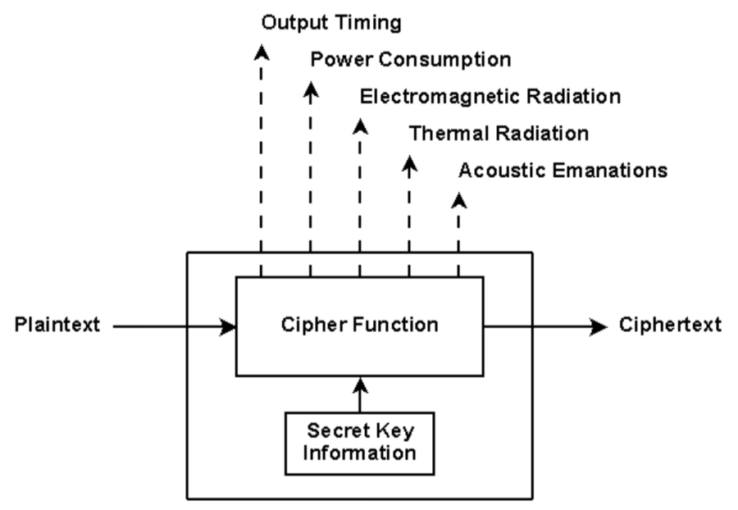
Side-Channel Attack
Any attack based on information gained from the physical implementation of a computer system, rather than weaknesses in the implemented algorithm itself
Timing information
Power consumption
Electromagnetic leaks
Sound

Slide 20
Side-Channel Attacks on AES
Cache (Cache-Timing) attack
Key idea: the difference in memory access time for table lookup caused by the cache can leak information about the secret key
Power Analysis Attack
Key idea: derive the secret key from the relationship between secret key information and the instantaneous power consumption

Slide 21
Lessons Learned
AES is a modern block cipher which supports three key lengths of 128, 192 and 256 bit. It provides excellent long-term security against brute-force attacks.
AES has been studied intensively since the late 1990s and no attacks have been found that are better than brute-force.
AES is not based on Feistel networks. Its basic operations use Galois field arithmetic and provide strong diffusion and confusion.
AES is part of numerous open standards such as IPsec or TLS, in addition to being the mandatory encryption algorithm for US government applications. It seems likely that the cipher will be the dominant encryption algorithm for many years to come.
AES is efficient in software and hardware.

