Slide 1
Block Ciphers_02
Instructor: Dr. Wei (Lisa) Li
Department of Computer Science, GSU

Slide 2
Mode of Block Cipher
Electronic Code Book mode (ECB)
Cipher Block Chaining mode (CBC)
Output Feedback mode (OFB)
Cipher Feedback mode (CFB)
Counter mode (CTR)
Galois Counter Mode (GCM)

Slide 3
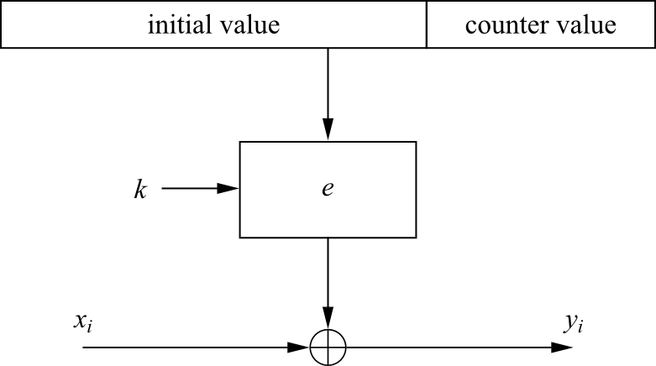
Counter Mode (CTR)
It uses a block cipher as a stream cipher (like the OFB and CFB)
The key stream is computed in a blockwise fashion
The input to the block cipher is a counter which assumes a different value every time the block cipher computes a new key stream block
Unlike CFB and OFB modes, the CTR mode can be parallelized since the 2nd encryption can begin before the 1st one has finished
Desirable for high-speed implementations, e.g., in network routers
Encryption: y_{i} = e_{k} (IV || CTR_{i} ) ⊕ x_{i}, i ≥ 1
Decryption : x_{i} = e_{k} (IV || CTR_{i} ) ⊕ y_{i}, i ≥ 1

Slide 4
Example: CTR
Assume the following implementation:
Block cipher algorithm: AES (with 128 bits)
Initiation Vector (IV): 96 bits
CTR: 128 – 96 = 32 bits
Number of blocks for encryption
with the same IV: 2³²
Plaintext size: 16 * 2³² = 2³⁶ bytes

Slide 5
Galois Counter Mode (GCM) (1)
It also computes a message authentication code (MAC), i.e., a cryptographic checksum is computed for a message
By making use of GCM, two additional services are provided:
Message Authentication
the receiver can make sure that the message was really created by the original sender
Message Integrity
the receiver can make sure that nobody tampered with the ciphertext during transmission

Slide 6
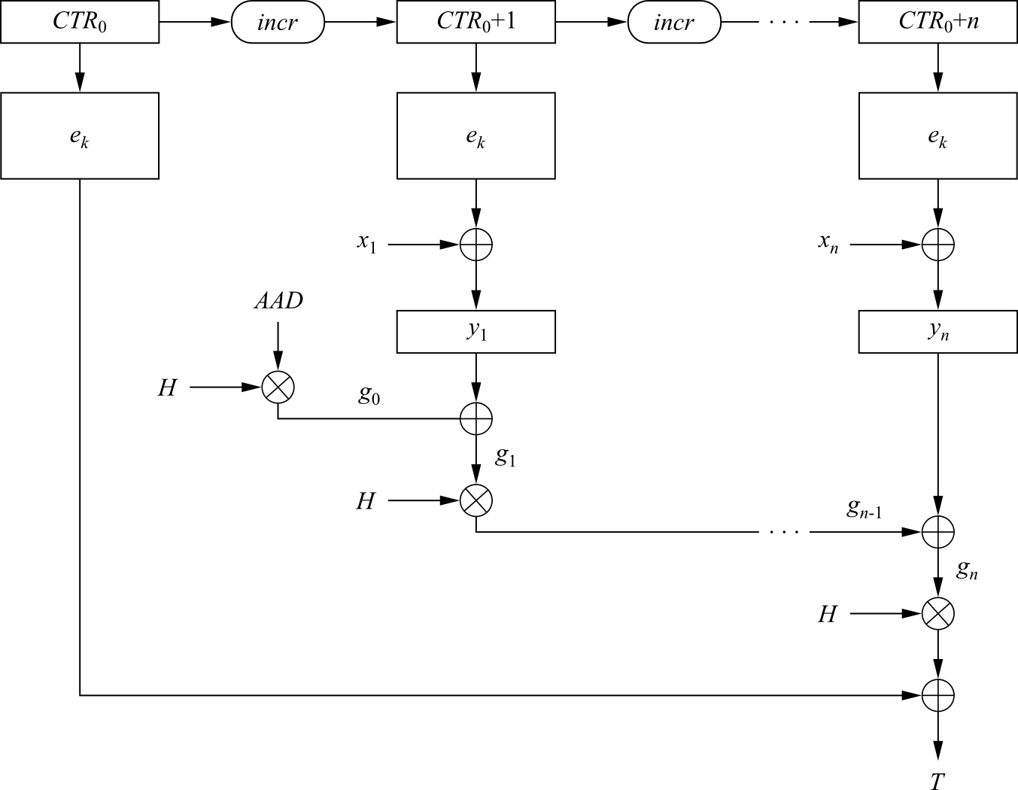
Galois Counter Mode (GCM) (2)
For encryption (counter mode)
An initial counter is derived from an IV and a serial number
The initial counter value is incremented then encrypted and XORed with the first plaintext block
For subsequent plaintexts, the counter is incremented and then encrypted

Slide 7
Galois Counter Mode (GCM) (3)
Encryption:
1. Derive a counter value CTR₀ from the IV and compute CTR₁ = CTR₀ + 1
2. Compute ciphertext: y_{i} = e_{k} (CTR_{i}) ⊕ x_{i}, i ≥ 1

Slide 8
Galois Counter Mode (GCM) (4)
For authentication
Protects authenticity of the plaintexts and the string additional authenticated data (AAD)
AAD is in clear (without encryption)
AAD may include addresses and parameters in a network protocols

Slide 9
Galois Counter Mode (GCM) (5)
For authentication
A chained Galois field multiplication is performed
For every plaintext an intermediate authentication parameter g_{i} is derived
g_{i} is computed as the XOR of the current ciphertext and the last g_{i-1}, and multiplied by the constant H
H is generated by encryption of the zero input with the block cipher
All multiplications are in the 128-bit Galois field GF(2¹²⁸)

Slide 10
Galois Counter Mode (GCM) (6)
Authentication:
1. Generate authentication subkey H = e_{k} (0)
2. Compute g₀ = AAD × H (Galois field multiplication)
3. Compute g_{i} = (g_{i−1} ⊕ y_{i}) × H, 1 ≤ i ≤ n (Galois field multiplication)
4. Final authentication tag: T = (g_{n} × H) ⊕ e_{k} (CTR₀)

Slide 11
Galois Counter Mode (GCM) (7)
Sender send the packet
[(y₁, y₂, …, y_{n}), T, AAD]
Receiver
Decrypts (y₁, y₂, …, y_{n}) by also using the counter mode
Checks the authenticity of data by computing an authentication tag T’ with (y₁, y₂, …, y_{n}) and AAD, which is exactly the same as the method used by sender
If T’ = T, it was not manipulated

Slide 12

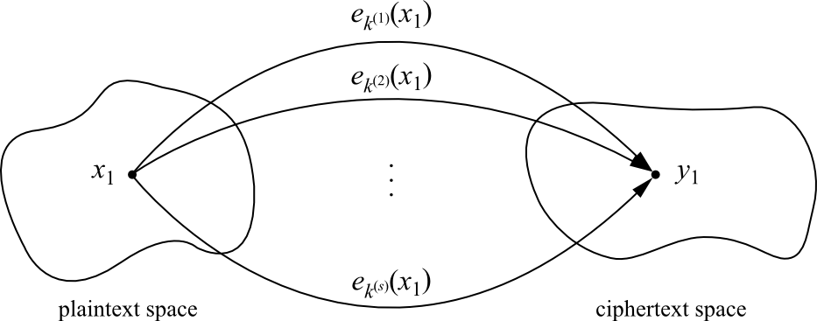
Exhaustive Key Search Revisited
A simple exhaustive search for a DES key knowing one pair (x₁,y₁):
However, for most other block ciphers a key search is somewhat more complicated
A brute-force attack can produce false positive results
Keys k_{i} that are found are not the one used for the encryption
The likelihood of this is related to the relative size of key space and plaintext space
A brute-force attack is still possible, but several pairs of plaintext–ciphertext are needed

Slide 13
Example: Exhaustive Key Search
Assume a cipher with a block width of 64 bit and a key size of 80 bit
If we encrypt x₁ under all possible 2⁸⁰ keys, we obtain 2⁸⁰ ciphertexts
However, there exist only 2⁶⁴ different ones
If we run through all keys for a given plaintext–ciphertext pair, we find on average 2⁸⁰/2⁶⁴ = 2¹⁶ keys that perform the mapping e_{k}(x₁) = y₁
In this example assuming two plaintext-ciphertext pairs, the likelihood is: 2^{80−2·64}=2 ⁻⁴⁸
for almost all practical purposes two plaintext-ciphertext pairs are sufficient
Given a block cipher with a key length of k bits and block size of n bits, as well as t plaintext–ciphertext pairs (x₁, y₁), ... , (x_{t} , y_{t}), the expected number of false keys which encrypt all plaintexts to the corresponding ciphertexts is:
2^{k−tn}

Slide 14
Increase Security of Block Ciphers
In some situations we wish to increase the security of block ciphers, e.g., if a cipher such as DES is available in hardware or software for legacy reasons in a given application
Two approaches are possible
Multiple encryption
theoretically much more secure, but sometimes in practice increases the security very little
Key whitening

Slide 15
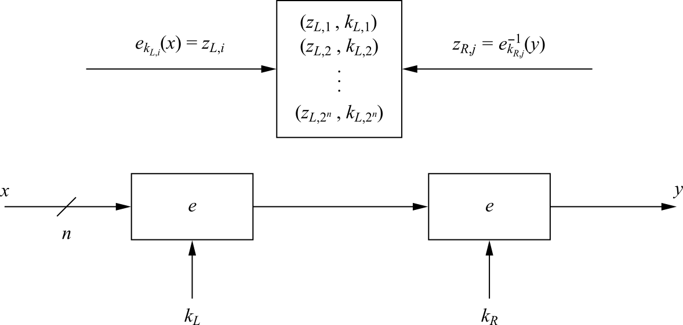
Double Encryption
A plaintext x is first encrypted with a key k_{L}, and the resulting ciphertext is encrypted again using a second key k_{R}
Assuming a key length of k bits, an exhaustive key search would require 2^{k}·2^{k} = 2^{2k} encryptions or decryptions

Slide 16
Meet-in-the-Middle Attack (1)
A Meet-in-the-Middle attack requires 2^{k}+2^{k} = 2^{k+1} operations!
Phase I: for the given (x₁, y₁) the left encryption is brute-forced for all k_{L,i}, i=1,2, ..., 2^{k} and a lookup table with 2^{k} entry (each n+k bits wide) is computed
the lookup table should be ordered by the result of the encryption (z_{L,i})
Phase II: the right encryption is brute-forced (using decryption) and for each z_{R,i} it is checked whether z_{R,i} is equal to any z_{L,i} value in the table of the first phase

Slide 17
Meet-in-the-Middle Attack (2)
Computational Complexity
Double encryption is not much more secure then single encryption!
number of encryptions and decryptions = 2^{k} +2^{k} = 2^{k+1}
number of storage locations = 2^{k}

Slide 18
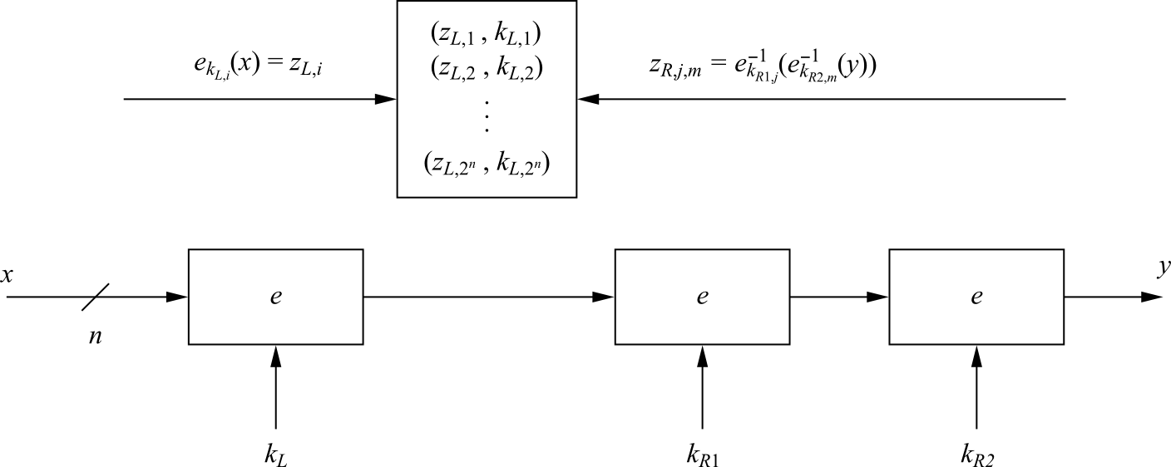
Triple Encryption
The encryption of a block three times: y = e_{k3} (e_{k2} (e_{k1} (x)))
In practice a variant scheme is often used EDE (encryption-decryption-encryption): y = e_{k3} (e⁻¹_{k2} (e_{k1} (x)))
Advantage: choosing k1=k2=k3 performs single DES encryption
Still we can perform a meet-in-the middle attack, and it reduces the effective key length of triple encryption from 3K to 2K!
The attacker must run 2¹¹² tests in the case of 3DES
Triple encryption effectively doubles the key length

Slide 19
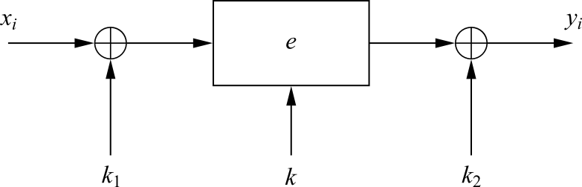
Key Whitening (1)
Makes block ciphers such as DES much more resistant against brute-force attacks
In addition to the regular cipher key k, two whitening keys k₁ and k₂ are used to XOR-mask the plaintext and ciphertext

Slide 20
Key Whitening (2)
It does not strengthen block ciphers against most analytical attacks such as linear and differential cryptanalysis
It is not a “cure” for inherently weak ciphers
The additional computational load is negligible
Its main application is ciphers that are relatively strong against analytical attacks but possess too short a key space especially DES
a variant of DES which uses key whitening is called DESX

Slide 21
Lessons Learned (1)
There are many different ways to encrypt with a block cipher. Each mode of operation has some advantages and disadvantages
Several modes turn a block cipher into a stream cipher
There are modes that perform encryption together together with authentication, i.e., a cryptographic checksum protects against message manipulation
The straightforward ECB mode has security weaknesses, independent of the underlying block cipher

Slide 22
Lessons Learned (2)
The counter mode allows parallelization of encryption and is thus suited for high speed implementations
Double encryption with a given block cipher only marginally improves the resistance against brute-force attacks
Triple encryption with a given block cipher roughly doubles key length
Triple DES (3DES) has an effective key length of 112 bits
Key whitening enlarges the DES key length without much computational overhead.

